Slide 1

Being Gracious Like Jesus
Matthew 5:38-53

Slide 2
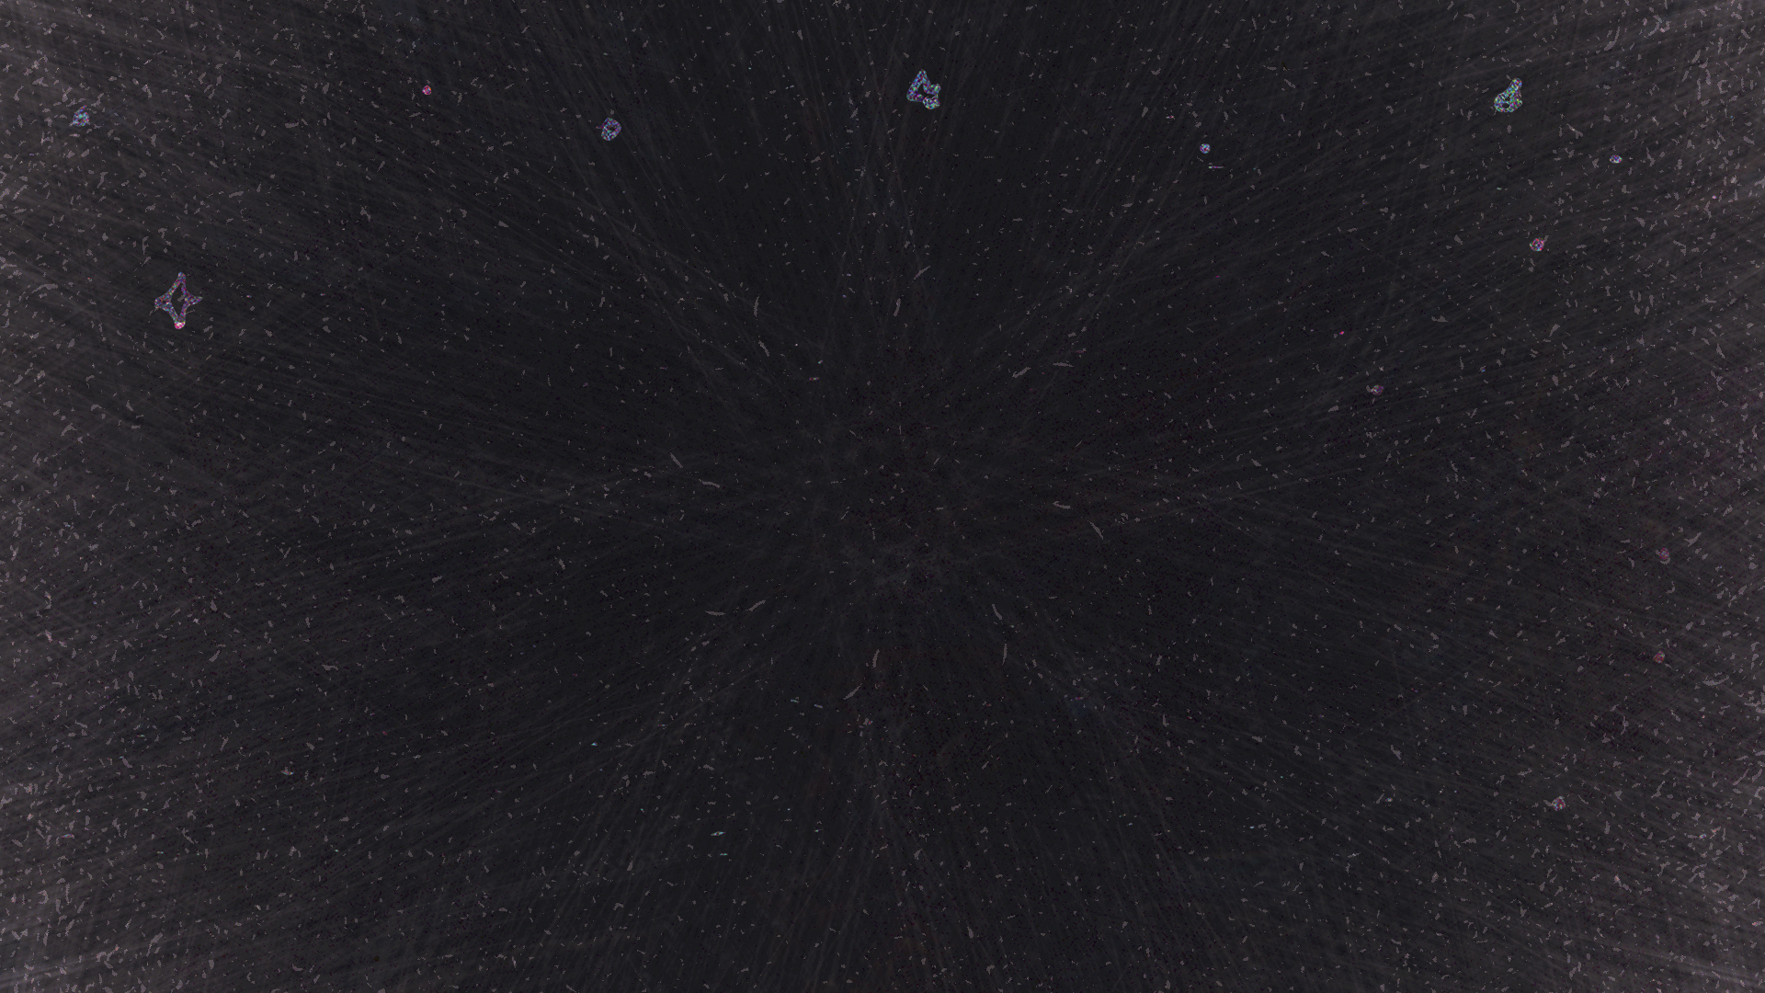
“You have heard that it was said, ‘An eye for an eye and a tooth for a tooth.’
Matthew 5:38
ESV

Slide 3
But I say to you, Do not resist the one who is evil. But if anyone slaps you on the right cheek, turn to him the other also.
Matthew 5:39
ESV

Slide 4
And if anyone would sue you and take your tunic, let him have your cloak as well. And if anyone forces you to go one mile, go with him two miles.
Matthew 5:40–41
ESV

Slide 5
Give to the one who begs from you, and do not refuse the one who would borrow from you.
Matthew 5:42–43
ESV

Slide 6
Passive-aggressive behavior can be a persons way of expressing negative feelings such as deep anger, hostility, insecurity and frustration indirectly, instead of directly.

Slide 7
He was oppressed, and he was afflicted, yet he opened not his mouth; like a lamb that is led to the slaughter, and like a sheep that before its shearers is silent, so he opened not his mouth.
Isaiah 53:7
ESV

Slide 8
And the chief priests accused him of many things. And Pilate again asked him, “Have you no answer to make? See how many charges they bring against you.” But Jesus made no further answer, so that Pilate was amazed.
Mark 15:3–5
ESV

Slide 9
He did not retaliate when he was insulted, nor threaten revenge when he suffered. He left his case in the hands of God, who always judges fairly.
1 Peter 2:23
NLT

Slide 10
‘graciousness’ is epieikés [1933] meaning fair, equitable, forbearance, tolerance, or to be lenient, yielding, or unassertive.

Slide 11
Let your gentleness be evident to all. The Lord is near.
Philippians 4:5
NIV

Slide 12
Graciousness is to bear wrong, even though we know, and may think we are right, and let the other off the hook.

Slide 13
They kept demanding an answer, so he stood up again and said, “All right, but let the one who has never sinned throw the first stone!”
John 8:7
NLT

Slide 14
How do I react when I catch someone in a wrong? When someone offends me? When I am offended?

Slide 15
Why do we act ungraciously?

Slide 16
Could it be that we do not trust God to get it right?

Slide 17
What is graciousness?

Slide 18
Being gracious is the attitude of forgiveness.

Slide 19
or rude. It does not demand its own way. It is not irritable, and it keeps no record of being wronged.
1 Corinthians 13:5
NLT

Slide 20
Beloved, never avenge yourselves, but leave it to the wrath of God, for it is written, “Vengeance is mine, I will repay, says the Lord.”
Romans 12:19
ESV

Slide 21
To the contrary, “if your enemy is hungry, feed him; if he is thirsty, give him something to drink; for by so doing you will heap burning coals on his head.”
Romans 12:20
ESV

Slide 22
Do not be overcome by evil, but overcome evil with good.
Romans 12:21
ESV

Slide 23
A desire to punish, is a desire to grieve the Holy Spirit.

Slide 24
Graciousness is being fully aware of the crime and still forgiving.

Slide 25
“It is I who sweep away your transgressions for My own sake and remember your sins no more.
Isaiah 43:25
HCSB

Slide 26
He will again have compassion on us; He will vanquish our iniquities. You will cast all our sins into the depths of the sea.
Micah 7:19
HCSB

Slide 27
As far as the east is from the west, so far has He removed our transgressions from us.
Psalm 103:12
HCSB

Slide 28
Being gracious is not forgetting, but it is forgiving.

Slide 29
To be ungracious is to hate your brother. To be ungracious is to not know God as He truly is.

Slide 30
But those who obey God’s word truly show how completely they love him. That is how we know we are living in him. Those who say they live in God should live their lives as Jesus did.
1 John 2:5–6
NLT

Slide 31
Whoever says “I know him” but does not keep his commandments is a liar, and the truth is not in him,
1 John 2:4
ESV

Slide 32
Whoever says he is in the light and hates his brother is still in darkness. Whoever loves his brother abides in the light, and in him there is no cause for stumbling.
1 John 2:9–10
ESV

Slide 33
But whoever hates his brother is in the darkness and walks in the darkness, and does not know where he is going, because the darkness has blinded his eyes.
1 John 2:11
ESV

Slide 34
Four ways I can be more gracious (Matthew 5:38-42)

Slide 35
I. Gracious people are willing to accept insults

Slide 36
II. Gracious people value people more than things

Slide 37
III. Gracious people are willing to serve beyond obligation

Slide 38
IV. Gracious people are willing to give to those in need

Slide 39
Why do we have such a hard time with being gracious or graciousness? Because we believe we are right or in the right.

Slide 40
It is most difficult for the self-righteous to be gracious because we believe we have done nothing wrong.

