Slide 1


TAKE
UP
YOUR
CROSS

Slide 2

Whoever wants to be my disciple must deny themselves and take up their cross and follow me. For whoever wants to save their life will lose it, but whoever loses their life for me will find it.
Matthew 16:24-25
1. Deny yourself
2. Take up your cross

Slide 3
“He is no fool who gives what he cannot keep to gain what he cannot lose”
-Jim Elliot
- Our lives are temporary
3. Lose your life
4. What this means for us
- Jesus is not asking for part of your life. He is asking for all of it

Slide 4
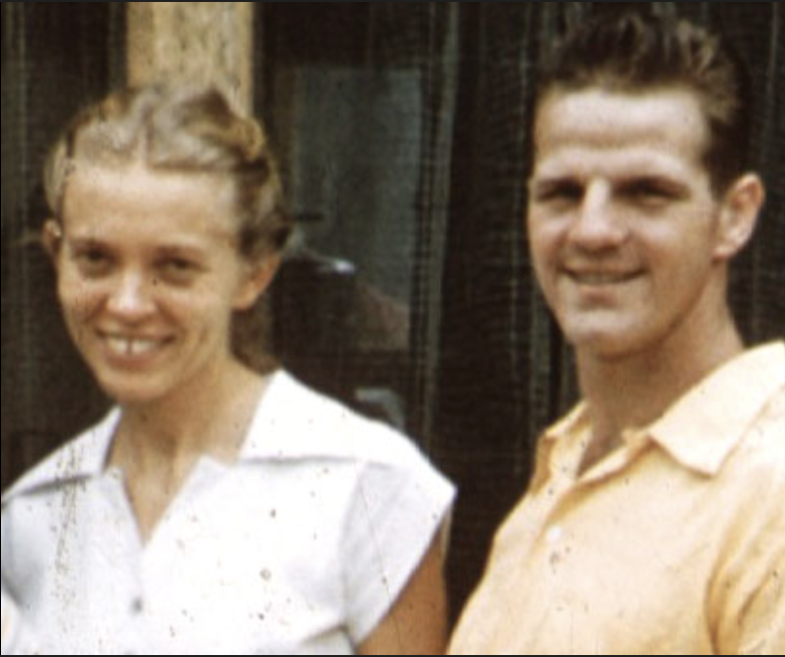
5. The great paradox
“Whoever loses their life for me will find it.”
“He is no fool who gives what he cannot keep to gain what he cannot lose”

