Slide 1
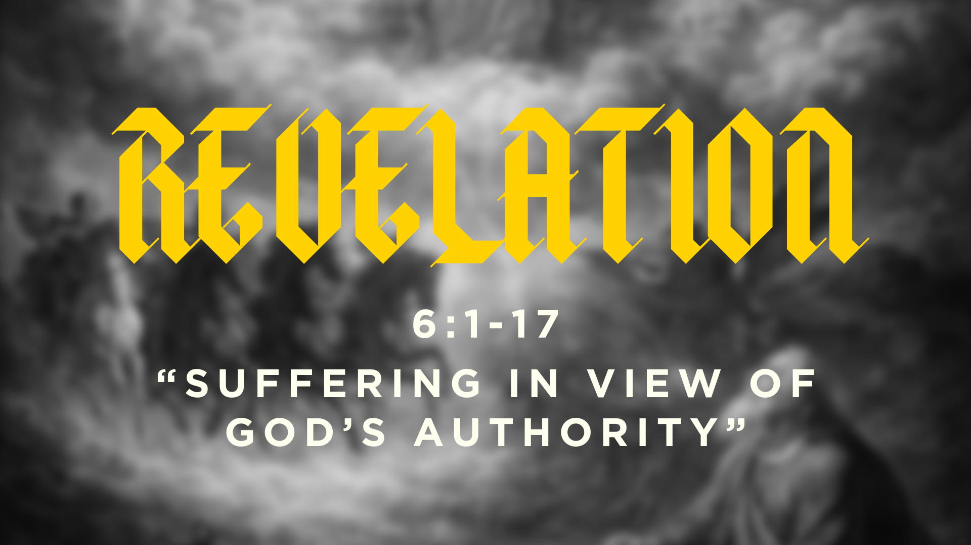

Slide 2
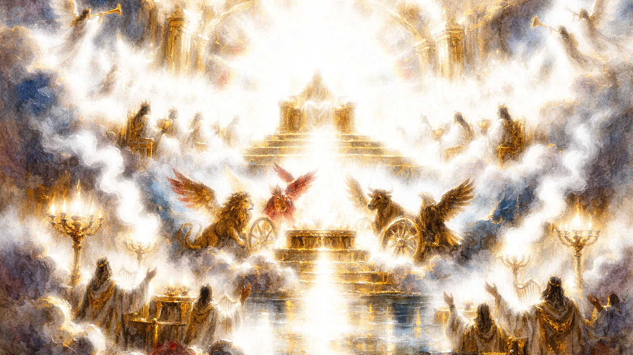

“Who is worthy to open the scroll and break its seals?” And no one in heaven or on earth or under the earth was able to open the scroll or to look into it, and I began to weep loudly because no one was found worthy to open the scroll or look into it.”
Revelation 5:2-3

Slide 3
“O Sovereign Lord, holy and true, how long before you will judge and avenge our blood on those who dwell on the earth?”
Revelation 6:10

Slide 4


Slide 5
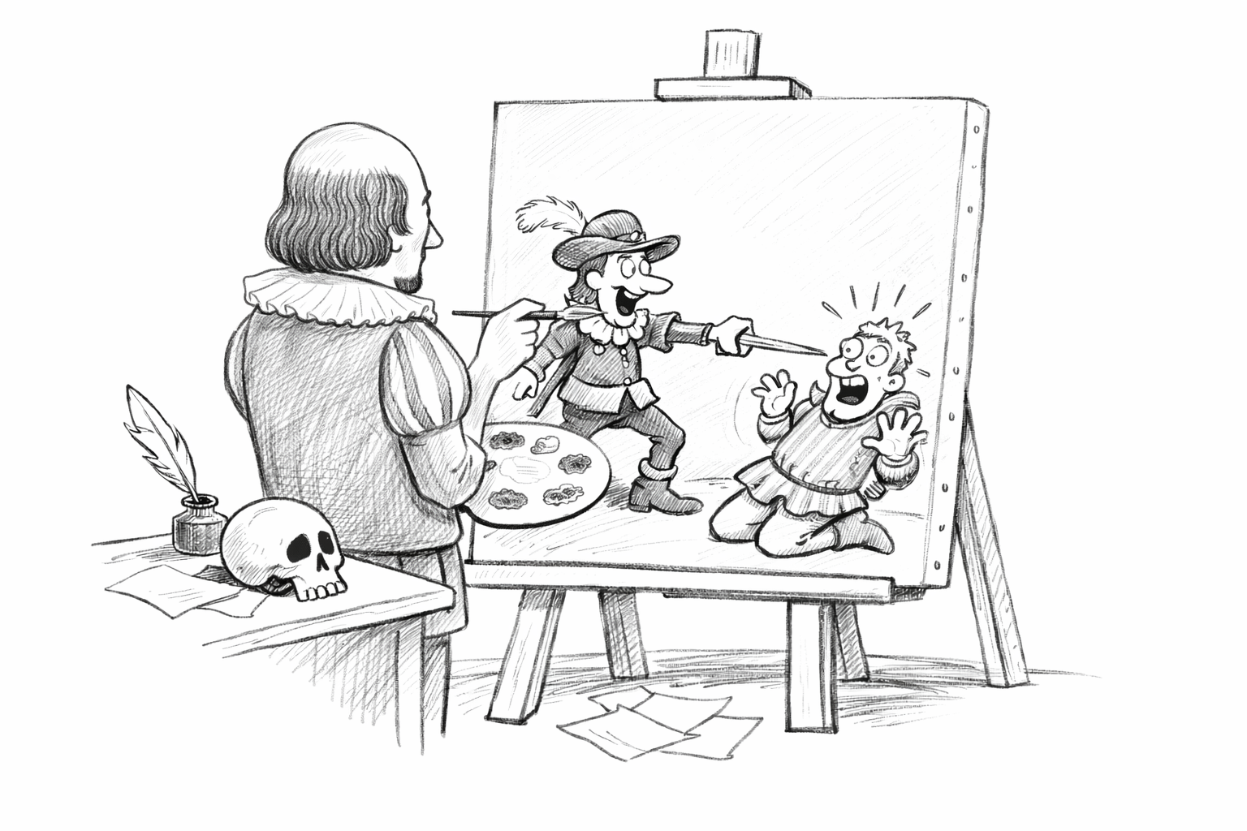

Slide 6
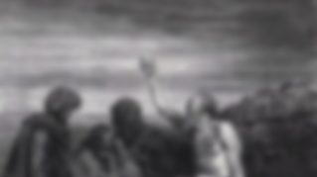
7 Why do the wicked live,
reach old age, and grow mighty in power?
8 Their offspring are established in their presence,
and their descendants before their eyes.
9 Their houses are safe from fear,
and no rod of God is upon them.
(Job 21:7-9)

Slide 7
“I have the keys of Death and Hades.”
Revelation 1:18

Slide 8
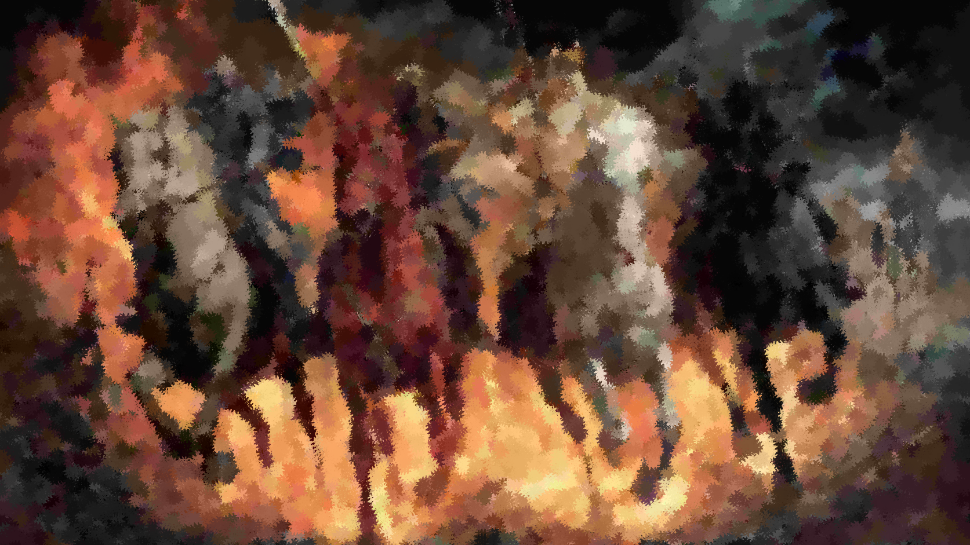

Slide 13
The seals reveal God’s justice against His enemies, the consequences of their sin, and they also serve to purify the saints.

Slide 14

“Some Christians may have wondered if Christ really was sovereign over disastrous circumstances…Rev. 6:1–8 is intended to show that Christ rules over such an apparently chaotic world and that suffering does not occur indiscriminately or by chance. This section reveals, in fact, that destructive events are brought about by Christ for both redemptive and judicial purposes. It is Christ sitting on His throne who controls all the trials and persecutions of the church.”
–G.K. Beale

Slide 15
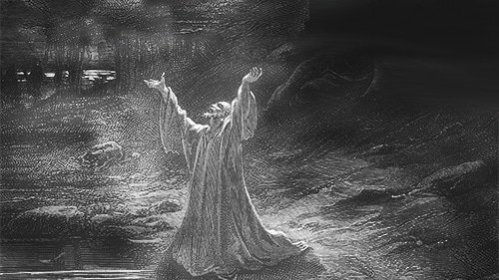
“O Lord, how long shall I cry for help, and you will not hear? Or cry to you ‘Violence!’ and you will not save?”

Slide 16
“Look among the nations, and see;
wonder and be astounded.
For I am doing a work in your days
that you would not believe if told.
6 For behold, I am raising up the Chaldeans,
that bitter and hasty nation,
who march through the breadth of the earth,
to seize dwellings not their own.”
Habakkuk 1:5-6

Slide 17
