Slide 1
Leader: Welcome to Holy Hermits Online Worship
4th Sunday in Lent - Refreshment Sunday Today we are remembering
Holy Hermit St Paul of Thebes
Prep: 8/3/2026 Proofed:10Mar26
Service Prep: Lauren | Chat Host: Viki | First Reader: Liz
Music: Lauren | Welcomer: Chris | Second Reader: Bob
Proof-reader: Kristine | Priest: N/A | Preacher: Lauren
Broadcaster: Barry | Deacon: Lauren | Fellowship: Leonie
Backup Broadcaster: Lauren | Leader: Julie | Safety Officer: Chris
Zoom Buttons: Lauren | Cantor: Jeremy | Attendance: Viki

Slide 2


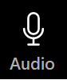



Hospitality
Leader:
Please mute for the service unless invited to offer your voice as part of the service ministry
Have the video camera on or off and turn the volume and brightness up or down on your device if things are too loud 🔉🔊or too bright🔅🔆
Our Cantor acts as our voice, offering the responses, in Bold Text, which we say together
Feel welcome to use the chat and reaction emojis 👍
🙏 Please take care of yourself in this space. 🙏 Come and go as you need
😴 It is great to take rest in this space, so falling asleep is also OK 😴
👂️ Remember, pastoral care is available to all in the community, if you'd like to speak to someone about anything spiritual. ❤️ Visit the help page at the website to reach out 🌐
Our Being Together ethos and safeguarding practices can also be accessed on the website 🫶​
🙌 Come as you are – we are all here together! 🙌
Notes:
Used Lent 2022

Slide 3
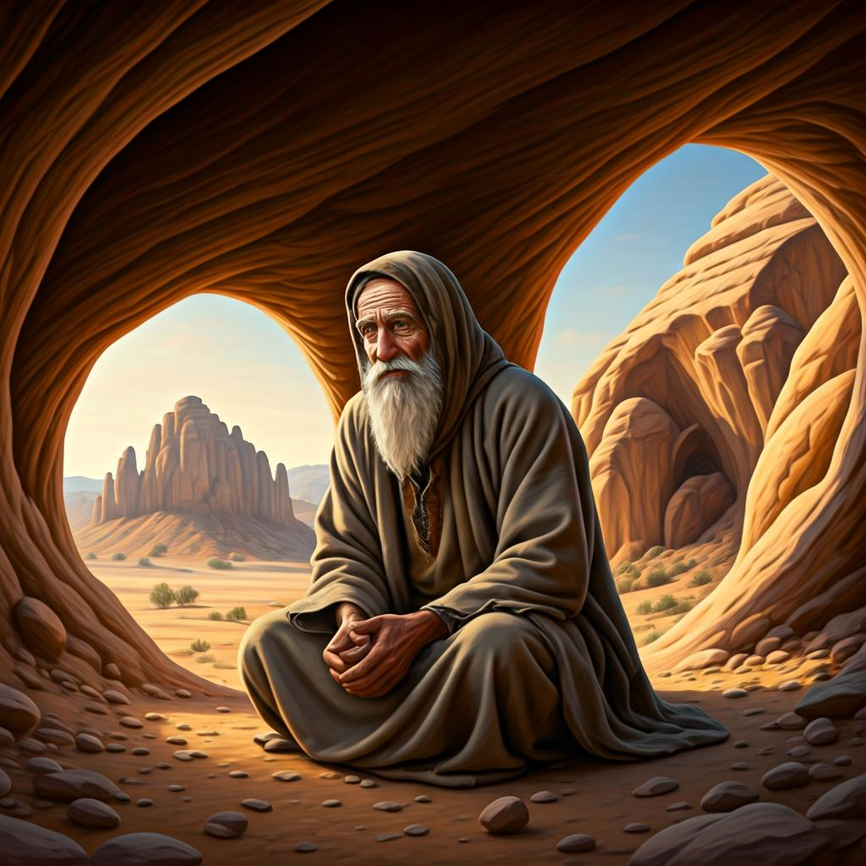
Leader: Our Holy Hermit Highlights for today
St Paul of Thebes fled persecution in 250 and discovered a life of deep joy in the desert, living “alone with God alone” for nearly ninety years. Sustained by a palm tree and a raven, he became a model of pure, persevering prayer. St Anthony later found him radiant with holiness, and after Paul died at 113, two lions dug his grave. Paul stayed in solitude not from fear but from love — he had found heaven in God’s presence. His legacy inspires us to embrace life’s unexpected paths and let devotion reshape us.
To read more about our hermits please click the link​​ in the send out

Slide 4
Invitation
Leader: As we settle into worship let your breath be soft, your mind be still, and your heart be open to the presence of God.
Opening Music: https://www.youtube.com/watch?v=0uGBxBw5Peo&feature=youtu.be

Slide 5
Leader and Cantor unmute
The Greeting
Leader: The Grace of the lord Jesus Christ, and the
love of God, and the fellowship of the Holy
Spirit, be with you all.
All: And also with you.

Slide 6
Gathering Prayer
Leader: We are seen by God and God is with us.
We are known by God and God understands us.
In all our comings and goings,
and in all our being and our doing, God sees us.
Let us seek to see God.

Slide 7
Gathering Prayer
All: Father God,
be with us now,
as we seek to draw closer to you,
inspire our hearts and minds,
so that we might see things as you see them.
In your name and for your glory, we pray.
Amen.

Slide 8
Sentence
Leader: I invite our Cantor to proclaim the sentence for today.
Cantor:
‘I am the light of the world,’ says the Lord; ‘those who follow me will have the light of life.’
John 8.12

Slide 9
Prayer of Approach
Leader: We pray the prayer of approach together
All: God, our loving parent,
who loves us with the nature of both mother and father –
on this Mothering Sunday,
we gather around you as your children,
to share in your perfect love.
Amen

Slide 10
Our First Hymn is
What Wondrous Love is This
https://www.youtube.com/watch?v=uwnJFEQrey0
We stay on mute
Leader and Cantor mute

Slide 11
Kyrie Eleison​
Leader: Lord, have mercy ​
All: Lord have mercy​
Leader: Christ have mercy​
All: Christ have mercy​
Leader: Lord have mercy​
All: Lord, have mercy​

Slide 12
The Deacon Introduces Confession​
The Lord comes, bringing to light things now hidden in darkness, and disclosing the purposes of the heart.
​​
Silence may be kept.​..
​
Let us then ask for mercy, confessing our sins in penitence and faith.

Slide 13
All: Merciful God, our maker and our judge,
we have sinned against you in thought, word, and deed,
and in what we have failed to do:
we have not loved you with our whole heart;
we have not loved our neighbours as ourselves;
we repent, and are sorry for all our sins.
Father, forgive us.
Strengthen us to love and obey you in newness of life;
through Jesus Christ our Lord.
Amen.

Slide 14
Words of Assurance offered by the Deacon
These words of assurance from the First Letter of John declare that:
If anyone sins, we have an advocate with the Father, Jesus Christ the righteous. He is the perfect offering for our sin, and not for ours only, but for the sins of the whole world.
(1 John 2: 1-2)
In this is love, not that we loved God, but that he loved us and sent his Son to be the perfect offering for our sins.
(1 John 4:10)

Slide 15
Collect
Leader: Gracious God,
in order that we children of earth
might discern good from evil
you sent your Son to be the light of the world:
as the light of Christ shines upon us,
may we learn what pleases you,
and live in truth and goodness;
through the same Jesus Christ our Lord,
who is alive and reigns with you and the Holy Spirit,
one God, now and for ever. Amen.

Slide 16
≈
The 1st reader unmutes
Leader: I invite the 1st reader to unmute and offer the 1st lesson when ready.
Reader 1: The 1st Reading is from 1 Samuel 16.1-13
¹The Lord said to Samuel, ‘How long will you grieve over Saul? I have rejected him from being king over Israel. Fill your horn with oil and set out; I will send you to Jesse the Bethlehemite, for I have provided for myself a king among his sons.’ ²Samuel said, ‘How can I go? If Saul hears of it, he will kill me.’ And the Lord said, ‘Take a heifer with you, and say, “I have come to sacrifice to the Lord .” ³Invite Jesse to the sacrifice, and I will show you what you shall do;
Continue…

Slide 17
≈
and you shall anoint for me the one whom I name to you.’ ⁴Samuel did what the Lord commanded, and came to Bethlehem. The elders of the city came to meet him trembling, and said, ‘Do you come peaceably?’ ⁵He said, ‘Peaceably; I have come to sacrifice to the Lord ; sanctify yourselves and come with me to the sacrifice.’ And he sanctified Jesse and his sons and invited them to the sacrifice. ⁶When they came, he looked on Eliab and thought, ‘Surely the Lord’s anointed is now before the Lord .’ ⁷But the Lord said to Samuel, ‘Do not look on his appearance or on the height of his stature,
Continue…

Slide 18
≈
because I have rejected him; for the Lord does not see as mortals see; they look on the outward appearance, but the Lord looks on the heart.’ ⁸Then Jesse called Abinadab, and made him pass before Samuel. He said, ‘Neither has the Lord chosen this one.’ ⁹Then Jesse made Shammah pass by. And he said, ‘Neither has the Lord chosen this one.’ ¹⁰Jesse made seven of his sons pass before Samuel, and Samuel said to Jesse, ‘The Lord has not chosen any of these.’ ¹¹Samuel said to Jesse, ‘Are all your sons here?’ And he said, ‘There remains yet the youngest, but he is keeping the sheep.’
Continue…

Slide 19
≈
And Samuel said to Jesse, ‘Send and bring him; for we will not sit down until he comes here.’ ¹²He sent and brought him in. Now he was ruddy, and had beautiful eyes, and was handsome. The Lord said, ‘Rise and anoint him; for this is the one.’ ¹³Then Samuel took the horn of oil, and anointed him in the presence of his brothers; and the spirit of the Lord came mightily upon David from that day forward. Samuel then set out and went to Ramah.
For the word of the Lord. Thanks be to God.​

Slide 20
Leader: We now say the psalm antiphonally, I invite the first reader to lead, and we will all respond with our cantor as our voice.
Psalm 23
¹The Lord is my shepherd:
therefore can I lack nothing.
²He will make me lie down in green pastures:
and lead me beside still waters.
³He will refresh my soul:
and guide me in right pathways for his name’s sake.
Continue…

Slide 21
⁴Though I walk through the valley of the shadow of death,
I will fear no evil:
for you are with me, your rod and your staff comfort me.
⁵You spread a table before me
in the face of those who trouble me:
you have anointed my head with oil,
and my cup shall be full.
⁶Surely your goodness and loving-kindness
will follow me all the days of my life:
and I shall dwell in the house of the Lord for ever.

Slide 22
The 2nd reader unmutes
Leader: Thank you, I invite the 2nd reader to unmute and offer the 2nd lesson when ready.
Reader 2: The 2nd Reading is from Romans 5.8-14
⁸For once you were darkness, but now in the Lord you are light. Live as children of light— ⁹for the fruit of the light is found in all that is good and right and true. ¹⁰Try to find out what is pleasing to the Lord. ¹¹Take no part in the unfruitful works of darkness, but instead expose them. ¹²For it is shameful even to mention what such people do secretly;
Continue…

Slide 23
¹³but everything exposed by the light becomes visible, ¹⁴for everything that becomes visible is light. Therefore it says,
‘Sleeper, awake!
Rise from the dead,
and Christ will shine on you.’
For the word of the Lord. Thanks be to God.

Slide 24

We pause before
​the Gospel ​​

Slide 25
Leader: The Gospel of our Lord Jesus Christ according to St John Chapter 9 beginning at the 1st verse
All: Glory to you Lord Jesus Christ.
¹ As he walked along, he saw a man blind from birth. ² His disciples asked him, ‘Rabbi, who sinned, this man or his parents, that he was born blind?’ ³ Jesus answered, ‘Neither this man nor his parents sinned; he was born blind so that God’s works might be revealed in him. ⁴ We must work the works of him who sent me while it is day; night is coming when no one can work. ⁵ As long as I am in the world, I am the light of the world.’ ⁶ When he had said this, he spat on the ground and made mud with the saliva and spread the mud on the man’s
Continue…

Slide 26
eyes, ⁷ saying to him, ‘Go, wash in the pool of Siloam’ (which means Sent). Then he went and washed and came back able to see. ⁸ The neighbours and those who had seen him before as a beggar began to ask, ‘Is this not the man who used to sit and beg?’ ⁹ Some were saying, ‘It is he.’ Others were saying, ‘No, but it is someone like him.’ He kept saying, ‘I am the man.’ ¹⁰ But they kept asking him, ‘Then how were your eyes opened?’ ¹¹ He answered, ‘The man called Jesus made mud, spread it on my eyes, and said to me, “Go to Siloam and wash.” Then I went and washed and received my sight.’ ¹² They said to him, ‘Where is he?’ He said, ‘I do not know.’
Continue…

Slide 27
¹³ They brought to the Pharisees the man who had formerly been blind. ¹⁴ Now it was a sabbath day when Jesus made the mud and opened his eyes. ¹⁵ Then the Pharisees also began to ask him how he had received his sight. He said to them, ‘He put mud on my eyes. Then I washed, and now I see.’ ¹⁶ Some of the Pharisees said, ‘This man is not from God, for he does not observe the sabbath.’ But others said, ‘How can a man who is a sinner perform such signs?’ And they were divided. ¹⁷ So they said again to the blind man, ‘What do you say about him? It was your eyes he opened.’ He said, ‘He is a prophet.’ ¹⁸ The Jews did not believe that he had been blind and had received his sight
Continue…

Slide 28
until they called the parents of the man who had received his sight ¹⁹ and asked them, ‘Is this your son, who you say was born blind? How then does he now see?’ ²⁰ His parents answered, ‘We know that this is our son, and that he was born blind; ²¹ but we do not know how it is that now he sees, nor do we know who opened his eyes. Ask him; he is of age. He will speak for himself.’ ²² His parents said this because they were afraid of the Jews; for the Jews had already agreed that anyone who confessed Jesus to be the Messiah would be put out of the synagogue. ²³ Therefore his parents said, ‘He is of age; ask him.’
Continue…

Slide 29
²⁴ So for the second time they called the man who had been blind, and they said to him, ‘Give glory to God! We know that this man is a sinner.’ ²⁵ He answered, ‘I do not know whether he is a sinner. One thing I do know, that though I was blind, now I see.’ ²⁶ They said to him, ‘What did he do to you? How did he open your eyes?’ ²⁷ He answered them, ‘I have told you already, and you would not listen. Why do you want to hear it again? Do you also want to become his disciples?’ ²⁸ Then they reviled him, saying, ‘You are his disciple, but we are disciples of Moses. ²⁹ We know that God has spoken to Moses, but as for this man, we do not know where he comes from.’
Continue…

Slide 30
³⁰ The man answered, ‘Here is an astonishing thing! You do not know where he comes from, and yet he opened my eyes. ³¹ We know that God does not listen to sinners, but he does listen to one who worships him and obeys his will. ³² Never since the world began has it been heard that anyone opened the eyes of a person born blind. ³³ If this man were not from God, he could do nothing.’
This is the Gospel of the Lord. Praise to you Lord Jesus Christ.

Slide 31
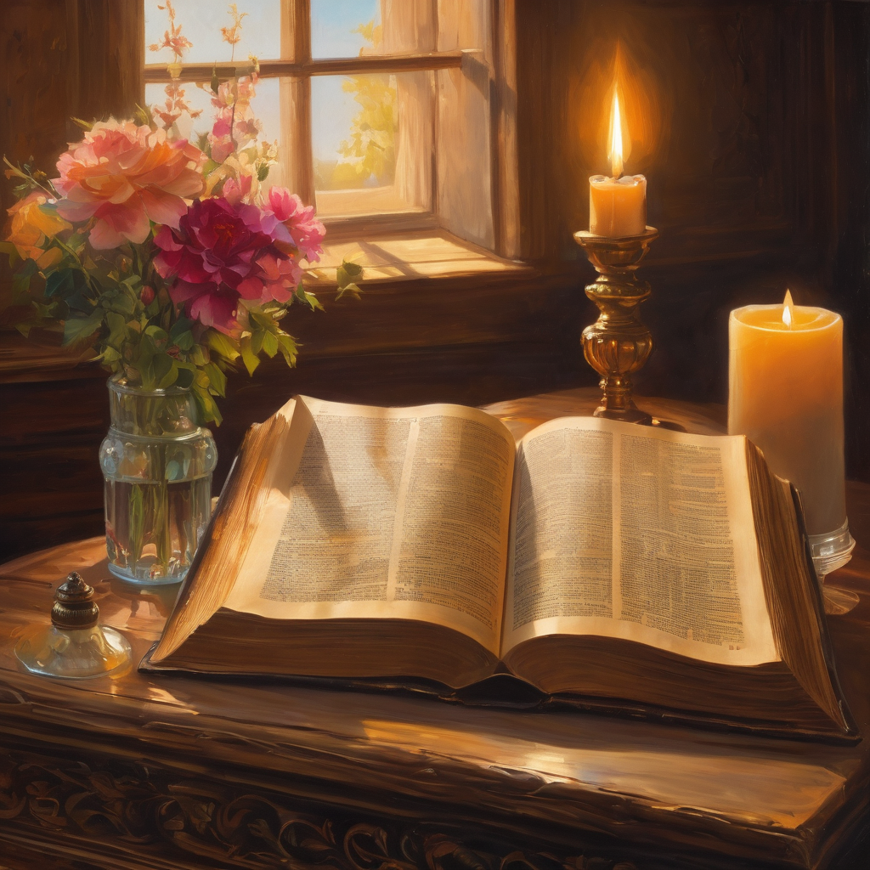
We pause
after ​the Gospel ​​

Slide 32
Leader: The Sermon is recorded to YouTube for sharing later.
Only the preacher's video and audio will be recorded.
The chat and other participants' feeds remain out of sight of the recording.
Leader and Cantor mute
Broadcaster exits screenshare
Preacher unmutes
Zoom buttons ”pins” preacher’s screen + selects “record to the cloud”
Sermon

Slide 33
Leader unmutes
Our next Hymn is
Saviour Like a Shepherd, He Leads Us
https://www.youtube.com/watch?v=tGO9_xGunBg
We stay on mute
Leader mutes

Slide 34
The Leader and Cantor unmute
The Greeting of Peace
Leader: We are the body of Christ
All: God’s Spirit is with us
Leader: The peace of the Lord be always with you.
All: And also with you.
Leader: A sign of peace may be exchanged
You may like to type 'Peace' into the chat, use the 'raise hand’ or other reaction buttons, or just simply wave via the screen with your video turned on
(Broadcaster exits shared screen for a few moments for the exchange of peace)

Slide 35
Prayer of Thanksgiving before Intercessions
Leader: As we enter prayer, I invite the second reader to unmute to lead our intercessions which follow the prayer of thanksgiving. Please feel free to change your body position as you need.

Slide 36
Prayer of Thanksgiving before Intercessions
Leader: Heavenly Father, today we thank you for the love of mothers and caregivers everywhere.
We give thanks for all those for whom this is or has been their Mother Church, where they have known the nurture of you.
Thank you, Lord, for being to all of us a loving parent, embodying the natures of the perfect mother and father, balanced in harmony to meet all our needs;
may we live in you, and learn from you always.
Amen.

Slide 37
Intercessions
Reader 2: We pray for creation and communities we share our lives with. We pause for a few moments to name either in our hearts, or out loud, or in the chat, those environments and communities we bring to the Lord in prayer.
PAUSE…
We entrust to you the community of Holy Hermits Online and our ministry partners:
Prosper the work of our hands and show us the way to your new creation.
Creator God, Hear our prayer.
St John's Cathedral Brisbane The Anglican Diocese of Southern Queensland St Gabriel’s, Carindale Benedictus Contemplative Church, Canberra Anglican Focus and Tithe.ly

Slide 38
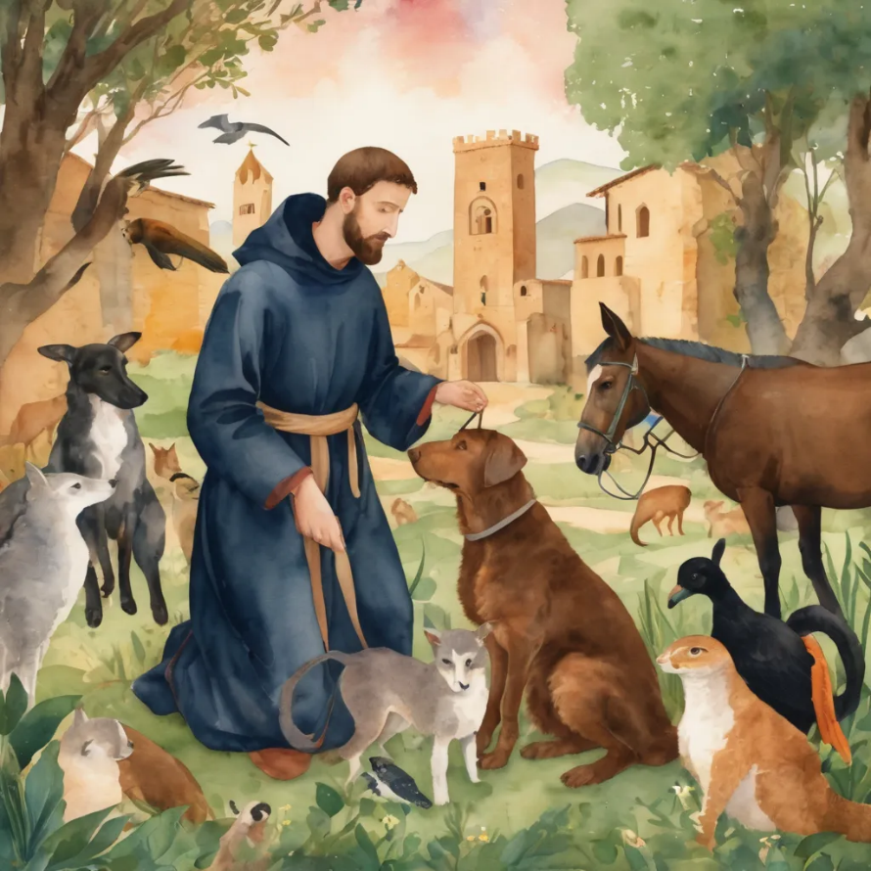
Reader 2: Loving Creator, we entrust to you all animals, especially those who are sick, anxious, ageing, lost, at risk, lonely, sad, hungry, in pain, homeless, abused, living in fear, encountering violence of any kind, in need of comfort, rehabilitation or transformation.
We invite your loving compassion for:
We name in our hearts, out loud or in the chat,
the animals we bring to the Lord in prayer. PAUSE…
Jasmine, ​
Leese(y), ​
Sid, Toots & Lulu​
Polly and Suki​
Fred, George & Percy​
Koshka ​
Jax
Lambert ​​
Kala, Nigel & Little One ​​
Toby​​
Taco​​
Paddy ​​
Rosie​

Slide 39
Reader 2: Eternal Trinity of Love, we uphold to you the people we love and carry cares for:
We name in our hearts, out loud or in the chat, those we bring to the Lord in prayer. PAUSE… We entrust to you those who have died, those who have died peacefully and those who have died tragically, The old and the young. Receive them into your Kingdom. Lord in your mercy, Hear our prayers. Amen.
Kerry, Les & Jake Julie, Ray, Tracey & Shane Mark, Desley & Bob ​​ Rachel, Mervyn & Gillian ​​Rev'd Shane & Janette​​ Alecia, Martin & Aidan​​ Matthew & Nicholas | Barry​​ Dr Julie ​​ Ruth​​ Phil​ May Susan Tanya​ Craig Neva​ | Bill & Marjorie​​ Aaron & Andrea Dilys & Tony, Paul & Darhon Judy & Mary​​ Bob & Di​ Pat & Julie Miriam Gayanne | Kirsten, Greg, Daphne & Beau Alan & Gaylene​ Jess & Leah ​​ Bonnie & girls Liz’s Godchildren Barry & Gwen ​

Slide 40
Pray Daily Cycle of Prayer
Leader: Loving God, joining with the Church in our cycle of prayer, we ask your blessings on:
The Anglican Church of Kenya
The Diocese of Melbourne: †Ric; Assistant Bishops – †Genieve, †Paul, †Kate; Clergy and People
The Parish of Tara
Liturgical Assistants in parishes and schools
St Paul’s School, Bald Hills: Principal – John; Chaplains – Nicki; staff & students

Slide 41
Commitment prayer for the week
Leader: Our commitment prayer for the week is A Prayer of Lament
https://www.youtube.com/watch?v=d8tLRZWOAcw

Slide 42
Leader: Let us pray together the prayer which Jesus gave us saying:
All: Our Father in heaven,
hallowed be your name,
your kingdom come, your will be done,
on earth as in heaven.
Give us today our daily bread.
Forgive us our sins
as we forgive those who sin against us.
Save us from the time of trial
and deliver us from evil.
For the kingdom, the power,
and the glory are yours
now and for ever.
Amen.

Slide 43
Devotions

Slide 44
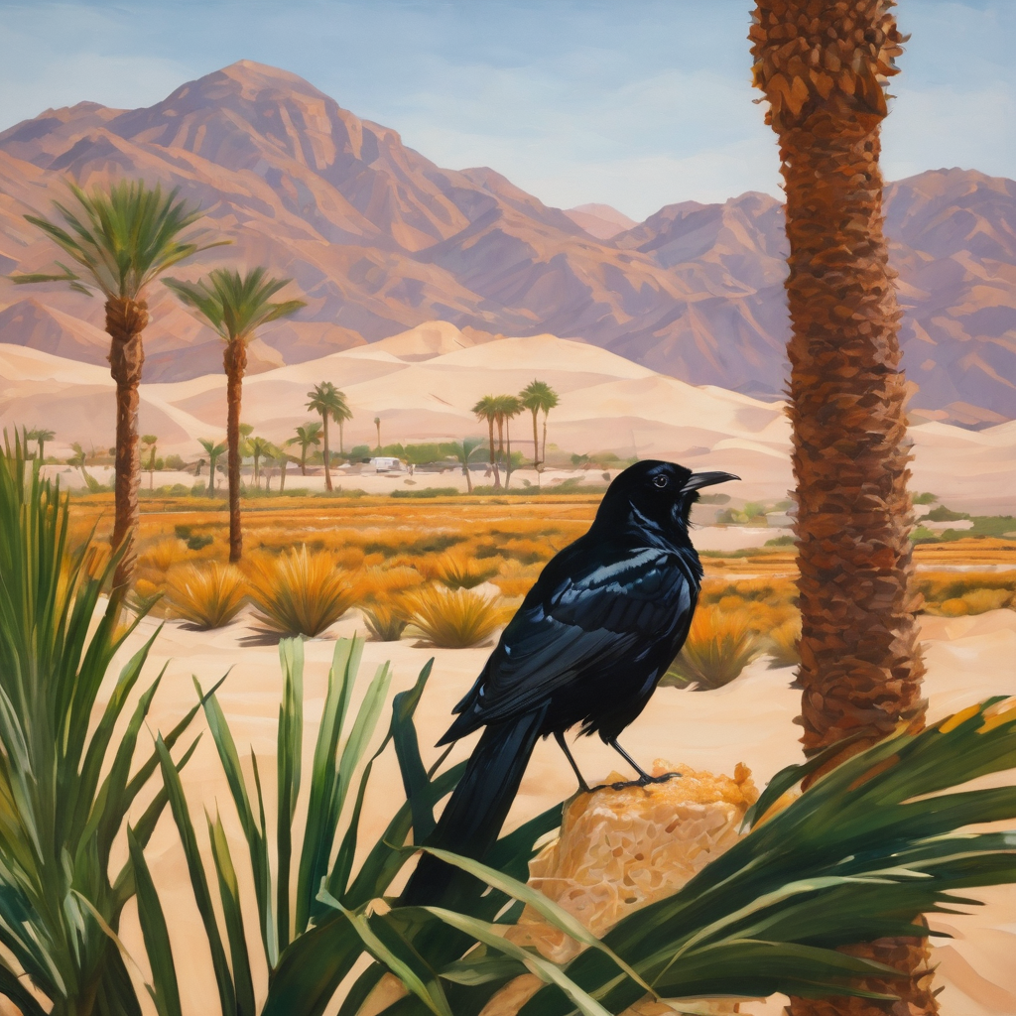
Hermit Wisdom

Slide 45
Leader: A prayer inspired by Holy Hermit St Paul of Thebes
Lord Jesus, living in the desert was not St. Paul’s dream existence. And yet this curve in the road made him phenomenally content and happy. Through this intercession, help us accept life’s twists and turns. Then let us use them to glorify you. Amen.

Slide 46
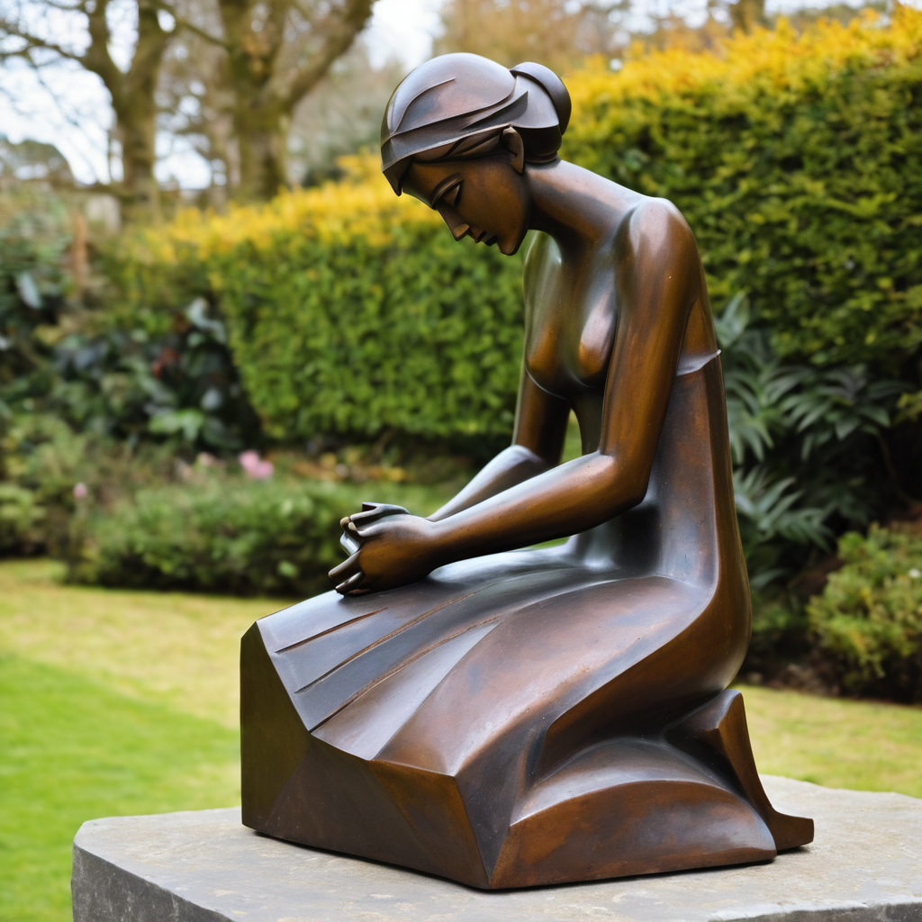
Leader: ​As we enter a few minutes of silence together, you are invited to pray this prayer of adoration and/or spend this time in contemplation. ​
The Spiritual Communion prayer follows
on the next slide. Let us be still.
Leader and Cantor Mute
​

Slide 47
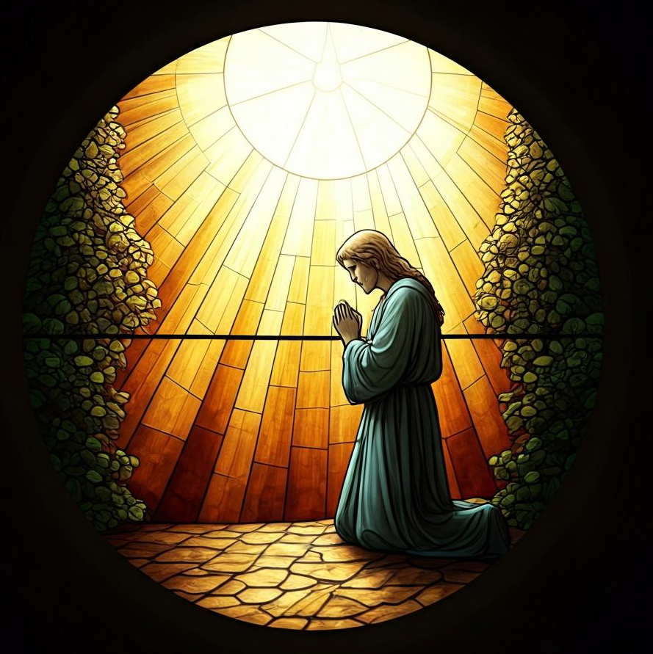
Prayer of Adoration
Dear Jesus, when we look at the world around us, help us to ask:
what do you see?
When we look at the people around us, help us to ask:
what do you see?
When we look at ourselves, help us to ask:
what do you see?
When we respond to the needs in our community, help us to ask:
what do you see?
Help us all to see with your love as our focus.
Amen.
​

Slide 48
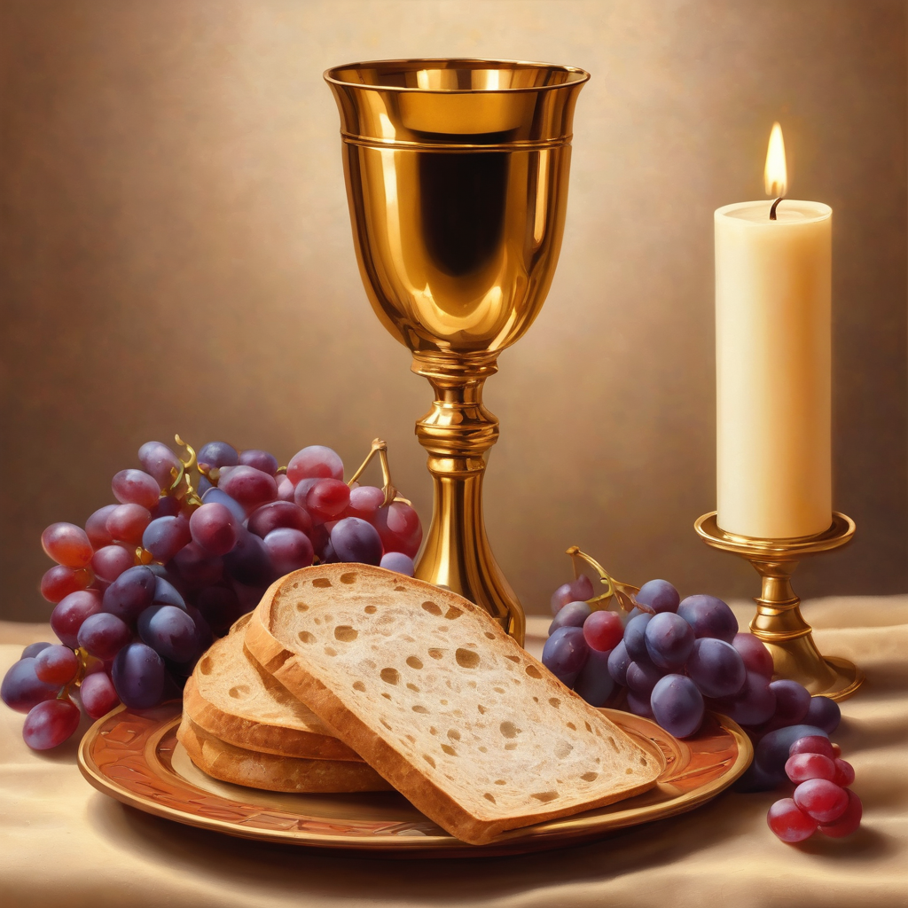
Oh, my Lord Jesus I turn to you
present at the Altar and in the
Tabernacle. I believe that you are
present in the Holy Sacrament of your
most Sacred Body and Blood. I love you
above all things and I desire to receive
you into my Soul. I cannot at this
moment receive you Sacramentally in
Holy Communion. Come spiritually into
my heart. Purify it, Sanctify it. Render
my heart like your own heart.
I embrace you as if you were already
there and unite myself wholly with
you. Never permit me to be separated
from you. Lord, I am not worthy to
receive you, but only say the word and I
shall be healed. Amen
Making a
Spiritual Communion
(Prayed in silence)

Slide 49
Leader unmutes
Our final song is
Ode to Joy
https://youtu.be/IgtQmnE9suQ
​We stay on mute
Leader and Cantor mute

Slide 50
Leader and cantor unmute
Sending Prayer
Leader: We pray our sending prayer together.
All: Lord Jesus,
help us to see you in each person we meet in the days ahead.
May we reveal something of your love and goodness to them.
In your name, we pray.
Amen.

Slide 51
The Benediction
Leader: Let us all invite God’s blessings together,
All: May the Lord bless us and keep us.
May the Lord’s face shine upon us and be gracious to us. May the Lord’s countenance be lifted upon us, and bring us peace.
Amen

Slide 52
Notices
Contemplative Service Team Workshop today @11am@ 6pm
Our Lenten study with the Cathedral continues Wednesday @ 7:30pm Contact Rev’d Jess if you would like to sign up (jgrant@stjohnscathedral.com.au).
Next week we welcome Rev’d Jess, who will join us in weekly worship as part of our clergy swap with the Cathedral
See HHO Events page for further upcoming events HHO Events

Slide 53
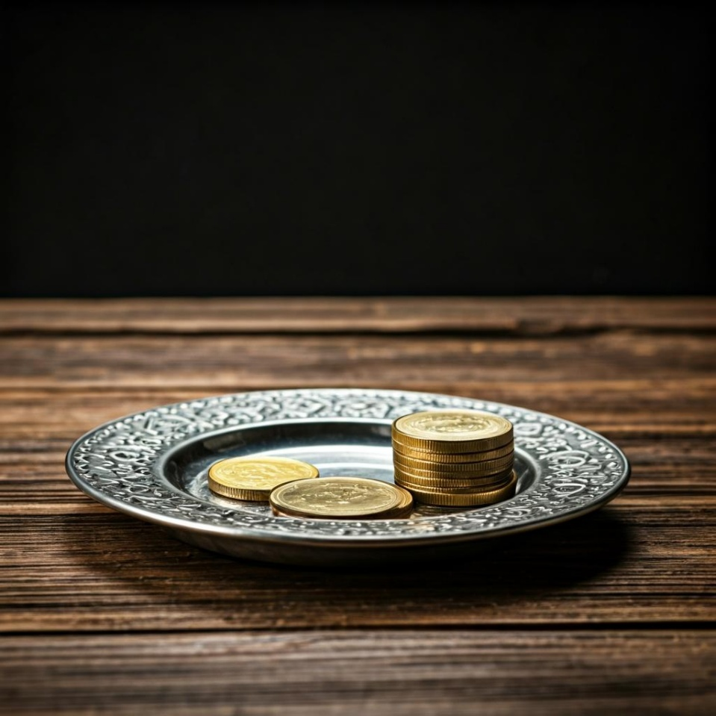
Offerings: Thank you for your regular gifts to this ministry
Offerings are most welcome via
The HHO App
Direct Debit
International Direct Debit
Please consider a one-off donation
or leaving a legacy in your Will
For further information go to HHO give page https://holyhermits.com.au/give

Slide 54
Serving next week
Sunday 22nd March
9:00 am AEST
Service Prep: Leonie | Chat Host: Rachel | First Reader: Viki
Music: Wiggles | Welcomer: Julie | Second Reader: Roselyn
Proof-reader: Chris | Priest: Jess | Preacher: Jess
Broadcaster: Kieron | Deacon: Jess | Fellowship: Julie
Backup Broadcaster: Jeremy | Leader: Jeremy | Safety Officer: Leonie
Zoom Buttons: Jeremy | Cantor: Kieron | Attendance: Rachel
Thank you for your ministry gifts
New Servers always welcome!
Please email Rev’d Lauren to get involved
holyhermits@anglicanchurchsq.org.au

Slide 55
The Dissmissal
Leader: I invite everyone to unmute for the Dismissal
Leader: Go in peace to love and serve the Lord.
All: In the name of Christ, Amen.

Slide 56

Fellowship time
Thank you, Julie for leading Fellowship
Please feel welcome to linger or pop a message in the chat and head off when you are ready.​
Extra resources developed
by Roots on the Web
Artwork by Padlet

