Slide 1
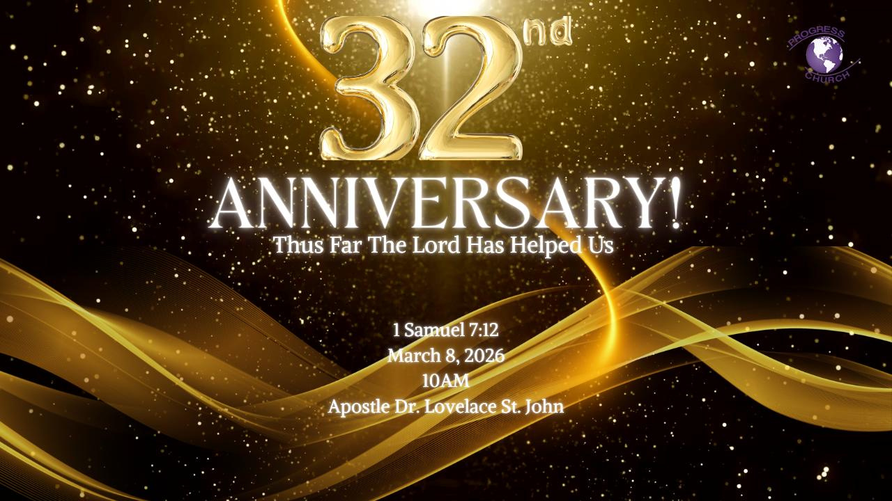

Slide 2



Scripture:
1 SAMUEL 7: 1- 12

Slide 3
INTRODUCTION
Samuel stood between two places, Mizpah and Shen, and he lifted a stone.
Not a throne. Not a trophy. A stone.
He called it Ebenezer, “the stone of help”.
He was saying: “We are still here because God helped us.”

Slide 4
1. The Help We Received Along the Way
When Samuel lifted that stone, he was reminding Israel that their story was not one of uninterrupted faithfulness. Because they had known idolatry, defeat, fear, and repentance. Yet God helped them anyway.
We were helped when we lacked wisdom.
We were helped when doors closed.
We were helped when strength failed.

Slide 5
1. The Help We Received Along the Way (con’t)
We were helped when faith was weak but God remained strong.
The testimony of the church is never, Look how capable we are, but rather, Look how merciful God has been.
We did not arrive here by talent alone.
We did not endure by strategy alone.
We did not overcome by determination alone.

Slide 6
2. It Was Never Our Own Strength
Success can create a subtle spiritual danger.
What once felt like dependence begins to feel like competence.
Deuteronomy 8:17: “You may say in your heart, ‘My power and the might of my hand have gained me this wealth.’”
Blessing often produces forgetfulness. Prosperity can erase memory. Stability can weaken humility.

Slide 7
2. It Was Never Our Own Strength (con’t)
Deuteronomy 8:17: “You may say in your heart, ‘My power and the might of my hand have gained me this wealth.’”
Sometimes the greatest danger is not failure, it is success without remembrance.
When we forget divine help, we subtly replace worship with self-confidence.
Prayer becomes shorter. Listening becomes rarer. Obedience becomes selective.

Slide 8
3. The Danger of Becoming Callous to God’s Voice
One of the quiet tragedies in long-term church service is spiritual callousness.
At first, God’s voice moves us deeply. Conviction is immediate. Worship is tender. Obedience is quick.
But familiarity can dull sensitivity.

Slide 9
3. The Danger of Becoming Callous to God’s Voice (con’t)
We learn church language.
We master ministry routines.
We know how to function without truly listening.
It is possible to work for God while no longer walking with God.
The heart becomes insulated, not rebellious, just numb.

Slide 10
4. Remembering Our Ebenezer Keeps Us Humble
Samuel’s stone was protection against spiritual amnesia.
When we remember God’s help:
Pride loses its grip.
Gratitude replaces entitlement.
Sensitivity to God’s voice returns.
Repentance becomes possible again.

Slide 11
4. Remembering Our Ebenezer Keeps Us
Every church must periodically stop and say:
We did not build this alone.
We did not sustain this alone.
We did not survive this alone.
Thus far — the Lord has helped us.

Slide 12
5. WHY WE NEED AN EBENEZER TODAY
Samuel’s stone protected Israel from forgetting.
Because remembering keeps us humble.
Every believer needs spiritual markers:
“God brought me through that.”
“God restored me there.”
“God carried me when I could not walk.”
Progress today we raise our Ebenezer again. Not celebrating ourselves.

Slide 13
Conclusion:
Today, the call is not merely to look backward but to look rightly.
Remember the prayers God answered.
Remember the doors He opened.
Remember the seasons He carried us when we could not carry ourselves.

Slide 14
Conclusion (con’t)
And hear the warning:
Do not say in your heart, “My power has done this.”
Do not allow long service to silence God’s voice.
Do not let familiarity replace dependence.
Instead, raise your Ebenezer again.

