Slide 1


Slide 2
Psalm 84:10 For better is one day in your courts than a thousand elsewhere. I would rather be a doorkeeper in the house of my God than dwell in the tents of wickedness.

Slide 3
The Lord is Almighty!
God, I confess that I have wanted….more than I have wanted You.
Lord, help me to delight in Your presence even when….
Lord, help (name) to desire You more than….

Slide 4
There is a moral divide between the sons of Noah.

Slide 5
God uses imperfect people to accomplish His perfect will.

Slide 6
What we choose to give honor too in our lives matters.

Slide 7
God controls the nations and His will never fails.

Slide 8
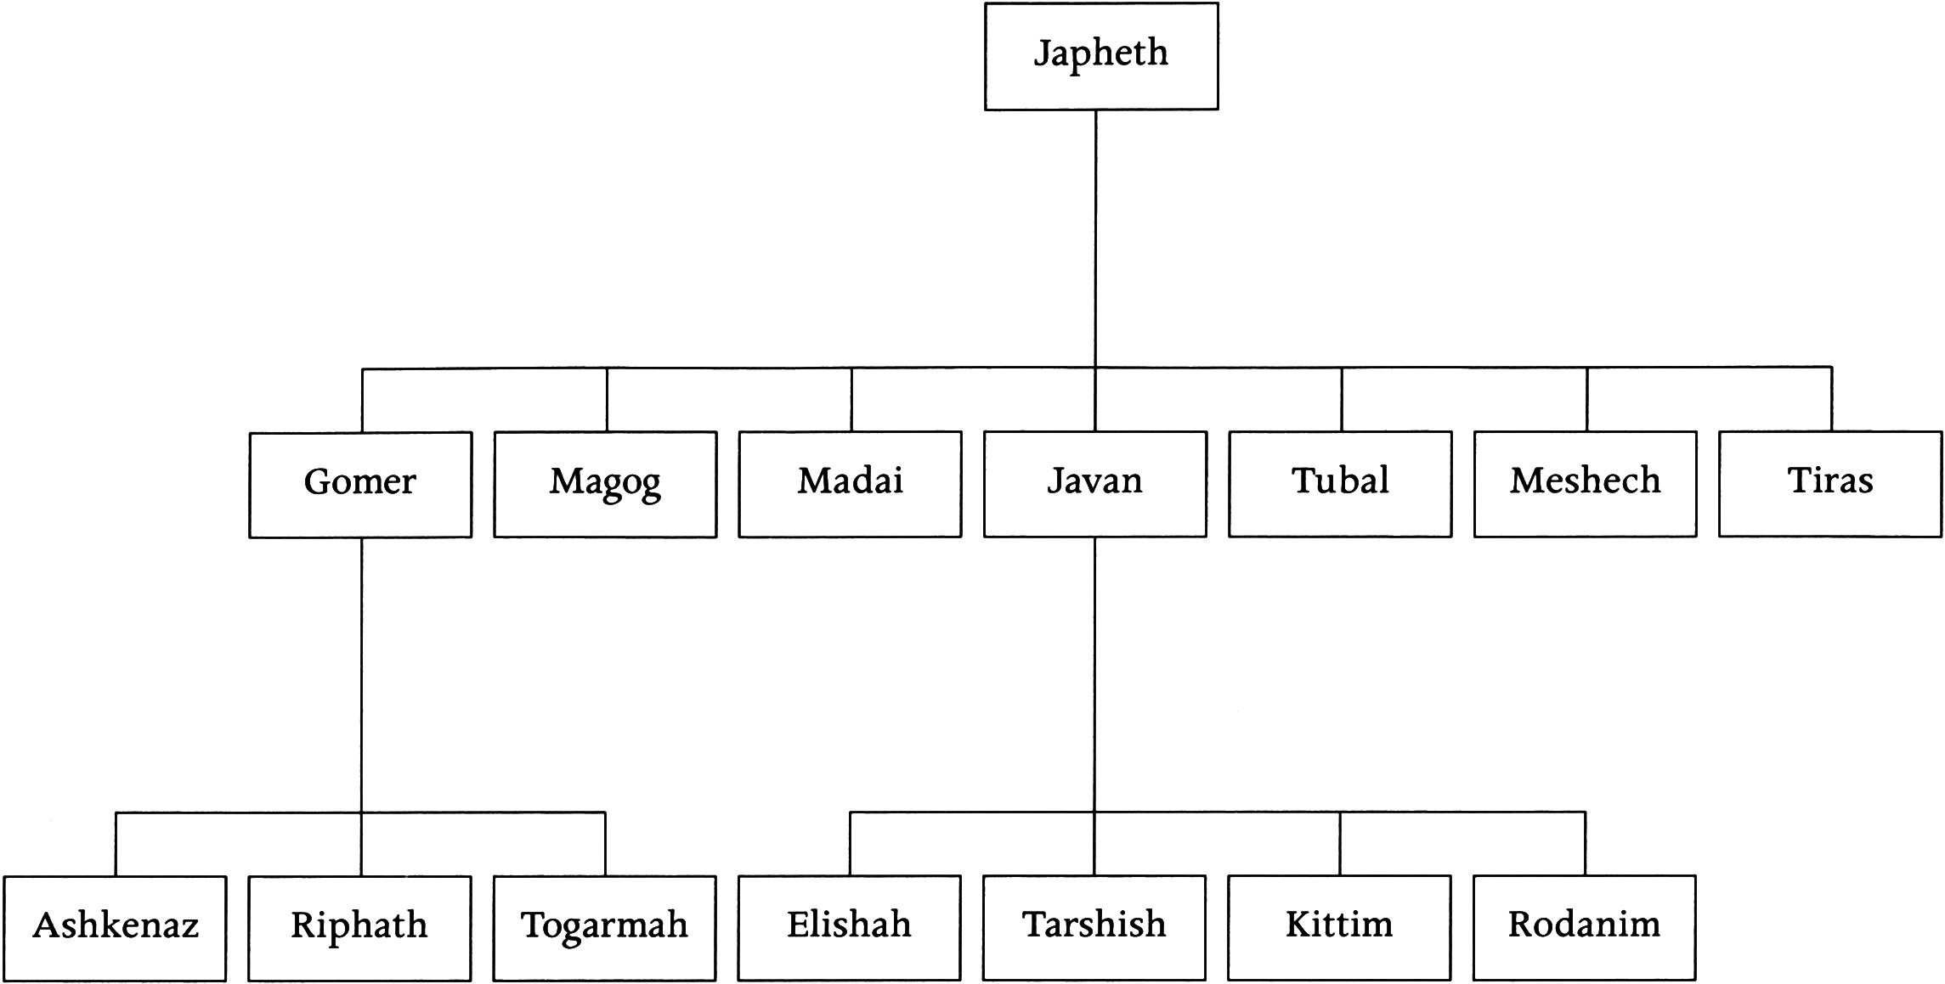

Slide 9
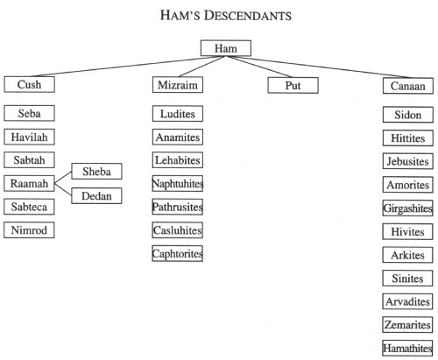

Slide 10
Some of Isreal’s most bitter enemies were birth from the line of Ham.

Slide 11
Nimrod built his kingdom through tyrannical leadership.

Slide 12
We are to be Kingdom builders not builders of our own kingdoms.

Slide 13
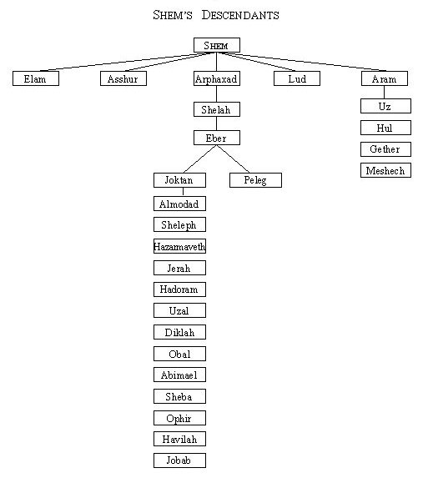

Slide 14
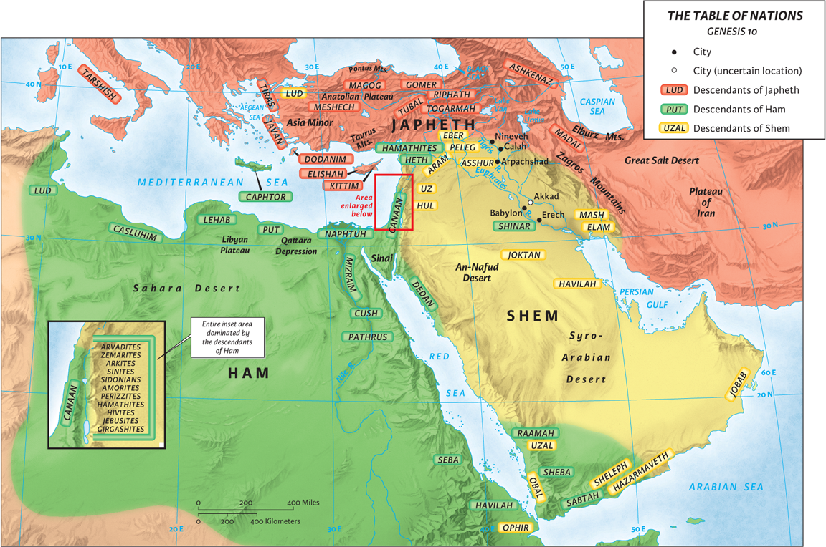

Slide 15
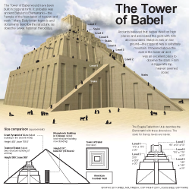

Slide 16
Do not chose comfort over obedience.

Slide 17
Our obedience always honors God.

