Slide 1
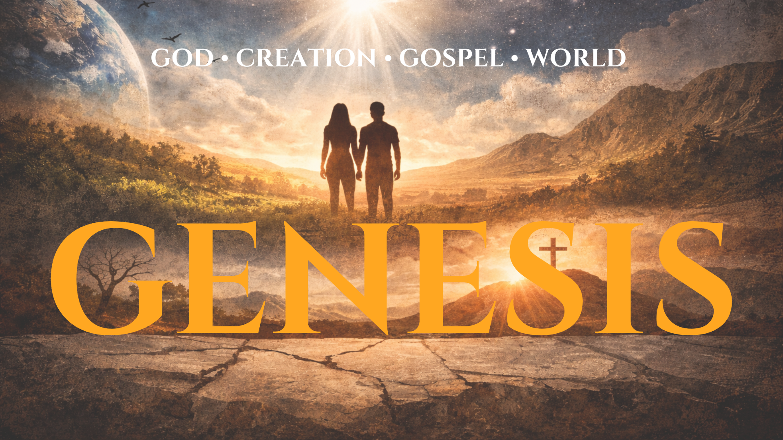


Slide 2
Psalm 145:3
“ Great is the Lord, and greatly to be praised, and his greatness is unsearchable.”

Slide 3
God You are king and your greatness is unsearchable!
Lord, I will tell of Your greatness because You have done ______ for me.
Lord, even though You alone satisfy the desire of every living thing, I confess that I try and find satisfaction in…..
Lord, in your greatness, sustain me as I ……

Slide 4
Burnt Offering:
        -Voluntary
        -Atonement of sin
        -Act of Gratitude

Slide 5
Worship is the only appropriate response to God’s saving grace!

Slide 6
The Right worship makes God’s heart happy.

Slide 7
In the promise we see God’s patience and grace.

Slide 8
In his abundant grace God patiently withholds his judgment of sin because he desires that not one should perish.

Slide 9
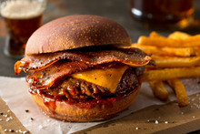

Slide 10
God was providing consequences to deter people form committing murder.

Slide 11
From the womb to the hardened criminal God values all human life.

Slide 12
Covenant:
Binding promise or solemn agreement.

Slide 13
The beauty of God’s covenant is that it is not dependent on man.

Slide 14
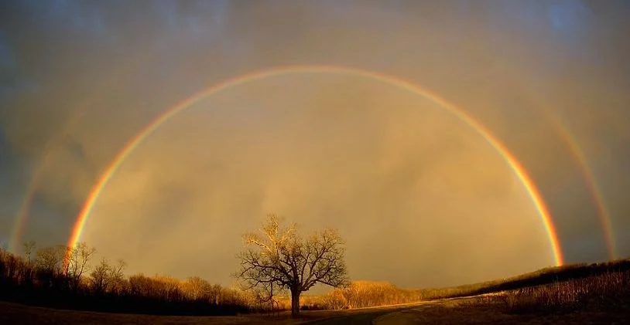

Slide 15
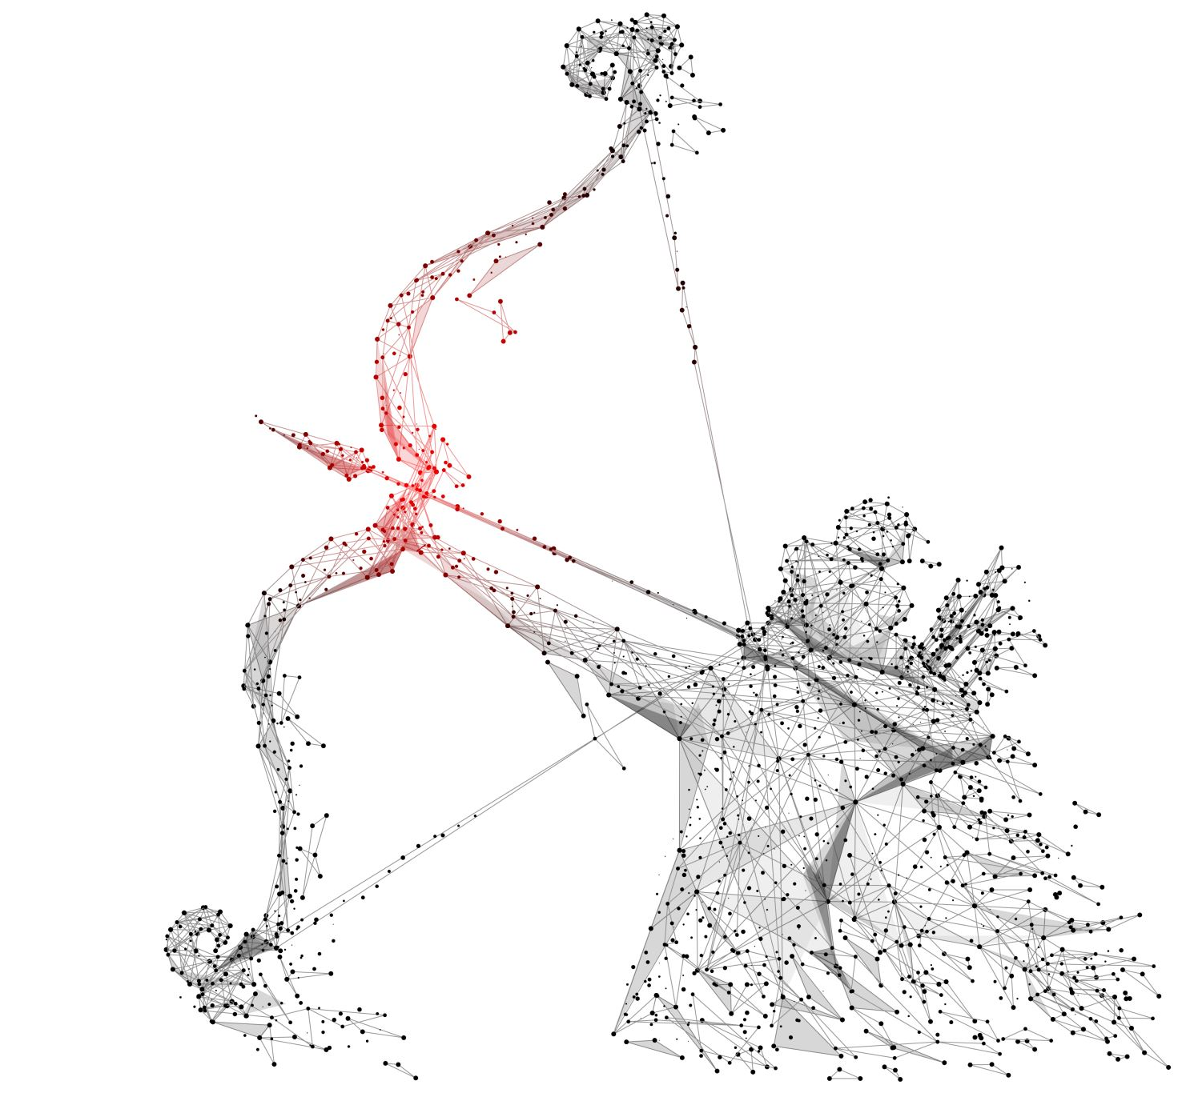
Gesheth:
Archers Bow

Slide 16
The bow was meant to be a visible sign of God’s invisible grace.

Slide 17
Noah’s worship was intentional.

Slide 18
Our lives are the altars from which we worship the Father.

