Slide 1
Leader: Welcome to Holy Hermits Online Worship
3rd Sunday in Lent
Today we are remembering
Holy Hermit Luke the Younger
Service Prep: Kristine | Chat Host: Rachel | First Reader: Phil
Music: Wiggles 🐶 | Welcomer: Julie | Second Reader: Helen
Proof-reader: Viki | Priest: N/A | Preacher: Flashback
Broadcaster: Lauren | Deacon: Lauren | Fellowship: Julie
Backup Broadcaster: Kieron | Leader: Jeremy | Safety Officer: Leonie
Zoom Buttons: Kieron | Cantor: Roselyn | Attendance: Rachel
Prep: 1/03/2026 Proofed: 01/03/2026

Slide 2






Hospitality
Leader:
Please mute for the service unless invited to offer your voice as part of the service ministry
Have the video camera on or off and turn the volume and brightness up or down on your device if things are too loud 🔉🔊or too bright🔅🔆
Our Cantor acts as our voice, offering the responses, in Bold Text, which we say together
Feel welcome to use the chat and reaction emojis 👍
🙏 Please take care of yourself in this space. 🙏 Come and go as you need
😴 It is great to take rest in this space, so falling asleep is also OK 😴
👂️ Remember, pastoral care is available to all in the community, if you'd like to speak to someone about anything spiritual. ❤️ Visit the help page at the website to reach out 🌐
Our Being Together ethos and safeguarding practices can also be accessed on the website 🫶​
🙌 Come as you are – we are all here together! 🙌
Notes:
Used Lent 2022

Slide 3
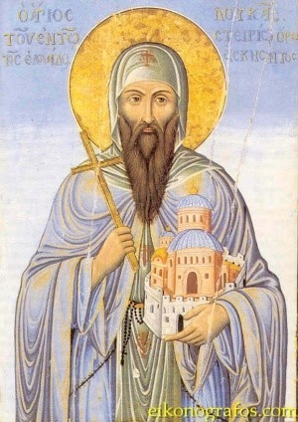
Leader: Our Holy Hermit Highlights for today
Luke, born to poor farmers in the Greek village of Kastorion, worked from childhood in the fields and as a shepherd. Devout and self‑disciplined, he avoided meat, dairy and eggs, drank only water, and fasted on Wednesdays and Fridays. Known for his generosity, he often gave his food and clothing to the poor—once even giving away nearly all his family’s planting seeds, which God repaid with an abundant harvest. From a young age he prayed fervently. After his father died, Luke briefly entered a monastery in Athens, but his mother’s prayers brought him home. Though concerned about his youth, she supported his deep religious devotion.
To read more about our hermits please click the link​​ in the send out

Slide 4
Luke returned home but soon embraced solitude on Mount Ioannou, praying and fasting for seven years and receiving the gift of foresight. Performing miracles drew many visitors. After serving a stylite in Patras for ten years, he resumed ascetic life and performed many miracles, healing sickness of soul and body until his death on February 7, 946.
To read more about our hermits please click the link​​ in the send out

Slide 5
Invitation
Leader: As we settle into worship let your breath be soft, your mind be still, and your heart be open to the presence of God.
Opening Music: https://www.youtube.com/watch?v=ukA2xvsA1qg

Slide 6
Leader and Cantor unmute
The Greeting
Leader: The Grace of the lord Jesus Christ, and the
love of God, and the fellowship of the Holy
Spirit, be with you all.
All: And also with you.

Slide 7
Gathering Prayer
Leader: Let us come together,
each of us known and loved
as a child of God.
We come to worship him,
Father, Son and Holy Spirit.
Lord Jesus, thank you that, as we come to you,
you are always waiting to welcome us
and draw us closer to you and deeper into your love.
Amen.

Slide 8
Prayer of Adoration
All:
God, all-seeing, all-knowing, and everywhere-present,
we bow in humble adoration of your perfect wisdom.
Jesus, love of the Father made flesh to dwell among us,
we come to adore your divinity wrapped in humanity.
Holy Spirit, messenger, comforter and counsellor,
imparting Christ’s teaching to our waiting, thirsting hearts;
be present with us now.
Amen.

Slide 9
Sentence
Leader: I invite our Cantor to proclaim the sentence for today.
Cantor:
‘The water that I will give,’ says the Lord, ‘will become in you a spring of water welling up to eternal life.’
John 4.14

Slide 10
Leader: We pray the prayer of approach together
All:
Almighty God, whose arms are open to all,
we gather to meet with you and hear your word for us today;
for you know us, all we have done and all that we are.
You offer us ‘living water’, all that we need for our lives today.
Amen.

Slide 11
Our First Hymn is
In These Days of Lenten Journey
https://www.youtube.com/watch?v=u2Li7FrW9HY
We stay on mute
Leader and Cantor mute

Slide 12
The Deacon Introduces Confession​
The Lord comes, bringing to light things now hidden in darkness, and disclosing the purposes of the heart.
​​
Silence may be kept.​..
​
Let us open our hearts and prepare for his coming, confessing our sins in penitence and faith.

Slide 13
All: ​Merciful God, our maker and our judge, ​
we have sinned against you ​in thought, word, and deed, ​and in what we have failed to do: ​
we have not loved you with our whole heart; ​
we have not loved our neighbours as ourselves; ​
we repent, and are sorry for all our sins.​
Father, forgive us. Strengthen us to love and obey you in newness of life; ​through Jesus Christ our Lord. ​Amen.​

Slide 14
Words of Assurance offered by the Deacon
These words of assurance from the First Letter of John declare that:
If anyone sins, we have an advocate with the Father, Jesus Christ the righteous. He is the perfect offering for our sin, and not for ours only, but for the sins of the whole world.
(1 John 2: 1-2)
In this is love, not that we loved God, but that he loved us and sent his Son to be the perfect offering for our sins.
(1 John 4:10)

Slide 15
Collect
Leader: O God, the fountain of life,
to a humanity parched with thirst
you offer the living water that springs from the Rock,
our Saviour Jesus Christ:
stir up within your people the gift of your Spirit,
that we may profess our faith with freshness
and announce with joy the wonder of your love.
We ask this through our Lord Jesus Christ,
who lives and reigns with you in the unity of the Holy Spirit,
one God, for ever and ever. Amen.

Slide 16
≈
The 1st reader unmutes
Leader: I invite the 1st reader to unmute and offer the 1st lesson when ready.
Reader 1: The 1st Reading is from Exodus 17.1-7
¹ From the wilderness of Sin the whole congregation of the Israelites journeyed by stages, as the Lord commanded. They camped at Rephidim, but there was no water for the people to drink. ² The people quarrelled with Moses, and said, ‘Give us water to drink.’ Moses said to them, ‘Why do you quarrel with me? Why do you test the Lord ?’ ³ But the people thirsted there for water; and the people complained against Moses and said, ‘Why did you bring us out of Egypt, to kill us and our children and livestock with thirst?’
Continue…

Slide 17
≈
⁴ So Moses cried out to the Lord , ‘What shall I do with this people? They are almost ready to stone me.’ ⁵ The Lord said to Moses, ‘Go on ahead of the people, and take some of the elders of Israel with you; take in your hand the staff with which you struck the Nile, and go. ⁶ I will be standing there in front of you on the rock at Horeb. Strike the rock, and water will come out of it, so that the people may drink.’ Moses did so, in the sight of the elders of Israel. ⁷ He called the place Massah and Meribah, because the Israelites quarrelled and tested the Lord , saying, ‘Is the Lord among us or not?’
For the word of the Lord. Thanks be to God.​

Slide 18
Leader: We now say the psalm antiphonally, I invite the first reader to lead, and we will all respond with our cantor as our voice.
Psalm 95
¹ O come, let us sing out to the Lord:
let us shout in triumph to the rock of our salvation.
² Let us come before his face with thanksgiving:
and cry out to him joyfully in psalms.
³ For the Lord is a great God:
and a great king above all gods.
⁴ In his hand are the depths of the earth:
and the peaks of the mountains are his also.
Continue…

Slide 19
⁵ The sea is his and he made it:
his hands moulded dry land.
⁶ Come, let us worship and bow down:
and kneel before the Lord our maker.
⁷ For he is the Lord our God:
we are his people and the sheep of his pasture.
⁸ Today if only you would hear his voice—
‘Do not harden your hearts as at Meribah:
as on that day at Massah in the wilderness;
Continue...

Slide 20
⁹ ‘When your forebears tested me:
put me to proof, though they had seen my works.
¹⁰ ‘Forty years long I loathed that generation and said:
“It is a people who err in their hearts,
for they do not know my ways”;
¹¹ ‘Of whom I swore in my wrath:
“They shall not enter my rest.”’

Slide 21
The 2nd reader unmutes
Leader: Thank you, I invite the 2nd reader to unmute and offer the 2nd lesson when ready.
Reader 2: The 2nd Reading is from Romans 5.1-11
¹ Therefore, since we are justified by faith, we have peace with God through our Lord Jesus Christ, ² through whom we have obtained access to this grace in which we stand; and we boast in our hope of sharing the glory of God. ³ And not only that, but we also boast in our sufferings, knowing that suffering produces endurance, ⁴ and endurance produces character, and character produces hope, ⁵ and hope does not disappoint us, because God’s love has been poured into our hearts through the Holy Spirit that has been given to us.
Continue…

Slide 22
⁶ For while we were still weak, at the right time Christ died for the ungodly. ⁷ Indeed, rarely will anyone die for a righteous person—though perhaps for a good person someone might actually dare to die. ⁸ But God proves his love for us in that while we still were sinners Christ died for us. ⁹ Much more surely then, now that we have been justified by his blood, will we be saved through him from the wrath of God. ¹⁰ For if while we were enemies, we were reconciled to God through the death of his Son, much more surely, having been reconciled, will we be saved by his life. ¹¹ But more than that, we even boast in God through our Lord Jesus Christ, through whom we have now received reconciliation.
For the word of the Lord. Thanks be to God.

Slide 23

We pause before
​the Gospel ​​

Slide 24
Leader: The Gospel of our Lord Jesus Christ according to St John Chapter 4 beginning at the 5th verse
All: Glory to you Lord Jesus Christ.
⁵ So he came to a Samaritan city called Sychar, near the plot of ground that Jacob had given to his son Joseph. ⁶ Jacob’s well was there, and Jesus, tired out by his journey, was sitting by the well. It was about noon. ⁷ A Samaritan woman came to draw water, and Jesus said to her, ‘Give me a drink’. ⁸ (His disciples had gone to the city to buy food.) ⁹ The Samaritan woman said to him, ‘How is it that you, a Jew, ask a drink of me, a woman of Samaria?’ (Jews do not share things in common with Samaritans.) ¹⁰ Jesus answered her, ‘If you knew the gift of God, and who it is that is saying to you, “Give me a drink”, you would have asked him, and he would have given you living water.’ ¹¹ The woman said to him, ‘Sir, you have no bucket, and the well is deep. Where do you get that living water?
Continue…

Slide 25
¹² Are you greater than our ancestor Jacob, who gave us the well, and with his sons and his flocks drank from it?’ ¹³ Jesus said to her, ‘Everyone who drinks of this water will be thirsty again, ¹⁴ but those who drink of the water that I will give them will never be thirsty. The water that I will give will become in them a spring of water gushing up to eternal life.’ ¹⁵ The woman said to him, ‘Sir, give me this water, so that I may never be thirsty or have to keep coming here to draw water.’ ¹⁶ Jesus said to her, ‘Go, call your husband, and come back.’ ¹⁷ The woman answered him, ‘I have no husband.’ Jesus said to her, ‘You are right in saying, “I have no husband”; ¹⁸ for you have had five husbands, and the one you have now is not your husband. What you have said is true!’ ¹⁹ The woman said to him, ‘Sir, I see that you are a prophet.
Continue…

Slide 26
²⁰ Our ancestors worshipped on this mountain, but you say that the place where people must worship is in Jerusalem.’ ²¹ Jesus said to her, ‘Woman, believe me, the hour is coming when you will worship the Father neither on this mountain nor in Jerusalem. ²² You worship what you do not know; we worship what we know, for salvation is from the Jews. ²³ But the hour is coming, and is now here, when the true worshippers will worship the Father in spirit and truth, for the Father seeks such as these to worship him. ²⁴ God is spirit, and those who worship him must worship in spirit and truth.’ ²⁵ The woman said to him, ‘I know that Messiah is coming’ (who is called Christ). ‘When he comes, he will proclaim all things to us.’ ²⁶ Jesus said to her, ‘I am he, the one who is speaking to you.’ ²⁷ Just then his disciples came. They were astonished that he was speaking with a woman,
Continue…

Slide 27
but no one said, ‘What do you want?’ or, ‘Why are you speaking with her?’ ²⁸ Then the woman left her water-jar and went back to the city. She said to the people, ²⁹ ‘Come and see a man who told me everything I have ever done! He cannot be the Messiah, can he?’ ³⁰ They left the city and were on their way to him. ³¹ Meanwhile the disciples were urging him, ‘Rabbi, eat something.’ ³² But he said to them, ‘I have food to eat that you do not know about.’ ³³ So the disciples said to one another, ‘Surely no one has brought him something to eat?’ ³⁴ Jesus said to them, ‘My food is to do the will of him who sent me and to complete his work. ³⁵ Do you not say, “Four months more, then comes the harvest”? But I tell you, look around you, and see how the fields are ripe for harvesting.
Continue…

Slide 28
³⁶ The reaper is already receiving wages and is gathering fruit for eternal life, so that sower and reaper may rejoice together. ³⁷ For here the saying holds true, “One sows and another reaps.” ³⁸ I sent you to reap that for which you did not labour. Others have laboured, and you have entered into their labour.’ ³⁹ Many Samaritans from that city believed in him because of the woman’s testimony, ‘He told me everything I have ever done.’ ⁴⁰ So when the Samaritans came to him, they asked him to stay with them; and he stayed there for two days. ⁴¹ And many more believed because of his word. ⁴² They said to the woman, ‘It is no longer because of what you said that we believe, for we have heard for ourselves, and we know that this is truly the Saviour of the world.’
For the word of the Lord. Thanks be to God.

Slide 29
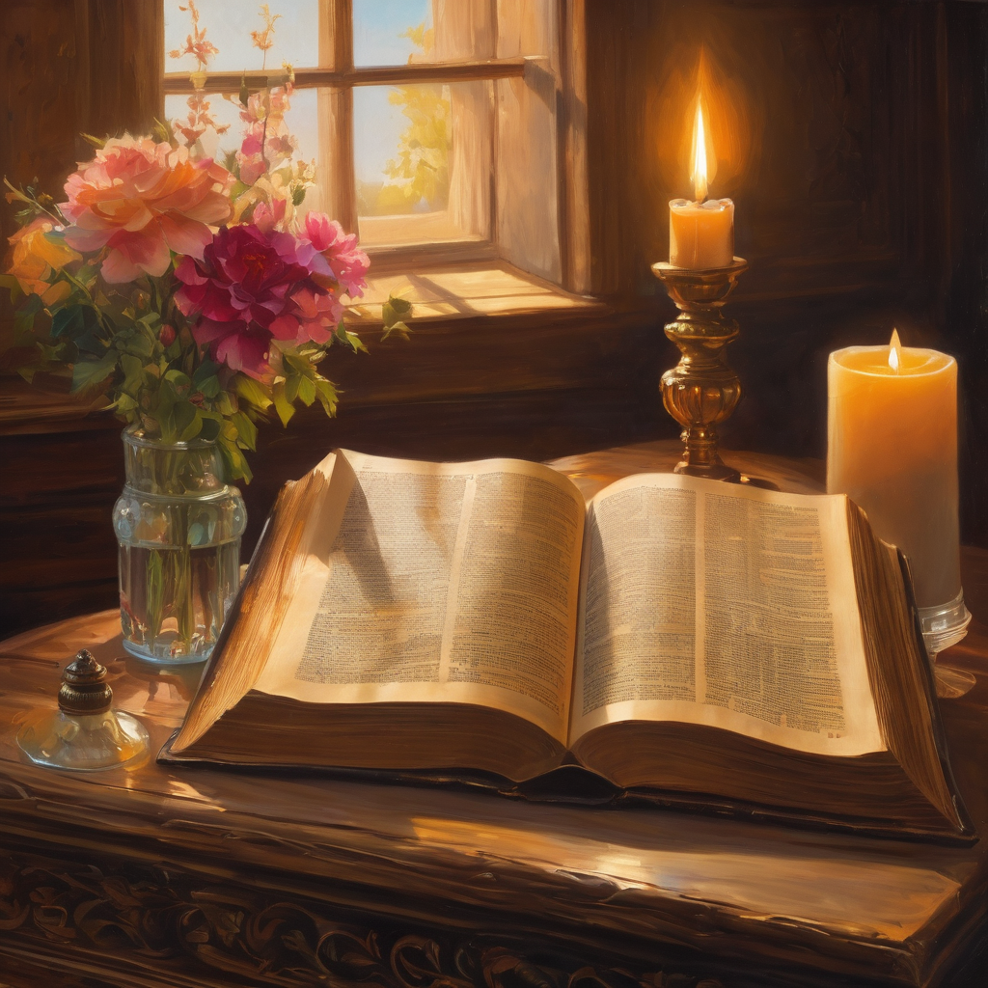
We pause
after ​the Gospel ​​

Slide 30
Leader: .
Leader and Cantor mute
Broadcaster exits screenshare
Flashback Sermon:
God fills empty
https://holyhermits.com.au/podcasts/media/2023-03-12-god-fills-empty

Slide 31
Leader unmutes
Our next Hymn is
Morning Has Broken
https://www.youtube.com/watch?v=3Rifby1tVE8
We stay on mute
Leader mutes

Slide 32
The Leader and Cantor unmute
The Greeting of Peace
Leader: We are the body of Christ
All: God’s Spirit is with us
Leader: The peace of the Lord be always with you.
All: And also with you.
Leader: A sign of peace may be exchanged
You may like to type 'Peace' into the chat, use the 'raise hand’ or other reaction buttons, or just simply wave via the screen with your video turned on
(Broadcaster exits shared screen for a few moments for the exchange of peace)

Slide 33
Prayer of Thanksgiving before Intercessions
Leader: As we enter prayer, I invite the second reader to unmute to lead our intercessions which follow the prayer of thanksgiving. Please feel free to change your body position as you need.
Leader: Thank you, Lord, for meeting us in our place of need.
When we are burdened by worldly cares, you come to us
and tell us of a world beyond our worries and toil,
where barriers of convention are cast aside and we are all one in you.
We thank you, Father, that the kingdom of heaven is in the midst of us,
and that here you shape our characters in the likeness of Christ,
to bear better witness in the world around us.
Amen.

Slide 34
Intercessions
Reader 2: We pray for creation and communities we share our lives with. We pause for a few moments to name either in our hearts, or out loud, or in the chat, those environments and communities we bring to the Lord in prayer.
PAUSE…
We entrust to you the community of Holy Hermits Online and our ministry partners:
Prosper the work of our hands and show us the way to your new creation.
Creator God, Hear our prayer.
St John's Cathedral Brisbane The Anglican Diocese of Southern Queensland St Gabriel’s, Carindale Benedictus Contemplative Church, Canberra Anglican Focus and Tithe.ly

Slide 35
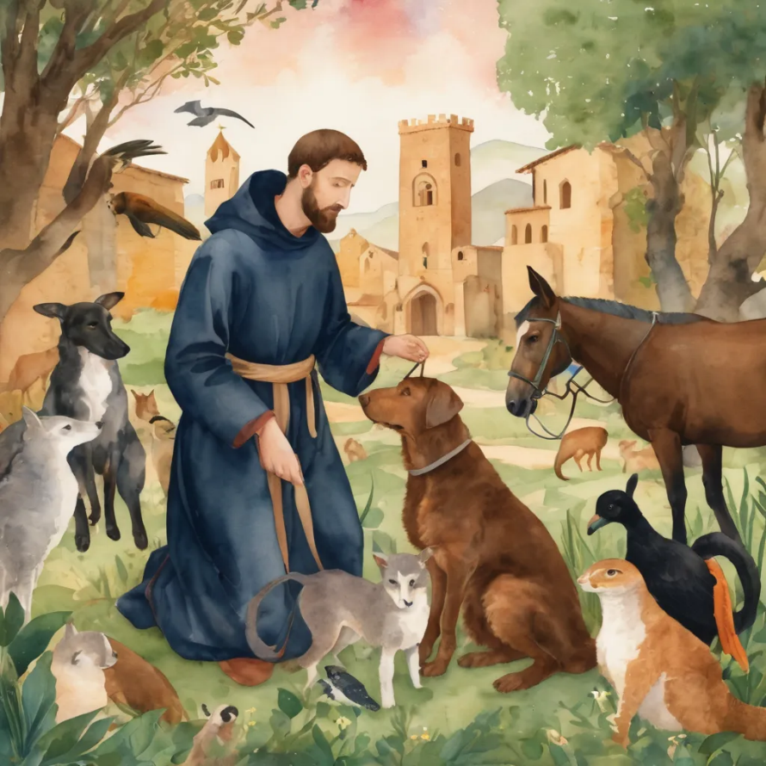
Reader 2: Loving Creator, we entrust to you all animals, especially those who are sick, anxious, ageing, lost, at risk, lonely, sad, hungry, in pain, homeless, abused, living in fear, encountering violence of any kind, in need of comfort, rehabilitation or transformation.
We invite your loving compassion for:
We name in our hearts, out loud or in the chat,
the animals we bring to the Lord in prayer. PAUSE…
Jasmine, ​
Leese(y), ​
Sid, Toots & Lulu​
Polly and Suki​
Fred, George & Percy​
Koshka ​
Jax
Lambert ​​
Kala, Nigel & Little One ​​
Toby​​
Taco​​
Paddy ​​
Rosie​

Slide 36
Reader 2: Eternal Trinity of Love, we uphold to you the people we love and carry cares for:
We name in our hearts, out loud or in the chat, those we bring to the Lord in prayer. PAUSE… We entrust to you those who have died, those who have died peacefully and those who have died tragically, The old and the young. Receive them into your Kingdom. Lord in your mercy, Hear our prayers. Amen.
Kerry, Les & Jake Julie, Ray, Tracey & Shane Mark, Desley & Bob ​​ Rachel, Mervyn & Gillian ​​Rev'd Shane & Janette​​ Alecia, Martin & Aidan​​ Steven & Vanessa | Barry​​ Dr Julie ​​ Ruth​​ Phil​ May Susan Tanya​ Craig Neva​ | Bill & Marjorie​​ Aaron & Andrea Dilys & Tony, Paul & Darhon Judy & Mary​​ Bob & Di​ Pat & Julie Miriam Gayanne | Kirsten, Greg, Daphne & Beau Alan & Gaylene​ Jess & Leah ​​ Bonnie & girls Liz’s Godchildren Barry & Gwen Matthew & Nicholas​

Slide 37
Pray Daily Cycle of Prayer
Leader: Loving God, joining with the Church in our cycle of prayer, we ask your blessings on:
The Episcopal Church in Jerusalem & The Middle East
The Diocese of Bunbury: †Ian; Clergy and People
The Parish of St Lucia: Katherine, Bill, Karol, Hugh
Child Care Centres
Matthew Flinders Anglican College, Buderim: Principal – Michelle; Chaplain - Kathrin; Chair of College Council - Peta; members of College Council; staff & students

Slide 38
Leader: Commitment prayer for the week:
Sustainability
Generous God, We hold before you the financial stability and future sustainability of Holy Hermits Online. Guide us as we seek to grow our community’s giving, so we may continue the work you have called us to—being together in this digital space. Show us where to place our energy as we explore new funding sources and fresh opportunities. Be present with us and those we meet as we reach out to charitable trusts and foundations, inviting their support for our outreach—especially to those unable to get to Church in person. ​
Continue…

Slide 39
Stir the hearts of all who believe in this mission to greater generosity, creativity, and commitment. We thank you for the partnerships you have already blessed us with, especially our home base at St John’s Cathedral.​ We pray in the name of Jesus, who lived on mission and said, ​
If in my name you ask me for anything, I will do it.​
Amen.

Slide 40
Leader: Let us pray together the prayer which Jesus gave us saying:
All: Our Father in heaven,
hallowed be your name,
your kingdom come, your will be done,
on earth as in heaven.
Give us today our daily bread.
Forgive us our sins
as we forgive those who sin against us.
Save us from the time of trial
and deliver us from evil.
For the kingdom, the power,
and the glory are yours
now and for ever.
Amen.

Slide 41
Devotions

Slide 42
Hermit Wisdom

Slide 43
Leader: Wisdom from Holy Hermit St Luke the Younger of Mt Stirion
Kontakion of St Luke of Mount Stirion Tone 8
God in ineffable judgment chose thee before thou wast fashioned according to His good pleasure; He took thee from thy mother's womb, He sanctified thee as His servant. As the Lover of mankind, He guided thee to Himself, before Whom thou dost now stand rejoicing, O Luke.

Slide 44
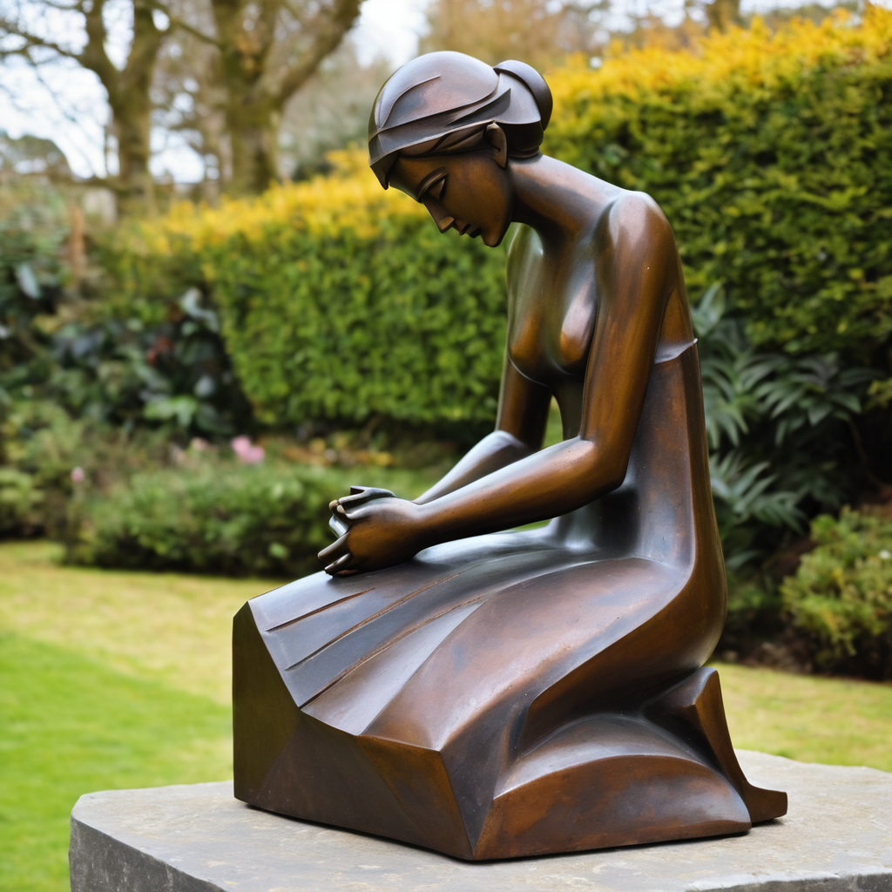
Leader: ​As we enter a few minutes of silence together, you are invited to pray this prayer of adoration and/or spend this time in contemplation. ​
The Spiritual Communion prayer follows
on the next slide. Let us be still.
Leader and Cantor Mute
​
Dear Jesus: you are the living water.
Thank you that you know and love each one of us:
Thank you that there is always more to learn about you:
Thank you that you help us learn more about who we are:
Help us to bring others to meet with you:
you are the living water.
Amen.

Slide 45
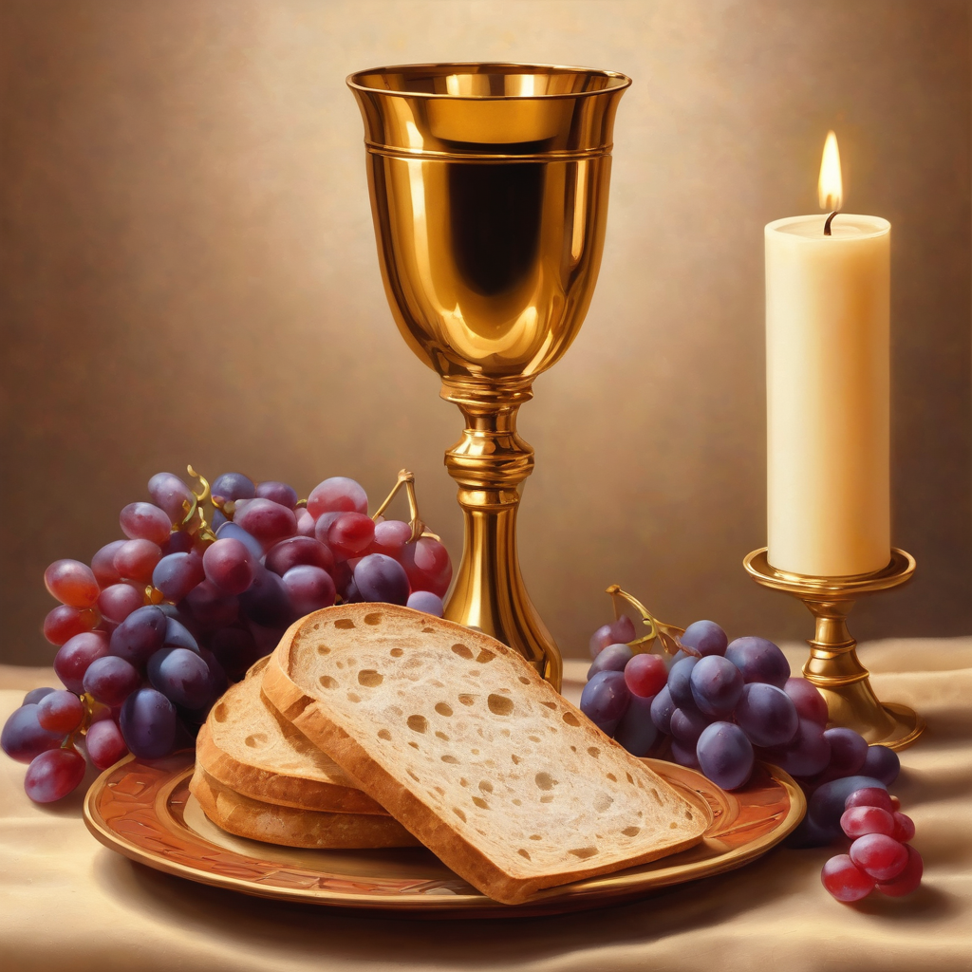
Oh, my Lord Jesus I turn to you
present at the Altar and in the
Tabernacle. I believe that you are
present in the Holy Sacrament of your
most Sacred Body and Blood. I love you
above all things and I desire to receive
you into my Soul. I cannot at this
moment receive you Sacramentally in
Holy Communion. Come spiritually into
my heart. Purify it, Sanctify it. Render
my heart like your own heart.
I embrace you as if you were already
there and unite myself wholly with
you. Never permit me to be separated
from you. Lord, I am not worthy to
receive you, but only say the word and I
shall be healed. Amen
Making a
Spiritual Communion
(Prayed in silence)

Slide 46
Leader unmutes
Our final song is
Drops In the Ocean
https://www.youtube.com/watch?v=bZH13wFGffg
​We stay on mute
Leader and Cantor mute

Slide 47
Leader and cantor unmute
Sending Prayer
Leader: We pray our sending prayer together.
All: Lord,
thank you that you choose to reveal yourself to us
and that you know us, love us, and sustain us.
Help us to return to you, again and again,
to be refreshed and renewed by your living water.
Amen.

Slide 48
The Benediction
Leader: Let us all invite God’s blessings together,
All: May the Lord bless us and keep us.
May the Lord’s face shine upon us and be gracious to us. May the Lord’s countenance be lifted upon us, and bring us peace. Amen

Slide 49
Notices
Our Lent study with the Cathedral continues Wednesday @ 7:30pm. Contact Re’d Jess if you would like to sign up (jgrant@stjohnscathedral.com.au).
Prayer and Praise with Our Animal Friends, Thursday 12th March @ 6pm
See HHO Events page for further upcoming events HHO Events

Slide 50
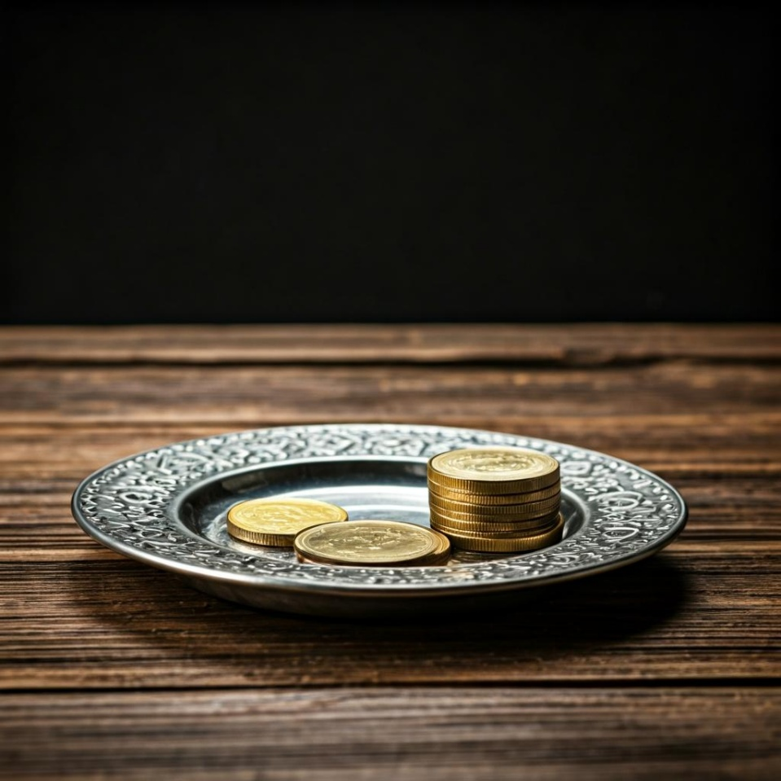
Offerings: Thank you for your regular gifts to this ministry
Offerings are most welcome via
The HHO App
Direct Debit
International Direct Debit
Please consider a one-off donation
or leaving a legacy in your Will
For further information go to HHO give page https://holyhermits.com.au/give

Slide 51
Serving next week
Sunday 15th March
9:00 am AEST
Service Prep: Lauren | Chat Host: Viki | First Reader: Liz
Music: Lauren | Welcomer: Chris | Second Reader: Bob
Proof-reader: Kristine | Priest: N/A | Preacher: Lauren
Broadcaster: Barry | Deacon: Lauren | Fellowship: Leonie
Backup Broadcaster: Lauren | Leader: Julie | Safety Officer: Chris
Zoom Buttons: Lauren | Cantor: Jeremy | Attendance: Viki
Thank you for your ministry gifts
New Servers always welcome!
Please email Rev’d Lauren to get involved
holyhermits@anglicanchurchsq.org.au

Slide 52
Leader: I invite everyone to unmute for the Dismissal
Leader: Go in peace to love and serve the Lord.
All: In the name of Christ, Amen.

Slide 53
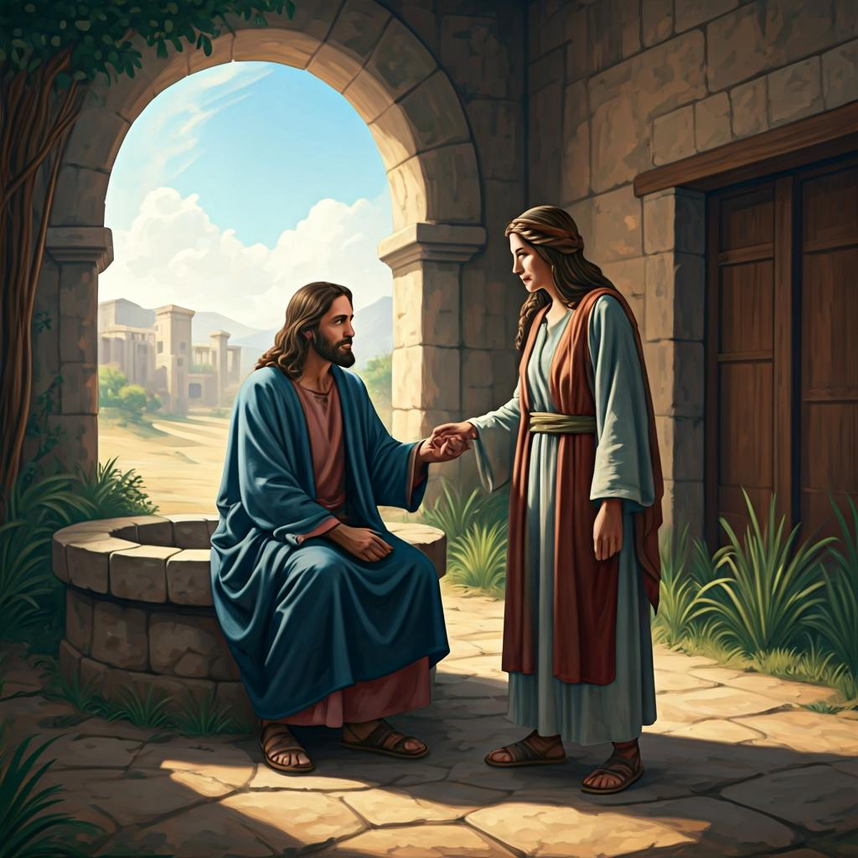
Fellowship time
Thank you, Julie for leading Fellowship
Please feel welcome to linger or pop a message in the chat and head off when you are ready.​
Extra resources developed
by Roots on the Web
Artwork by Padlet

