Slide 1
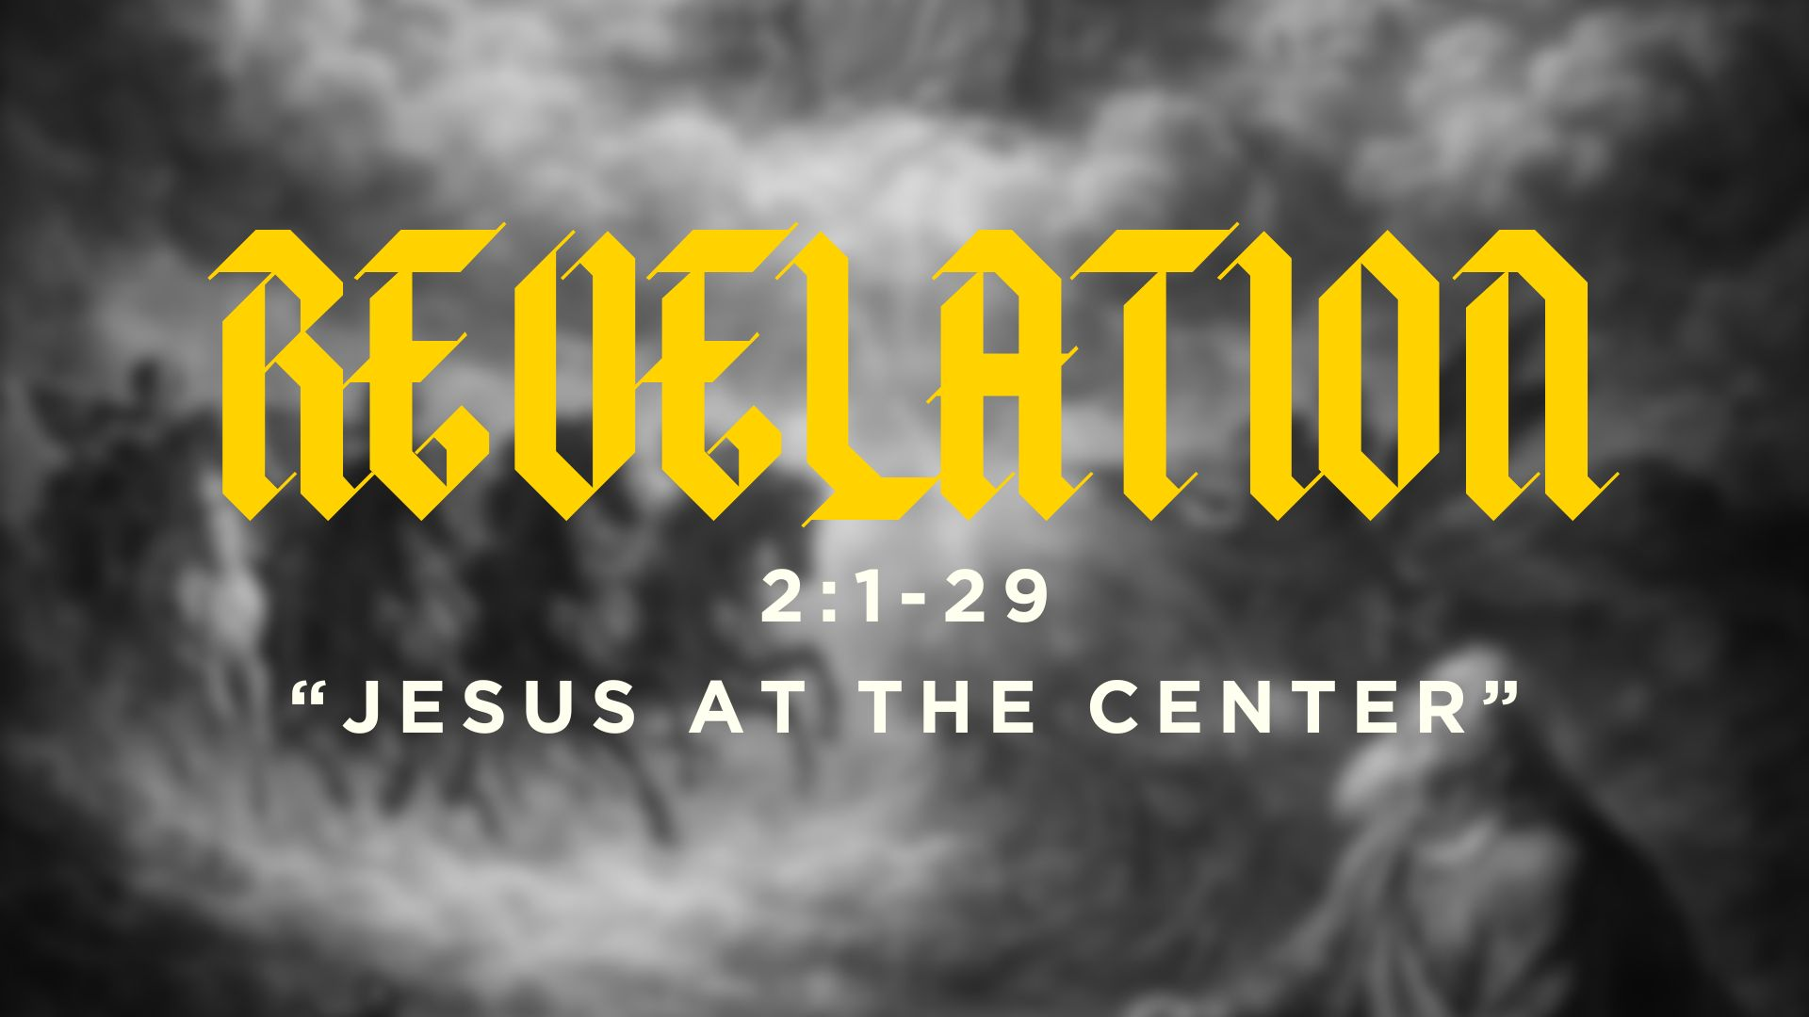

Slide 2

“Search me, O God, and know my heart!
Try me and know my thoughts!
And see if there be any grievous way in me,
and lead me in the way everlasting!”
–Psalm 139:23

Slide 3
God wants you to wait.
There are areas of your life you don’t want God to change.
There are areas in your life that need adjustment—areas you may not even realize.

Slide 4
“Write what you see in a book and send it to the seven churches, to Ephesus and to Smyrna and to Pergamum and to Thyatira and to Sardis and to Philadelphia and to Laodicea.”
(Revelation 1:11)

Slide 5
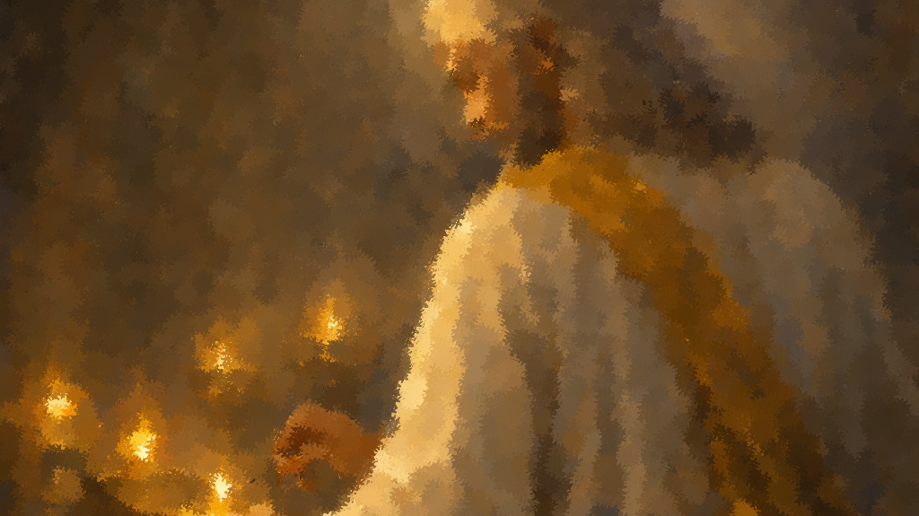
12 Then I turned to see the voice that was speaking to me, and on turning I saw seven golden lampstands, 13 and in the midst of the lampstands one like a son of man, clothed with a long robe and with a golden sash around his chest. 14 The hairs of his head were white, like white wool, like snow. His eyes were like a flame of fire, 15 his feet were like burnished bronze, refined in a furnace, and his voice was like the roar of many waters. 16 In his right hand he held seven stars, from his mouth came a sharp two-edged sword, and his face was like the sun shining in full strength.
(Revelation 1:12-16)

Slide 7
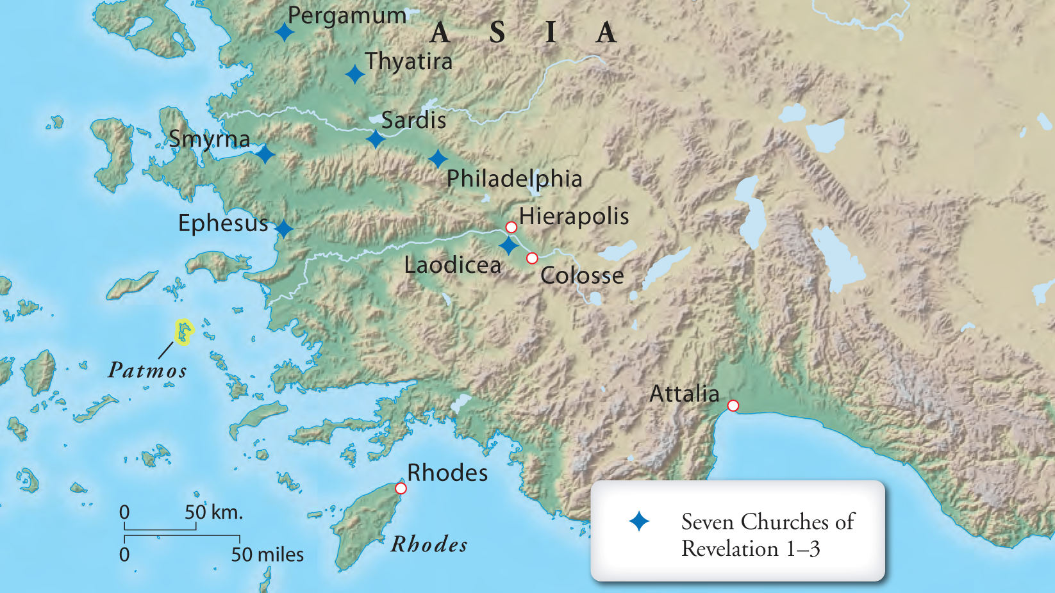

Slide 8
The Struggles of the Seven Churches and Their Call to Action
Church | Problem | Resulting Struggle | Call to Action | Verse

Slide 9
The Struggles of the Seven Churches and Their Call to Action
Church | Problem | Resulting Struggle | Call to Action | Verse
Ephesus | Lost first love | Mechanical devotion, passionless service | Remember, repent, do first works again | 2:4–5

Slide 10
The Struggles of the Seven Churches and Their Call to Action
Church | Problem | Resulting Struggle | Call to Action | Verse
Ephesus | Lost first love | Mechanical devotion, passionless service | Remember, repent, do first works again | 2:4–5
Smyrna | None (faithful under trial) | External persecution, poverty | Be faithful even to death | 2:9–10

Slide 11
The Struggles of the Seven Churches and Their Call to Action
Church | Problem | Resulting Struggle | Call to Action | Verse
Ephesus | Lost first love | Mechanical devotion, passionless service | Remember, repent, do first works again | 2:4–5
Smyrna | None (faithful under trial) | External persecution, poverty | Be faithful even to death | 2:9–10
Pergamum | Compromise with false teaching/idolatry | Confusion, moral compromise, risk of judgment | Repent or face judgment | 2:14–16

Slide 12
The Struggles of the Seven Churches and Their Call to Action
Church | Problem | Resulting Struggle | Call to Action | Verse
Ephesus | Lost first love | Mechanical devotion, passionless service | Remember, repent, do first works again | 2:4–5
Smyrna | None (faithful under trial) | External persecution, poverty | Be faithful even to death | 2:9–10
Pergamum | Compromise with false teaching/idolatry | Confusion, moral compromise, risk of judgment | Repent or face judgment | 2:14–16
Thyatira | Tolerating immorality & false prophecy | Moral corruption, loss of discernment, compromised works | Repent, hold fast, reject Jezebel | 2:20–25

Slide 13
Ephesus: Faithfulness and works are present, but their heart is cold.
Thyatira: Love, faith, and service exist, but they let sin remain.

Slide 14
When we struggle, spiritual correction strengthens our faith!

Slide 15
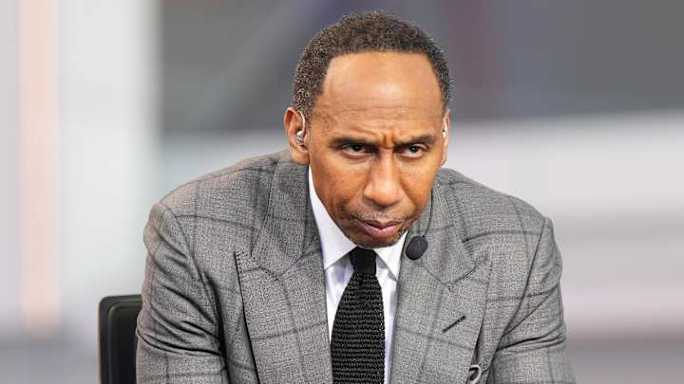

Slide 16


Slide 17
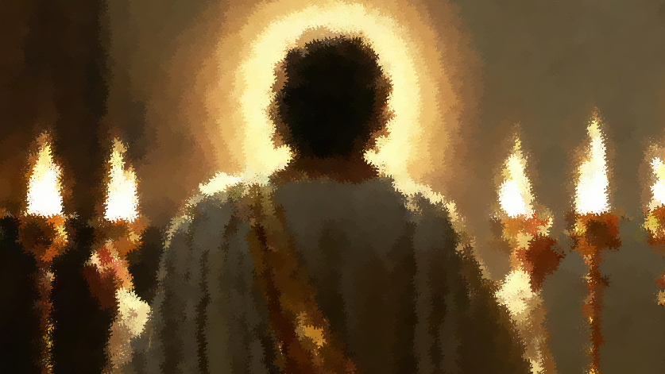

Slide 18
Spiritual correction strengthens our faith
when we know Jesus stands with us.

