Slide 1
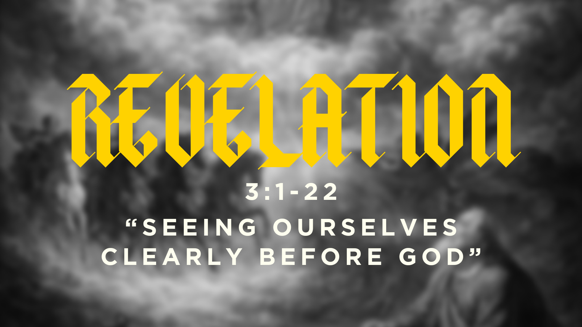

Slide 2
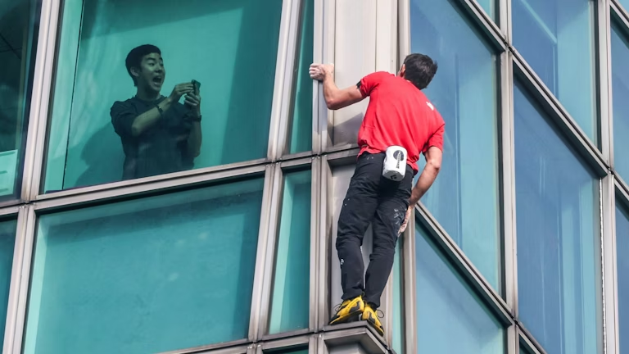
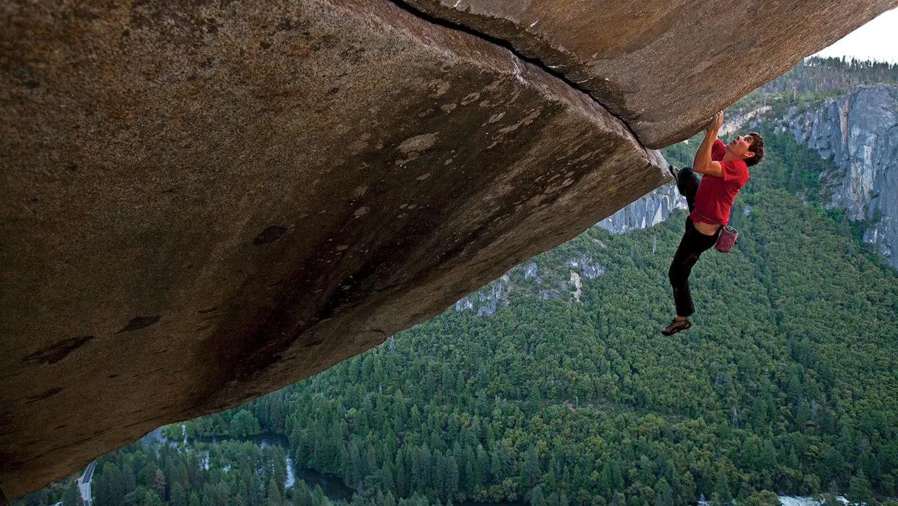

Slide 3
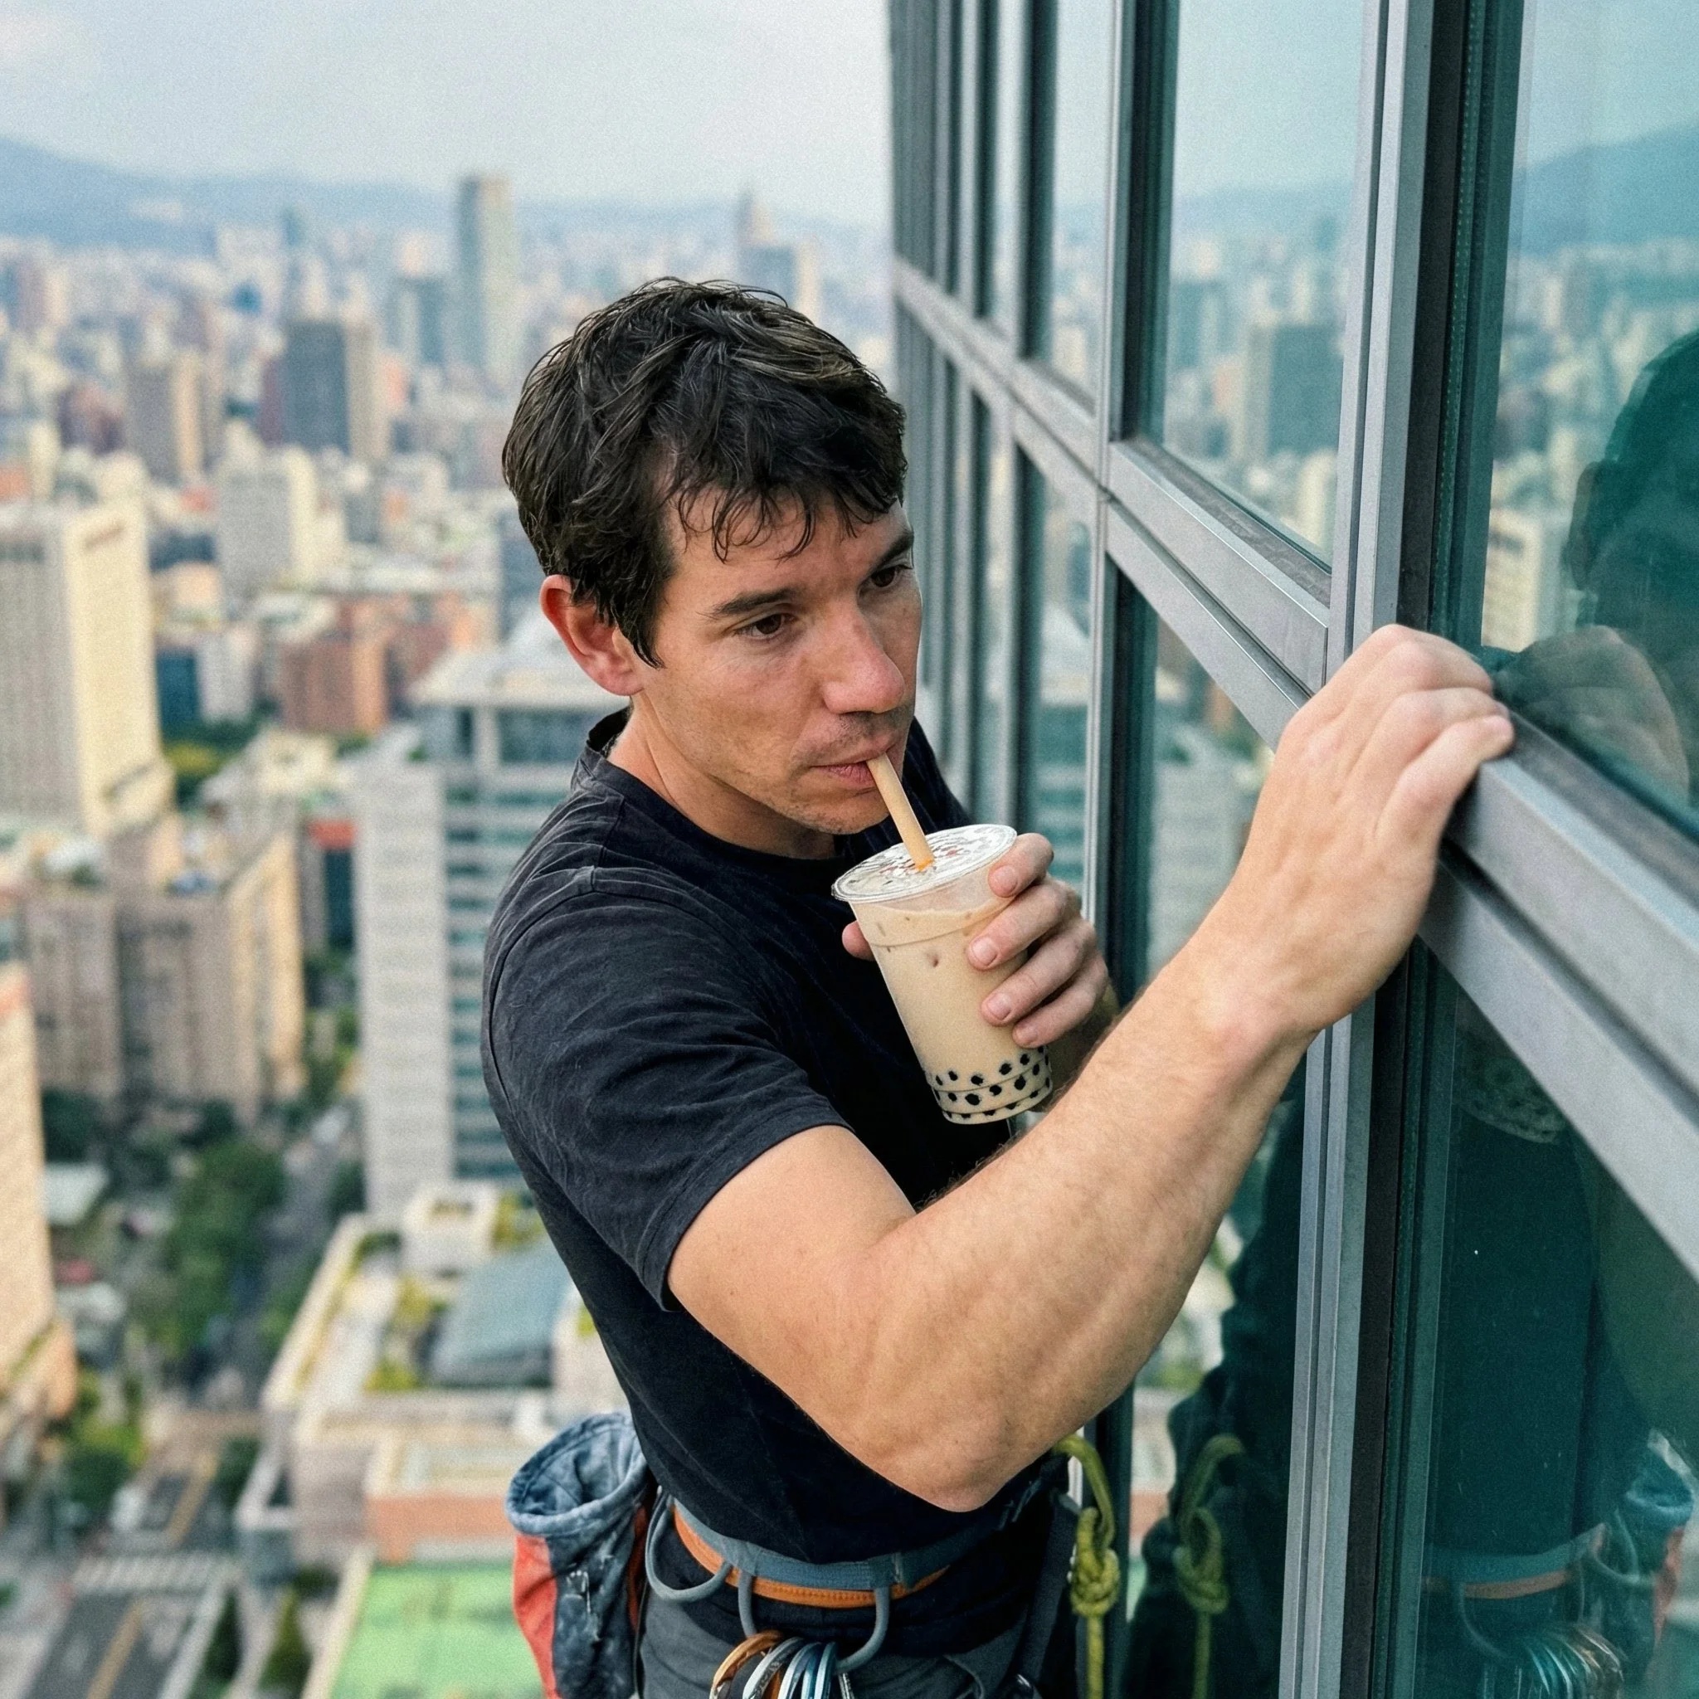

Slide 4
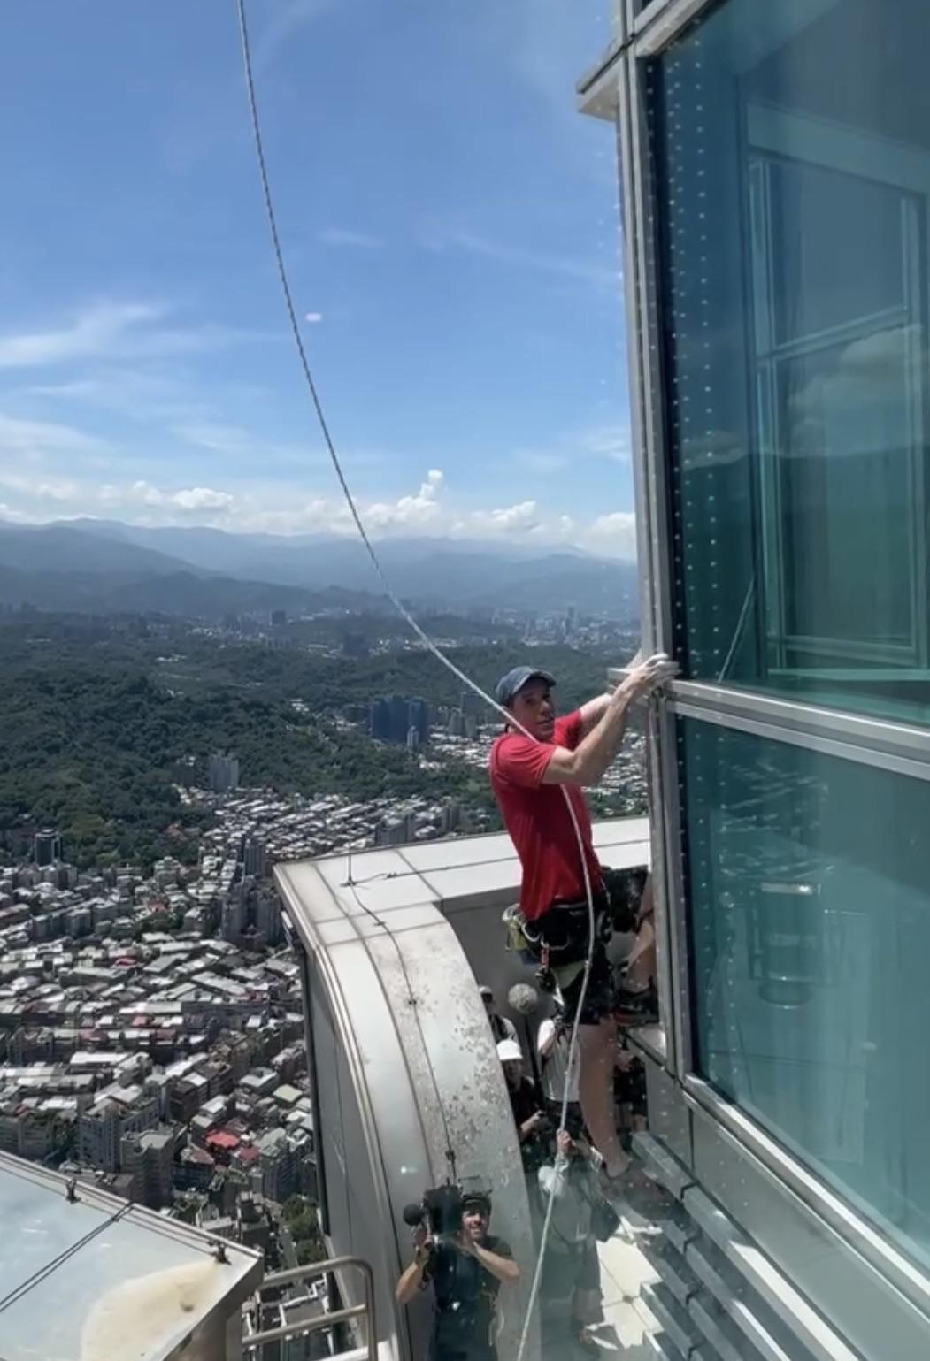
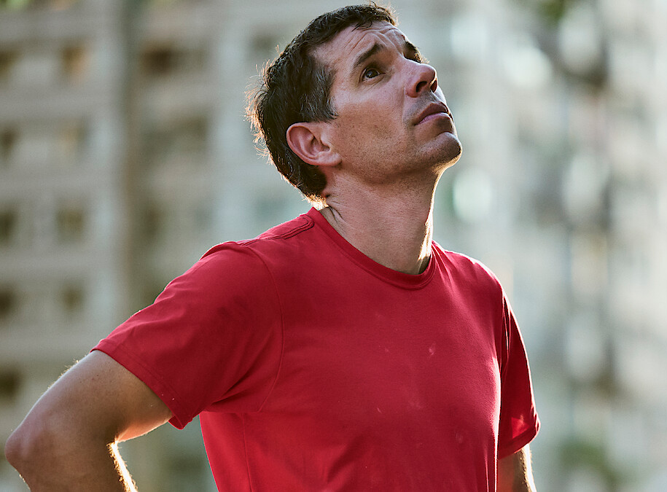
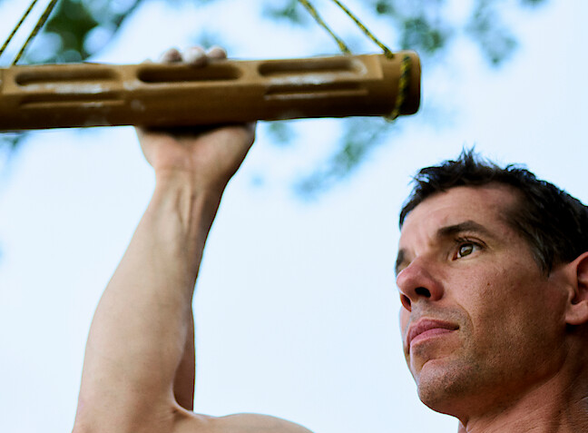

Slide 5
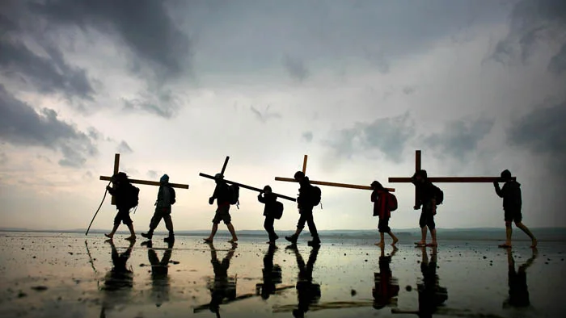

Slide 6
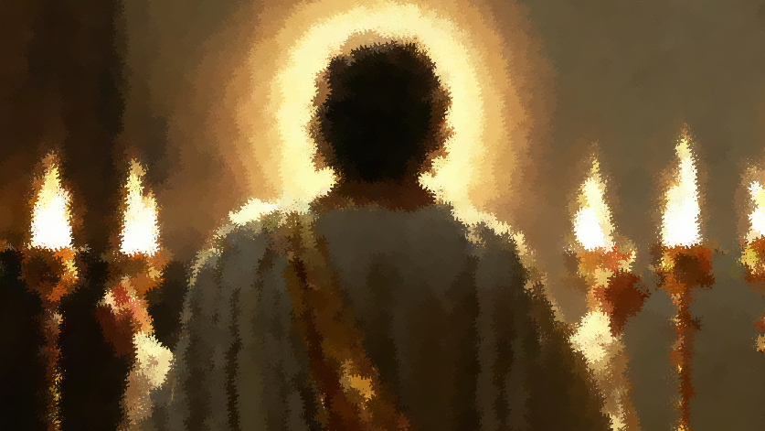
Are you aware of your spiritual condition?

Slide 7

Sardis
“‘I know your works. You have the reputation of being alive, but you are dead. 2 Wake up, and strengthen what remains and is about to die, for I have not found your works complete in the sight of my God.”
(Revelation 3:1-2)

Slide 8
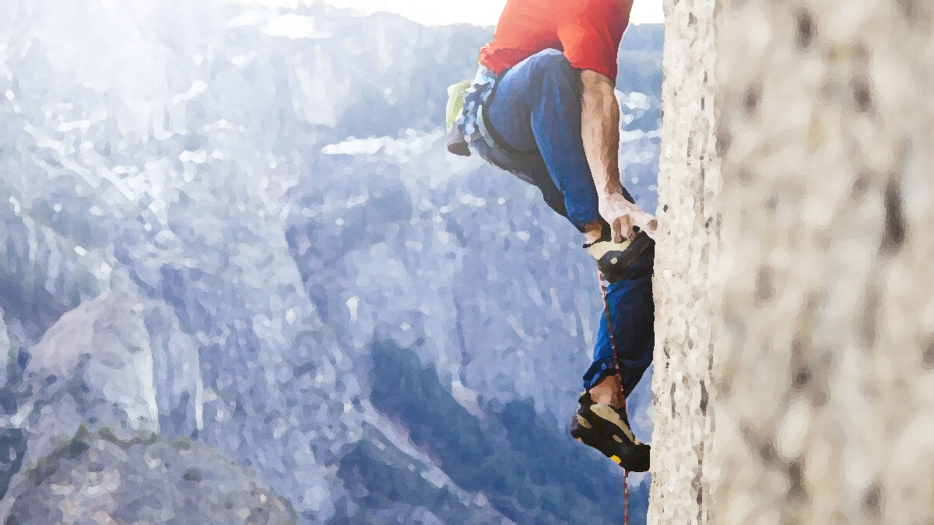
Spiritual Assessment:
1. Wake up from complacency.

Slide 9
“Be sober-minded; be watchful. For the enemy prowls around like a roaring lion, looking for someone to devour.”
(1 Peter 5:8)

Slide 10
Philadelphia
“‘I know your works. Behold, I have set before you an open door, which no one is able to shut. I know that you have but little power, and yet you have kept my word and have not denied my name.”
(Revelation 3:8)

Slide 11
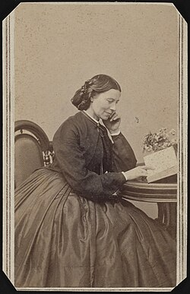

Slide 12
Spiritual Assessment:
Wake up from complacency.
Don’t underestimate the value of being faithful.

Slide 13
Laodicea
“‘I know your works: you are neither cold nor hot. Would that you were either cold or hot! 16 So, because you are lukewarm, and neither hot nor cold, I will spit you out of my mouth. 17 For you say, “I am rich, I have prospered, and I need nothing,” not realizing that you are wretched, pitiable, poor, blind, and naked.
(Revelation 3:15-17)

Slide 14

“…the American Church is a difficult place to fit in if you want to live out New Testament Christianity. The goals of American Christianity are often a nice marriage, children who don’t swear, and good church attendance. Taking the words of Christ literally and seriously is rarely considered.”
Francis Chan, Crazy Love

Slide 15
“…that I may know him and the power of his resurrection, and may share his sufferings, becoming like him in his death, 11 that by any means possible I may attain the resurrection from the dead.”
(Phil. 3:10-11)

Slide 16
Spiritual Assessment:
Wake up from complacency.
Don’t underestimate the value of being faithful.
Be aware that comfortable faith can create false security.

Slide 17
Church | Spiritual Condition | Call for Awareness / Response | Verse Location
Sardis | Looked alive but was dead; complacent | Wake up, strengthen what remains, remember what you received, repent | Revelation 3:1–3
Philadelphia | Small but faithful; possibly underestimated | Hold fast to what you have; continue in faithfulness and obedience | Revelation 3:7–13
Laodicea | Appeared rich but was poor and lukewarm | Be zealous and repent; rely on Christ, not on self-sufficiency | Revelation 3:14–22

Slide 18

We can persevere by being aware of our spiritual condition and respond.

