Slide 1
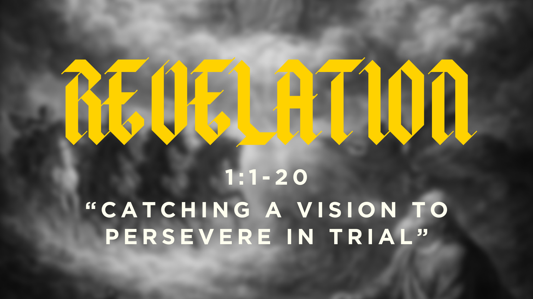

Slide 2
THE CLARITY OF REVELATION
It’s the clarity to know that even when life as God’s people is disorienting, and it looks like the world-system and the devil are going to win, God will have the last word and bring history to a decisive victory for Jesus.

Slide 3
SERMON OUTLINE
1. The purpose of John’s Revelation
2. The person of John’s Revelation
3. The power of John’s Revelation

Slide 4
SERMON OUTLINE
1. The purpose of John’s Revelation: God has a message for his churches
REVELATION 1:1-3
1 The revelation from Jesus Christ, which God gave him to show his servants what must soon take place. He made it known by sending his angel to his servant John, 2 who testifies to everything he saw—that is, the word of God and the testimony of Jesus Christ. 3 Blessed is the one who reads aloud the words of this prophecy, and blessed are those who hear it and take to heart what is written in it, because the time is near.”

Slide 5
“Heeding the message isn’t conceived as an onerous duty imposed by an authoritarian king. Those hearing the message of the book are encouraged to keep it because such obedience will bring them joy and help them flourish. ‘Keeping’ not only refers to what one does but also means that one receives and internalizes the worldview and theological perspective communicated in the book… To put it another way, the obedience isn’t mindlessly carrying out orders. Those who obey imbibe an entirely different way of looking at the world. Indeed, they are motivated by love on the basis of Christ’s redeeming death.”
– Tom Schreiner

Slide 6
REVELATION 1:4-6
“4 John to the seven churches that are in Asia:
Grace to you and peace from him who is and who was and who is to come, and from the seven spirits who are before his throne, 5 and from Jesus Christ the faithful witness, the firstborn of the dead, and the ruler of kings on earth.
To him who loves us and has freed us from our sins by his blood 6 and made us a kingdom, priests to his God and Father, to him be glory and dominion forever and ever. Amen.”

Slide 7
Worldview | Christianity | Identity politics
Origin | Made good in God’s image | We are blank slates, good from birth
Problem | Sin as rebellion against God that ruins us personally and societally | Oppressive systems of inequality (racism, sexism, capitalism, abuse of power)
Solution | Accept God’s grace in Jesus Christ through repentance and faith | Dismantle oppressive systems, fight the ‘bad groups’ that oppress ‘good groups’

Slide 8
QUESTIONS TO CONSIDER
If your job required you to support something that violated your conscience, would you abstain even if it marked you as a Christian?

Slide 9
REVELATION 1:1
1 The revelation of Jesus Christ…
SERMON OUTLINE
1. The purpose of John’s Revelation: God has a message for his churches
2. The person of John’s Revelation: Jesus Christ
3. The power of John’s Revelation

Slide 10
APOCALYPTIC LITERATURE
WHAT IS IT?: Writing where there is a revelation from an otherworldly being that comes to a human recipient, disclosing a transcendent reality about future salvation and a supernatural world beyond what our eyes can see.
WHAT IS IT FOR? To call its hearers to live in accord with what is revealed, transforming their lives. John’s visions function to comfort persecuted Christians and warn Christians not to compromise with the world-system.
WHAT IS ITS FORM? It comes in visions given to John, that are symbolic and full of allusions to Old Testament imagery. This creates the difficulty of understanding its symbolism.

Slide 11
REVELATION 1:12-19
“12 Then I turned to see the voice that was speaking to me, and on turning I saw seven golden lampstands, 13 and in the midst of the lampstands one like a son of man, clothed with a long robe and with a golden sash around his chest. 14 The hairs of his head were white, like white wool, like snow. His eyes were like a flame of fire, 15 his feet were like burnished bronze, refined in a furnace, and his voice was like the roar of many waters. 16 In his right hand he held seven stars, from his mouth came a sharp two-edged sword, and his face was like the sun shining in full strength.
17 When I saw him, I fell at his feet as though dead. But he laid his right hand on me, saying, “Fear not, I am the first and the last, 18 and the living one. I died, and behold I am alive forevermore, and I have the keys of Death and Hades. 19 Write therefore the things that you have seen, those that are and those that are to take place after this.”

Slide 12
Imagery | Revelation | Old Testament
Lampstands | “Seven lampstands” | Zechariah 4: lampstand (the temple) with seven lamps (the power of the Holy Spirit)
Son of Man | “One like a son of man” | Daniel 10: the divine figure who is ‘in the likeness of the children of man’
Eyes | “Eyes were like a flame of fire” | Daniel 10: “his eyes like flaming torches…”
Voice | “Voice was like the roar of many waters” | Ezekiel 43: “And the sound of his coming was like the sound of many waters”
Mouth | “From his mouth came a sharp two-edged word” | Isaiah 49: “He made my mouth like a sharp sword”

Slide 13
QUESTIONS TO CONSIDER
1. Have you considered that God in his holiness can know you completely yet handle your sin through Jesus Christ?
2. Have you considered that God sees all of us, and there will always be a place for you in His Son?
3. Have you considered that God loves those he disciplines, and his correction comes from a heart of compassion and love? He only trims, prunes, and grows those he wants to keep close to him forever.

Slide 14
“Part of Christ’s priestly role is to tend the lampstands. The OT priest would trim the lamps, remove the wick and old oil, refill the lamps with fresh oil, and relight those that had gone out. Likewise, Christ tends the ecclesial lampstands by commending, correcting, exhorting, and warning (see chs. 2– 3) in order to secure the churches’ fitness for service as lightbearers in a dark world.”
– G.K. Beale

