Slide 1
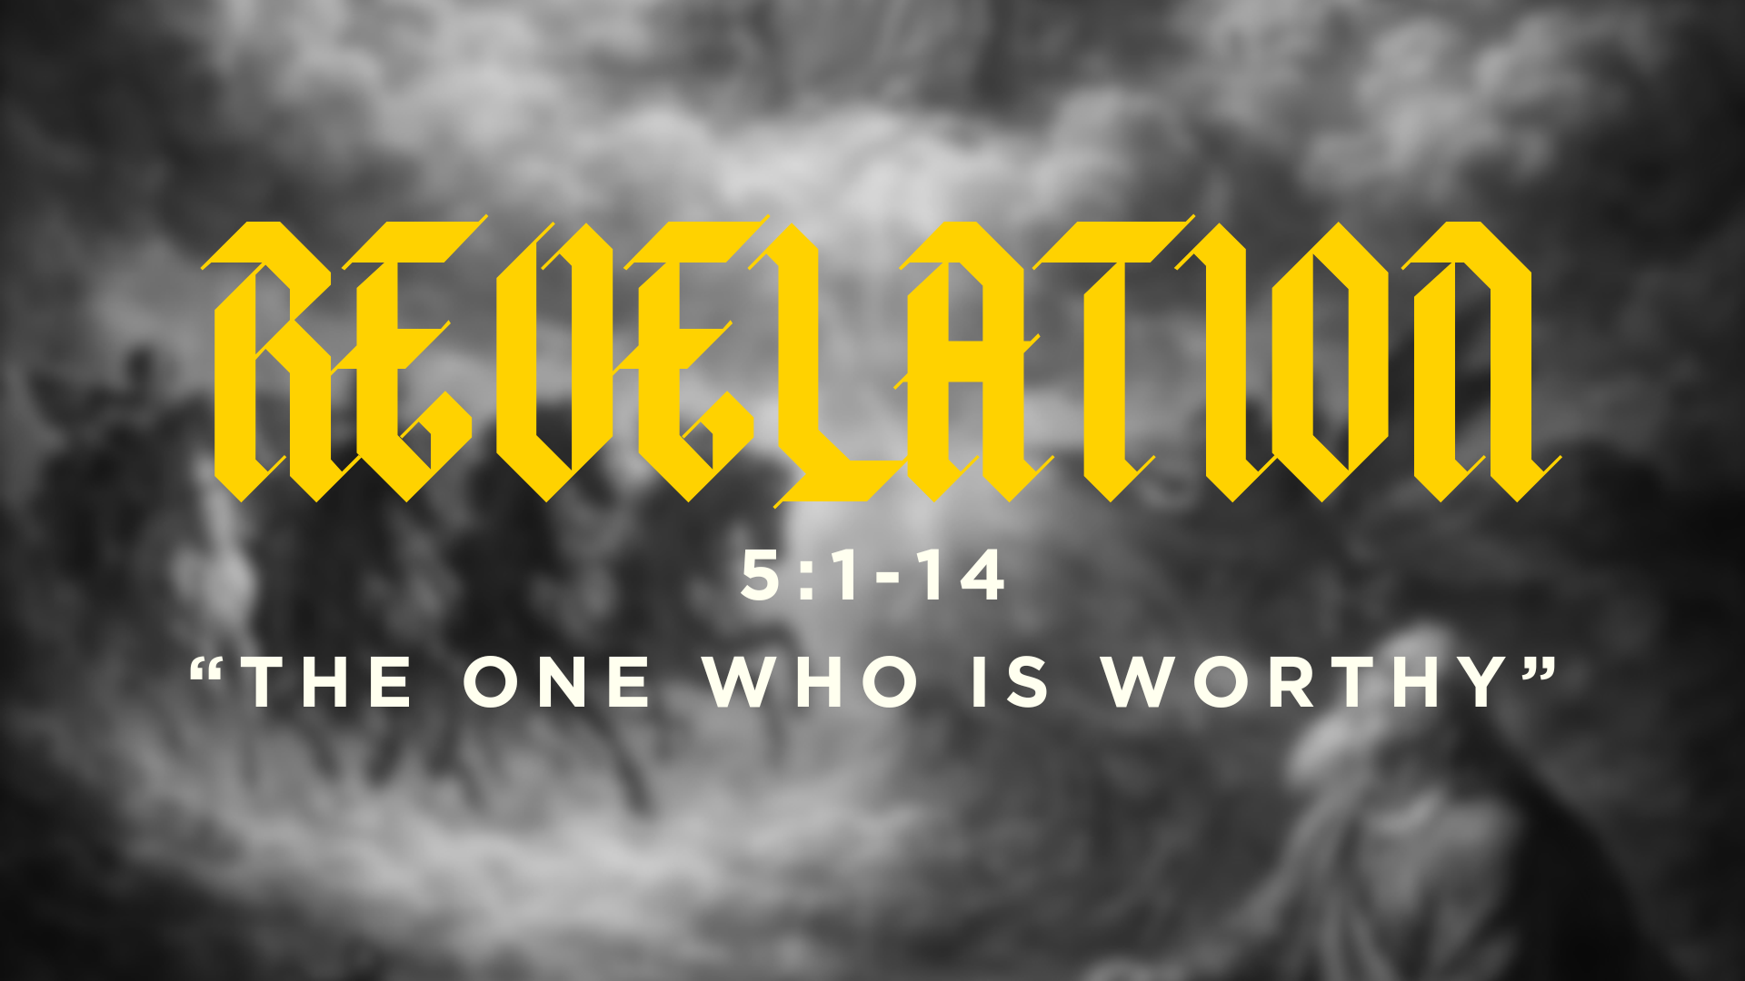

Slide 2
“The import of what John sees is astonishing and gets to the very heart of the Christian gospel. The Lamb didn’t conquer through war and battle but by suffering death. Victory didn’t come by smashing his opponents but by giving up his own life in suffering love. In other words, Jesus doesn’t come first as a lion but as a lamb. This fits with John’s Gospel, where Jesus says he didn’t come to condemn the world but to save the world (cf. John 3:16–18)...
Sacrificial love that offers salvation to all characterizes the ministry of Jesus Christ. Such sacrificial love stands in remarkable contrast to the rule of every human empire. As Morris remarks, the kingdoms of the world feature power and strength—Russia the bear, Britain the lion, France the tiger, and the United States the eagle—but the NT vision stands apart in featuring the Lamb!” – Tom Schreiner

Slide 3
The paradox of God’s rule
Divine love rules through self-donation–through giving– rather than self-assertion and cruel domination.
Jesus undoes the power of death and sin by absorbing them in his body, and dying on the cross. He buries their power through his death for the sins of the world. He wrestles death into the grave, and rises as the Victor.
This is victory through sacrifice.

Slide 4
The paradox of God’s rule
And this is how the intensity of God and the gentleness of God meet. At the cross, the Lion who had every right to crush his enemies, to topple Rome, to punish Israel for disobedience, to judge the world–he inaugurated his kingdom through dying on a tree for his enemies.
Enemy-love is the upside-down logic of how God’s power meets the world. Enemy-love is the logic of how God meets sinners, like you and me, in the gospel.

Slide 5

Question to Consider
Do you know God as both the Lion and the Lamb?

Slide 6
Jesus is the lion and the lamb
Jesus is the Lion who brings God’s kingdom through voluntarily laying down his life as the Lamb.
This is the character of God.

Slide 7
The blood that makes us noble
The blood of the Lamb not only reconciles us to God relationally, but gives us a purpose in his family.

Slide 8
The blood that makes us noble
In the Ancient Near East, when kings conquered foreign lands, they would set up statues, or images, of themselves, to indicate that their rule extended to that place.
We are God’s image.

Slide 9
The blood that makes us noble
“The death and resurrection of the Lamb not only procured redemption but also liberated those whom he ransomed to serve as a kingdom and priests. The notion that believers are a kingdom and priests… has already been communicated in [Revelation] 1:6; John reaches back to Exod. 19:6, where Israel is commissioned to be a priestly kingdom.” – Tom Schreiner

Slide 10
The blood that makes us noble
But the problem with mixing Asian self-effacement with the idea of biblical humility, is then you miss the fact that sometimes God does call us to assert our individuality. He has given us a royal charter to represent his authority, for the good of others, and sometimes that requires breaking from the crowd.

Slide 11
The blood that makes us noble
Who is missing out on God’s blessing because you haven’t stepped out to share the unique gifts and perspectives that God put in you?

Slide 12
The blood that makes us noble
What small step will you take today, so people don’t miss out on how God made you the way you the way you are?
You might need to act on that desire to reach out to somebody. Or invite somebody to do something with you.
The world might need a lot more of you in it, in order for God’s purposes to come to pass.

Slide 13
The end for which we were made
“11 Then I looked, and I heard around the throne and the living creatures and the elders the voice of many angels, numbering myriads of myriads and thousands of thousands, 12 saying with a loud voice,
“Worthy is the Lamb who was slain, to receive power and wealth and wisdom and might and honor and glory and blessing!”
13 And I heard every creature in heaven and on earth and under the earth and in the sea, and all that is in them, saying,
“To him who sits on the throne and to the Lamb be blessing and honor and glory and might forever and ever!”
14 And the four living creatures said, “Amen!” and the elders fell down and worshiped.”

Slide 14
The end for which we were made
We all desperately want to be addicted.
We crave feeling compelled to honor a singular reason for living that brings clarity and meaning to our life.

