Slide 1
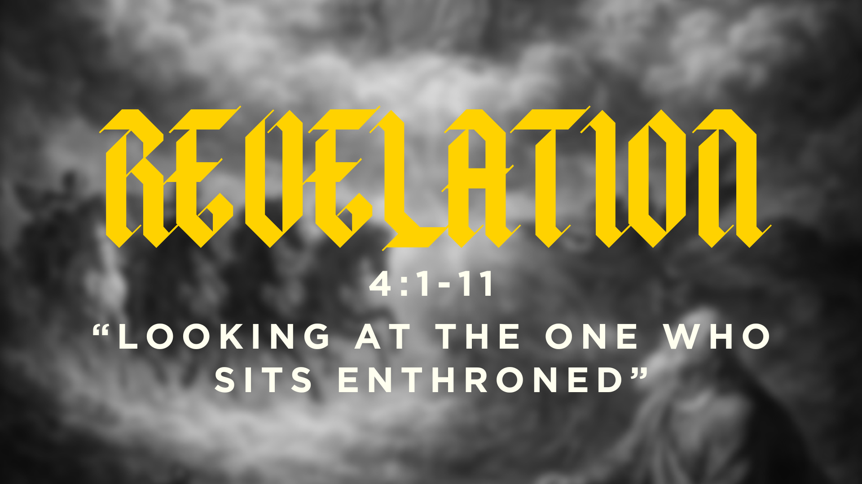

Slide 2
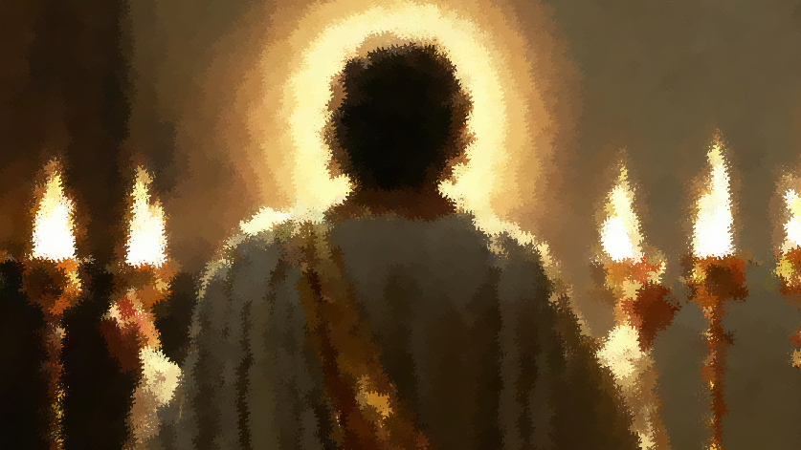

Slide 3
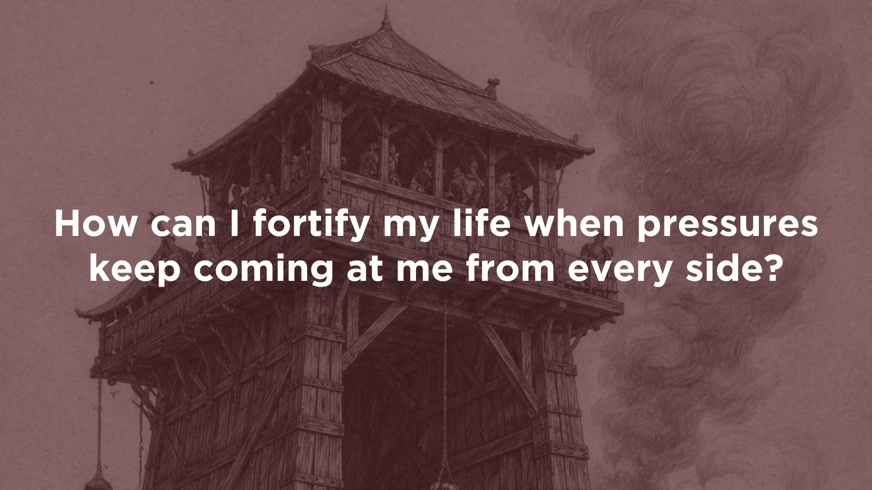

Slide 4
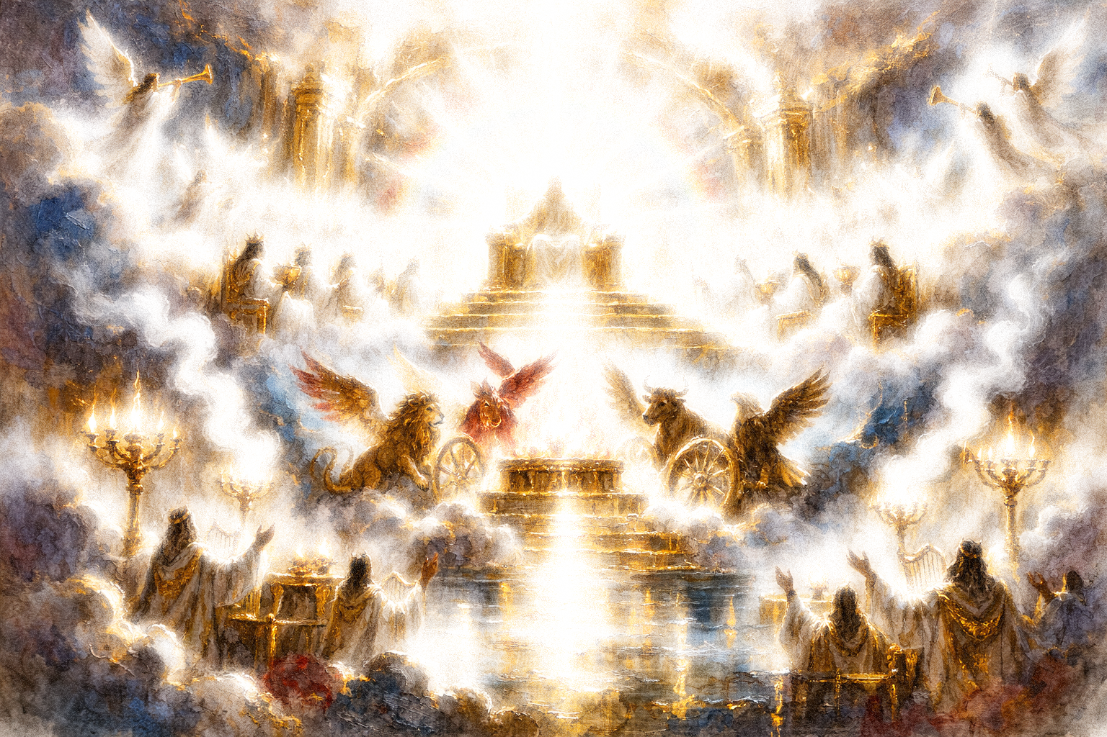

After this I looked, and behold, a door standing open in heaven! And the first voice, which I had heard speaking to me like a trumpet, said, “Come up here, and I will show you what must take place after this.”
Revelation 4:1

Slide 5
At once I was in the Spirit, and behold, a throne stood in heaven, with one seated on the throne. 3 And he who sat there had the appearance of jasper and carnelian, and around the throne was a rainbow that had the appearance of an emerald.
Revelation 4:2-3

Slide 6
26 And above the expanse over their heads there was the likeness of a throne, in appearance like sapphire; and seated above the likeness of a throne was a likeness with a human appearance.
Ezekiel 1:26

Slide 7

“What is God like?”…I must acknowledge that it cannot be answered except to say that God is not like anything; that is, He is not exactly like anything or anybody. We learn by using what we already know as a bridge over which we pass to the unknown.
…when the prophet Ezekiel saw heaven opened and beheld visions of God, he found himself looking at that which he had no language to describe. What he was seeing was wholly different from anything he had ever known before, so he fell back upon the language of resemblance.”
A.W. Tozer, The Knowledge of the Holy

Slide 8
Around the throne were twenty-four thrones, and seated on the thrones were twenty-four elders, clothed in white garments, with golden crowns on their heads.
Revelation 4:4-6

Slide 9
Who are the “24 Elders” in Revelation?
Some say that the elders are the patriarchs and the apostles. (12+12=24)
Some say the elders are heavenly beings.

Slide 10
And around the throne, on each side of the throne, are four living creatures, full of eyes in front and behind: 7 the first living creature like a lion, the second living creature like an ox, the third living creature with the face of a man, and the fourth living creature like an eagle in flight. 8 And the four living creatures, each of them with six wings, are full of eyes all around and within…
Revelation 4:6-8
Ref. Ezekiel chapters 1 and 10, Isaiah chapter 6.

Slide 11
“…the lion is the most majestic wild animal, the ox the most impressive domestic animal, human beings are the crown of creation, and the eagle stands out among the flying creatures. Most likely, John communicates that the living creatures superintend the entirety of the created order for God’s sake. They are his lieutenants and servants, devoting themselves to the Lord’s work.”
Thomas R. Schreiner

Slide 12
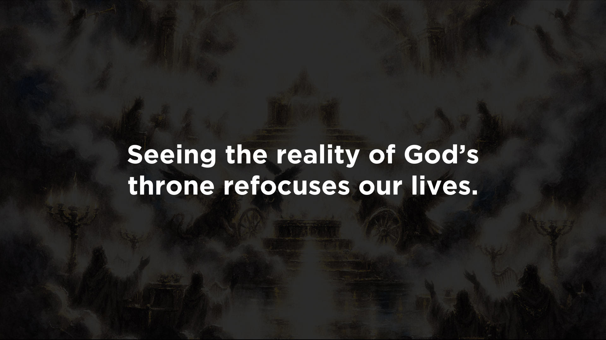

Slide 13
“Holy, holy, holy, is the Lord God Almighty,
who was and is and is to come!” Revelation 4:8

Slide 14
“Holy, holy, holy, is the Lord God Almighty,
who was and is and is to come!” Revelation 4:8

Slide 15
“Holy, holy, holy, is the Lord God Almighty,
who was and is and is to come!” Revelation 4:8

Slide 16
“Holy, holy, holy, is the Lord God Almighty,
who was and is and is to come!” Revelation 4:8

Slide 17
“Worthy are you, our Lord and God,
to receive glory and honor and power,
for you created all things,
and by your will they existed and were created.”
Revelation 4:11

Slide 18
“The hymns remind readers and hearers, amid the sufferings and tensions of life, that the purpose of life is doxological.”
Thomas R. Schreiner

Slide 20
We fortify our lives by knowing the reality of a glorious God.

