Slide 1

The Attitude of Hunger and Goodness
Luke 6:21;1-11; Matthew 5:6

Slide 2
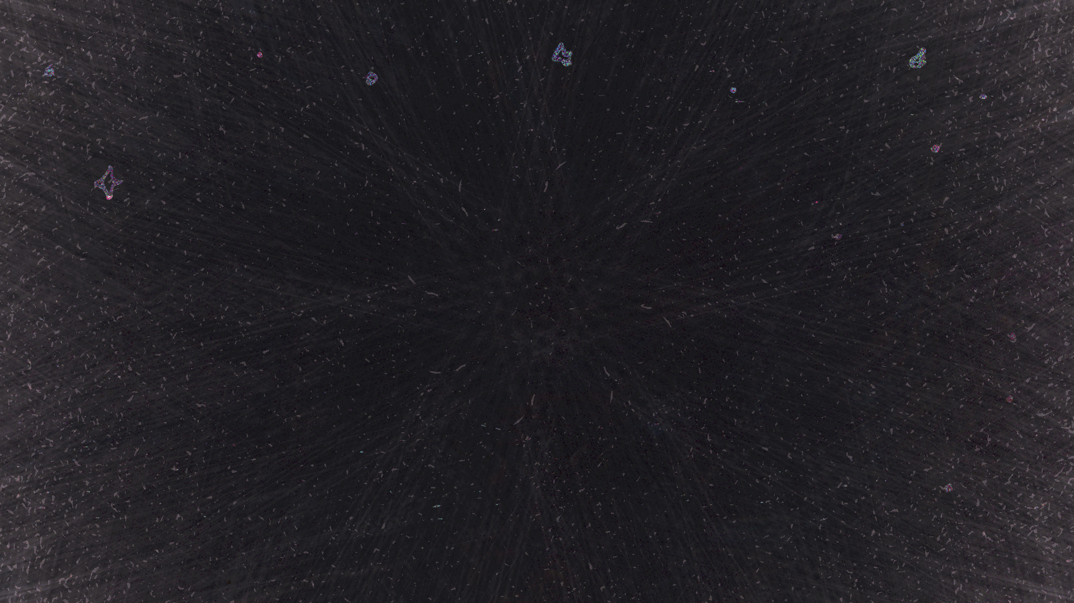
“Blessed are you who are hungry now, for you shall be satisfied. “Blessed are you who weep now, for you shall laugh.
Luke 6:21
ESV

Slide 3
“Blessed are those who hunger and thirst for righteousness, for they shall be satisfied.
Matthew 5:6
ESV

Slide 4
What is it that I value? What is it that man values? What is that which our society values?

Slide 5
The real value of a thing is its utility, its power or capacity of procuring or producing good.
An American Dictionary of the English Language

Slide 6
The things in life that we should pursue as being of any worth are those things that have the power, the capability, the capacity of procuring or producing good.

Slide 7
Should my goal, my purpose in this life be about producing goodness?

Slide 8
And let us consider how to stir up one another to love and good works,
Hebrews 10:24
ESV

Slide 9
…not get tired of doing what is good. At just the right time we will reap a harvest of blessing if we don’t give up. Therefore, whenever we have the opportunity, we should do good to everyone—especially to those in the family of faith.
Galatians 6:9–10
NLT

Slide 10
…be proud and not to trust in their money, which is so unreliable. Their trust should be in God, who richly gives us all we need for our enjoyment.
1 Timothy 6:17
NLT

Slide 11
Tell them to use their money to do good. They should be rich in good works and generous to those in need, always being ready to share with others.
1 Timothy 6:18
NLT

Slide 12
What good is it, dear brothers and sisters, if you say you have faith but don’t show it by your actions? Can that kind of faith save anyone?
James 2:14
NLT

Slide 13
God has given you more than enough of His favor for you to be excessive in good works.
Am I excessive in good and doing good works?

Slide 14
Do I produce goodness into society, in this life, into the Kingdom, into my family and friends? Unto the stranger?

Slide 15
What is the key to remaining in the LORD?
Hunger

Slide 16
Do I have an attitude of hunger for the things of God and the heart of God?

Slide 17
The desire to pursue goodness and produce goodness only comes from a vessel that abides in God.

Slide 18
Remain in me, and I will remain in you. For a branch cannot produce fruit if it is severed from the vine, and you cannot be fruitful unless you remain in me.
John 15:4
NLT

Slide 19
But if you remain in me and my words remain in you, you may ask for anything you want, and it will be granted!
John 15:7
NLT

Slide 20
How great is the goodness you have stored up for those who fear you. You lavish it on those who come to you for protection, blessing them before the watching world.
Psalm 31:19
NLT

Slide 21
The Lord is good to everyone. He showers compassion on all his creation.
Psalm 145:9
NLT

Slide 22
What is it to be satisfied?
To be full, to be filled; without want or need

Slide 23
When we have an attitude of hunger and thirst for God and the things of God we will be, and become, satisfied.

Slide 24
The question: Am I satisfied.

Slide 25
But you are to be perfect, even as your Father in heaven is perfect.
Matthew 5:48
NLT

Slide 26
“You have heard the law that says, ‘Love your neighbor’ and hate your enemy. But I say, love your enemies! Pray for those who persecute you!
Matthew 5:43–44
NLT

Slide 27
In that way, you will be acting as true children of your Father in heaven. For he gives his sunlight to both the evil and the good, and he sends rain on the just and the unjust alike.
Matthew 5:45
NLT

Slide 28
If you love only those who love you, what reward is there for that? Even corrupt tax collectors do that much.
Matthew 5:46
NLT

Slide 29
If you are kind only to your friends, how are you different from anyone else? Even pagans do that.
Matthew 5:47
NLT

Slide 30
But you are to be perfect, even as your Father in heaven is perfect.
Matthew 5:48
NLT

Slide 31
Do you have the hunger to be perfect?

Slide 32
Do you have the hunger to do good and be good?

Slide 33
Do I desire to be right in God’s eyes?
The righteousness of God is to be right in God’s eyes.

Slide 34
Do we have a hunger to love well as God loves us, as Jesus has loved us?

Slide 35
The issue for Jesus: it is better to do good and meet a human in need than to be a stickler of traditions and law.

Slide 36
Do we have a reputation for meeting the needs of our fellow human being, brothers and sisters, than using law and religious tradition to avoid doing the good we are called to do?

Slide 37
Sin of Omission – not doing something when it is our power to do so morally and spiritually. (James 4:17)

