Slide 1
CHRISTIAN LEADERSHIP

Slide 2
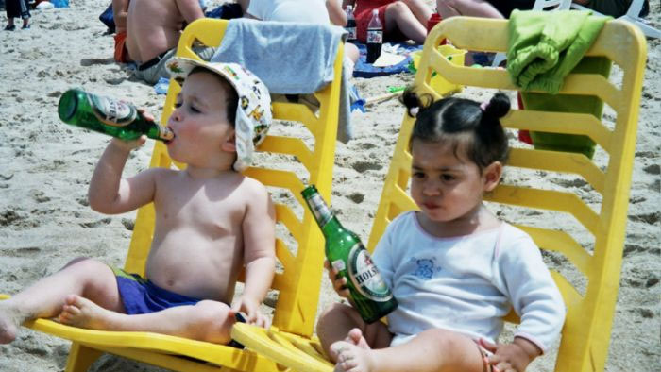
...NEW GENERATION...

Slide 3
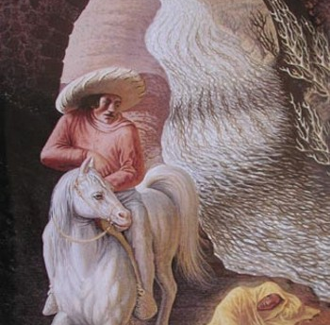
...PERCEPTION...
“human beings behave not in accordance with the truth, but the truth as they perceive it to be”

Slide 4


Slide 5


Slide 6


Slide 7
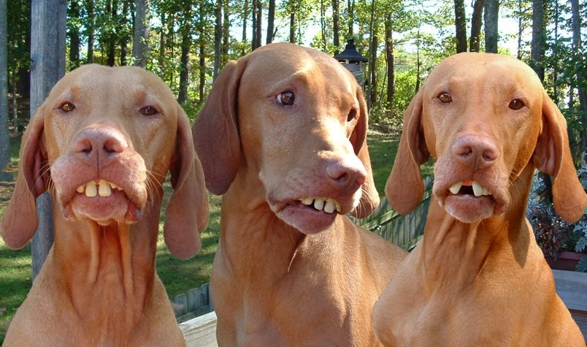
...ASSOCIATION...

Slide 8

...EVALUATION...

Slide 9
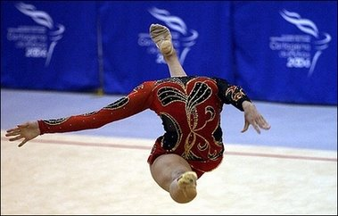
...DECISIONS...

Slide 10

...OUTCOMES...

Slide 11
CHRISTIAN LEADERSHIP
Hebrews 13:7 Remember your leaders, who spoke the word of God to you. Consider the outcome of their way of life and imitate their faith.

Slide 12
...word worth listening to...

Slide 13
...faith worth embracing...

Slide 14
...life worth imitating...

Slide 15
