Slide 1


PICTURES OF GOD’S PEOPLE
MANY METAPHORS USED OF GOD’S PEOPLE
IN THE NEW TESTAMENT
eg.
THE BODY, THE BRIDE, THE FAMILY,
THE TEMPLE, THE FLOCK

Slide 2

THE CHURCH:
THE FLOCK OF GOD
SERMON 4 IN SERIES
“UNDERSTANDING THE CHURCH OF GOD”
1 MARCH 2026
CLIC@FEDERATION UNIVERSITY, BERWICK

Slide 3
SCRIPTURES
JOHN 10: 1 – 18
PSALM 23: 1 – 6
1 PETER 5: 1 – 4
ACTS 20: 28

Slide 4
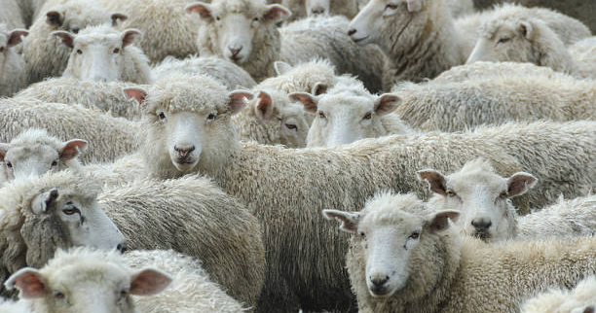



Slide 5

Sheep, in general, are:
not intelligent
get lost easily, ie no sense of direction
restless
Need plenty of water
often unable to fend for themselves
with a need a lot of care
Highly social and have a strong instinct
to gather together
– exhibit a strong flocking behaviour.

Slide 6
THE BEHAVIOUR OF SHEEP & MEN IS SIMILAR IN MANY WAYS
OUR COLLECTIVE MIND (FLOCKING INSTINCTS)
OUR FEARS & OUR TIMIDITY
OUR STUBBONNESS & STUPIDITY
OUR PERVERSE HABITS
OUR INABILITY TO CARE FOR OURSELVES

Slide 7
OLD TESTAMENT ROOTS OF “FLOCK” eg
Isaiah 40:11;
Zechariah 10: 3
ISRAEL – THE HOUSE OF JUDAH - IS REGARDED AS THE LORD’S FLOCK
THE LORD IS THE OWNER AND PROTECTOR OF THE SHEEP – HE WILL TEND TO THEM, HE WILL GATHER & CARRY THE LAMBS, HE WILL GENTLY LEAD THE NURSING LAMBS
THE SHEEP OWE THE LORD ALLEGIANCE – WHICH IS DEMONSTRATED BY THEM KEEPING HIS WORD

Slide 8
OLD TESTAMENT ROOTS OF “FLOCK”
COMMUNICATES
THAT ISRAEL IS UNDER THE CARE & PROTECTION OF THE GOOD SHEPHERD (PSALMS 95:7; EZEKIEL 34:31)
THAT WHILE THE FLOCK MAY BE SCATTERED IN JUDGEMENT (EZEKIEL 34:12) THERE IS ALWAYS THE HOPE OF RESTORATION & REGATHERING (JEREMIAH 23; 1- 3)
THAT HIS PEOPLE ARE THE OBJECTS OF HIS SAVING GRACE & HEIRS OF ALL THE COVENANT PROMISES (MICAH 7: 14)

Slide 9
OLD TESTAMENT ROOTS OF “FLOCK”
COMMUNICATES
THE PEOPLE’S HELPLESSNESS
NAIVETÉ
SIMPLICITY
DEPENDENCE
SEE
PSALMS 74:1; 77:20; 78:52; 79:13; ISAIAH 40:11; ZECHARIAH 9:16; 10:3; 11:7, 17.

Slide 10
THE SHEEP
&
THEIR RELATIONSHIP TO THE SHEPHERD
JOHN 10: 1 - 6

Slide 11
Truly, truly, I say to you, he who does not enter by the door into the fold of the sheep, but climbs up some other way, he is a thief and a robber.
But he who enters by the door is a shepherd of the sheep.
To him, the doorkeeper opens, and the sheep hear his voice, and he calls his own sheep by name and leads them out.
John 10 : 1 -3 (NASB, 1999)

Slide 12

FAMILIARITY
LESSON #1

Slide 13
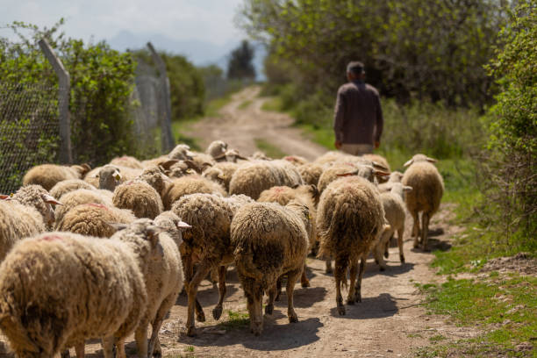
HE CALLS HIS OWN SHEEP BY NAME…
THE SHEEP HEAR HIS VOICE…

Slide 14
I am the good shepherd, and I know My own and my own know Me, even as the Father knows Me and I know the Father; and I lay down My life for the sheep.
John 10 : 14 - 15 (NASB, 1999)

Slide 15
INTIMACY
LESSON #2

Slide 16
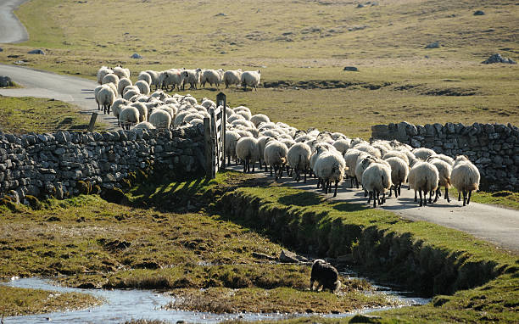
When He has brought out all His own, He goes before them, and the sheep follow Him, for they know His voice
John 10: 4 (ESV)

Slide 17
THE SHEPHERD
&
HIS PROVISION FOR HIS SHEEP
JOHN 10: 7 - 10

Slide 18
So Jesus said to them again,
“Truly, truly I say to you,
I am the door of the sheep.
All who come before Me are thieves and robbers, but the sheep do not hear them.
I am the door; If anyone enters through Me, he will be saved, and will go in and out and find pasture.
The thief comes only to steal and kill and destroy; I came that they might have life, and have it abundantly.
John 10 : 7 - 10 (NASB, 1999)

Slide 19

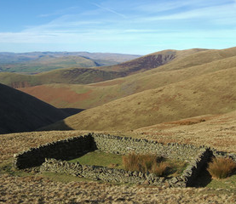
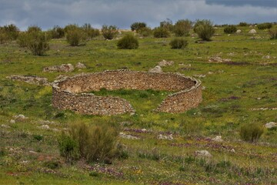
EXAMPLES OF A SHEEP FOLD

Slide 20
JESUS IS THE DOOR
HE IS PROTECTOR
AS WELL AS PROVIDER
LESSON #3

Slide 21
NOT JUST SAVED,
BUT ALSO SAFE
CHRIST PROVIDES ABUNDANT LIFE FOR HIS SHEEP.
BUT
WHAT IS ABUNDANT LIFE ?

Slide 22
ABUNDANT LIFE IS NOT AN ABUNDANCE OF THINGS.
IT IS NOT AN OVERFLOWING OF WEALTH AND LIQUID ASSETS
IT IS NOT A LIFESTYLE THAT CAN BE PURCHASED OR EARNED
ABUNDANT LIFE IS BEING SATISFIED BY THE LIFE THAT THE LORD HAS PROVIDED FOR YOU.

Slide 23
P5ALM 23: 1 – 6 (NASB, 1999)
SCRIPTURE STATES THAT THE GOOD SHEPHERD WILL
LEAD HIS SHEEP TO GREEN PASTURES
LOOK FOR THE STRAYS
KEEP HIS SHEEP FROM POISONOUS PLANTS
TAKE HIS SHEEP TO GOOD WATER
PROVIDE EVERYTHING NECESSARY
FOR THE HEALTH OF THE SHEEP

Slide 24
QUALIFICATIONS REQUIRED TO BE A SHEEP

Slide 25
Just to be a sheep that follows the shepherd wherever he leads; trusting and knowing that the shepherd knows best for the sheep.
John 10 : 14 - 15 (NASB, 1999)

Slide 26
THE SHEPHERD’S HEART
FOR HIS SHEEP
JOHN 10: 11 - 16

Slide 27
I am the good shepherd; the good shepherd lays down His life for the sheep.
He who is a hired hand, and not a shepherd, who is not the owner of the sheep, sees the wolf coming, and leaves the sheep and flees and the wolf snatches them and scatters them.
He flees because he is a hired hand and is not concerned about the sheep.
John 10 : 11 – 13 (NASB, 1999)

Slide 28
I am the good shepherd; and
I know My own and My own know Me, even as the Father knows Me and I know the Father; and
I lay down My life for the sheep.
John 10 : 14 – 15 (NASB, 1999)

Slide 29
COMPASSION
LESSON #4

Slide 30
Jesus felt compassion for his sheep deep within Him. (Matthew 9: 36)
His Heart was full of sacrificial love
He devoted His whole life to us every day and ultimately was willing to pay the supreme sacrifice..
THE HEART OF OUR SHEPHERD –
HE WILLINGLY LAID DOWN HIS LIFE
FOR HIS SHEEP

Slide 31
ONE FLOCK,
ONE SHEPHERD
LESSON #5
There will be sheep “not of this fold” who will respond
to the voice of the shepherd

Slide 32
THE SHEPHERD’S MARK
ON HIS SHEEP
Exodus 21: 1- 6; DEUTERONOMY 15: 12 -17;
GALATIANS 6:17

Slide 33
CAN WE TRULY SAY THAT WE HAVE BEEN MARKED BY OUR LORD?
”..I BEAR ON MY BODY
THE BRAND-MARKS OF JESUS”
Galatians 6: 17
EVERY SHEPHERD HAS TO MARK HIS SHEEP – THERE IS PAIN FOR BOTH SHEEP & SHEPHERD
BUT
THERE COMES AN INDELIBLE MARK OF OWNERSHIP THAT CAN NEVER BE ERASED.

Slide 34
WHAT IS THE MARK OF THE GOOD SHEPHERD?
IT IS THE MARK OF THE CROSS THAT IDENTIFIES US WITH HIMSELF FOR ALL TIME.
‘If anyone wishes to come after Me,
he must deny himself, and take up his cross and follow Me”
Matthew 16: 24 – 26 (NASB, 1999)

Slide 35


HAVE WE REALLY COME UNDER THE LORD’S DIRECTION & MANAGEMENT?
WE CANNOT HAVE IT BOTH WAYS –
EITHER
WE BELONG OR
WE DON’T

Slide 36
Not everyone who says to Me, “Lord, Lord”
will enter the kingdom of heaven,
but he who does the will of My Father who is in heaven
Matthew 7: 21 - 23
JESUS WARNS US THAT THERE WILL BE A DAY WHEN WE WILL SAY “LORD, DID WE NOT DO MANY THINGS IN YOUR NAME LIKE PROPHESY, CAST OUT DEMONS, PERFORM MANY MIRACLES”
BUT
HE WILL RETORT THAT HE WILL ASK US TO DEPART FROM HIM AS HE NEVER KNEW US AS HIS OWN

Slide 37
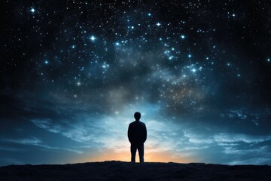
SOME QUESTIONS

Slide 38
Do I really belong to Him?
Do I really recognize His right to me?
Do I respond to His authority and acknowledge His ownership?
Am I able to find freedom and true fulfillment with Him as my Shepherd?
Do I sense a purpose and deep contentment because I am under His direction?
Am I able to know rest and repose in belonging to Him?

Slide 39
CAN I REALISTICALLY SAY
WITH GRATITUDE AND HONESTY THAT
I BELONG TO JESUS
AND
THAT “THE LORD IS MY SHEPHERD” & I AM PART OF HIS FLOCK?

Slide 40
AM I WILLING TO HUMBLE MYSELF, TO LAY ASIDE MY EGO,
TO PUT THINGS INTO PROPER PERSPECTIVE THAT
CHRIST THE CREATOR OF ALL THINGS CALLS HIMSELF MY SHEPHERD AND INVITES ME TO CONSIDER MYSELF HIS SHEEP – HIS SPECIAL OBJECT OF AFFECTION AND ATTENTION

Slide 41
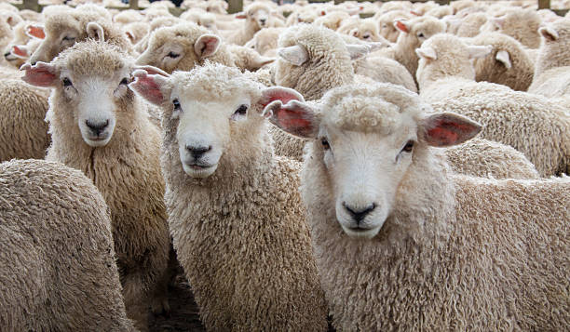

Slide 42


www.clichurch.com
clic church inc
clic.church
email: connect@clichurch.com

