Slide 1
REPORT: Bob & Eileen edmondson
Global Training Network
2024 to 2025

Slide 2
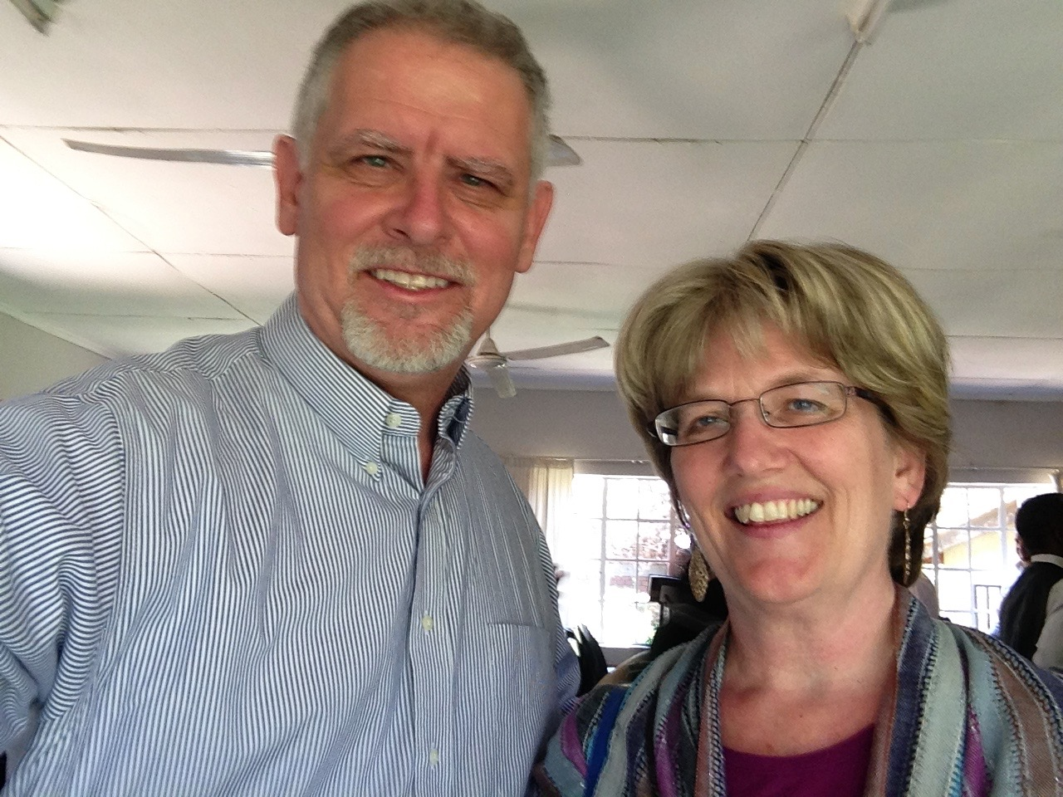
Bob & Eileen Early 2026
January: Philippines

Slide 3
Bob & Eileen Early 2026
January: Philippines
  2 Classes in Mindanao

Slide 4
Bob & Eileen Early 2026
January: Philippines
  2 Classes in Mindanao
  Medical issue

Slide 5
Bob & Eileen Early 2026
January: Philippines
  2 Classes in Mindanao
  Medical issue
  1 Class in Cauayan

Slide 6
Bob & Eileen Early 2026
January: Philippines
  2 Classes in Mindanao
  Medical issue
  1 Class in Cauayan
  Medical Issue Resolved

Slide 7
Bob & Eileen 2024-2025
Statistics for 2024-25

Slide 8
Bob & Eileen 2024-2025
Statistics for 2024-25
  Cameroon, Kurdistan, Nepal, Philippines, Qatar, and Rwanda

Slide 9
Bob & Eileen 2024-2025
Statistics for 2024-25
  Cameroon, Kurdistan, Nepal, Philippines, Qatar, and Rwanda
  Six countries, 12 locations, 14 groups, 34 classes, 399 leaders.

Slide 10
Bob & Eileen 2024-2025
Statistics for 2024-25
  1048 salvations /481 baptized

Slide 11
Bob & Eileen 2024-2025
Statistics for 2024-25
  1048 salvations /481 baptized
  85 house churches and bible studies launched

Slide 12
Bob & Eileen 2024-2025
Statistics for 2024-25
  2021 additional leaders trained

Slide 13
Bob & Eileen 2026
Goals for 2026

Slide 14
Bob & Eileen 2026
Goals for 2026
  Reduce to 5 countries

Slide 15
Bob & Eileen 2026
Goals for 2026
  Reduce to 5 countries
  Train in Rwanda, Kurdistan, Philippines, Cameroon and Qatar

Slide 16
Bob & Eileen 2026
Goals for 2026
  Reduce to 5 countries
  Train in Rwanda, Kurdistan, Philippines, Cameroon and Qatar
  Additional Monthly Support

Slide 17
Bob & Eileen 2026
Goals for 2026
  Recruit trainers for Kurdistan, Cameroon, and Qatar

Slide 18
Bob & Eileen 2026
Goals for 2026
  Recruit trainers for Kurdistan, Cameroon, and Qatar
  $10,000 to fund Books for Kurdistan

Slide 19
Bob & Eileen 2026
Goals for 2026
  Recruit trainers for Kurdistan, Cameroon, and Qatar
  $10,000 to fund Books for Kurdistan COMPLETED

Slide 20
Bob & Eileen 2026
Goals for 2026
  Grant Funding for Major Kurdish Translation Work

Slide 21
Bob & Eileen 2026
Goals for 2026
  Grant Funding for Major Kurdish Translation Work
  Write Book Manuscript on Shifting World Views in Western Civilization

