Slide 1

Approximately over 2 billion people worldwide celebrate the Lunar New Year each year, making it one of the most widely observed cultural festivals globally. Celebrated predominantly across East and Southeast Asia—including China, Vietnam, and South Korea—the festival is a major event for diaspora communities worldwide.
每年全球约有超过20亿人庆祝农历新年，使其成为全球最广为人知的文化节日之一。农历新年主要在东亚和东南亚地区庆祝，包括中国、越南和韩国，同时也是世界各地侨民社区的重要节日。

Slide 2
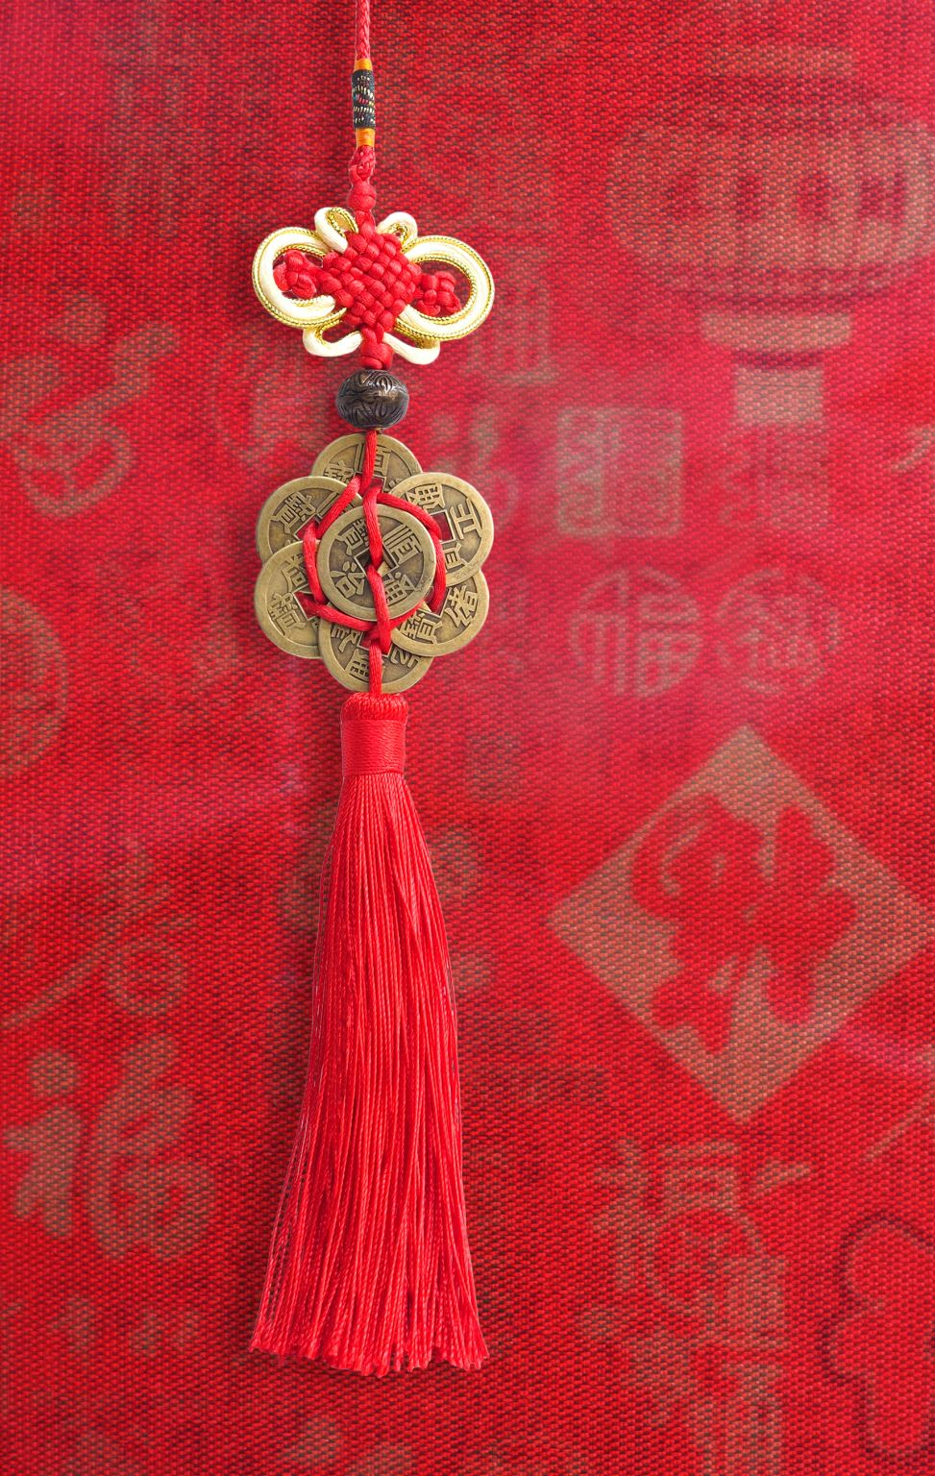
Chinese New Year celebration comes with greetings and wishes for Long Life, Good Health, Wealth, Prosperity, and Abundance in Provision and Success.
中国新年庆祝活动充满了对长寿、健康、财富、繁荣、富足和成功的美好祝愿。

Slide 3
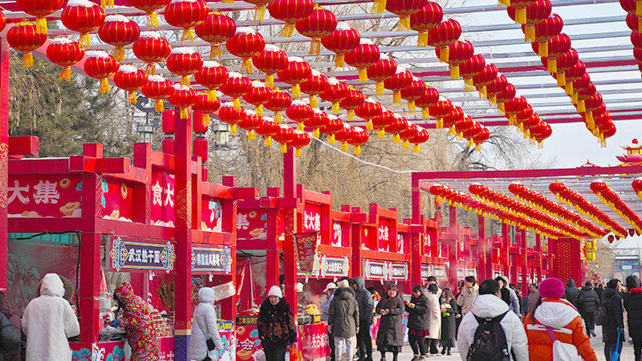

Slide 4
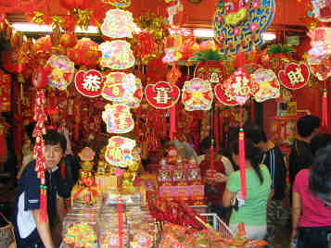
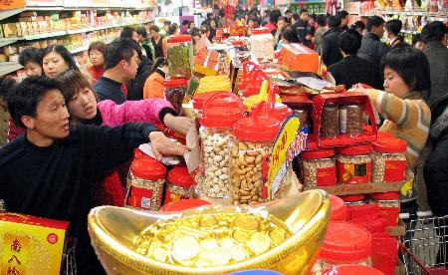
Chinese New Year Shopping

Slide 5
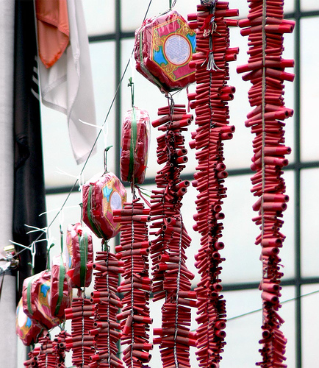
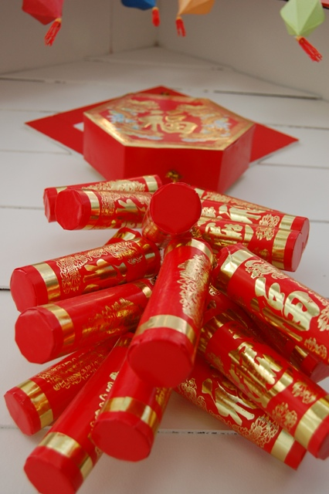

Slide 6
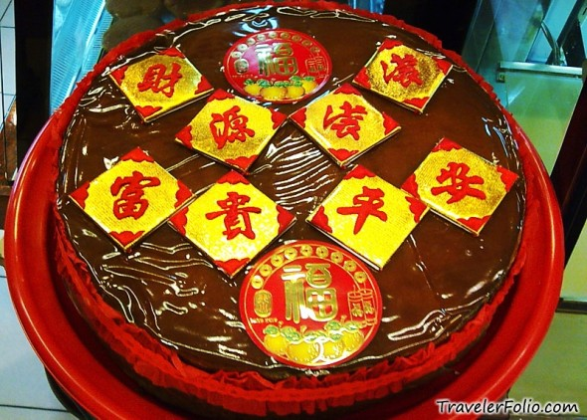
Chinese New Year rice cake – “Nian gao”(年糕) sounds like “年高”, which literally means “increasingly prosperous year in year out”!

Slide 7
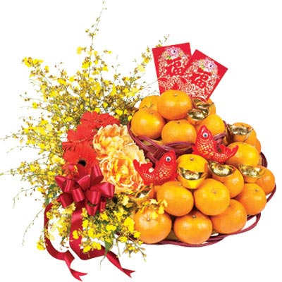
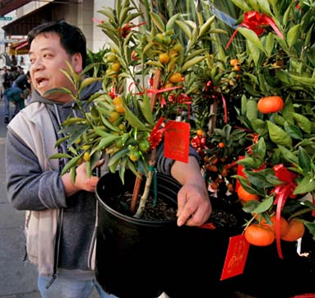

Slide 8
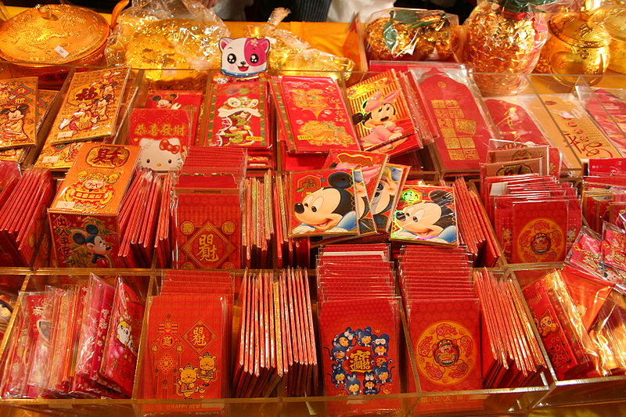

Slide 9
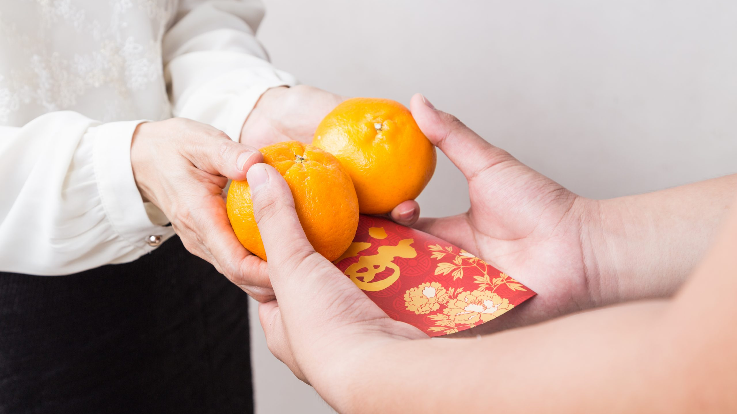

Slide 10


Slide 11
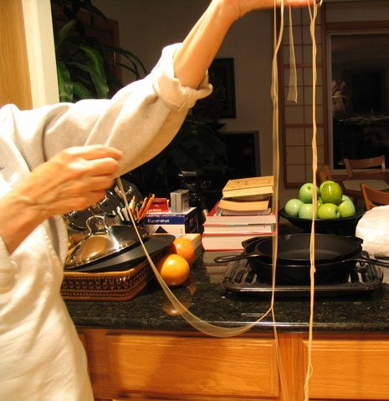
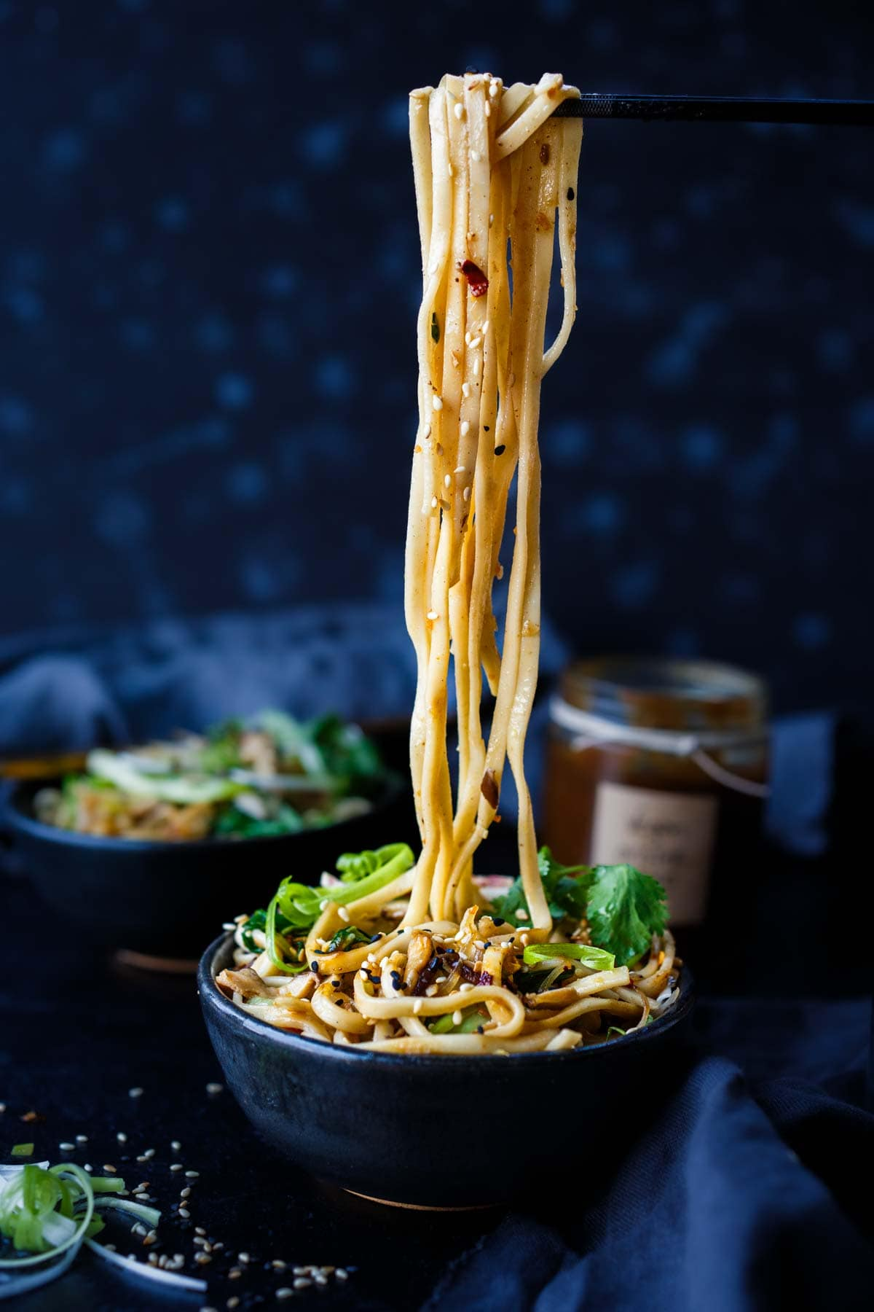
Long Life Noodles !
长寿面！

Slide 12
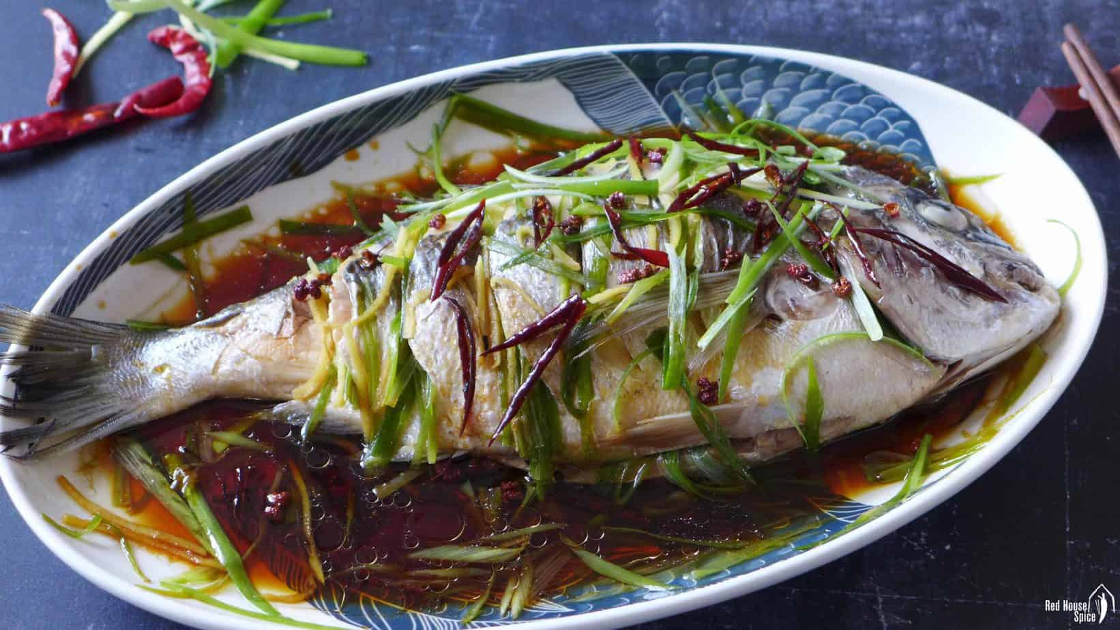
May you have abundance every year. 年年有馀
Chinese New Year fish, or yu (鱼), is a crucial, symbolic dish representing prosperity, as its name is a homophone for "surplus".

Slide 13

Overseas Chinese, particularly in Malaysia and Singapore, celebrate by tossing yusheng (or Raw Fish Salad) to usher in prosperity, wealth, and good fortune for the new year.
海外华人，特别是马来西亚和新加坡的华人，会通过抛捞鱼生（或生鱼沙拉）来庆祝新年，祈求繁荣、财富和好运。

Slide 14
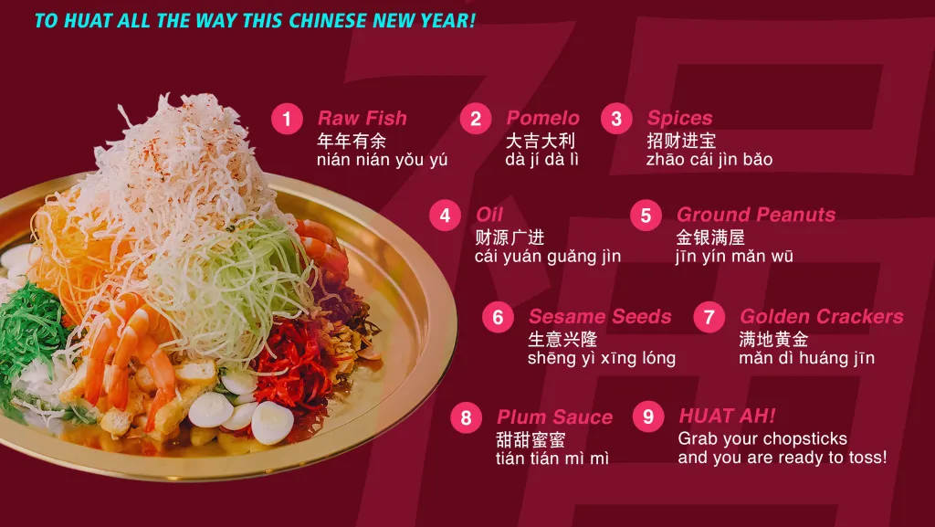

Slide 15

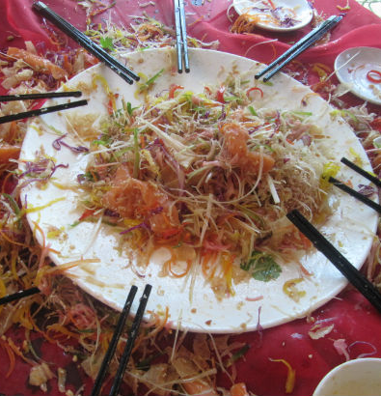

Slide 16
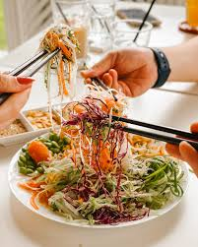
Meaning | Simplified Characters
Congratulations and Prosperity | 恭喜发财
Happy New Year | 新年快乐
May you have abundance every year. | 年年有馀
Happy New Year, now give me a red envelope. | 恭喜发财，红包拿来
Relace the old with the new | 除旧迎新

Slide 17

The Key to Long Life, Health, Wealth,
Prosperity & Success
The Origin of 福 (“Blessings”)

Slide 18
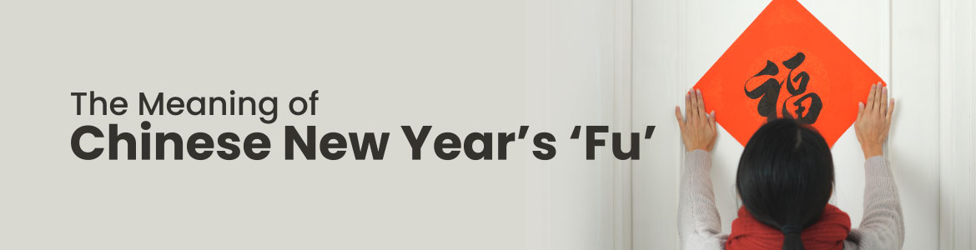
In the study of the character “福”, the radical 礻is derived from an earlier pictogram 示 depicting an altar used in the worship of God.
礻 — the altar: worship, divine presence, relationship with God

Slide 19

神 – God the creator and ruler of the universe and source of all moral authority; the supreme being

Slide 20
“一口田” (literally “one,” “mouth,” and “field”) fullness, order, provision, completeness

Slide 21
The Lord God took the man and put him in the Garden of Eden to work it and take care of it. Genesis 2:15 niv
耶 和 华 神 将 那 人 安 置 在 伊 甸 园 ， 使 他 修 理 ， 看 守 。創 世 記 2:15

Slide 22
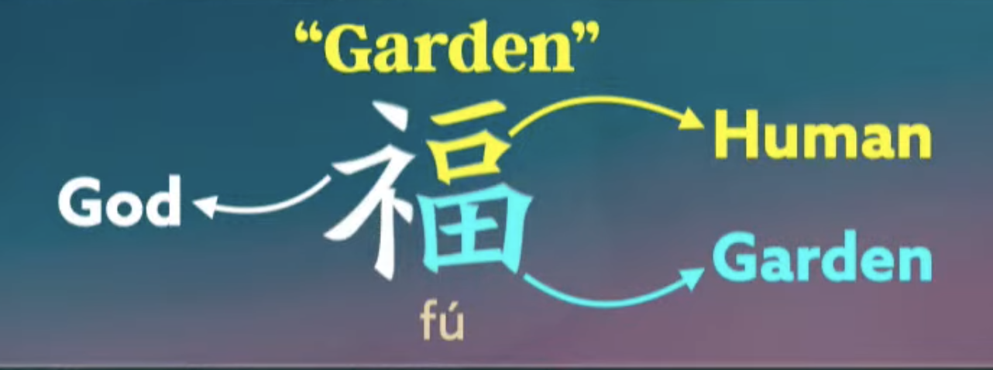
One man in a Garden - 花园里有一个人。
God at the center -上帝居于中心
Work flowing from relationship -工作源于人际关系
Life ordered and fruitful -生活井然有序，硕果累累。

Slide 23
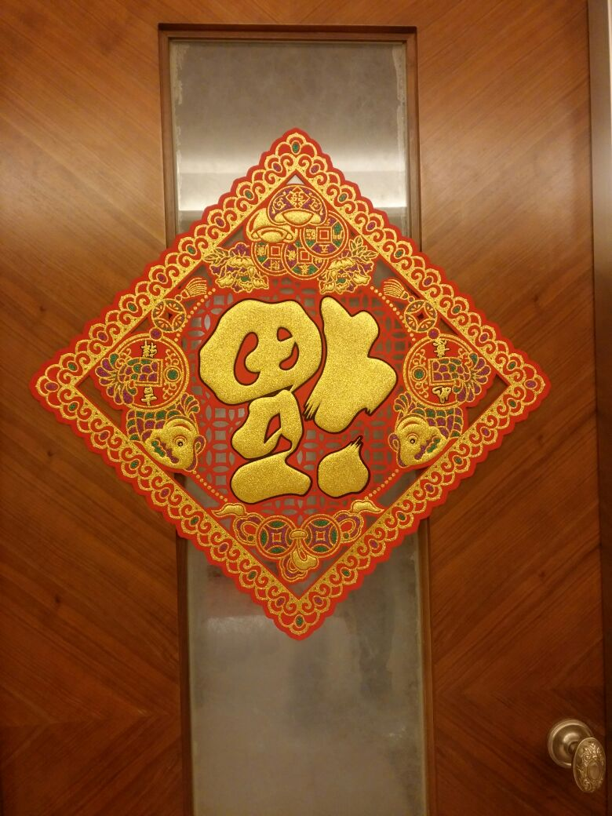

Slide 24
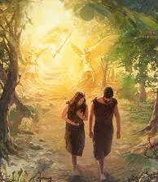
SIN Separate us from God For the wages of sin is death, but the free gift of God is eternal life in Christ Jesus our Lord. Romans 6:23 esv 因 为 罪 的 工 价 乃 是 死 ； 惟 有 神 的 恩 赐 ， 在 我 们 的 主 基 督 耶 稣 里 ， 乃 是 永 生 。 羅 馬 書 6:23

Slide 25

The thief comes only to steal and kill and destroy. I came that they may have life and have it abundantly.
John 10:10 esv
盗 贼 来 ， 无 非 要 偷 窃 ， 杀 害 ， 毁 坏 ； 我 来 了 ， 是 要 叫 羊 （ 或 作 ： 人 ） 得 生 命 ， 并 且 得 的 更 丰 盛 。
約 翰 福 音 10:10

Slide 26
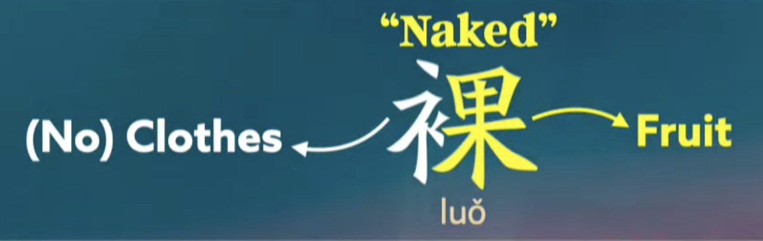
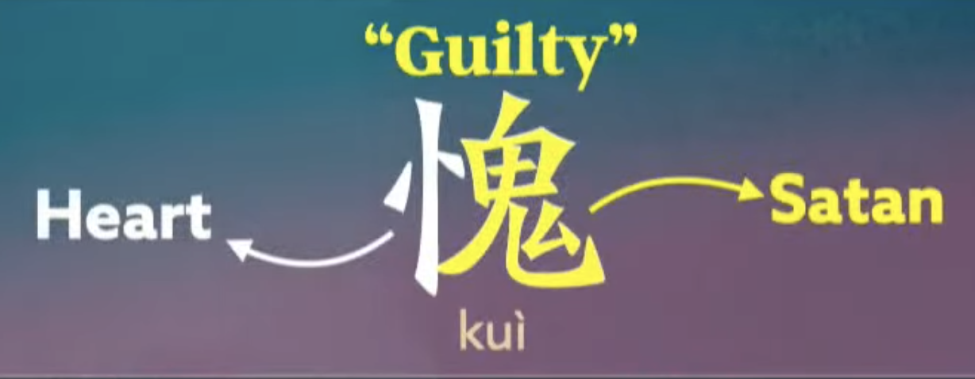

Slide 27
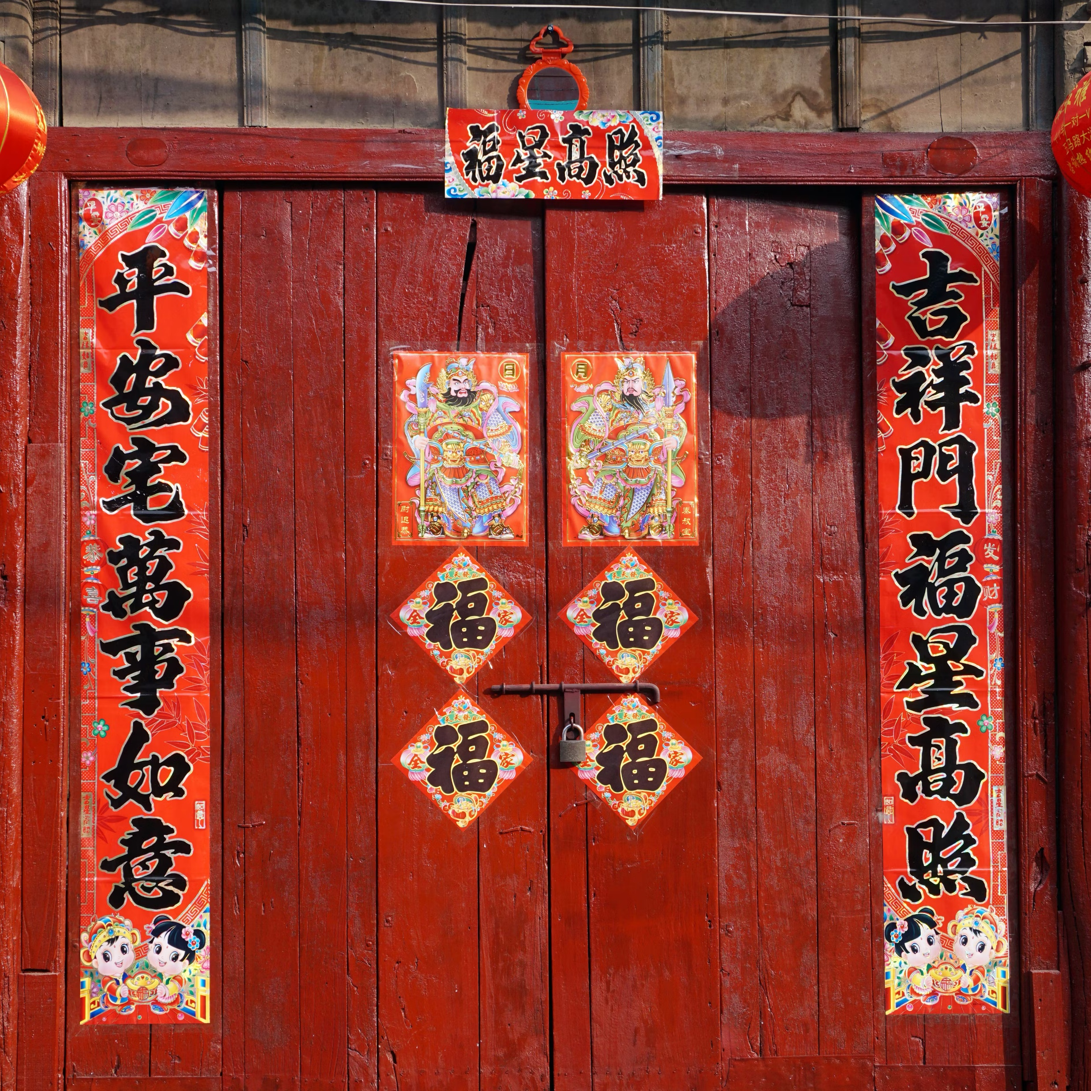
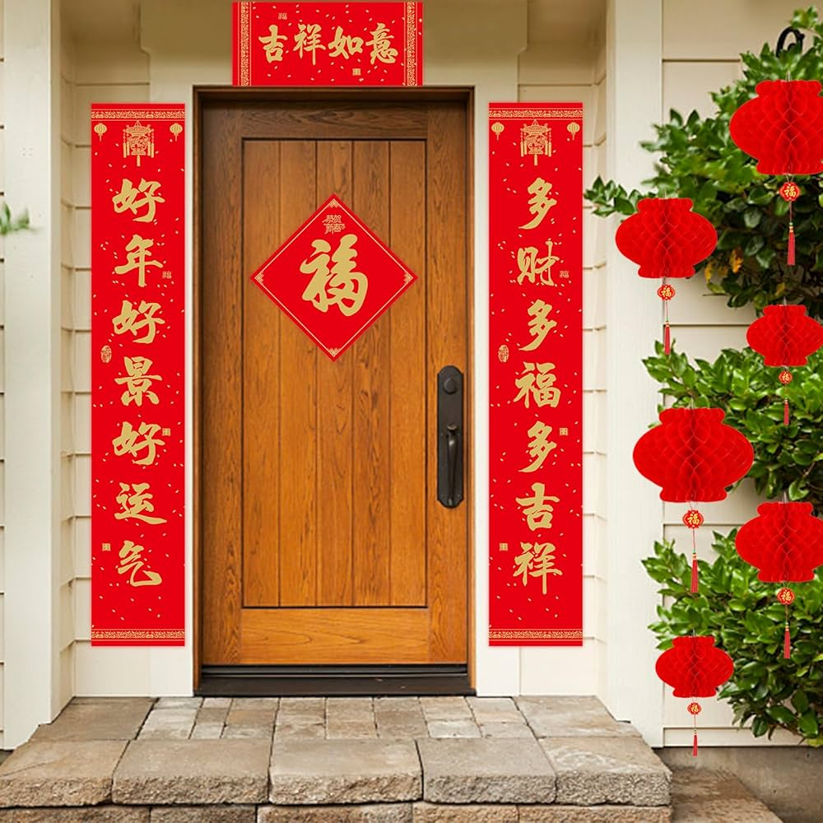

Slide 28
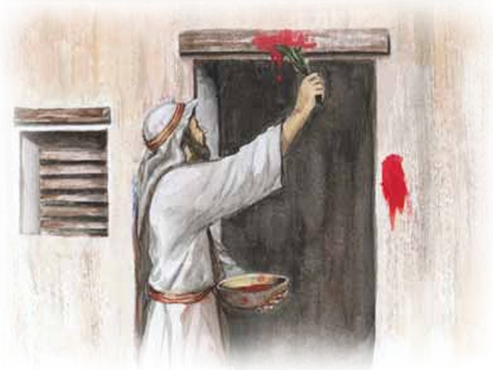
The symbolism in the Passover .The night of the tenth plague, the angel of death passed over Egypt and killed all the firstborn of Egypt who weren't dwelling under blood-stained lintels and doorposts, was the night when God delivered the Hebrews from Egypt.
逾越节的象征意义。第十灾之夜，死亡天使越过埃及，杀死了所有没有住在血迹斑斑的门楣和门框下的埃及长子，而就在当晚，上帝将希伯来人从埃及拯救出来。

Slide 29
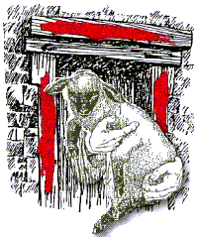
For Christ, our Passover lamb, has been sacrificed.
1 Corinthians 5:7b niv
因 为 我 们 逾 越 节 的 羔 羊 基 督 已 经 被 杀 献 祭 了。
歌 林 多 前 書 5:7

Slide 30
In this is love, not that we have loved God but that he loved us and sent his Son to be the propitiation for our sins.
1 John 4:10 esv
不 是 我 们 爱 神 ， 乃 是 神 爱 我 们 ， 差 他 的 儿 子 为 我 们 的 罪 作 了 挽 回 祭 ， 这 就 是 爱 了 。約 翰 一 書 4:10

Slide 31
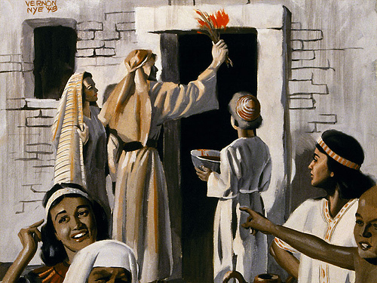

Slide 32
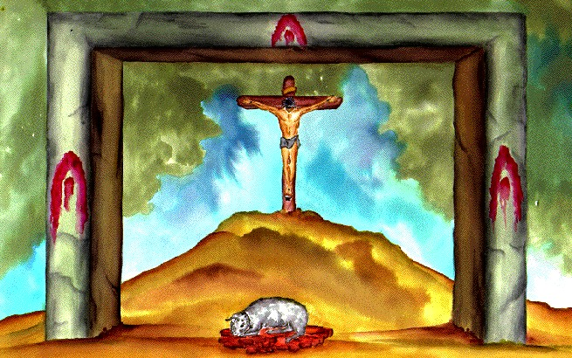
And this is eternal life, that they know you, the only true God, and Jesus Christ whom you have sent.
John 17:3 esv
认 识 你 ─ 独 一 的 真 神 ， 并 且 认 识 你 所 差 来 的 耶 稣 基 督 ， 这 就 是 永 生 。
約 翰 福 音 17:3

Slide 33
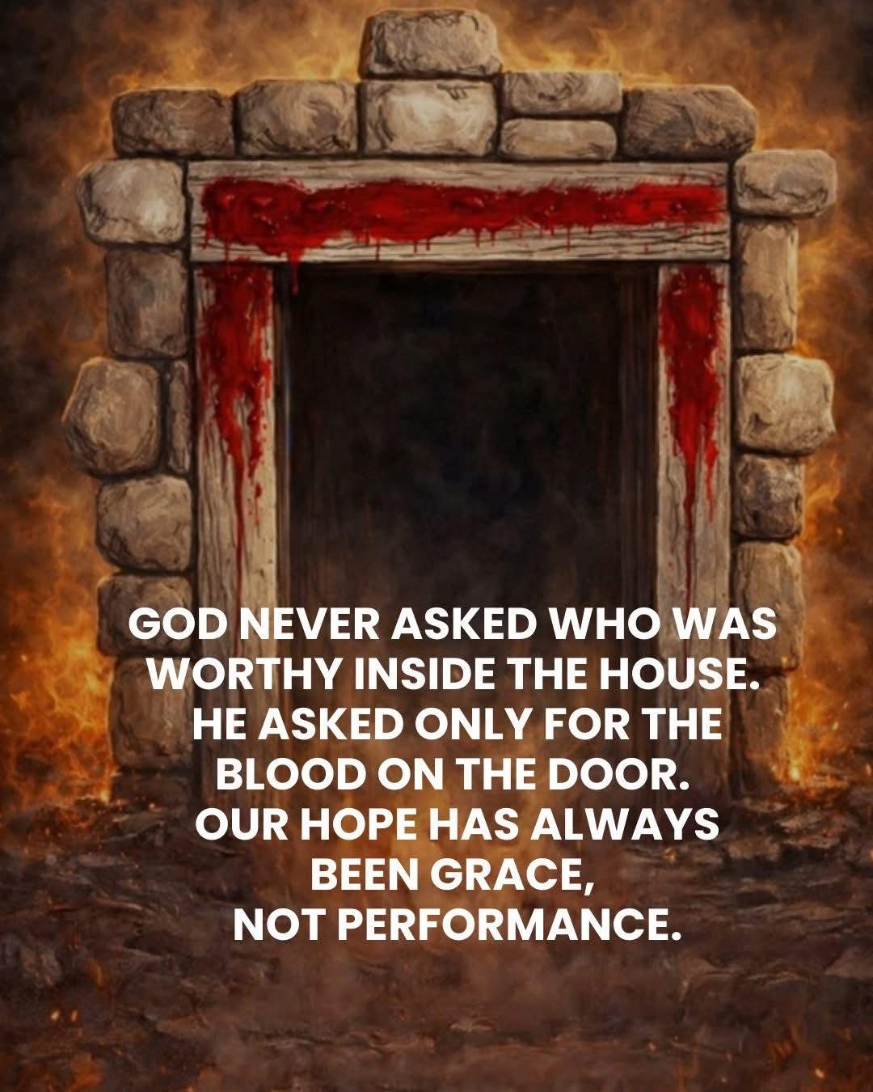
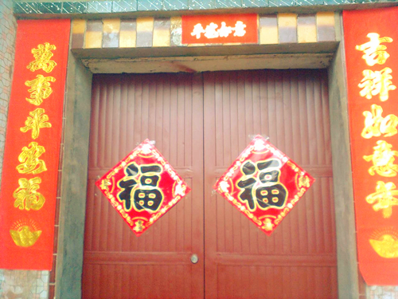
神从来没有问过谁可以配得在那屋子里，祂只看那屋子的门框上是否涂了羔羊的血，那是神的恩典，并非人的行为。

Slide 34
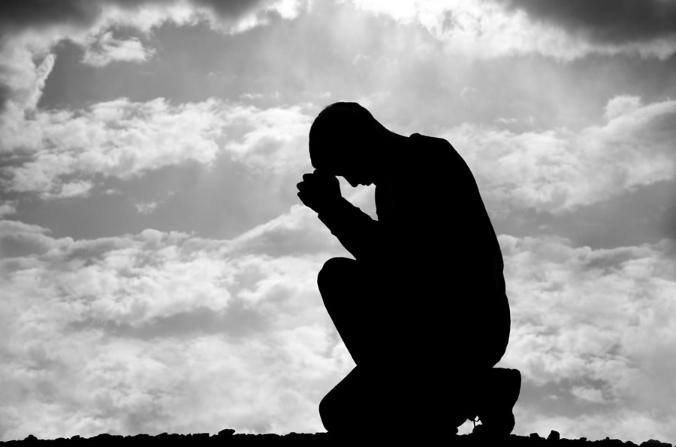
He who conceals his sins does not prosper, but whoever confesses and renounces them finds mercy.
Prov 28:13 niv
遮 掩 自 己 罪 过 的 ， 必 不 亨 通 ； 承 认 离 弃 罪 过 的 ， 必 蒙 怜 恤 。箴 言 28:13

Slide 35
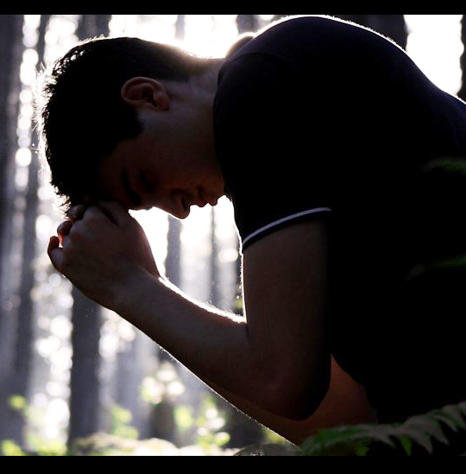
If we confess our sins, he is faithful and just to forgive us our sins and to cleanse us from all unrighteousness.
1 John 1:9 esv
我 们 若 认 自 己 的 罪 ， 神 是 信 实 的 ， 是 公 义 的 ， 必 要 赦 免 我 们 的 罪 ， 洗 净 我 们 一 切 的 不 义 。
約 翰 一 書 1:9

Slide 36
The Origin of 福 (“Blessings”)
Prosperity was never about wealth. It is about God who is at the center of your life
真正的繁荣从来都与财富无关。它关乎上帝，祂是你生活的中心。

