Slide 1


Slide 2


Slide 3



Slide 4
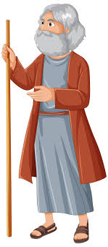
Abraham in the Bible
Genesis 25.8 (NASV)
“Abraham breathed his last and died at a good old age, an old man and satisfied with life……”

Slide 5
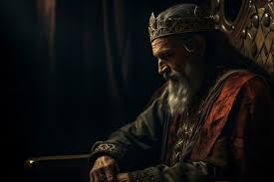
King Solomon
Ecclesiastes 1.2 (NIV)
““Meaningless! Meaningless!” says the Teacher. “Utterly meaningless! Everything is meaningless.”

Slide 6
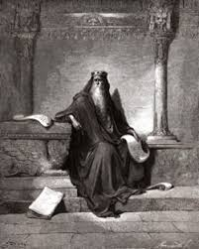
Ecclesiastes 12.8 (NLT)
“Everything is meaningless,” says the Teacher, “completely meaningless.”

Slide 7
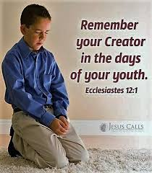
Ecclesiastes 12.1 (NIV)
“Remember your Creator in the days of your youth, before the days of trouble come….”

Slide 8
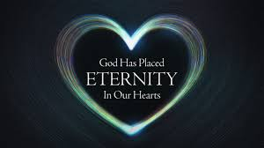
Eternity in your heart
Ecclesiastes 3.11 (NIV)
“Yet God has made everything beautiful for its own time. He has planted eternity in the human heart,….”

Slide 9
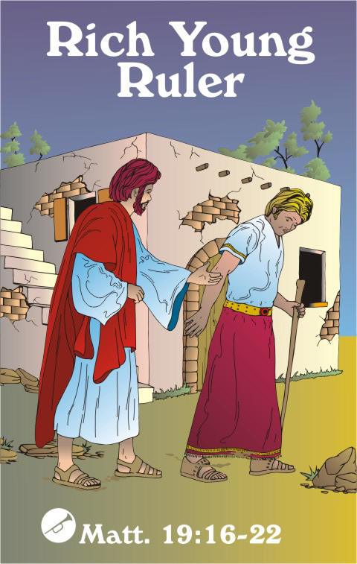
Rich Young Ruler – eternal life
Mark 10. 17, 21 (ESV)
“17 And as he was setting out on his journey, a man ran up and knelt before him and asked him, “Good Teacher, what must I do to inherit eternal life?” 21And Jesus, looking at him, loved him, and said to him, “You lack one thing: go, sell all that you have and give to the poor, and you will have treasure in heaven; and come, follow me.”

Slide 10
John 17.3 (NIV)
“Now this is eternal life: that they know you, the only true God, and Jesus Christ, whom you have sent.”

Slide 11
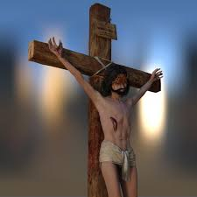
Psalms 103.2-5 (NIV)
“2 Praise the Lord, my soul, and forget not all his benefits—
3 who forgives all your sins and heals all your diseases,
4 who redeems your life from the pit and crowns you with love and compassion,
5 who satisfies your desires with good things so that your youth is renewed like the eagle’s”

