Slide 1
Leader: Welcome to Holy Hermits Online Worship
The 1st Sunday in Lent
Today we are remembering
Holy Hermit Richard Rolle de Hampole
Service Prep: Leonie | Chat Host: Rachel | First Reader: Phil
Music: Wiggles 🐶 | Welcomer: Julie | Second Reader: Vanessa
Proof-reader: Kristine | Priest: N/A | Preacher: Lauren (recorded)
Broadcaster: Kieron | Deacon: N/A | Fellowship: Leonie
Backup Broadcaster: Barry | Leader: Jeremy | Safety Officer: Leonie
Zoom Buttons: Viki | Cantor: Julie | Attendance: Rachel
Prep: 13/02/2026 Proofed:14/02/2026

Slide 2






Hospitality
Leader:
Please mute for the service unless invited to offer your voice as part of the service ministry
Have the video camera on or off and turn the volume and brightness up or down on your device if things are too loud 🔉🔊or too bright🔅🔆
Our Cantor acts as our voice, offering the responses, in Bold Text, which we say together
Feel welcome to use the chat and reaction emojis 👍
🙏 Please take care of yourself in this space. 🙏 Come and go as you need
😴 It is great to take rest in this space, so falling asleep is also OK 😴
👂️ Remember, pastoral care is available to all in the community, if you'd like to speak to someone about anything spiritual. ❤️ Visit the help page at the website to reach out 🌐
Our Being Together ethos and safeguarding practices can also be accessed on the website 🫶​
🙌 Come as you are – we are all here together! 🙌
Notes:
Used Lent 2022

Slide 3
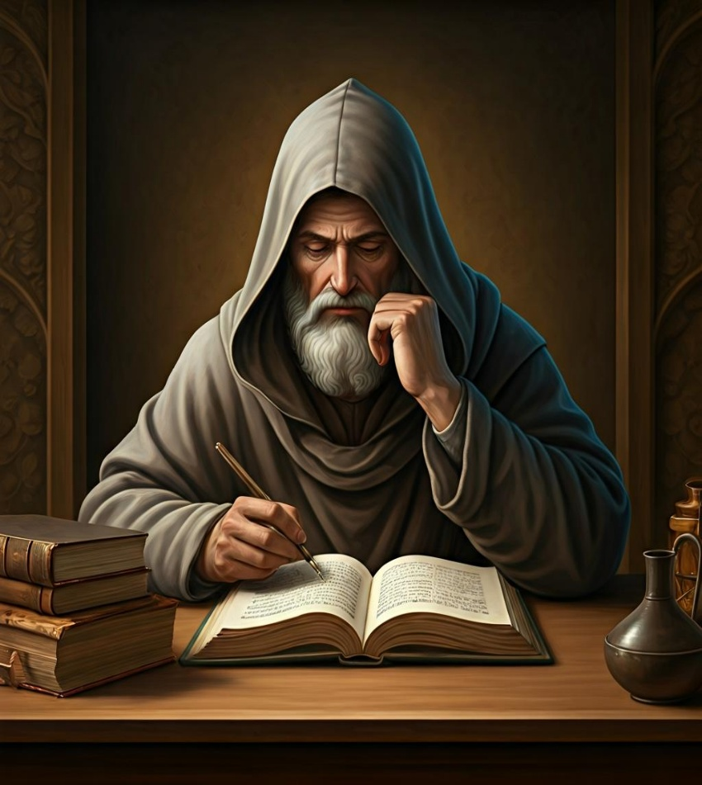
Leader: Our Holy Hermit Highlights for today
Richard de Rolle a passionate 14th-century English mystic and hermit, inspired many with his vibrant writings on the soul’s longing for God. Renowned for his heartfelt language, Rolle wrote in both Latin and English, making spiritual wisdom accessible to all. He taught that loving God and people transforms us deeply.
To read more about our hermits please click the link​​ in the send out

Slide 4
Invitation
Leader: As we settle into worship let your breath be soft, your mind be still, and your heart be open to the presence of God.
Opening Music: https://www.youtube.com/watch?v=QC86e11jmow

Slide 5
Leader and Cantor unmute
The Greeting
Leader: The Grace of the lord Jesus Christ, and the
love of God, and the fellowship of the Holy
Spirit, be with you all.
All: And also with you.

Slide 6
Gathering Prayer
Leader: Rejoice in the Lord,
for he calls us to be honest with him,
offering his forgiveness,
to teach us the way to go
as we make our choices.
Let us walk with him, in faith.

Slide 7
Gathering Prayer
All: Lord Jesus,
you know that life
can be complicated.
You faced tough choices
but chose to be true to your father, God.
By your Holy Spirit,
instruct and guide us
that we will be able to know
what is good and true. Amen.

Slide 8
Sentence
Leader: I invite our Cantor to proclaim the sentence for today.
Cantor: We do not live by bread alone, but by every word that comes from the mouth of God.
Matthew 4.4

Slide 9
Leader: We pray the prayer of approach together
All: Creator God, in these testing times
we bring to our worship all that we have faced, all that we have overcome, all that we need to hold on to and all that we need to release.
Help us to worship you in spirit and in truth.
Amen.

Slide 10
Our First Hymn is
Forty Days and Forty Nights
https://www.youtube.com/watch?v=9N29ZnwU4LM
We stay on mute
Leader and Cantor mute

Slide 11
The LA Introduces Confession​
The Lord comes, bringing to light things now hidden in darkness, and disclosing the purposes of the heart.
​​
Silence may be kept.​..
​
Let us open our hearts and prepare for his coming, confessing our sins in penitence and faith.

Slide 12
All: ​Merciful God, our maker and our judge, ​
we have sinned against you ​in thought, word, and deed, ​
and in what we have failed to do: ​
we have not loved you with our whole heart; ​
we have not loved our neighbours as ourselves; ​
we repent, and are sorry for all our sins.​
Father, forgive us. Strengthen us to love and obey you
in newness of life; ​through Jesus Christ our Lord. ​
Amen.​

Slide 13
Words of Assurance offered by the LA
These words of assurance from the First Letter of John declare that:
If anyone sins, we have an advocate with the Father, Jesus Christ the righteous. He is the perfect offering for our sin, and not for ours only, but for the sins of the whole world.
(1 John 2: 1-2)
In this is love, not that we loved God, but that he loved us and sent his Son to be the perfect offering for our sins.
(1 John 4:10)

Slide 14
Collect
Leader: Almighty God, whose Son fasted forty days in the wilderness, and was tempted as we are, yet did not sin: give us grace to direct our lives in obedience to your will, that, as you know our weakness, so we may know your power to save;
through Jesus Christ our Redeemer,
who lives and reigns with you and the Holy Spirit,
one God, now and for ever.
Amen.

Slide 15
≈
The 1st reader unmutes
Leader: I invite the 1st reader to unmute and offer the 1st lesson when ready.
Reader 1: The 1st Reading is from Genesis 2.15-17; 3.1-7
2 ¹⁵ The Lord God took the man and put him in the garden of Eden to till it and keep it. ¹⁶ And the Lord God commanded the man, ‘You may freely eat of every tree of the garden; ¹⁷ but of the tree of the knowledge of good and evil you shall not eat, for in the day that you eat of it you shall die.’ 3 ¹ Now the serpent was more crafty than any other wild animal that the Lord God had made.
Continue…

Slide 16
≈
He said to the woman, ‘Did God say, “You shall not eat from any tree in the garden”?’ ² The woman said to the serpent, ‘We may eat of the fruit of the trees in the garden; ³ but God said, “You shall not eat of the fruit of the tree that is in the middle of the garden, nor shall you touch it, or you shall die.” ’⁴ But the serpent said to the woman, ‘You will not die; ⁵ for God knows that when you eat of it your eyes will be opened, and you will be like God, knowing good and evil.’ ⁶ So when the woman saw that the tree was good for food,
Continue…

Slide 17
and that it was a delight to the eyes, and that the tree was to be desired to make one wise, she took of its fruit and ate; and she also gave some to her husband, who was with her, and he ate. ⁷ Then the eyes of both were opened, and they knew that they were naked; and they sewed fig leaves together and made loincloths for themselves.
For the word of the Lord. Thanks be to God.​

Slide 18
Leader: We now say the psalm antiphonally, I invite the first reader to lead, and we will all respond with our cantor as our voice.
Psalm 32
¹ Blessed are those whose sin is forgiven:
whose iniquity is put away.
² Blessed are those to whom the Lord imputes no blame:
and in whose spirit there is no guile.
³ For whilst I held my tongue:
my bones wasted away with my daily complaining.
⁴ Your hand was heavy upon me day and night:
and my moisture was dried up like a drought in summer.
Continue…

Slide 19
⁵ Then I acknowledged my sin to you:
and my iniquity I did not hide;
⁶ I said ‘I will confess my transgressions to the Lord’:
and so you forgave the wickedness of my sin.
⁷ For this cause shall everyone that is faithful
make their prayer to you in the day of trouble:
and in the time of the great water-flood,
it shall not come near them.
⁸ You are a place to hide me in,
you will preserve me from trouble:
you will surround me with deliverance on every side.
Continue…

Slide 20
⁹ ‘I will instruct you, and direct you in the way that you should go:
I will fasten my eye upon you, and give you counsel.
¹⁰ ‘Be not like horse or mule, that have no understanding:
whose forward course must be curbed with bit and bridle.’
¹¹ Great tribulations remain for the ungodly:
but whoever puts their trust in the Lord,
mercy embraces them on every side.
¹² Rejoice in the Lord, you righteous, and be glad:
and shout for joy, all you that are true of heart.

Slide 21
The 2nd reader unmutes
Leader: Thank you, I invite the 2nd reader to unmute and offer the 2nd lesson when ready.
Reader 2: The 2nd Reading is from Romans 5.12-21
¹² Therefore, just as sin came into the world through one man, and death came through sin, and so death spread to all because all have sinned— ¹³ sin was indeed in the world before the law, but sin is not reckoned when there is no law. ¹⁴ Yet death exercised dominion from Adam to Moses, even over those whose sins were not like the transgression of Adam, who is a type of the one who was to come.
Continue…

Slide 22
¹⁵ But the free gift is not like the trespass. For if the many died through the one man’s trespass, much more surely have the grace of God and the free gift in the grace of the one man, Jesus Christ, abounded for the many. ¹⁶ And the free gift is not like the effect of the one man’s sin. For the judgement following one trespass brought condemnation, but the free gift following many trespasses brings justification. ¹⁷ If, because of the one man’s trespass, death exercised dominion through that one, much more surely will those who receive the abundance of grace and the free gift of righteousness exercise dominion in life through the one man, Jesus Christ.
Continue…

Slide 23
¹⁸ Therefore just as one man’s trespass led to condemnation for all, so one man’s act of righteousness leads to justification and life for all. ¹⁹ For just as by the one man’s disobedience the many were made sinners, so by the one man’s obedience the many will be made righteous. ²⁰ But law came in, with the result that the trespass multiplied; but where sin increased, grace abounded all the more, ²¹ so that, just as sin exercised dominion in death, so grace might also exercise dominion through justification leading to eternal life through Jesus Christ our Lord.
For the word of the Lord. Thanks be to God.

Slide 24

We pause before
​the Gospel ​​

Slide 25
Leader: The Gospel of our Lord Jesus Christ according to St Matthew 4.1-11
¹ Then Jesus was led up by the Spirit into the wilderness to be tempted by the devil.
² He fasted for forty days and forty nights, and afterwards he was famished.
³ The tempter came and said to him, ‘If you are the Son of God, command these stones to become loaves of bread.’
⁴ But he answered, ‘It is written,
Continue…

Slide 26
“One does not live by bread alone,
but by every word that comes from the mouth of God.” ’
⁵ Then the devil took him to the holy city and placed him on the pinnacle of the temple, ⁶ saying to him, ‘If you are the Son of God, throw yourself down; for it is written,
“He will command his angels concerning you”,
and “On their hands they will bear you up,
so that you will not dash your foot against a stone.” ’
⁷ Jesus said to him, ‘Again it is written, “Do not put the Lord your God to the test.” ’
Continue…

Slide 27
⁸ Again, the devil took him to a very high mountain and showed him all the kingdoms of the world and their splendour;
⁹ and he said to him, ‘All these I will give you, if you will fall down and worship me.’
¹⁰ Jesus said to him, ‘Away with you, Satan! for it is written,
“Worship the Lord your God,
and serve only him.” ’
¹¹ Then the devil left him, and suddenly angels came and waited on him.
For the word of the Lord. Thanks be to God.

Slide 28
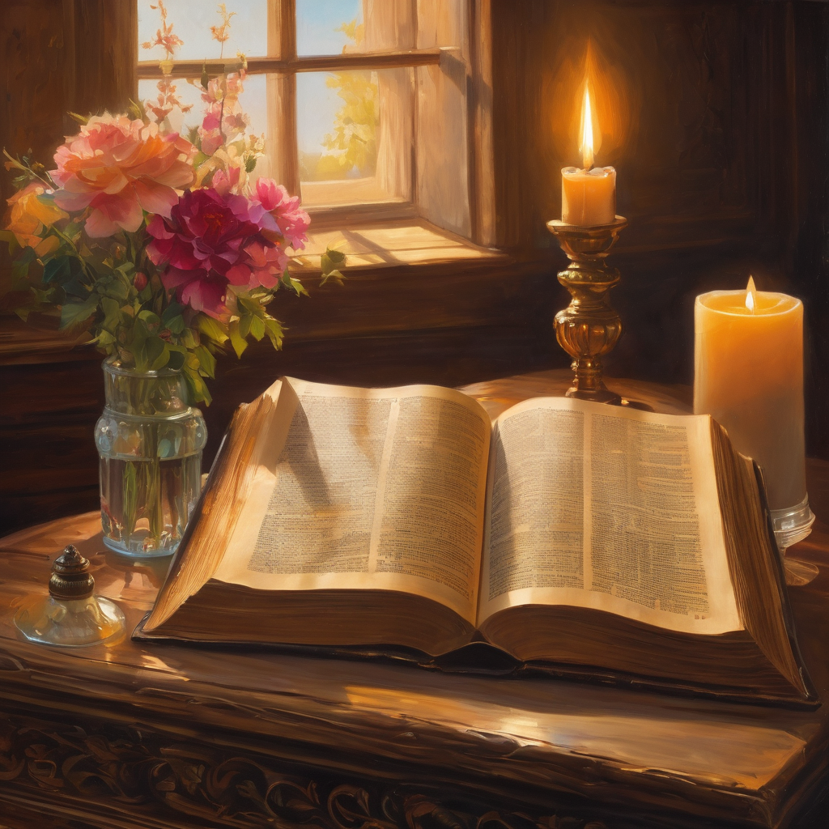
We pause
after ​the Gospel ​​

Slide 29
Leader: .
Leader and Cantor mute
Broadcaster exits screenshare
Recorded Sermon:
Our Lenten Journey
https://youtu.be/J3Ip04fWZ8k

Slide 30
Leader unmutes
Our next Hymn is
Forty Days (From Ashes We Came)
https://www.youtube.com/watch?v=Ezq7fKWP42A
We stay on mute
Leader mutes

Slide 31
The Leader and Cantor unmute
The Greeting of Peace
Leader: We are the body of Christ
All: God’s Spirit is with us
Leader: The peace of the Lord be always with you.
All: And also with you.
Leader: A sign of peace may be exchanged
🙏🏾 🙏You may like to type 'Peace' into the chat, use the 'raise hand’ or other reaction buttons, or just simply wave via the screen with your video turned on 🙏🏾 🙏
🕊️(Broadcaster exits shared screen for a few moments for the exchange of peace) 🕊️

Slide 32
Prayer of Thanksgiving before Intercessions
Leader: As we enter prayer, I invite the second reader to unmute to lead our intercessions which follow the prayer of thanksgiving. Please feel free to change your body position as you need.
Leader: God of all goodness:
for the courage you give us in times of testing,
we praise you;
for the abundance of grace and gift in our world,
we praise you;
for the strength to live life to the full with faith in you,
we praise you. Amen.

Slide 33
Intercessions
Reader 2: We pray for creation and communities we share our lives with. We pause for a few moments to name either in our hearts, or out loud, or in the chat, those environments and communities we bring to the Lord in prayer.
PAUSE…
We entrust to you the community of Holy Hermits Online and our ministry partners:
Prosper the work of our hands and show us the way to your new creation.
Creator God, Hear our prayer.
St John's Cathedral Brisbane The Anglican Diocese of Southern Queensland St Gabriel’s, Carindale Benedictus Contemplative Church, Canberra Anglican Focus and Tithe.ly

Slide 34
Intercessions
Reader 2: We pray for creation and communities we share our lives with. We pause for a few moments to name either in our hearts, or out loud, or in the chat, those environments and communities we bring to the Lord in prayer.
PAUSE…
We entrust to you the community of Holy Hermits Online and our ministry partners:
St John's Cathedral Brisbane
The Episcopal Diocese of Texas, Canon Joann and the Mission Amplification Team
The Anglican Diocese of Southern Queensland
Benedictus Contemplative Church, Canberra
Anglican Focus
St Gabriel's Carindale
Tithe.ly
Prosper the work of our hands and show us the way to your new creation.
Creator God, Hear our prayer.

Slide 35
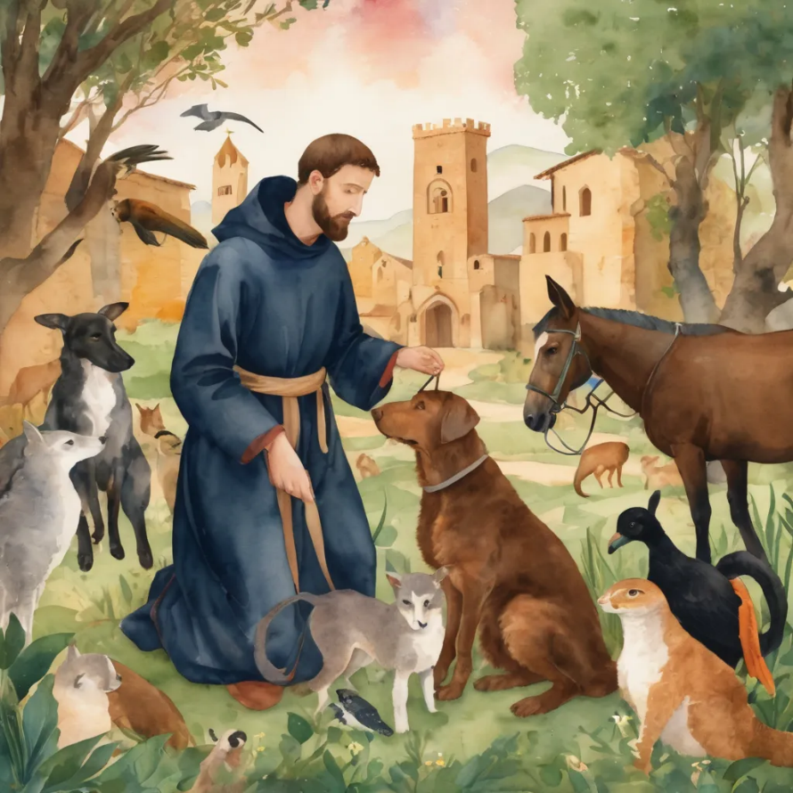
Reader 2: Loving Creator, we entrust to you all animals, especially those who are sick, anxious, ageing, lost, at risk, lonely, sad, hungry, in pain, homeless, abused, living in fear, encountering violence of any kind, in need of comfort, rehabilitation or transformation.
We invite your loving compassion for:
We name in our hearts, out loud or in the chat,
the animals we bring to the Lord in prayer. PAUSE…
Jasmine, ​
Leese(y), ​
Sid, Toots & Lulu​
Polly and Suki​
Fred, George & Percy​
Koshka ​
Jax
Lambert ​​
Kala, Nigel & Little One ​​
Toby​​
Taco​​
Paddy ​​
Rosie​

Slide 36
Reader 2: Eternal Trinity of Love, we uphold to you the people we love and carry cares for:
We name in our hearts, out loud or in the chat, those we bring to the Lord in prayer. PAUSE… We entrust to you those who have died, those who have died peacefully and those who have died tragically, The old and the young. Receive them into your Kingdom. Lord in your mercy, Hear our prayers. Amen.
Kerry, Les & Jake Julie, Ray, Tracey & Shane Mark, Desley & Bob ​​ Rachel, Mervyn & Gillian ​​Rev'd Shane & Janette​​ Alecia, Martin & Aidan​​ Steven & Vanessa | Barry​​ Dr Julie ​​ Ruth​​ Phil​ May Susan Tanya​ Craig Neva​ | Bill & Marjorie​​ Aaron & Andrea Dilys & Tony, Paul & Darhon Judy & Mary​​ Bob & Di​ Pat & Julie Miriam Gayanne | Kirsten, Greg, Daphne & Beau Alan & Gaylene​ Jess & Leah ​​ Bonnie & girls Liz’s Godchildren Barry & Gwen Matthew & Nicholas​

Slide 37
Pray Daily Cycle of Prayer
Leader: Loving God, joining with the Church in our cycle of prayer, we ask your blessings on:
• The Church of Ireland
• The Diocese of Sydney: †Kanishka; Assistant Bishops –
†Peter, †Christopher, †Peter, †Michael, †Malcolm, †Gary; Clergy and People
• The Parish of Quilpie
• Anglicare SQ Southport Respite Centre
• St John’s College UQ: Warden - Rose; Chaplain – Samuel;
Chair of Council - John; members of College Council; staff & students

Slide 38

Leader: Commitment prayer for the week:
A Prayer for during the Emergence of AI
https://youtu.be/uhkBwPKHNXw?si=WwSOZUNb3P8SiEm7​

Slide 39
Leader: Let us pray together the prayer which Jesus gave us saying:
All: Our Father in heaven,
hallowed be your name,
your kingdom come, your will be done,
on earth as in heaven.
Give us today our daily bread.
Forgive us our sins
as we forgive those who sin against us.
Save us from the time of trial
and deliver us from evil.
For the kingdom, the power,
and the glory are yours
now and for ever.
Amen.

Slide 40
Devotions

Slide 41
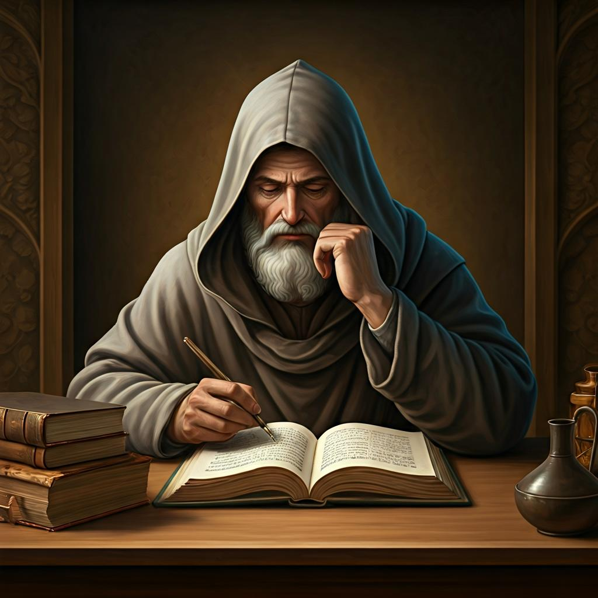
Hermit Wisdom

Slide 42
Leader: Wisdom from Richard Rolle de Hampole
“What is love but the transforming of the desire into the loved thing itself? Every lover is assimilated to his or her beloved. Love makes the loving one, like what he or she loves.”

Slide 43
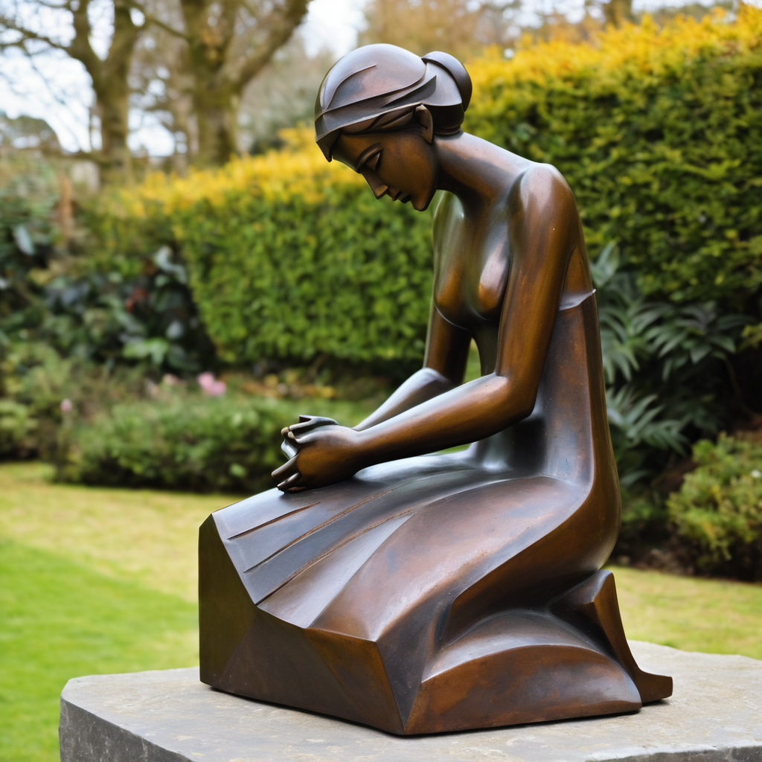
Leader: ​As we enter a few minutes of silence together, you are invited to pray this prayer of adoration and/or spend this time in contemplation. ​
The Spiritual Communion prayer follows
on the next slide. Let us be still.
Leader and Cantor Mute
​
Lord, when we are not sure what to do, help us to really look
and really listen and ask, ‘What would Jesus do?’ so that we can know your way to live.
Amen

Slide 44
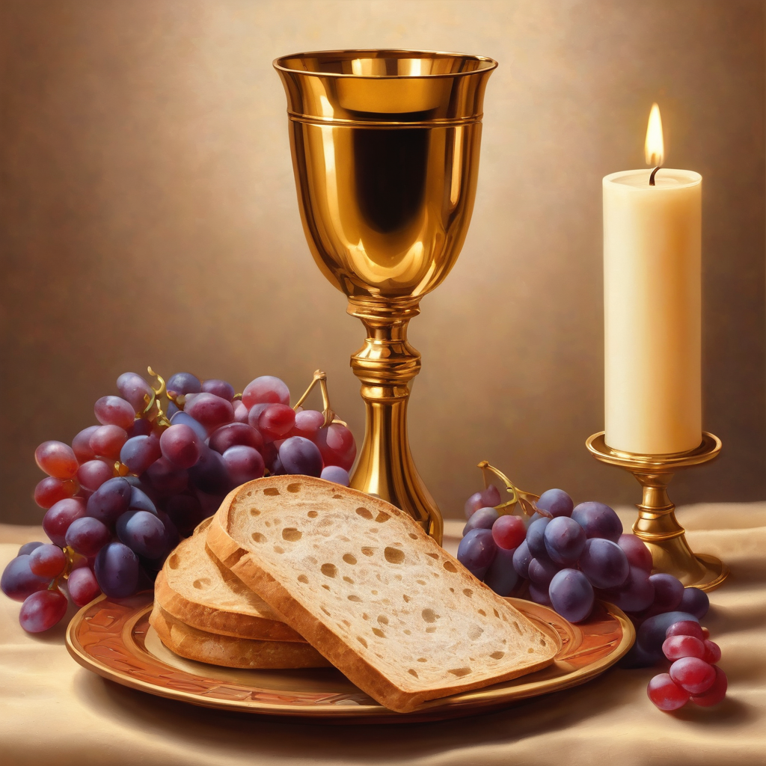
Oh, my Lord Jesus I turn to you
present at the Altar and in the
Tabernacle. I believe that you are
present in the Holy Sacrament of your
most Sacred Body and Blood. I love you
above all things and I desire to receive
you into my Soul. I cannot at this
moment receive you Sacramentally in
Holy Communion. Come spiritually into
my heart. Purify it, Sanctify it. Render
my heart like your own heart.
I embrace you as if you were already
there and unite myself wholly with
you. Never permit me to be separated
from you. Lord, I am not worthy to
receive you, but only say the word and I
shall be healed. Amen
Making a
Spiritual Communion
(Prayed in silence)

Slide 45
Leader unmutes
Our final song is
Good
https://www.youtube.com/watch?v=fAEEc-y1WqE
​We stay on mute
Leader and Cantor mute

Slide 46
Leader and cantor unmute
Sending Prayer
Leader: We pray our sending prayer together.
All: Compassionate and loving God, through your Son Jesus Christ you have fed us and have reconciled your people to yourself. Following his example of fasting and prayer,may we obey you with willing hearts and serve one another in holy love.
Amen

Slide 47
The Benediction
Leader: Let us all invite God’s blessings together,
All: May the Lord bless us and keep us.
May the Lord’s face shine upon us and be gracious to us. May the Lord’s countenance be lifted upon us, and bring us peace. Amen

Slide 48
Notices
Lenten Study starting Wednesday 25th February @7:30pm with Rev’d Jess from the Cathedral, please email her to join jgrant@stjohnscathedral.com.au see the Friday send out for more information
Sunday 1st March Companion Animals workshop @ 11:30, all are welcome
See HHO Events page for further upcoming events HHO Events

Slide 49
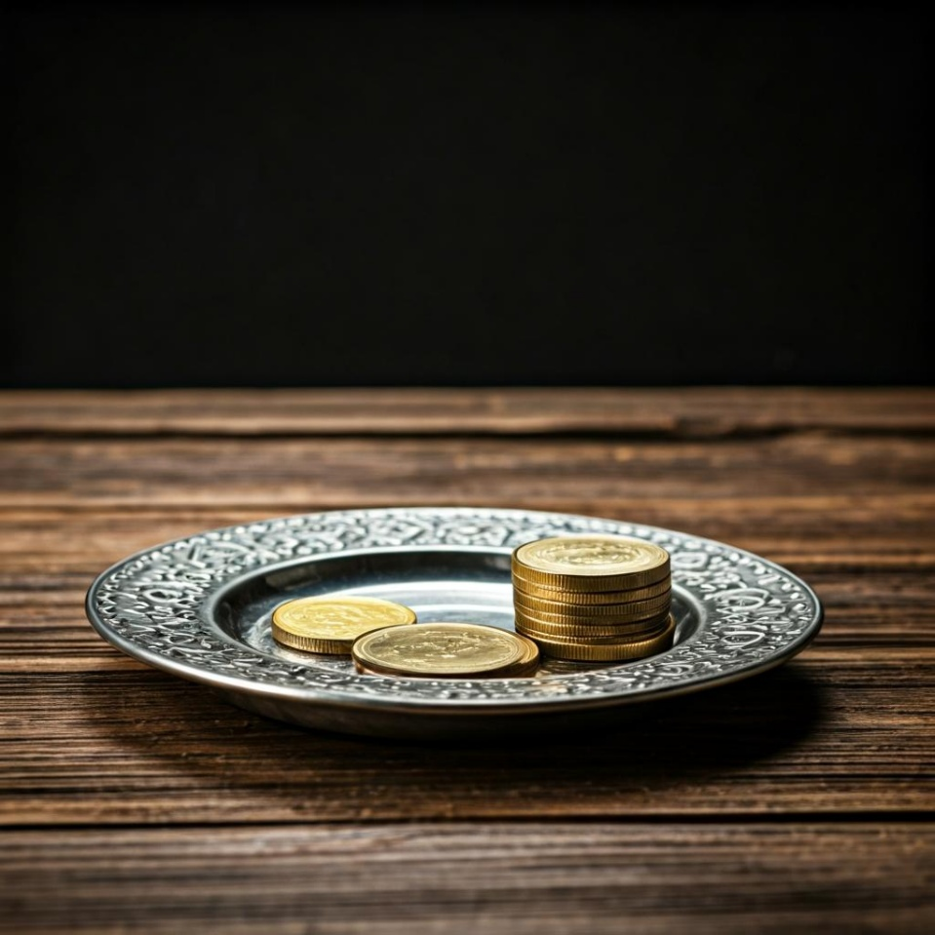
Offerings: Thank you for your regular gifts to this ministry
Offerings are most welcome via
The HHO App
Direct Debit
International Direct Debit
Please consider a one-off donation
or leaving a legacy in your Will
For further information go to HHO give page https://holyhermits.com.au/give

Slide 50
Serving next week
Sunday 1st March
9:00 am AEST
Service Prep: Leonie | Chat Host: Viki | First Reader: Bob
Music: Wiggles 🐶 | Welcomer: Chris | Second Reader: Roselyn
Proof-reader: Chris | Priest: N/A | Preacher: Lauren
Broadcaster: Barry | Deacon: Lauren | Fellowship: Leonie
Backup Broadcaster: Lauren | Leader: Julie | Safety Officer: Chris
Zoom Buttons: Lauren | Cantor: Jeremy | Attendance: Viki
Thank you for your ministry gifts
New Servers always welcome!
Please email Rev’d Lauren to get involved
holyhermits@anglicanchurchsq.org.au

Slide 51
Leader: I invite everyone to unmute for the Dismissal
Leader: Go in peace to love and serve the Lord.
All: In the name of Christ, Amen.

Slide 52
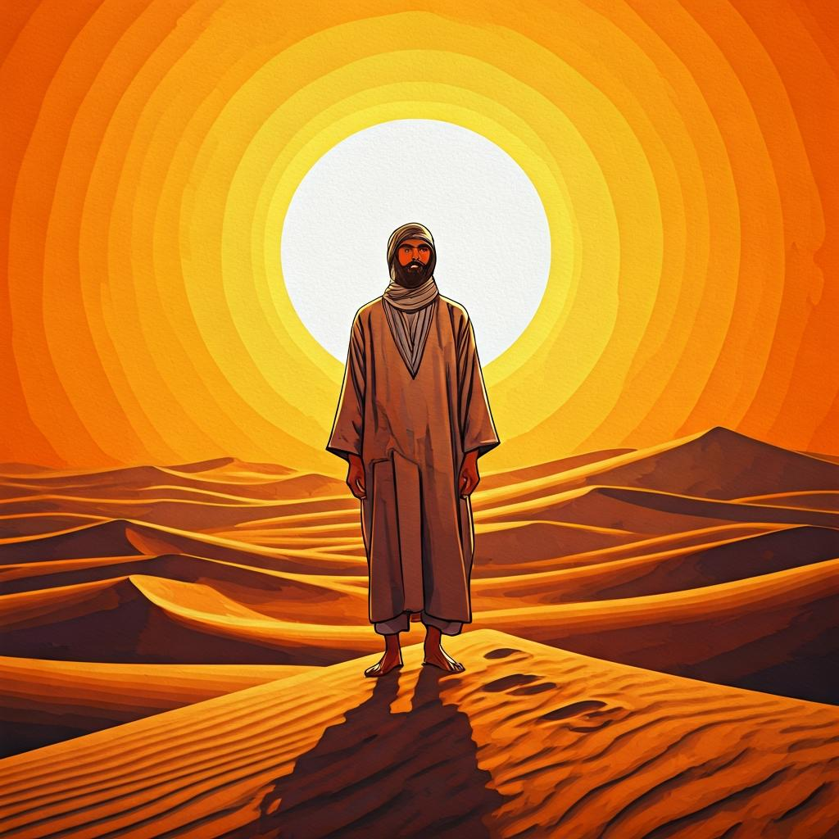
Fellowship time
Thank you, Leonie for leading Fellowship
Please feel welcome to linger or pop a message in the chat and head off when you are ready.​
Celebrate Birthdays & Anniversaries
Extra resources developed
by Roots on the Web
Artwork by Padlet

