Slide 1

Mercy Revealed
Michael Christie

Slide 2


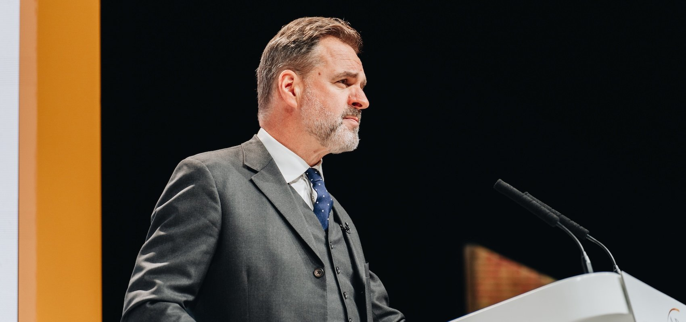
https://firstthings.com/the-great-christian-reset/

Slide 3
I have a view that we’re probably in the very early phase of a Christian revival, and this reawakening will be an antidote to the great ‘awokening’ that has caused so much harm.
- NIALL FERGUSON

Slide 4
In the midst of the squalor, misery, illness, and anonymity of ancient cities, Christianity provided an island of mercy and security. It started with Jesus.
- RODNEY STARK
The Triumph of Christianity

Slide 5
Mercy to the full range of human needs is such an essential mark of being a Christian that it can be used as a test of true faith. Mercy is not optional or an addition to being a Christian. Rather, a life poured out in deeds of mercy is the inevitable sign of true faith.
- TIM KELLER
Ministries of Mercy

Slide 6
EXODUS 33:15-23
¹⁵ Then Moses said to him, “If your Presence does not go with us, do not send us up from here. ¹⁶ How will anyone know that you are pleased with me and with your people unless you go with us? What else will distinguish me and your people from all the other people on the face of the earth?”

Slide 7
¹⁷ And the Lord said to Moses, “I will do the very thing you have asked, because I am pleased with you and I know you by name.” ¹⁸ Then Moses said, “Now show me your glory.” ¹⁹ And the Lord said, “I will cause all my goodness to pass in front of you, and I will proclaim my name, the Lord, in your presence. I will have mercy on whom I will have mercy, and I will have compassion on whom I will have compassion.

Slide 8
²⁰ But,” he said, “you cannot see my face, for no one may see me and live.” ²¹ Then the Lord said, “There is a place near me where you may stand on a rock. ²² When my glory passes by, I will put you in a cleft in the rock and cover you with my hand until I have passed by. ²³ Then I will remove my hand and you will see my back; but my face must not be seen.”

Slide 9
EXODUS 34:5-8
⁵ Then the Lord came down in the cloud and stood there with him and proclaimed his name, the Lord. ⁶ And he passed in front of Moses, proclaiming, “The Lord, the Lord, the compassionate [merciful] and gracious God, slow to anger, abounding in love and faithfulness, ⁷ maintaining love to thousands, and forgiving wickedness, rebellion and sin.

Slide 10
Yet he does not leave the guilty unpunished; he punishes the children and their children for the sin of the parents to the third and fourth generation.” ⁸ Moses bowed to the ground at once and worshiped.

Slide 11


Slide 12
A Request
Moses said, “Now show me your glory.” And the Lord said, “I will cause all my goodness to pass in front of you, and I will proclaim my name, the Lord, in your presence. I will have mercy on whom I will have mercy, and I will have compassion on whom I will have compassion.
- EXODUS 33:18-19

Slide 13
We may have been Christians for many years, but have we ever really longed for some person, direct knowledge and experience of God? Oh, I know, we pray for causes, we pray for the Church, we pray for missionaries, we pray for our own efforts that we organize, yes, but that is not what I am concerned about. We all ask for personal blessings, but how much do we know of this desire for God himself?
- DR. MARTIN LLOYD-JONES

Slide 14
I want to know Christ… Not that I have already obtained all this, or have already arrived at my goal, but I press on to take hold of that for which Christ Jesus took hold of me… Forgetting what is behind and straining toward what is ahead, I press on toward the goal to win the prize for which God has called me heavenward in Christ Jesus. All of us, then, who are mature should take such a view of things.
- PHILIPPIANS 3:10, 12-15

Slide 15
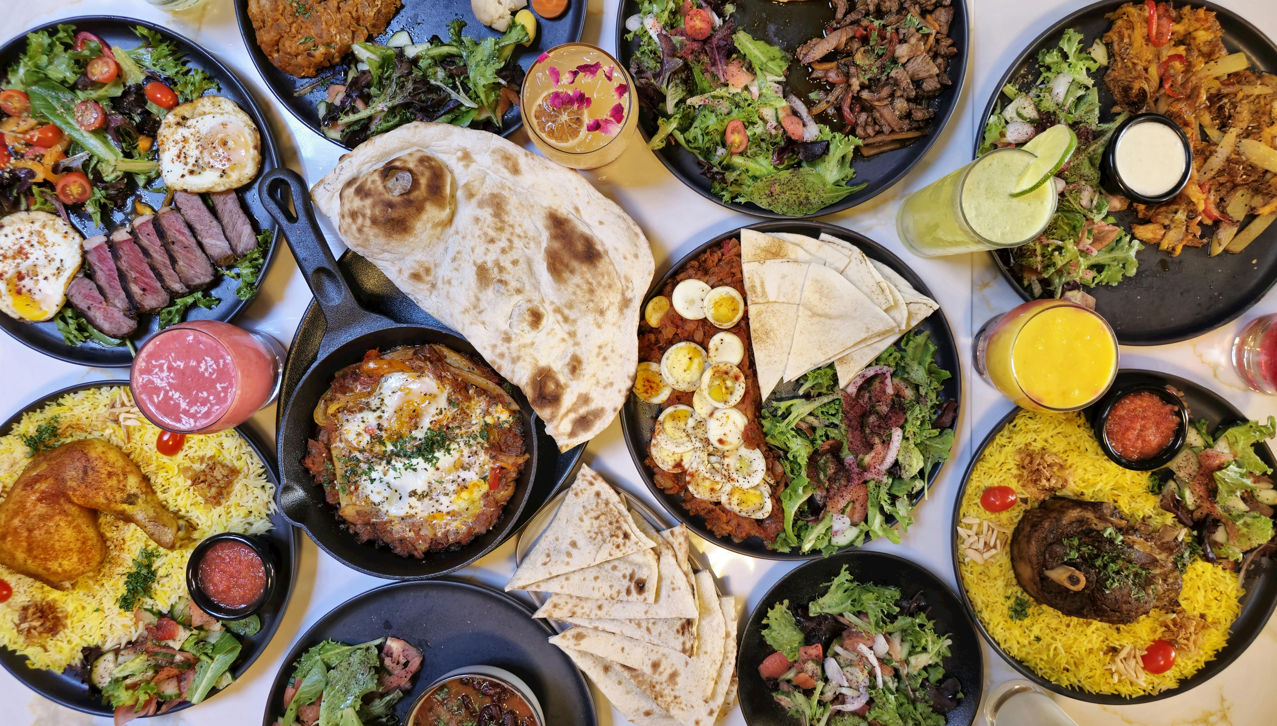
Psalm 34:8: Taste and see that the LORD is good.

Slide 16
Come near to the holy men and women of the past, and you will soon feel the heat of their desire after God. They mourned for Him, they prayed and wrestled and sought for Him day and night, in season and out, and when they had found Him, the finding was all the sweeter for the long seeking. Moses used the fact that he knew God as an argument for knowing Him better… he rose to make the daring request, "I beseech thee, show me thy glory”.
A.W. TOZER
The Pursuit of God

Slide 17
His Revelation
He passed in front of Moses, proclaiming, “The Lord, the Lord, the compassionate [merciful] and gracious God, slow to anger, abounding in love and faithfulness, maintaining love to thousands, and forgiving wickedness, rebellion and sin.
- EXODUS 34:6-7

Slide 18
Rachum: Merciful, compassionate
The stirring of tender mercy within God’s own being. The word conveys the warmth of parental compassion, a mercy that is neither detached nor reluctant but eager to relieve misery and restore fellowship.
- STRONG’S HEBREW

Slide 19
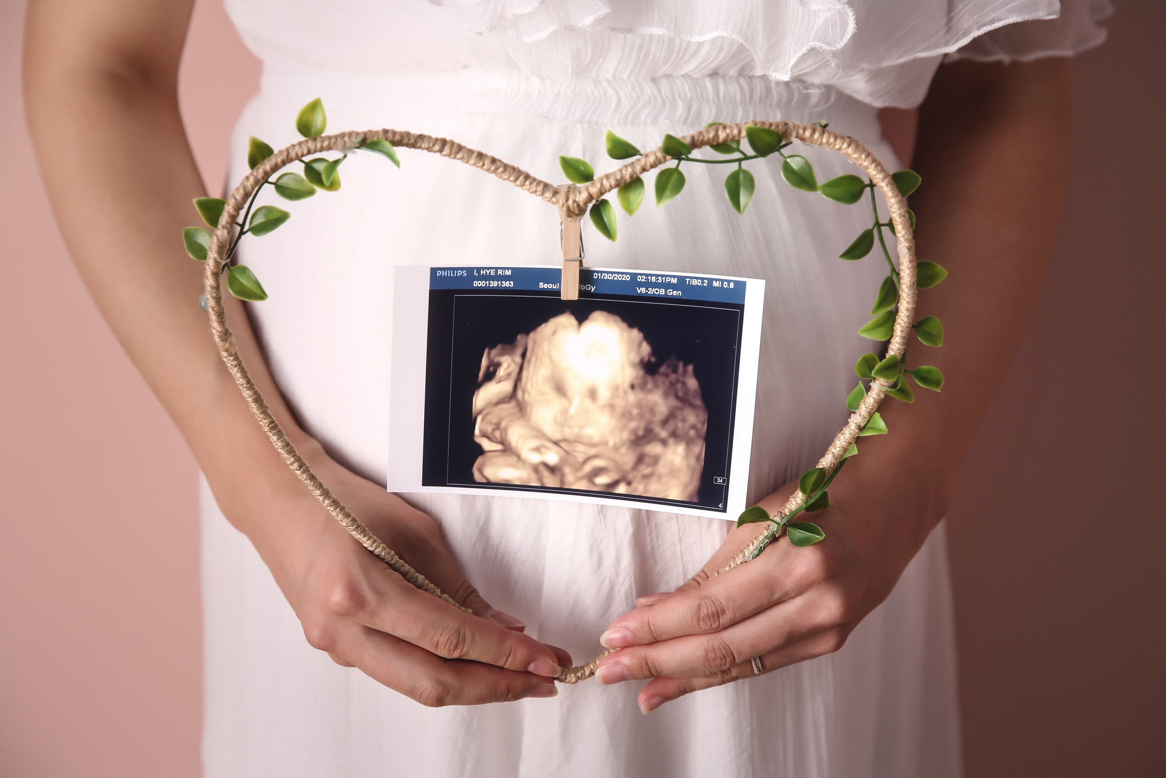

Slide 20
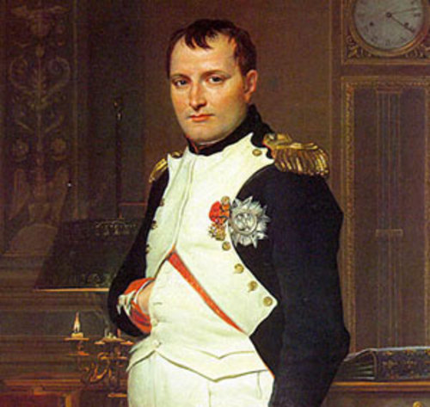

Slide 21
But when the kindness and love of God our Savior appeared, he saved us, not because of righteous things we had done, but because of his mercy. He saved us through the washing of rebirth and renewal by the Holy Spirit, whom he poured out on us generously through Jesus Christ our Savior.
- TITUS 3:4-6

Slide 22
The steadfast love of the LORD never ceases; his mercies never come to an end; they are new every morning.
- LAMENTATIONS 3:22-23 (ESV)

Slide 23
Our Response
Moses bowed to the ground at once and worshiped.
- EXODUS 34:8-9

Slide 24
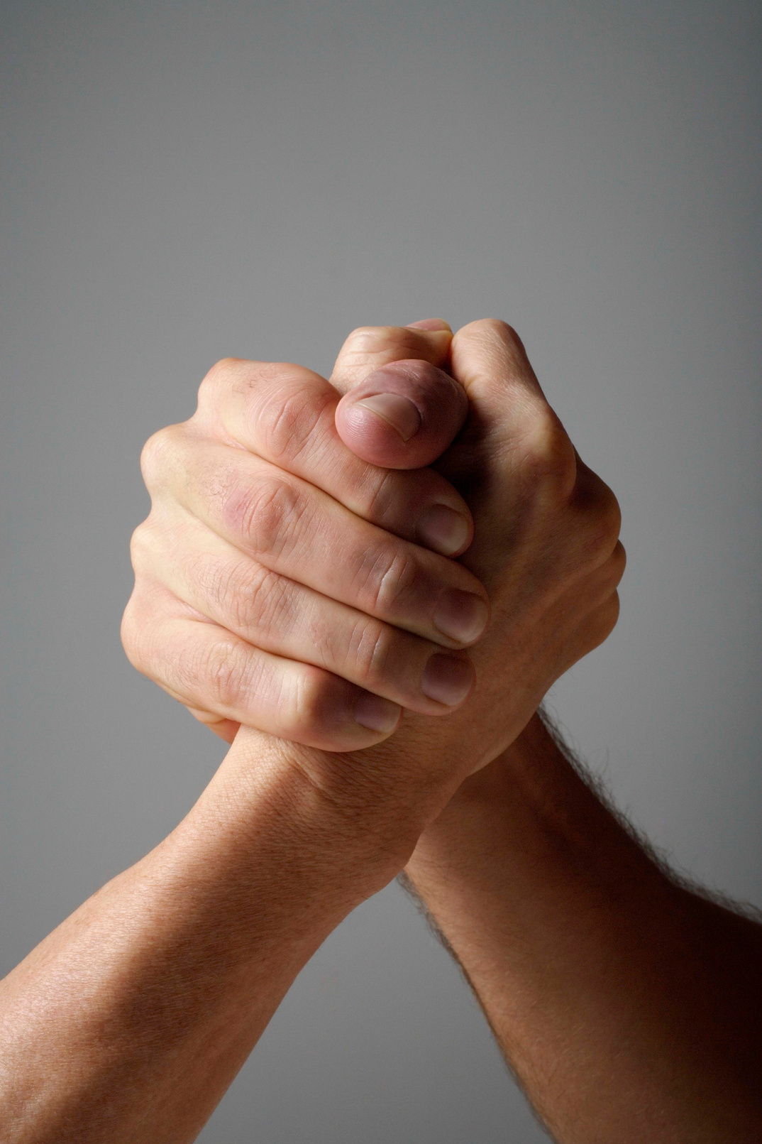

Slide 25
Therefore, God exalted him to the highest place and gave him the name that is above every name, that at the name of Jesus every knee should bow, in heaven and on earth and under the earth, and every tongue acknowledge that Jesus Christ is Lord.
- PHILIPPIANS 2:9-11

Slide 26


Slide 27
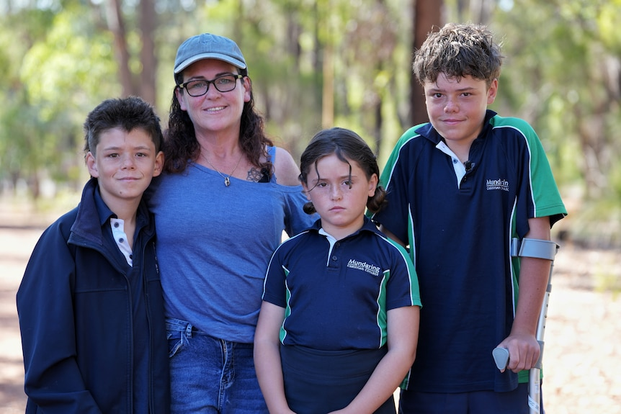
Austin (right) raised the alarm after he and his brother Beau, mother Joanne and sister Grace (left to right) were swept out to sea. (ABC News: Briana Shepherd); https://www.abc.net.au/news/2026-02-07/austin-appelbee-quindalup-rescue-global-phenomenon/106306482

Slide 28

Prayer & Worship Night
6:30pm on Friday, 13 March

