Slide 1
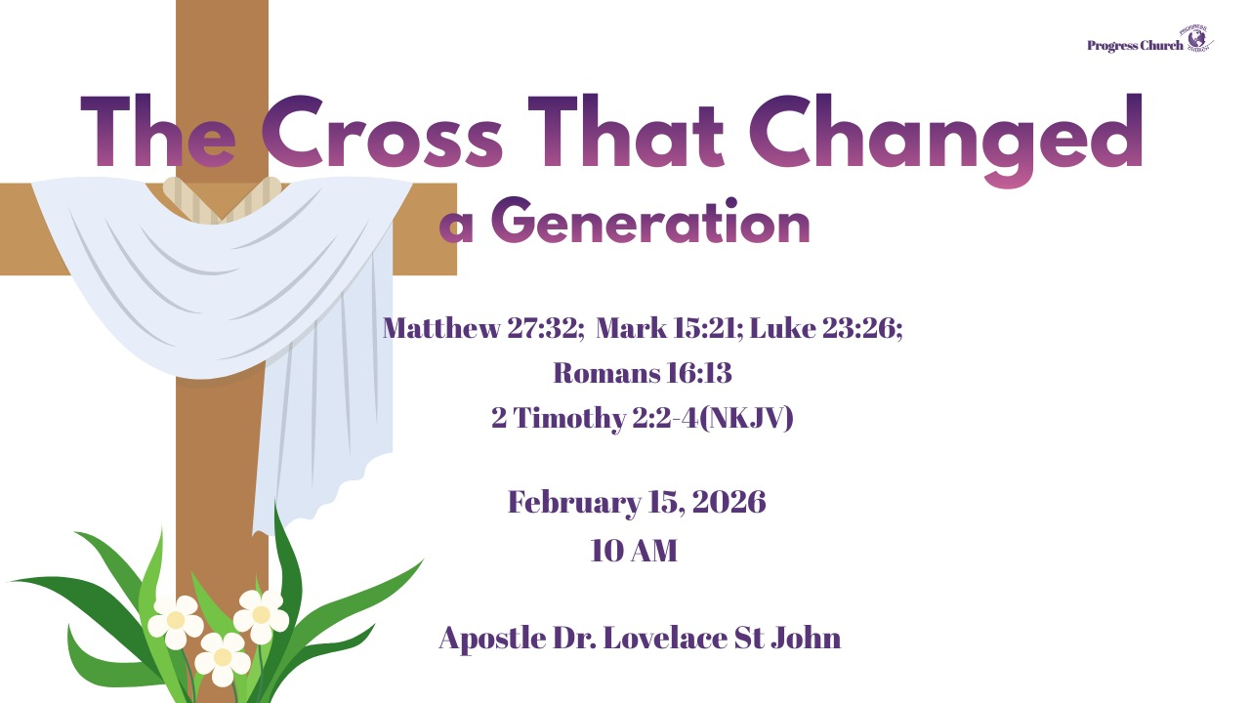

Slide 2



Scripture:
Matthew 27:32
Mark 15:21
Luke 23:26
Romans 16:13

Slide 3
INTRODUCTION
God can use unexpected, inconvenient, even painful interruptions to move people.
Some of life’s most transformative moments sneak up on us unannounced.
Pain rarely asks permission.
Misfortune never schedules an appointment.
Hard seasons do not consult our calendar.
One moment everything is normal, and the next moment you are carrying something you never asked for.

Slide 4
1. GOD’S WORK BEYOND THE SPOTLIGHT.
The Gospel story is not only shaped by apostles and miracles, but by unnamed, interrupted, ordinary people.
Simon was a man on the margins, a, likely black, African visiting for the Passover. He was coming "in from the country," perhaps just arriving from North Africa, minding his own business. To the Roman soldiers, he was simply a convenient tool. To the crowd, he was insignificant. He was a bystander.

Slide 5
1. GOD’S WORK BEYOND THE SPOTLIGHT (con’t)
But on that day, God took a man from the margins of life and thrust him into the very center of human history.
He came to worship.
He did not come to suffer.
He did not come to be noticed.
He certainly did not come to carry a cross.
But heaven had other plans.

Slide 6
GOD’S WORK BEYOND THE SPOTLIGHT (cont’d)
Matthew 27:32 — “As they were going out, they found a man of Cyrene named Simon; they compelled him to carry his cross.”
They compelled him. He did not volunteer. He was forced.
What looked like a Roman interruption was a divine appointment.
What looks like an injustice and unfair was a divine setup.

Slide 7
GOD’S WORK BEYOND THE SPOTLIGHT (con’t)
Matthew 27:32 — “As they were going out, they found a man of Cyrene named Simon; they compelled him to carry his cross.”
Mark 15:21 — notes Simon is “the father of Alexander and Rufus”
Luke 23:26 — says they “laid on him the cross to carry behind Jesus.”

Slide 8
2. WHAT LOOKS LIKE MISFORTUNE MAY BE POSITIONING
Luke 23:26 “Now as they led Him away, they laid hold of a certain man, Simon a Cyrenian, who was coming from the country, and on him they laid the cross that he might bear it after Jesus.”
The phrase.
After Jesus.
Simon walked directly behind Christ.
He was close enough to see the blood.

Slide 9
2. WHAT LOOKS LIKE MISFORTUNE MAY BE POSITIONING
The phrase (cont)
Close enough to hear the labored breathing.
Close enough to witness the suffering, Savior.
Pain moved him from the crowd into proximity.
He was no longer a spectator.
He was walking in the footsteps of the Messiah.

Slide 10
3. FOLLOWING BEHIND
Luke 23:26- “Now as they led Him away, they laid hold of a certain man, Simon a Cyrenian, who was coming from the country, and on him they laid the cross that he might bear it after Jesus.”
A. Submitting to the Burden: Simon did not struggle; he submitted to the compulsion. Sometimes, coming out of the margins means accepting the reality of our struggle and asking, "Lord, how can I carry this with you?"

Slide 11
3. FOLLOWING BEHIND (con’t)
B. Seeing the Savior: In that moment, Simon’s eyes were on Jesus. He was not just carrying a piece of wood; he was supporting the Savior in his lowest moment.
C. The Power of Presence: Sometimes we cannot fix our circumstances. We cannot remove the cross. But we can, like Simon, offer our presence, our endurance, and in doing so, find that Christ is walking with us, not just ahead of us.

Slide 12
4. THE LEGACY OF AN INTERRUPTED MAN
Mark 15:21 – “Then they compelled a certain man, Simon a Cyrenian, the father of Alexander and Rufus, as he was coming out of the country and passing by, to bear His cross.”
They were known in the early church
Simon’s encounter transformed his household
Romans 16:13 – “Greet Rufus, chosen in the Lord, and his mother and mine.”

Slide 13
4. THE LEGACY OF AN INTERRUPTED MAN (con’t)
A moment of obedience can create a generational testimony.
From Forced Labor to Faith Lineage
Simon started as, a compelled carrier; he became a remembered father
God uses what you never planned to shape what you will become.

Slide 14
5. THE CROSS HE CARRIED SHAPED HIS DESTINY
Mark 15:21- “Then they compelled a certain man, Simon a Cyrenian, the father of Alexander and Rufus, as he was coming out of the country and passing by, to bear His cross.”
This moment did not end at Calvary. It entered his household. It changed his family.
The cross that Simon carried affected the next generation.
Because he carried the cross, his sons carried the faith.

Slide 15
5. THE CROSS HE CARRIED SHAPED HIS DESTINY (Con’t)
Because he carried the cross, his sons carried the faith.
Your response to hardship is writing your family’s spiritual future.
Your children are watching how you handle pressure.
Your generation is learning from your endurance.
The cross you carry today may become the testimony your children stand on tomorrow.

Slide 16
6. PAIN CAN EITHER HARDEN YOU OR SHAPE YOU
Simon had a choice. He could not control the soldiers. But he could control his spirit.
Pain will either make you bitter, or it will make you better.
Romans 8:28 declares: “All things work together for good to them that love God.”

Slide 17
6. PAIN CAN EITHER HARDEN YOU OR SHAPE YOU (cont’d)
All things.
The betrayal. The loss. The misunderstanding. The humiliation. The delay. The heavy cross.
God does not waste weight.
2 Corinthians 4:17 says: “For our light affliction, which is but for a moment, worketh for us a far more exceeding and eternal weight of glory.”
Weight, produces glory. The cross was heavy. But the glory was heavier.

Slide 18
7. WHY WE MUST EMBRACE THE HARD SEASON
James 1:2–4 tells us: “Count it all joy… knowing that the trying of your faith worketh patience.”
Joy is not pretending it doesn’t hurt. Joy is recognizing that it is working.
Working patience. Working character. Working endurance. Working destiny.
If Simon had not carried that cross, he might have remained anonymous.

Slide 19
7. WHY WE MUST EMBRACE THE HARD SEASON (con’t)
But hardship pulled him into history. Hardship turned him from a bystander into a participant in redemption.
Sometimes the very thing you are praying away is the very thing preparing you.
Sometimes the interruption is actually an introduction.
An introduction to deeper faith.
An introduction to greater calling.
An introduction to generational impact.

Slide 20
8. FROM MARGIN TO MISSION
Simon started on the margins.
A foreigner. A visitor. A passerby. But the cross moved him to mission.
He did not preach a sermon. He did not write a book.
He carried a burden. And that burden changed his destiny.
The hardship you are carrying is not evidence that God has abandoned you.

Slide 21
8. FROM MARGIN TO MISSION (con’t)
It may be evidence that He has selected you.
Selected you to grow.
Selected you to mature.
Selected you to shape a generation.
Selected you to walk after Jesus.

Slide 22
9. THE GREATER IS ON THE OTHER SIDE
The cross he did not choose became the catalyst for something greater.
And because he carried it, his sons became known in the Lord.
What cross, are you resisting?
What weight have you been resenting?

Slide 23
9. THE GREATER IS ON THE OTHER SIDE (con’t)
What if this is not your destruction?
What if this is your preparation?
What if this is the shaping of your destiny?
What if this is the making of your generation?

Slide 24
CONCLUSION
The cross is heavy.
But it is not pointless.
It is producing something.
It is positioning you.
It is deepening you.
It is aligning you with Christ.
And on the other side of this season is something greater.

