Slide 1
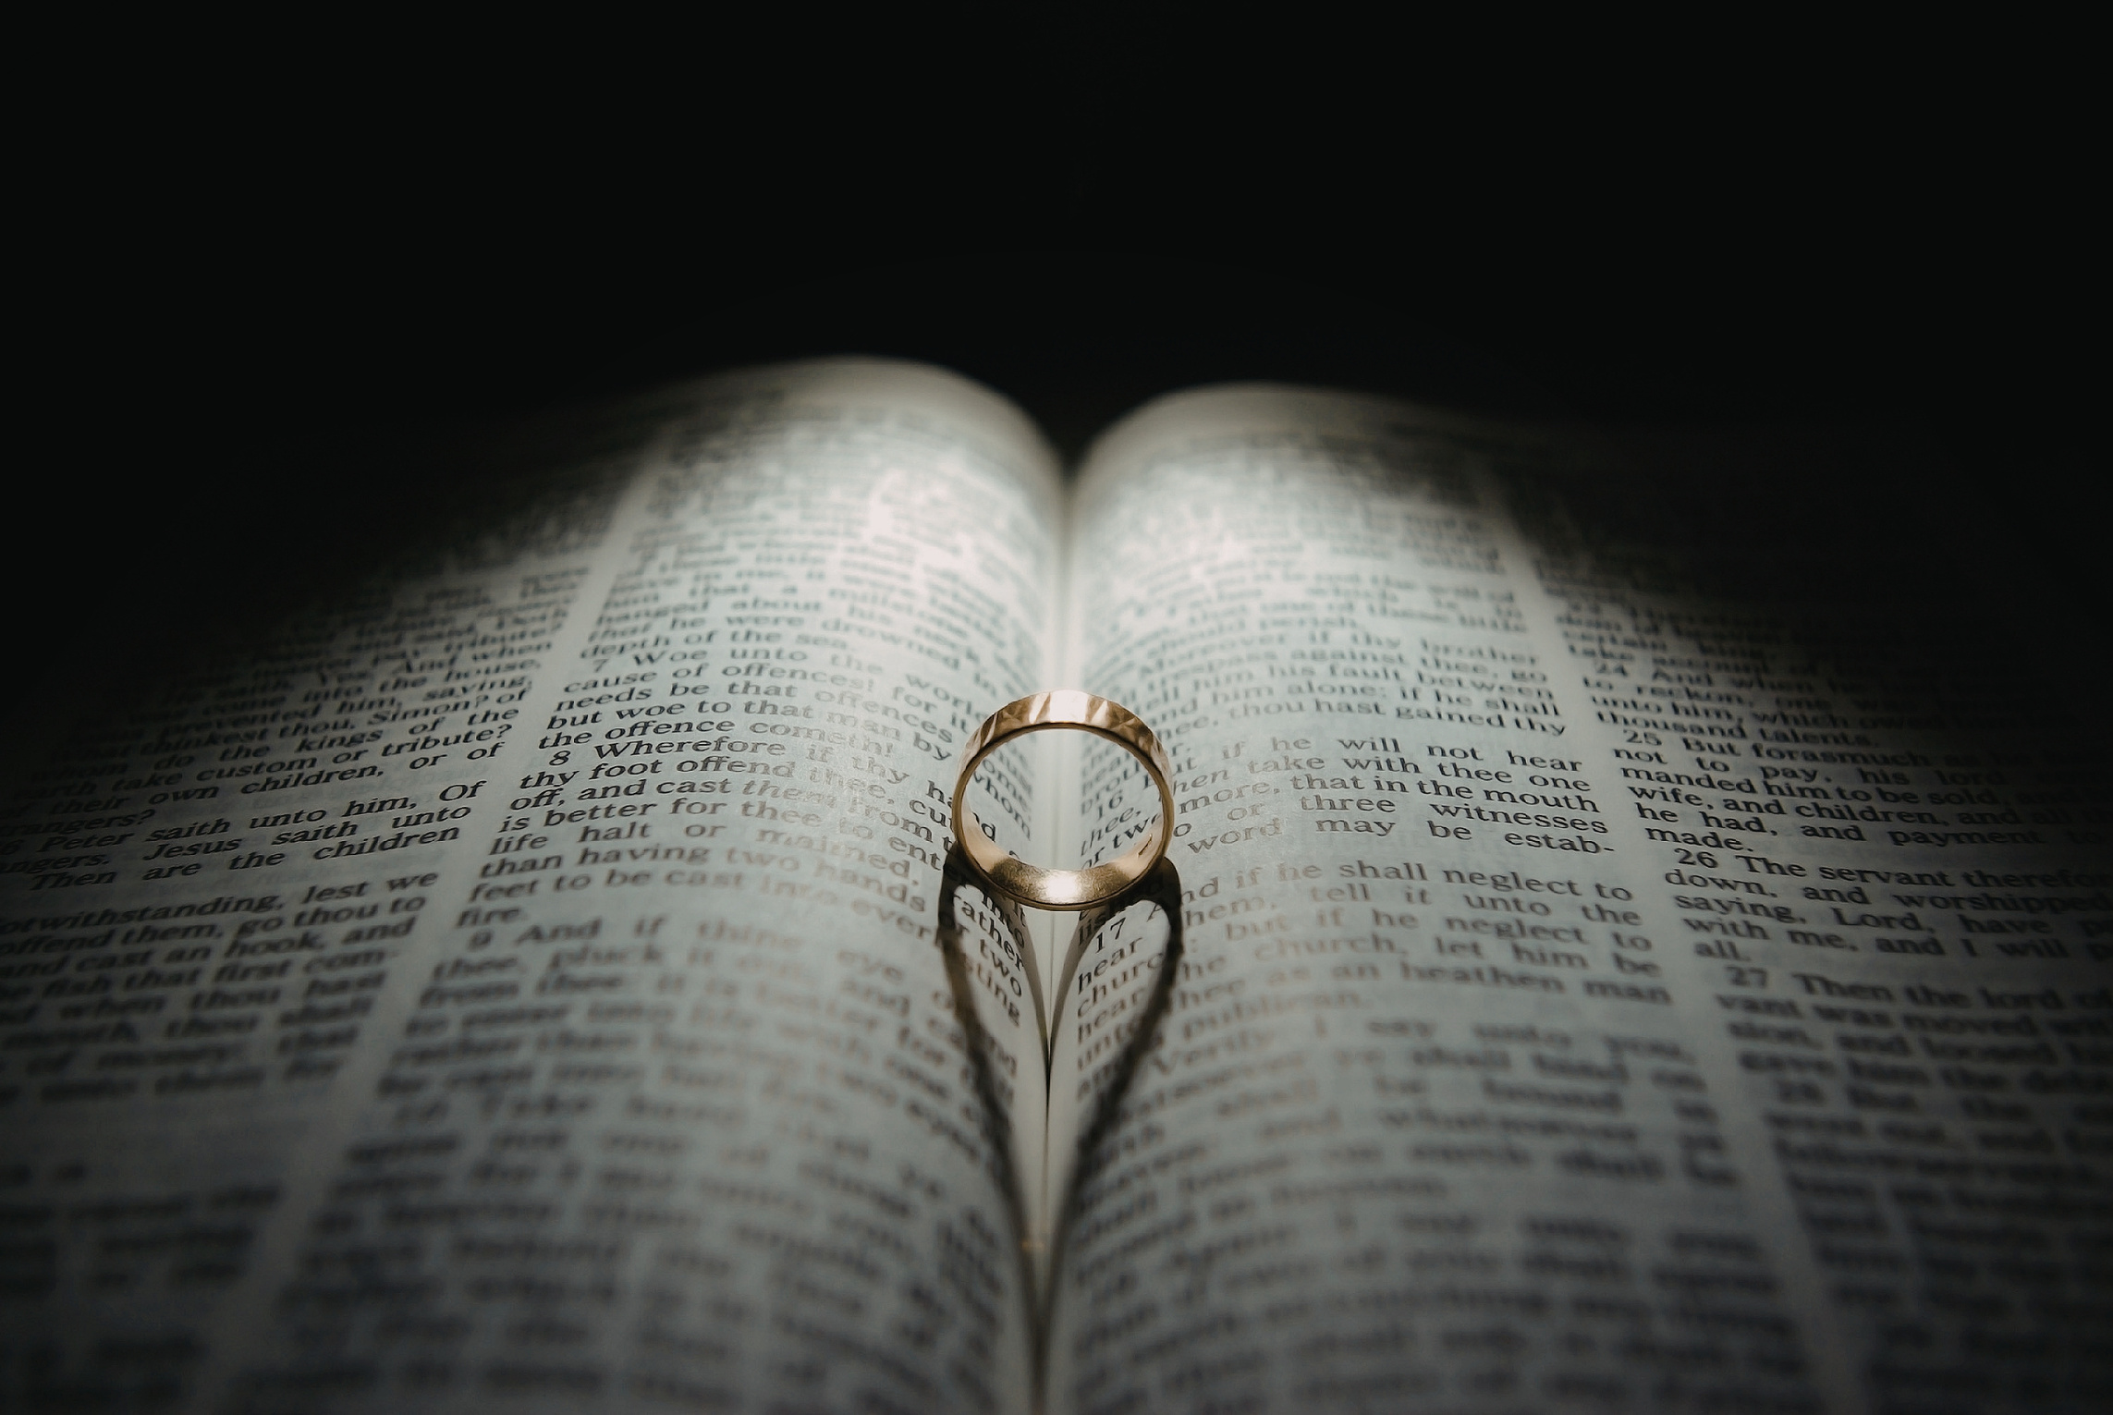

Slide 2
Bride of Christ

Slide 3
Husbands, love your wives, just as Christ loved the church and gave himself up for her to make her holy, cleansing her by the washing with water through the word, and to present her to himself as a radiant church, without stain or wrinkle or any other blemish, but holy and blameless.
Ephesians 5:25-27

Slide 4
This mystery is profound, and I am saying that it refers to Christ and the church.
Ephesians 5:32

Slide 5
First Stage:
The Pursuit

Slide 6
For He chose us in Him before the creation of the world to be holy and blameless in his sight.
Ephesians 1:4

Slide 7
...for you were bought with a price. Therefore, honour God with your bodies.
1 Corinthians 6:20

Slide 8
Excruciating / Ex cruciatus (Latin)
‘Out of the cross’ or ‘from the cross’

Slide 9
Let the Cross stand as the loudest and final declaration of your worth.

Slide 10
Second Stage:
The Promise

Slide 11
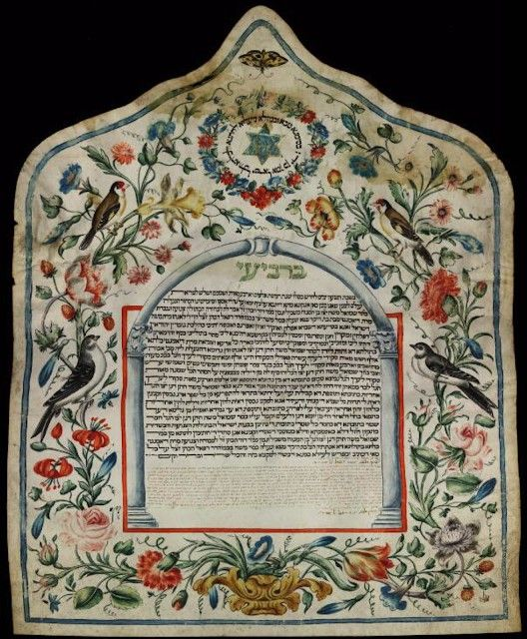
300-year-old
Decorated Ketubah
Source: Library of Congress - African and Middle Eastern Division.

Slide 12
Now it is God who makes both us and you stand firm in Christ. He anointed us, set his seal of ownership on us, and put his Spirit in our hearts as a deposit, guaranteeing what is to come.
2 Corinthians 1:21-22

Slide 13
Kiddushin (קִדוּשִׁין)
Set Apart

Slide 14
In the same way, after the supper he took the cup, saying, “This cup is the new covenant in my blood, which is poured out for you
Luke 22:20

Slide 15
Third Stage:
The Preparation

Slide 16
My Father’s house has many rooms; if that were not so, would I have told you that I am going there to prepare a place for you? And if I go and prepare a place for you, I will come back and take you to be with me that you also may be where I am.
John 14:2-3

Slide 17
But about that day or hour no one knows, not even the angels in heaven, nor the Son, but only the Father.
Matthew 24:36

Slide 18
What do we do while we wait?
  Keep the lamp burning
  Keep the door open

Slide 19
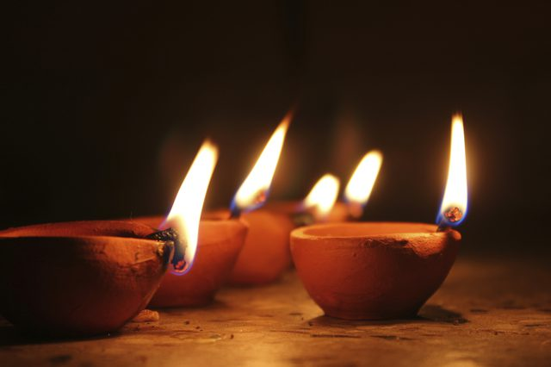
Parable of the Ten Virgins
Matthew 25:1-3

Slide 20
You can be near the activity of faith and still be far from the heart of God.

Slide 21
The Spirit and the bride say, “Come!” And let the one who hears say, “Come!” Let the one who is thirsty come; and let the one who wishes take the free gift of the water of life.
Revelation 22:17

Slide 22
