Slide 1

Befriended by the King
Michael Christie

Slide 2

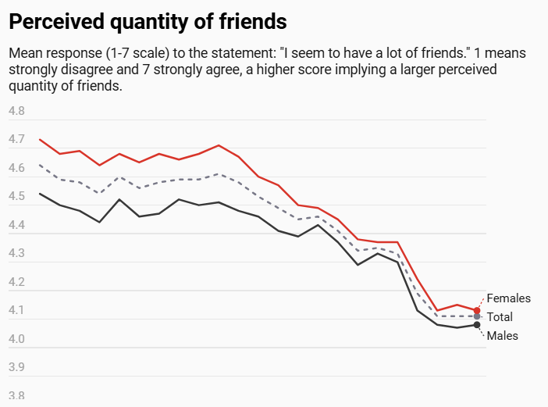
Credit: The Household, Income and Labour Dynamics in Australia (HILDA) Survey; https://findanexpert.unimelb.edu.au/news/131852-fewer-friends--more-time-stress--the-essential-charts-from-this-year%E2%80%99s-hilda-survey

Slide 3


Slide 4
There’s always been an issue once you start to hit this age range. We start to lose institutions where we used to build communities, such as places of worship, colleges, offices, schools … Once you leave your 20s, it sort of feels like a social purgatory.
Jermaine Ijieh, GroundFloor
The Guardian

Slide 5
2 SAMUEL 9:1-13
¹ David asked, “Is there anyone still left of the house of Saul to whom I can show kindness for Jonathan’s sake?” ² Now there was a servant of Saul’s household named Ziba. They summoned him to appear before David, and the king said to him, “Are you Ziba?” “At your service,” he replied.

Slide 6
³ The king asked, “Is there no one still alive from the house of Saul to whom I can show God’s kindness?” Ziba answered the king, “There is still a son of Jonathan; he is lame in both feet.”
⁴ “Where is he?” the king asked. Ziba answered, “He is at the house of Makir son of Ammiel in Lo Debar.” ⁵ So King David had him brought from Lo Debar, from the house of Makir son of Ammiel.

Slide 7
⁶ When Mephibosheth son of Jonathan, the son of Saul, came to David, he bowed down to pay him honor. David said, “Mephibosheth!” “At your service,” he replied.
⁷ “Don’t be afraid,” David said to him, “for I will surely show you kindness for the sake of your father Jonathan. I will restore to you all the land that belonged to your grandfather Saul, and you will always eat at my table.”

Slide 8
⁸ Mephibosheth bowed down and said, “What is your servant, that you should notice a dead dog like me?”
⁹ Then the king summoned Ziba, Saul’s steward, and said to him, “I have given your master’s grandson everything that belonged to Saul and his family.

Slide 9
¹⁰ You and your sons and your servants are to farm the land for him and bring in the crops, so that your master’s grandson may be provided for.
And Mephibosheth, grandson of your master, will always eat at my table.” (Now Ziba had fifteen sons and twenty servants.)

Slide 10
¹¹ Then Ziba said to the king, “Your servant will do whatever my lord the king commands his servant to do.” So Mephibosheth ate at David’s table like one of the king’s sons. ¹² Mephibosheth had a young son named Mika, and all the members of Ziba’s household were servants of Mephibosheth. ¹³ And Mephibosheth lived in Jerusalem, because he always ate at the king’s table; he was lame in both feet.

Slide 11
The Pursuit of Friendship
David asked, “Is there anyone still left of the house of Saul to whom I can show kindness for Jonathan’s sake?” … Ziba answered the king, “There is still a son of Jonathan; he is lame in both feet.” “Where is he?” the king asked. Ziba answered, “He is at the house of Makir son of Ammiel in Lo Debar.” So King David had him brought from Lo Debar…
- 2 SAMUEL 9:1-5

Slide 12
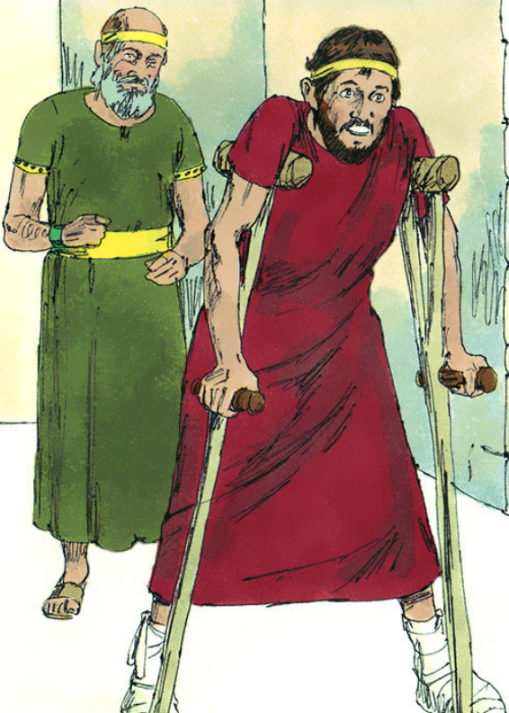

Slide 13
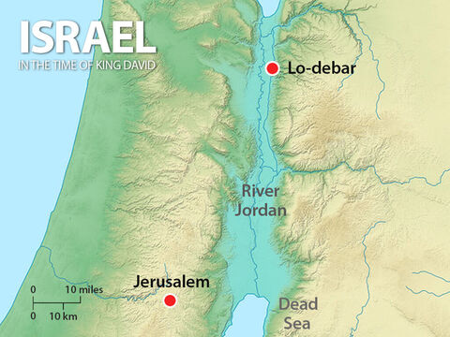

Slide 14
The true light that gives light to everyone was coming into the world. He was in the world, and though the world was made through him, the world did not recognize him. He came to that which was his own, but his own did not receive him. Yet to all who did receive him, to those who believed in his name, he gave the right to become children of God.
- JOHN 1:9-12

Slide 15
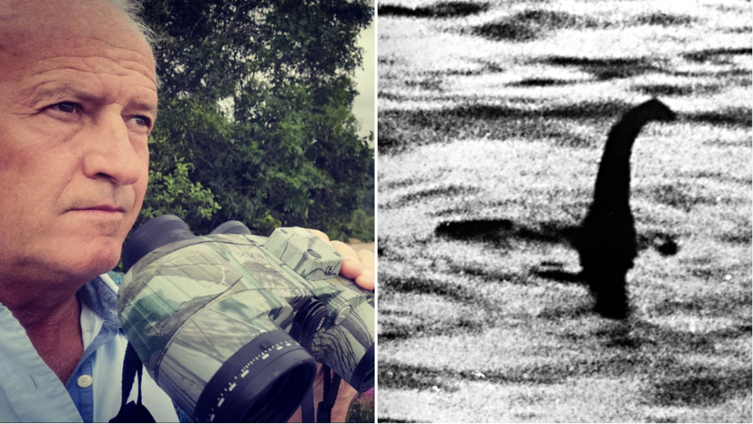
https://www.guinnessworldrecords.com/news/2023/10/why-this-man-has-spent-three-decades-of-his-life-searching-for-the-loch-ness-mons-759688

Slide 16
The Posture of Friendship
When Mephibosheth son of Jonathan, the son of Saul, came to David, he bowed down to pay him honor. David said, “Mephibosheth!” “At your service,” he replied. “Don’t be afraid,” David said to him, “for I will surely show you kindness for the sake of your father Jonathan. I will restore to you all the land that belonged to your grandfather Saul, and you will always eat at my table.”
- 2 SAMUEL 9:6-7

Slide 17
And he passed in front of Moses, proclaiming, “The Lord, the Lord, the compassionate and gracious God, slow to anger, abounding in love [Hb. hesed] and faithfulness.
- EXODUS 34:6

Slide 18
God raised us up with Christ and seated us with him in the heavenly realms in Christ Jesus, in order that in the coming ages he might show the incomparable riches of his grace, expressed in his kindness to us in Christ Jesus.
- EPHESIANS 2:6-7

Slide 19
In love he predestined us for adoption to sonship through Jesus Christ, in accordance with his pleasure and will— to the praise of his glorious grace, which he has freely given us in the One he loves.
- EPHESIANS 1:5-6

Slide 20
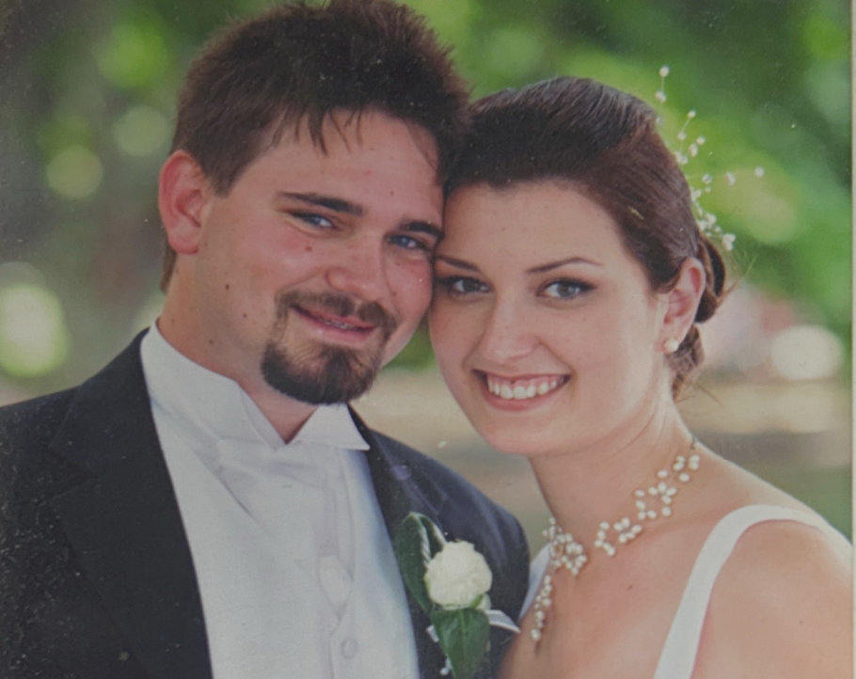

Slide 21
The Position & Provision of Friendship
“I will restore to you all the land that belonged to your grandfather Saul, and you will always eat at my table.” … Mephibosheth ate at David’s table like one of the king’s sons. ... And Mephibosheth lived in Jerusalem, because he always ate at the king’s table; he was lame in both feet.
- 2 SAMUEL 9:8, 11-13

Slide 22
Here I am! I stand at the door and knock. If anyone hears my voice and opens the door, I will come in and eat with that person, and they with me.
- REVELATION 3:20

Slide 23
[Jesus] died for us so that, whether we are awake or asleep, we may live together with him. Therefore encourage one another and build each other up, just as in fact you are doing.
- 1 THESSALONIANS 5:10-11

Slide 24


Slide 25
[I often] bluster and yell on behalf of God’s holy presence, instead of taking off my shoes myself, kneeling on holy ground, and inviting whoever happens to be around to join with me.
EUGENE PETERSEN
Subversive Spirituality

