Slide 1
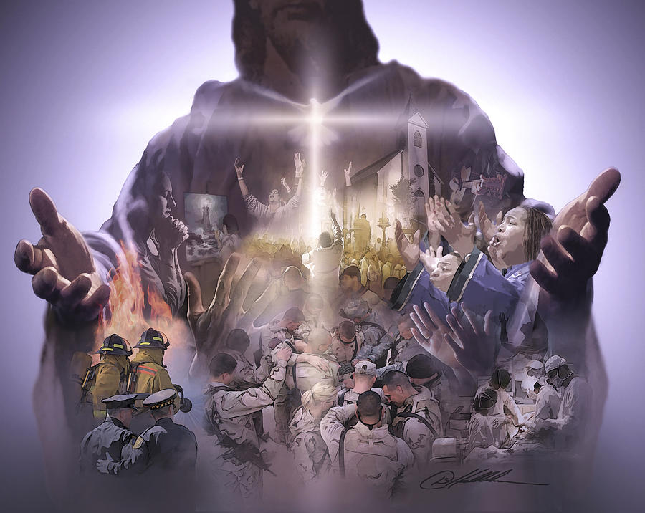

The Church: The Body Of Christ

Slide 2

The Church Is A Divine Mystery Now Revealed
(Ephesians 3:1–12)

Slide 3
In reading this, then, you will be able to understand my insight into the mystery of Christ, ⁵ which was not made known to people in other generations as it has now been revealed by the Spirit to God’s holy apostles and prophets. ⁶ This mystery is that through the gospel the Gentiles are heirs together with Israel, members together of one body, and sharers together in the promise in Christ Jesus. Ephesians 3:4-12 NIV

Slide 4
1st Truth About The Church:
CHRIST IS THE HEAD
Our Source, Authority, and Direction

Slide 5
For the husband is the head of the wife even as Christ is the head of the church, his body, and is himself its Savior.
Ephesians 5:23 esv
" And he is the head of the body, the church. He is the beginning, the firstborn from the dead, that in everything he might be preeminent.” Colossians 1:18 esv

Slide 6
Now you are the body of Christ and individually members of it.
1 Corinthians 12:27 esv
so we, though many, are one body in Christ, and individually members one of another.
Romans 12:5 esv

Slide 7
For in him the whole fullness of deity dwells bodily, ¹⁰ and you have been filled in him, who is the head of all rule and authority.
Colossians 2:9-10 esv
And he put all things under his feet and gave him as head over all things to the church, ²³ which is his body, the fullness of him who fills all in all. Ephesians 1:22-23 esv

Slide 8
CHIRST THE HEAD OF THE CHURCH
The church does not exist for itself.
Christ love the Body
Christ gives life to the Body
Christ provides direction for the Body
Christ holds authority over the Body
Spiritual maturity begins with submission to Christ, not activity for Christ.

Slide 9
2nd Truth About The Church:
UNITY IN DIVERSITY
Every Member is Connected and Necessary. - No One Is Optional

Slide 10
One Body with Many Members
For just as the body is one and has many members, and all the members of the body, though many, are one body, so it is with Christ. ¹³ For in one Spirit we were all baptized into one body—Jews or Greeks, slaves or free—and all were made to drink of one Spirit.
1 Corinthians 12:12-13 esv
But as it is, God arranged the members in the body, each one of them, as he chose.
1 Corinthians 12:18 esv

Slide 11
“The eye cannot say to the hand, “I have no need of you,” nor again the head to the feet, “I have no need of you.” ²² On the contrary, the parts of the body that seem to be weaker are indispensable, ²³ and on those parts of the body that we think less honorable we bestow the greater honor, and our unpresentable parts are treated with greater modesty,”
1 Corinthians 12:21-23 ESV

Slide 12
For just as each of us has one body with many members, and these members do not all have the same function, ⁵ so in Christ we, though many, form one body, and each member belongs to all the others. ⁶ We have different gifts, according to the grace given to each of us. If your gift is prophesying, then prophesy in accordance with your faith; ⁷ if it is serving, then serve; if it is teaching, then teach; ⁸ if it is to encourage, then give encouragement; if it is giving, then give generously; if it is to lead, do it diligently; if it is to show mercy, do it cheerfully.
Romans 12:4-8 niv

Slide 13
CH _ _ CH
What’s missing?
U R

Slide 14

3rd Truth About The Church:
Love Is the Environment Where the Body Grows to Maturity

Slide 15
Rather, speaking the truth in love, we are to grow up in every way into him who is the head, into Christ, ¹⁶ from whom the whole body, joined and held together by every joint with which it is equipped, when each part is working properly, makes the body grow so that it builds itself up in love.
Ephesians 4:15-16 esv

Slide 16
In your relationships with one another, have the same mindset as Christ Jesus:
Philippians 2:5 niv
Do everything without grumbling or arguing, ¹⁵ so that you may become blameless and pure, “children of God without fault in a warped and crooked generation.” Then you will shine among them like stars in the sky.
Philippians 2:1-15 niv

Slide 17
Therefore if you have any encouragement from being united with Christ, if any comfort from his love, if any common sharing in the Spirit, if any tenderness and compassion, ² then make my joy complete by being like-minded, having the same love, being one in spirit and of one mind. ³ Do nothing out of selfish ambition or vain conceit. Rather, in humility value others above yourselves, ⁴ not looking to your own interests but each of you to the interests of the others. Philippians 2:1-15 niv

Slide 18
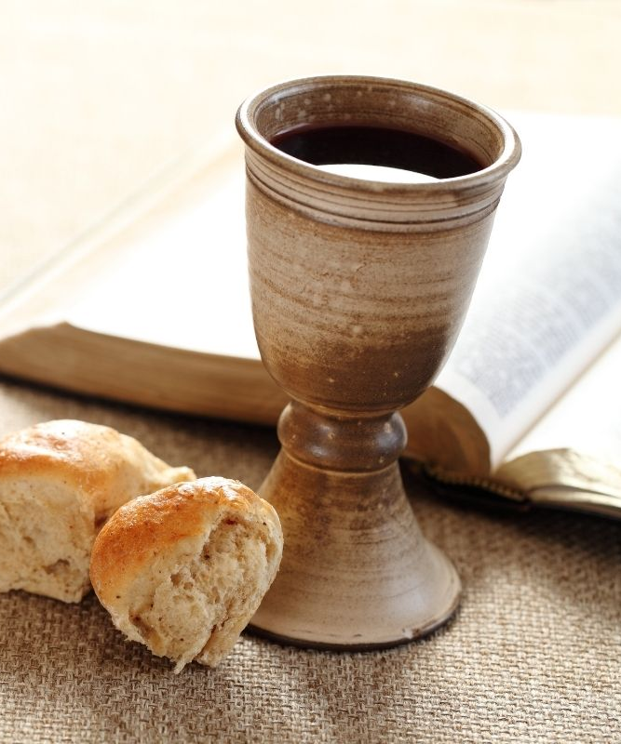
HOLY COMMUNION
Is not the cup of thanksgiving for which we give thanks a participation in the blood of Christ? And is not the bread that we break a participation in the body of Christ? ¹⁷ Because there is one loaf, we, who are many, are one body, for we all share the one loaf. 1 Corinthians 10:16-17 NIV
For whenever you eat this bread and drink this cup, you proclaim the Lord’s death until he comes.
1 Corinthians 11:26 NIV

