Slide 1
Leader: Welcome to Holy Hermits Online Worship 5th Sunday after Epiphany
Today, we remember Holy Hermit
Sister Angela of Stroud
Service Prep: Kristine | Chat Host: Rachel | First Reader: Liz
Music: Wiggles 🐶 | Welcomer: Julie | Second Reader: Margo
Proof-reader: Chris | Priest: N/A | Preacher: Flashback
Broadcaster: Kieron | Deacon: Lauren | Fellowship: Leonie
Backup Broadcaster: Lauren | Leader: Lauren | Safety Officer: Leonie
Zoom Buttons: Viki | Cantor: Jeremy | Attendance: Rachel
Prep: 01/02/2026 Proofed:01/02/2026🌸

Slide 2






Hospitality
Leader:
Please mute for the service unless invited to offer your voice as part of the service ministry
Have the video camera on or off and turn the volume and brightness up or down on your device if things are too loud 🔉🔊or too bright🔅🔆
Our Cantor acts as our voice, offering the responses, in Bold Text, which we say together
Feel welcome to use the chat and reaction emojis 👍
🙏 Please take care of yourself in this space. 🙏 Come and go as you need
😴 It is great to take rest in this space, so falling asleep is also OK 😴
👂️ Remember, pastoral care is available to all in the community, if you'd like to speak to someone about anything spiritual. ❤️ Visit the help page at the website to reach out 🌐
Our Being Together ethos and safeguarding practices can also be accessed on the website 🫶​
🙌 Come as you are – we are all here together! 🙌
Notes:
Used Lent 2022

Slide 3
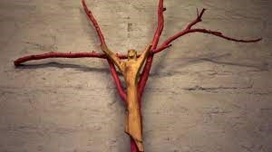
Leader: Our Holy Hermit Highlights for today – Sister Angela
Wendy Hope Solling was born in Maitland, New South Wales on March 7, 1926. She studied at East Sydney Technical College immediately after WWII, and then at Slade Art School in London, where her sculptures were well received. In 1952 she returned to Australia and held several more exhibitions of her work. Some of her works now reside in the Anglican cathedral in Newcastle, NSW.
After meeting a Franciscan priest, she returned to England to join the Anglican Community of St Clare in 1955, taking the name of
Sister Angela. In 1975, at the request of the Bishop of
Newcastle, she led the establishment of a community of
Clare Sisters at Stroud in the Diocese of Newcastle, NSW.
Continues…

Slide 4
She was the guiding force behind the construction of a group of buildings of handmade mud bricks and local timbers decorated with her sculptures, including the Monastery of the Blessed Virgin Mary and the Hermitage of the Bernadine of Siena.
Sister Angela was an unconventional leader, believing that the rules of religious “are made by men…because they are afraid we don’t know how to love…if we knew how to love fully enough, none of these rules would be required”. She made a space at Stroud to which people could retreat.
Read more about
Sister Angela
please click the link on the send out

Slide 5
Invitation
Leader: As we settle into worship let your breath be soft, your mind be still, and your heart be open to the presence of God.
Opening music:
https://www.youtube.com/watch?v=i1qQOGCyRbY

Slide 6
Leader and Cantor unmute
The Greeting
Leader:
The Grace of the lord Jesus Christ,
and the love of God,
and the fellowship of the Holy Spirit,
be with you all.
All: And also with you.

Slide 7
Gathering Prayer
Leader: Let us come to truly worship,
focusing on God.
Forgetting the daily distractions,
let us expect to hear from God.
May we be willing to respond to God’s call
wherever it may lead us.

Slide 8
Gathering Prayer
All: God, May our faith rest not on earthly wisdom, Lord,
but on your power.
May our worship arise, not from our familiar practices,
but by the moving of your Spirit.
May our lives reflect not just what we have learned,
but how we are changed by you,
that we may be bold to do your work in our world.
Amen.

Slide 9
Sentence
Leader: I invite our Cantor to proclaim the sentence for today.
Cantor:
Let your light shine before others, so that they may see your good works and give glory to your Father in heaven.
Matthew 5.16

Slide 10
Prayer of Approach
Leader: We pray the prayer of approach together
All: God of this moment and of all time,
you call us to do more than just be here.
You call us to stand up for justice: and we will.
You call us to speak for the voiceless: and we will.
You call us to worship with integrity: and we will.
For you are our God and we are your people:
Alleluia. Amen.

Slide 11
Our First Hymn is
Praise to the Lord, the Almighty
https://www.youtube.com/watch?v=roxlm_gCb7c
We stay on mute
Leader and Cantor mute

Slide 12
The Deacon or LA Introduces Confession​
Christ the Son of God has been revealed as a light to the nations.​​
Silence may be kept.​..
​
Let us bring our darkness to his light, confessing our sins in penitence and faith.

Slide 13
All: ​Merciful God, our maker and our judge, ​
we have sinned against you ​in thought, word, and deed, ​
and in what we have failed to do: ​
we have not loved you with our whole heart; ​
we have not loved our neighbours as ourselves; ​
we repent, and are sorry for all our sins.​
Father, forgive us. Strengthen us to love and obey you
in newness of life; ​through Jesus Christ our Lord. ​
Amen.​

Slide 14
Words of Assurance offered by the Deacon or LA
These words of assurance from the First Letter of John declare that:
If anyone sins, we have an advocate with the Father, Jesus Christ the righteous. He is the perfect offering for our sin, and not for ours only, but for the sins of the whole world.
(1 John 2: 1-2)
In this is love, not that we loved God, but that he loved us and sent his Son to be the perfect offering for our sins.
(1 John 4:10)

Slide 15
Collect
Leader: Faithful God,
you have appointed us your witnesses,
to be a light that shines in the world:
let us not hide the bright hope you have given us,
but tell everyone your love,
revealed in Jesus Christ the Lord,
who lives and reigns with you in the unity of the Holy Spirit,
one God, for ever and ever.
Amen.

Slide 16
The 1st reader unmutes
Leader: I invite the 1st reader to unmute and offer the 1st lesson when ready.
Reader 1: The 1st Reading is from Isaiah 58.1-9a
¹ Shout out, do not hold back! Lift up your voice like a trumpet! Announce to my people their rebellion, to the house of Jacob their sins. ² Yet day after day they seek me and delight to know my ways, as if they were a nation that practised righteousness and did not forsake the ordinance of their God; they ask of me righteous judgements, they delight to draw near to God.
Continues…

Slide 17
³ ‘Why do we fast, but you do not see? Why humble ourselves, but you do not notice?’ Look, you serve your own interest on your fast-day, and oppress all your workers. ⁴ Look, you fast only to quarrel and to fight and to strike with a wicked fist. Such fasting as you do today will not make your voice heard on high. ⁵ Is such the fast that I choose, a day to humble oneself? Is it to bow down the head like a bulrush, and to lie in sackcloth and ashes?
Continues…

Slide 18
Will you call this a fast, a day acceptable to the Lord ?
⁶ Is not this the fast that I choose: to loose the bonds of injustice, to undo the thongs of the yoke, to let the oppressed go free, and to break every yoke? ⁷ Is it not to share your bread with the hungry, and bring the homeless poor into your house; when you see the naked, to cover them, and not to hide yourself from your own kin?
Continues…

Slide 19
⁸ Then your light shall break forth like the dawn, and your healing shall spring up quickly; your vindicator shall go before you, the glory of the Lord shall be your rearguard. ⁹ Then you shall call, and the Lord will answer; you shall cry for help, and he will say, Here I am. If you remove the yoke from among you, the pointing of the finger, the speaking of evil,
For the word of the Lord. Thanks be to God.​

Slide 20
Leader: We now say the psalm antiphonally, I invite the first reader to lead, and we will all respond with our cantor as our voice.
¹ O praise the Lord. Blessed are they that fear the Lord:
and greatly delight in his commandments.
² Their children shall be mighty in the land:
an upright race who will be blessed.
³ Riches and plenty shall be in their house:
and their righteousness shall stand for ever.
⁴ Light arises in darkness for the upright:
gracious and merciful are the righteous.
Psalm 112
Continues…

Slide 21
⁵ It goes well with those who act generously and lend:
who guide their affairs with justice.
⁶ Surely they shall never be moved:
the righteous shall be held in everlasting remembrance.
⁷ They will not fear bad tidings:
their hearts are steadfast, trusting in the Lord.
⁸ Their hearts are confident and will not fear:
they will see the downfall of their enemies.
Continues…

Slide 22
⁹ They give freely to the poor:
their righteousness stands for ever,
their head is uplifted in glory.
¹⁰ The wicked shall see it and be angry:
they shall gnash their teeth and consume away;
and the hope of the wicked shall fail.

Slide 23
The 2nd reader unmutes
Leader: Thank you, I invite the 2nd reader to unmute and offer the 2nd lesson when ready.
Reader 2: The 2nd Reading is from 1 Corinthians 2.1-13
¹ When I came to you, brothers and sisters, I did not come proclaiming the mystery of God to you in lofty words or wisdom. ² For I decided to know nothing among you except Jesus Christ, and him crucified. ³ And I came to you in weakness and in fear and in much trembling. ⁴ My speech and my proclamation were not with plausible words of wisdom, but with a demonstration of the Spirit and of power,
Continues…

Slide 24
⁵ so that your faith might rest not on human wisdom but on the power of God. ⁶ Yet among the mature we do speak wisdom, though it is not a wisdom of this age or of the rulers of this age, who are doomed to perish.
⁷ But we speak God’s wisdom, secret and hidden, which God decreed before the ages for our glory. ⁸ None of the rulers of this age understood this; for if they had, they would not have crucified the Lord of glory. ⁹ But, as it is written, ‘What no eye has seen, nor ear heard, nor the human heart conceived, what God has prepared for those who love him’—
Continues…

Slide 25
¹⁰ these things God has revealed to us through the Spirit; for the Spirit searches everything, even the depths of God. ¹¹ For what human being knows what is truly human except the human spirit that is within? So also no one comprehends what is truly God’s except the Spirit of God.
¹² Now we have received not the spirit of the world, but the Spirit that is from God, so that we may understand the gifts bestowed on us by God. ¹³ And we speak of these things in words not taught by human wisdom but taught by the Spirit, interpreting spiritual things to those who are spiritual.
For the word of the Lord. Thanks be to God.

Slide 26

We pause before
​the Gospel ​​

Slide 27
The Gospel of our Lord Jesus Christ according to St Matthew Chapter 5 beginning at the 13th verse.
All: Glory to you Lord Jesus Christ
¹³ ‘You are the salt of the earth; but if salt has lost its taste, how can its saltiness be restored? It is no longer good for anything, but is thrown out and trampled under foot. ¹⁴ ‘You are the light of the world. A city built on a hill cannot be hidden. ¹⁵ No one after lighting a lamp puts it under the bushel basket, but on the lampstand, and it gives light to all in the house. ¹⁶ In the same way, let your light shine before others, so that they may see your good works and give glory to your Father in heaven. ¹⁷ ‘Do not think that I have come to abolish the law or the prophets; I have come not to abolish but to fulfil.
Continues…

Slide 28
¹⁸ For truly I tell you, until heaven and earth pass away, not one letter, not one stroke of a letter, will pass from the law until all is accomplished. ¹⁹ Therefore, whoever breaks one of the least of these commandments, and teaches others to do the same, will be called least in the kingdom of heaven; but whoever does them and teaches them will be called great in the kingdom of heaven. ²⁰ For I tell you, unless your righteousness exceeds that of the scribes and Pharisees, you will never enter the kingdom of heaven.
This is the gospel of the Lord. All: Praise to you Lord Jesus Christ.

Slide 29
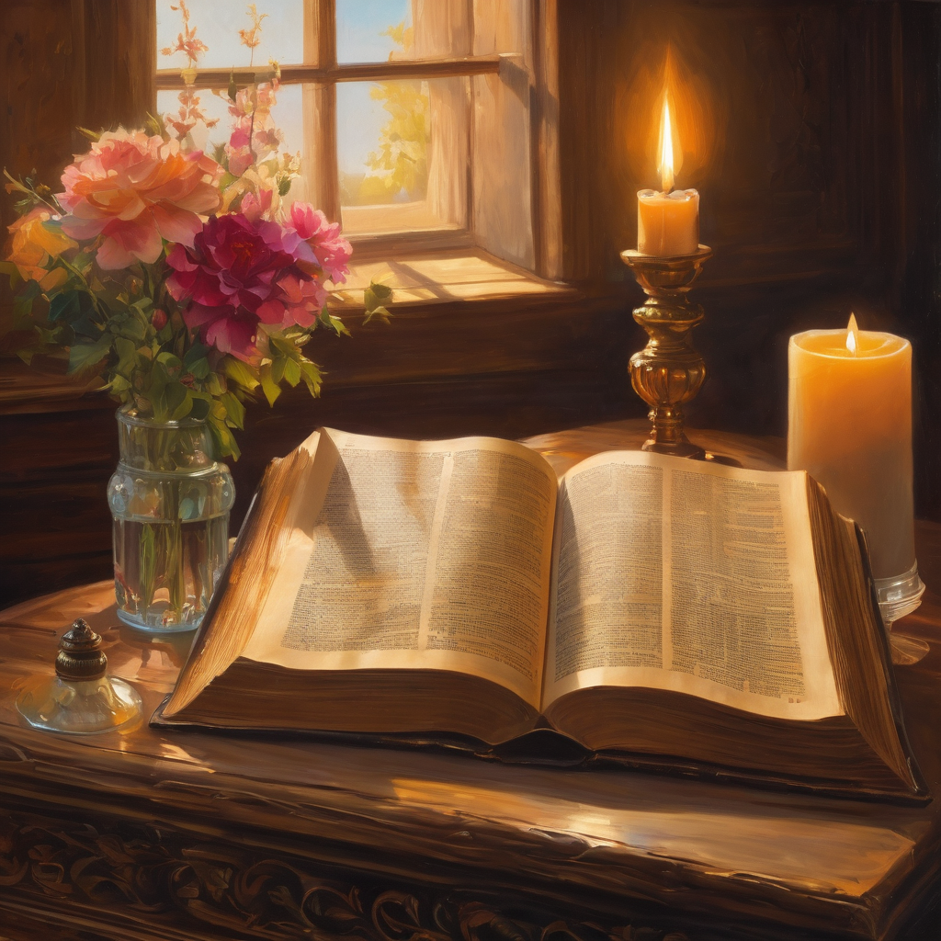
We pause
after ​the Gospel ​​

Slide 30
Leader: .
Leader and Cantor mute
Broadcaster exits screenshare
Flashback Sermon
Bright and Salty
https://youtu.be/5ExdDxMPSIU?si=RcBoqghuI56-ik39

Slide 31
Leader unmutes
Our next Hymn is
Shine Jesus Shine
https://www.youtube.com/watch?v=nTIGVIcHsFE
We stay on mute
Leader mutes

Slide 32
The Leader and Cantor unmute
The Greeting of Peace
Leader: We are the body of Christ
All: God’s Spirit is with us
Leader: The peace of the Lord be always with you.
All: And also with you.
Leader: A sign of peace may be exchanged
You may like to type 'Peace' into the chat, use the 'raise hand’ or other reaction buttons, or just simply wave via the screen with your video turned on
(Broadcaster exits shared screen for a few moments for the exchange of peace)

Slide 33
Leader: As we enter prayer, I invite the second reader to unmute to lead our intercessions which follow the prayer of thanksgiving. Please feel free to change your body position as you need.
Continue…

Slide 34
Prayer of Thanksgiving before Intercessions
Leader:
We praise you, life-giving God,
for the example of all those throughout history
who have bravely stood up for justice:
For those who have brought your healing where there was hatred;
for those who have shone your light of reconciliation
where there was division;
for those who have gone in your name
to places of turmoil and discrimination.
Thank you for inspiring them, empowering them
and for their footsteps in which we would follow, in Jesus’ name.
Amen.

Slide 35
Intercessions
Reader 2: We pray for creation and communities we share our lives with. We pause for a few moments to name either in our hearts, or out loud, or in the chat, those environments and communities we bring to the Lord in prayer.
PAUSE…
We entrust to you the community of Holy Hermits Online and our ministry partners:
Prosper the work of our hands and show us the way to your new creation.
Creator God, Hear our prayer.
St John's Cathedral Brisbane The Anglican Diocese of Southern Queensland St Gabriel’s, Carindale Benedictus Contemplative Church, Canberra Anglican Focus and Tithe.ly

Slide 36
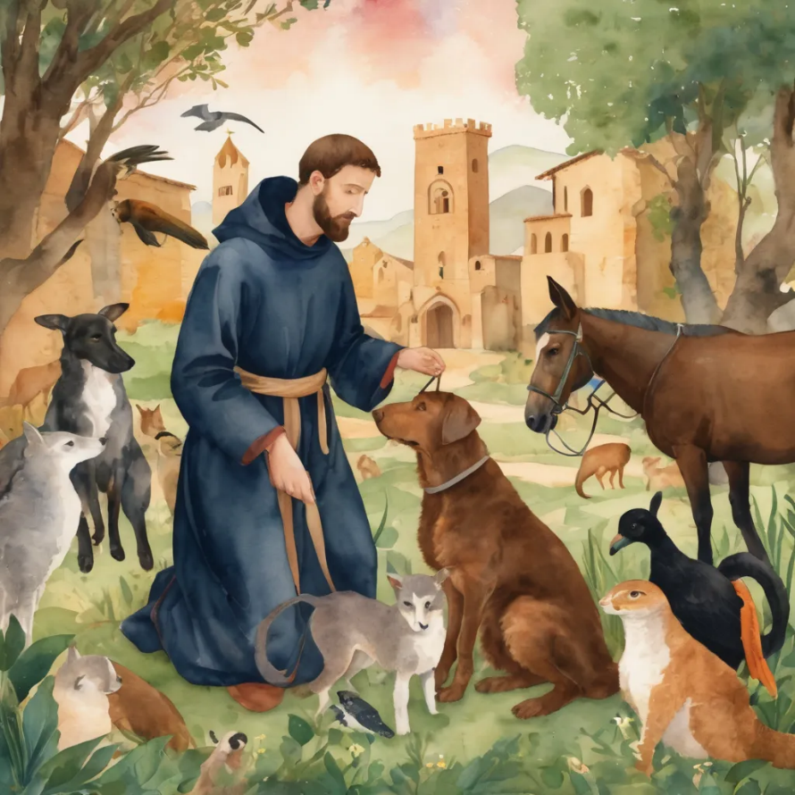
Reader 2: Loving Creator, we entrust to you all animals, especially those who are sick, anxious, ageing, lost, at risk, lonely, sad, hungry, in pain, homeless, abused, living in fear, encountering violence of any kind, in need of comfort, rehabilitation or transformation.
We invite your loving compassion for:
We name in our hearts, out loud or in the chat,
the animals we bring to the Lord in prayer. PAUSE…
Jasmine, ​
Leese(y), ​
Sid, Toots & Lulu​
Polly and Suki​
Fred, George & Percy​
Koshka ​
Jax
Lambert ​​
Kala, Nigel & Little One ​​
Toby​​
Taco​​
Paddy ​​
Rosie​

Slide 37
Reader 2: Eternal Trinity of Love, we uphold to you the people we love and carry cares for:
We name in our hearts, out loud or in the chat, those we bring to the Lord in prayer. PAUSE… We entrust to you those who have died, those who have died peacefully and those who have died tragically, The old and the young. Receive them into your Kingdom. Lord in your mercy, Hear our prayers. Amen.
Kerry, Les & Jake Julie, Ray, Tracey & Shane Mark, Desley & Bob ​​ Rachel, Mervyn & Gillian ​​Rev'd Shane & Janette​​ Alecia, Martin & Aidan​​ Steven & Vanessa | Barry​​ Dr Julie ​​ Ruth​​ Phil​ May Susan Tanya​ Craig Neva​ | Bill & Marjorie​​ Aaron & Andrea Dilys & Tony, Paul & Darhon Judy & Mary​​ Bob & Di​ Pat & Julie Miriam Gayanne | Kirsten, Greg, Daphne & Beau Alan & Gaylene​ Jess & Leah ​​ Bonnie & girls Liz’s Godchildren Barry & Gwen Matthew & Nicholas​

Slide 38
Pray Daily Cycle of Prayer
Leader: Loving God, joining with the Church in our cycle of prayer, we ask your blessings on:
Hong Kong Sheng Kung Hui
The Diocese of Bunbury: †Ian; Clergy and People
The Parish of Morningside: Martyn, Warwick
Logan Multicultural Ministry
Matthew Flinders Anglican College, Buderim: Principal – Michelle; Chaplain - Kathrin; Chair of College Council - Peta; members of College Council; staff & students

Slide 39
Commitment prayer for the week: Lay Ministry
God of love, pour out your Holy Spirit on our lay ministry at Holy Hermits Online.​​
Bless those who offer their ministry gifts as cantors, readers, prayer writers, Liturgical Assistants, lay leaders, service prep team members, broadcasters, proof-readers, welcomers, tech supporters and helpers in any way. We pray each one feels encouraged to continue serving you.​​
Give courage to those who hear your voice and offer their ministry gifts so that they too can serve you in the future.​​
Thank you for your rich blessings on our community.​​
​In Jesus' name we pray. ​
Amen.

Slide 40
Leader: Let us pray together the prayer which Jesus gave us saying:
All: Our Father in heaven,
hallowed be your name,
your kingdom come, your will be done,
on earth as in heaven.
Give us today our daily bread.
Forgive us our sins
as we forgive those who sin against us.
Save us from the time of trial
and deliver us from evil.
For the kingdom, the power,
and the glory are yours
now and for ever.
Amen.

Slide 41
Devotions

Slide 42
Hermit Wisdom – Sister Angela of Stroud

Slide 43
Leader:
The community at Stroud was described by Patricia Brennan (1999, p.18) as
“a church in exile for women and men seeking a wider vision of Christian spirituality”.
Sister Angela supported the push for the ordination of women, saying,
“I don’t understand the ins and outs at all, but I’m with you all the way because it’s what I feel in my heart and in prayer”.
She was an early candidate, ordained a deacon at the age of 66 on November 11, 1989, and a priest on December 21, 1992.

Slide 44
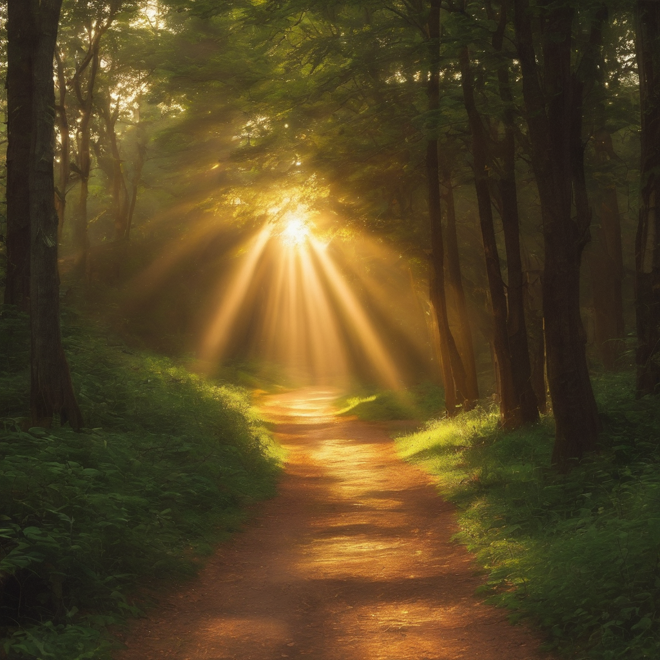
Leader: ​As we enter a few minutes of silence together, you are invited to pray this prayer of adoration and/or spend this time in contemplation. ​
The Spiritual Communion prayer follows
on the next slide. Let us be still.
Leader and Cantor Mute.
​
Living God, we celebrate your desire for justice and mercy. When others stay silent, we will speak up, for you are the living Word. When others stand down if things get tough we will stand up in the power of your Spirit, for you are our inspiration; Father, Son and Holy Spirit. Amen.

Slide 45
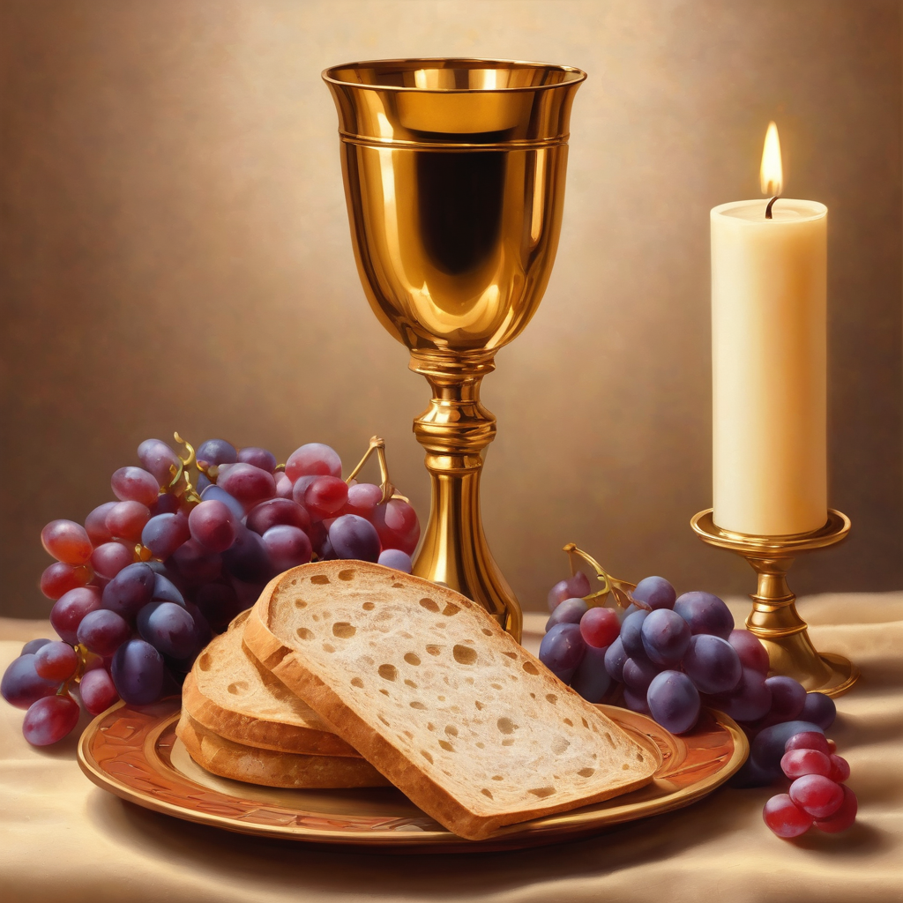
Oh, my Lord Jesus I turn to you
present at the Altar and in the
Tabernacle. I believe that you are
present in the Holy Sacrament of your
most Sacred Body and Blood. I love you
above all things and I desire to receive
you into my Soul. I cannot at this
moment receive you Sacramentally in
Holy Communion. Come spiritually into
my heart. Purify it, Sanctify it. Render
my heart like your own heart.
I embrace you as if you were already
there and unite myself wholly with
you. Never permit me to be separated
from you. Lord, I am not worthy to
receive you, but only say the word and I
shall be healed. Amen
Making a
Spiritual Communion
(Prayed in silence)

Slide 46
Leader unmutes
Our final song is
My Lighthouse
https://www.youtube.com/watch?v=lFBZJGSgyVQ
​We stay on mute
Leader and Cantor mute

Slide 47
Leader and cantor unmute
Sending Prayer
Leader: We pray our sending prayer together.
All: Ever-present God,
as we leave our time of worship,
may we also take on the challenge
of hearing your call to justice,
and know that we do not leave that behind when we leave here.
May we know true worship that brings growth,
spreads light, and lifts the oppressed,
and know that we do not leave that behind when we leave here.
Amen.

Slide 48
The Benediction
Leader: Let us all invite God’s blessings together,
All: May the Lord bless us and keep us.
May the Lord’s face shine upon us and be gracious to us.
May the Lord’s countenance be lifted upon us,
and bring us peace. Amen

Slide 49
Notices
Rev’d Canon Jess will be leading a Lenten study for 6 weeks, more information to come
See HHO Events page for further upcoming events HHO Events especially at the Cathedral online

Slide 50
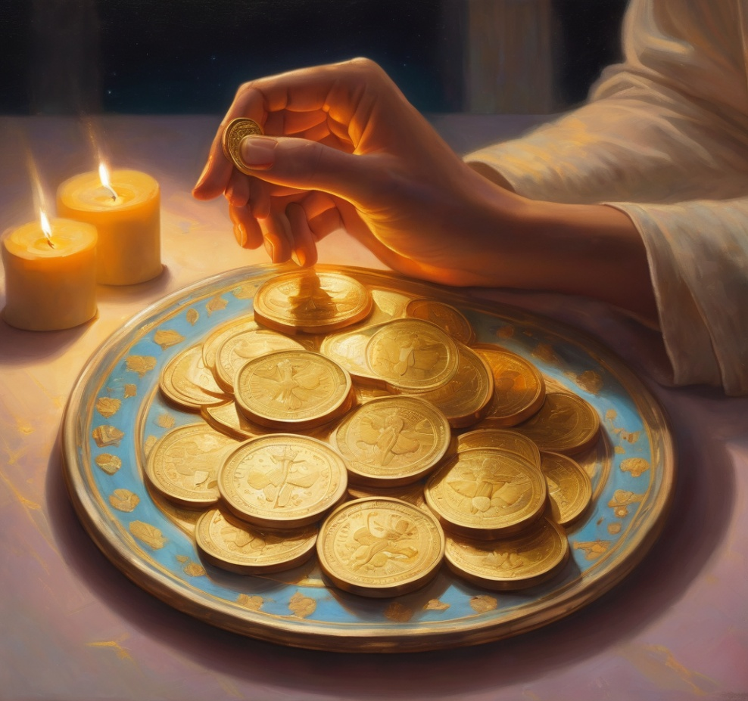
Leader: Thank you for your regular gifts to this ministry. Offerings are most welcome via:
The HHO App
Direct Debit
International Direct Debit
Please consider a one-off donation
or leaving a legacy in your Will
For further information go to HHO give page
https://holyhermits.com.au/give

Slide 51
Serving next week
Sunday 15th February
9:00 am AEST
Service Prep: Lauren | Chat Host: Viki | First Reader: Helen
Music: Lauren | Welcomer: Chris | Second Reader: Liz
Proof-reader: Kristine | Priest: N/A | Preacher: Lauren
Broadcaster: Barry | Deacon: Lauren | Fellowship: Julie
Backup Broadcaster: Lauren | Leader: Julie | Safety Officer: Chris
Zoom Buttons: Lauren | Cantor: Margo | Attendance: Viki
Thank you for your ministry gifts
New Servers always welcome!
Please email Rev’d Lauren to get involved
holyhermits@anglicanchurchsq.org.au

Slide 52
Leader: I invite everyone to unmute for the Dismissal
Leader: Go in peace to love and serve the Lord.
All: In the name of Christ, Amen.

Slide 53

Fellowship time
Thank you, Leonie for leading Fellowship
Please feel welcome to linger or pop a message in the chat and head off when you are ready.​
Artwork by Padlet: Let your light shine before others, so that they may see your good works and give glory to your Father in heaven. Matthew 5.16 and inspired by the creativity of Sister Angela
Extra resources developed
by Roots on the Web

