Slide 1

Repentance and Renewal
Michael Christie

Slide 2

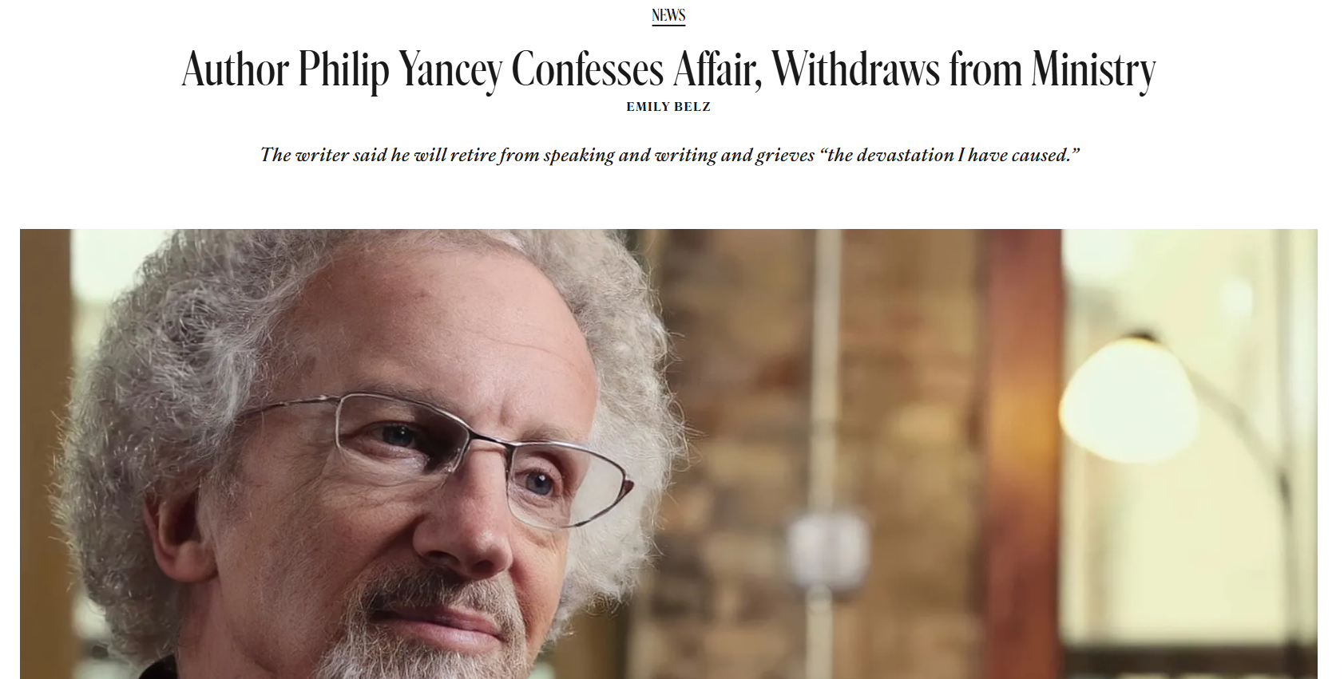
Credit: Christianity Today, https://www.christianitytoday.com/2026/01/author-philip-yancey-confesses-affair-withdraws-from-ministry/

Slide 3
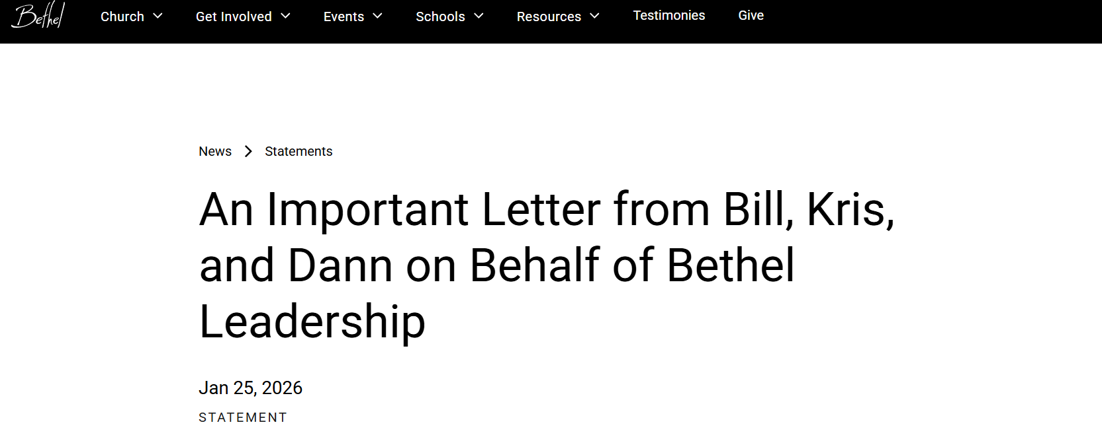
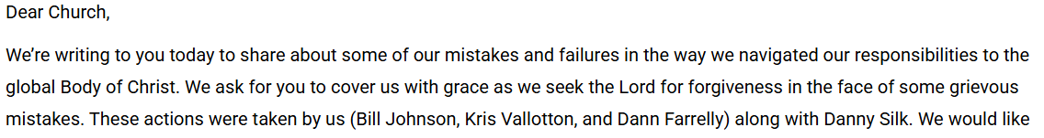
https://www.bethel.com/news/an-important-letter-from-bill-kris-and-dann-on-behalf-of-bethel-leadership

Slide 4
Jesus was one of the greatest social reformers, but he accomplished it by transforming the individual. He was not a revolutionist; he was the redeemer. But by redeeming the individual personality he brought about many social reforms.
- BILLY GRAHAM

Slide 5
PSALM 51
For the director of music. A psalm of David. When the prophet Nathan came to him after David had committed adultery with Bathsheba.
¹ Have mercy on me, O God, according to your unfailing love; according to your great compassion blot out my transgressions.

Slide 6
² Wash away all my iniquity and cleanse me from my sin. ³ For I know my transgressions, and my sin is always before me.
⁴ Against you, you only, have I sinned and done what is evil in your sight; so you are right in your verdict and justified when you judge. ⁵ Surely I was sinful at birth, sinful from the time my mother conceived me.

Slide 7
⁶ Yet you desired faithfulness even in the womb; you taught me wisdom in that secret place.
⁷ Cleanse me with hyssop, and I will be clean; wash me, and I will be whiter than snow. ⁸ Let me hear joy and gladness; let the bones you have crushed rejoice.
⁹ Hide your face from my sins and blot out all my iniquity. ¹⁰ Create in me a pure heart, O God, and renew a steadfast spirit within me.

Slide 8
¹¹ Do not cast me from your presence or take your Holy Spirit from me. ¹² Restore to me the joy of your salvation and grant me a willing spirit, to sustain me.
¹³ Then I will teach transgressors your ways, so that sinners will turn back to you. ¹⁴ Deliver me from the guilt of bloodshed, O God, you who are God my Savior, and my tongue will sing of your righteousness.

Slide 9
¹⁵ Open my lips, Lord, and my mouth will declare your praise.
¹⁶ You do not delight in sacrifice, or I would bring it; you do not take pleasure in burnt offerings.
¹⁷ My sacrifice, O God, is a broken spirit; a broken and contrite heart you, God, will not despise.

Slide 10
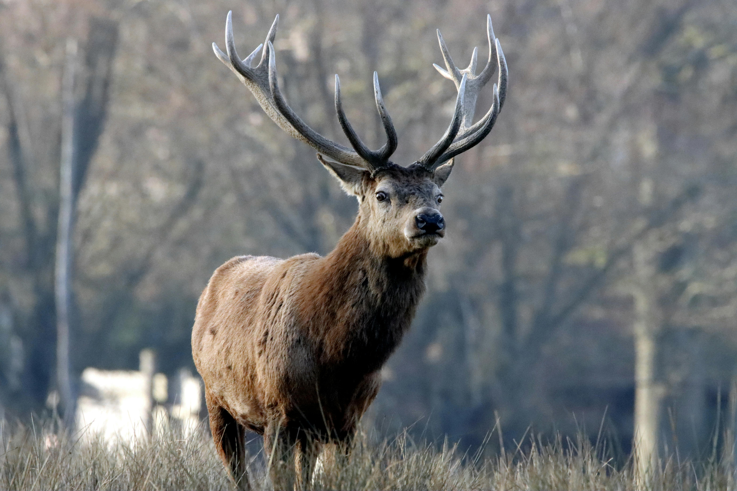

Slide 11
Repentance
Have mercy on me, O God, according to your unfailing love; according to your great compassion blot out my transgressions. Wash away all my iniquity and cleanse me from my sin. For I know my transgressions, and my sin is always before me. Against you, you only, have I sinned and done what is evil in your sight…
- PSALM 51:1-4

Slide 12
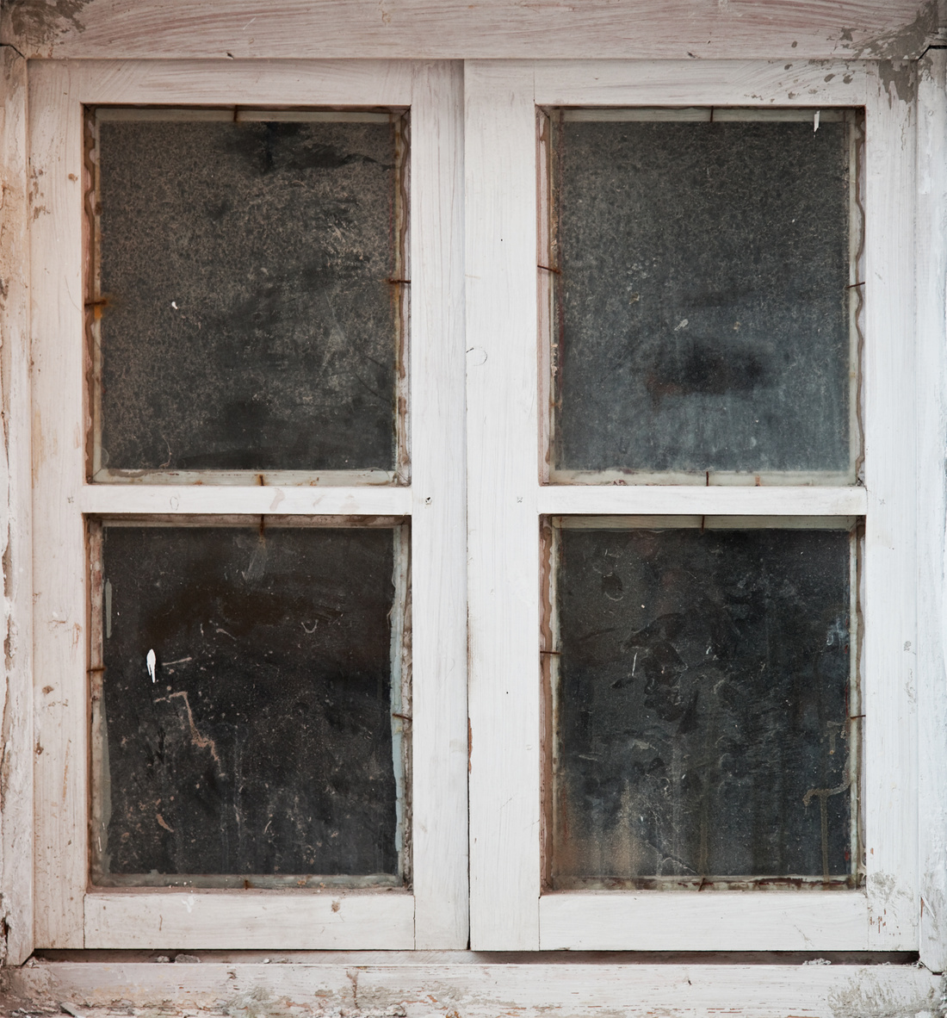

Slide 13
Blessed are the poor in spirit, for theirs the kingdom of heaven.
- MATTHEW 5:3

Slide 14
Do not expect God to cover what you are not willing to uncover.
- DUNCAN CAMPBELL

Slide 15
Who is a God like you, who pardons sin and forgives the transgression of the remnant of his inheritance? You do not stay angry forever but delight to show mercy.
- MICAH 7:18

Slide 16
But because of his great love for us, God, who is rich in mercy, made us alive with Christ even when we were dead in transgressions—it is by grace you have been saved.
- EPHESIANS 2:4-5

Slide 17
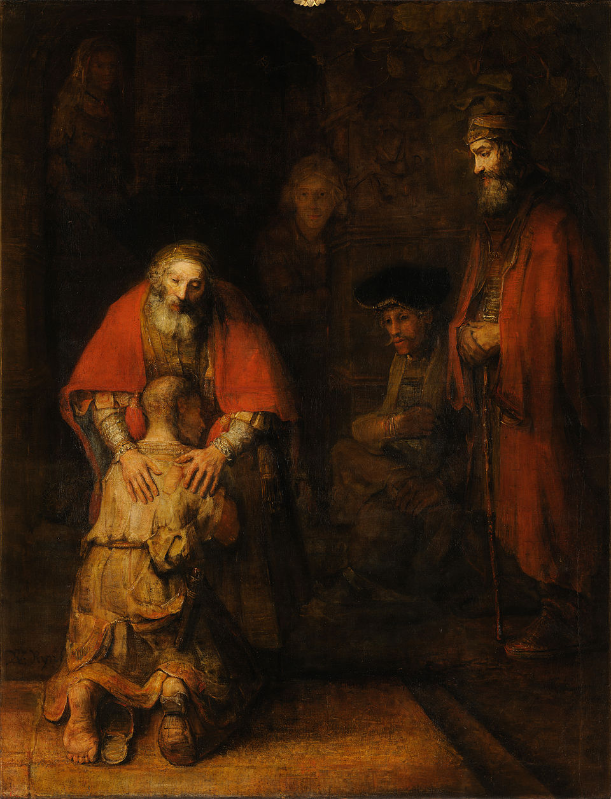

Slide 18
Reconciliation
Yet you desired faithfulness even in the womb; you taught me wisdom in that secret place. Cleanse me with hyssop, and I will be clean; wash me, and I will be whiter than snow. Let me hear joy and gladness; let the bones you have crushed rejoice. Hide your face from my sins and blot out all my iniquity.
- PSALM 51:6-9

Slide 19

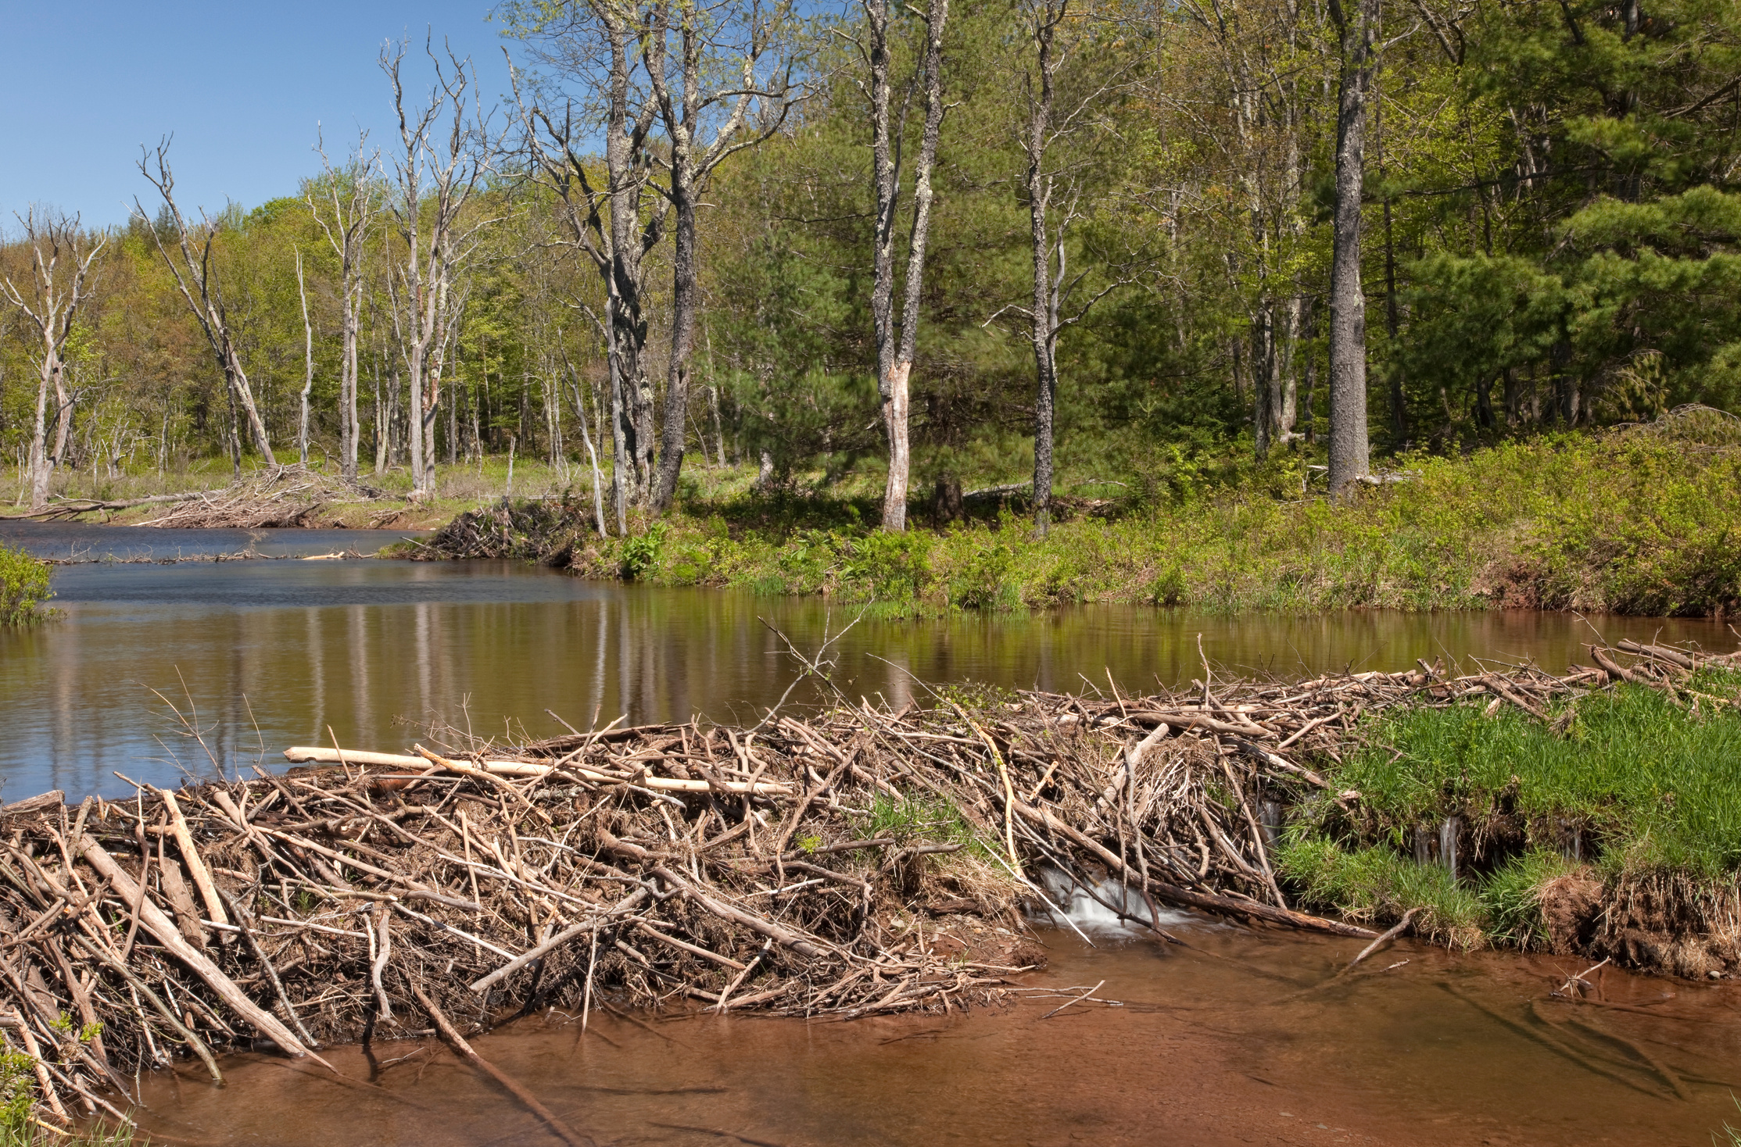

Slide 20
If we confess our sins, he is faithful and just and will forgive us our sins and purify us from all unrighteousness.
- 1 JOHN 1:9

Slide 21

Air your Dirty Laundry Here
100% Confidential
Anonymous
Free!

Slide 22
Nothing in all creation is hidden from God’s sight. Everything is uncovered and laid bare before the eyes of him to whom we must give account.
- HEBREWS 4:13

Slide 23
Therefore, since we have a great high priest who has ascended into heaven, Jesus the Son of God, let us hold firmly to the faith we profess. For we do not have a high priest who is unable to empathize with our weaknesses, but we have one who has been tempted in every way, just as we are—yet he did not sin. Let us then approach God’s throne of grace with confidence, so that we may receive mercy and find grace to help us in our time of need.
- HEBREWS 4:14-16

Slide 24
Renewal
Create in me a pure heart, O God, and renew a steadfast spirit within me. Do not cast me from your presence or take your Holy Spirit from me. Restore to me the joy of your salvation and grant me a willing spirit, to sustain me. Then I will teach transgressors your ways, so that sinners will turn back to you.
- PSALM 51:10-13

Slide 25
Therefore, if anyone is in Christ, the new creation has come: The old has gone, the new is here! All this is from God, who reconciled us to himself through Christ
- 2 CORINTHIANS 5:17-18

Slide 26
