Slide 1
Welcome!
We’re So Glad You Are Here!

Slide 2
Heirs of the
Promise
Genesis 24: 1-9 NIV

Slide 3
Abraham was now very old, and the Lord had blessed him in every way. 2 He said to the senior servant in his household,
the one in charge of all that he had,
“Put your hand under my thigh.
Genesis 24: 1-9 NIV

Slide 4
3 I want you to swear by the Lord,
the God of heaven and the God of earth, that you will not get a wife for my son from the daughters of the Canaanites, among whom I am living, 4 but will go to my country and my own relatives
and get a wife for my son Isaac.”
Genesis 24: 1-9 NIV

Slide 5
5 The servant asked him,
“What if the woman is unwilling to come back with me to this land?
Shall I then take your son back to the country you came from?”
Genesis 24: 1-9 NIV

Slide 6
6 “Make sure that you do not
take my son back there,”
Abraham said.
Genesis 24: 1-9 NIV

Slide 7
7 “The Lord, the God of heaven, who brought me out of my father’s household and my native land and who spoke to me and promised me on oath, saying, ‘To your offspring I will give this land’—
he will send his angel before you so that you can get a wife for my son from there.
Genesis 24: 1-9 NIV

Slide 8
8 If the woman is unwilling to come back with you, then you will be released
from this oath of mine.
Only do not take my son back there.
Genesis 24: 1-9 NIV

Slide 9
9 So the servant put his hand under the thigh of his master Abraham and swore
an oath to him concerning this matter.
Genesis 24: 1-9 NIV

Slide 10
Heirs of the
Promise
Abraham is Obedient

Slide 11
3 I want you to swear by the Lord,
the God of heaven and the God of earth, that you will not get a wife for my son from the daughters of the Canaanites, among whom I am living,
4 but will go to my country
and my own relatives
and get a wife for my son Isaac.
Genesis 24: 3-4 NIV

Slide 12
6 “Make sure that you do not
take my son back there,”
Abraham said.
Genesis 24: 6 NIV

Slide 13
Heirs of the
Promise
The Servant
is Sent

Slide 14
9 So the servant put his hand under the thigh of his master Abraham and swore
an oath to him concerning this matter.
Genesis 24: 9 NIV

Slide 15
10 Then the servant left, taking with him ten of his master’s camels loaded with all kinds of good things from his master.
Genesis 24: 10 NIV

Slide 16
Heirs of the
Promise
The Father Orchestrates

Slide 17
12 Then he prayed,
“Lord, God of my master Abraham,
make me successful today, and show kindness to my master Abraham.
Genesis 24: 12 NIV

Slide 18
15 Before he had finished praying, Rebekah came out with her jar on her shoulder. She was the daughter of Bethuel son of Milkah,
who was the wife of
Abraham’s brother Nahor.
Genesis 24: 15 NIV

Slide 19
26 Then the man bowed down and worshiped the Lord, 27 saying, “Praise be to the Lord, the God of my master Abraham, who has not abandoned his kindness and faithfulness to my master. As for me, the Lord has led me on the journey to the house of my master’s relatives.”
Genesis 24: 26-27 NIV

Slide 20
Heirs of the
Promise
A Willing Heart
Receives

Slide 21
57 Then they said, “Let’s call the young woman and ask her about it.” 58 So they called Rebekah and asked her,
“Will you go with this man?”
“I will go,” she said.
Genesis 24: 57-58 NIV

Slide 22
60 And they blessed Rebekah
and said to her,
“Our sister, may you increase
to thousands upon thousands;
may your offspring possess
the cities of their enemies.”
Genesis 24: 60 NIV

Slide 23
67 Isaac brought her into the tent of his mother Sarah, and he married Rebekah.
So she became his wife,
and he loved her;
Genesis 24: 67 NIV

Slide 24
Conclusion:
Let us give thanks
to the Father
who guarantees the promise,
to the Holy Spirit
who seeks willing hearts,
and to the Son
who faithfully loves His Church.

Slide 25
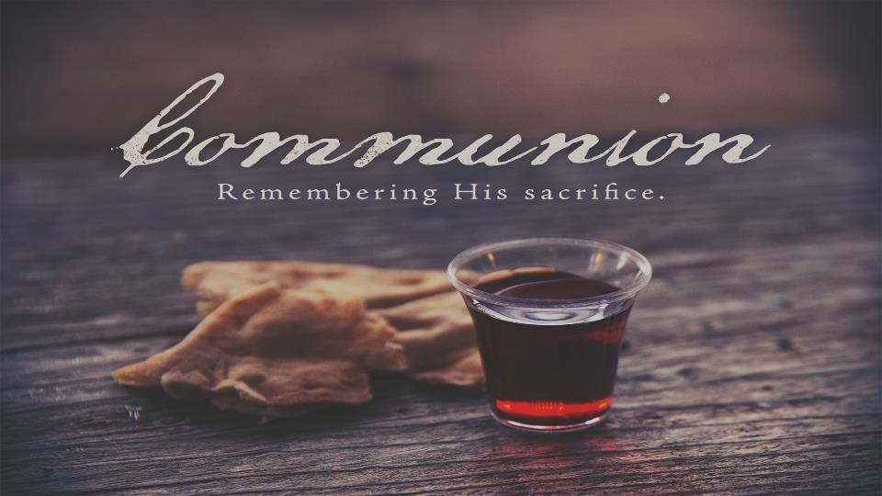

Slide 26


Slide 27


