Slide 1
Leader: Welcome to Holy Hermits Online Worship
4th Sunday after Epiphany
Today, we remember Holy Hermit
Macarius of Egypt
Service Prep: Kristine | Chat Host: Viki | First Reader: Phil
Music: Wiggles | Welcomer: Chris | Second Reader: Bob
Proof-reader: Viki | Priest: N/A | Preacher: Lauren
Broadcaster: Lauren | Deacon: Lauren | Fellowship: Julie
Backup Broadcaster: Barry | Leader: Jeremy | Safety Officer: Chris
Zoom Buttons: Viki | Cantor: Roselyn | Attendance: Viki
Prep: 28/01/2026 Proofed:28/01/2026🌸

Slide 2


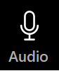



Hospitality
Leader:
Please mute for the service unless invited to offer your voice as part of the service ministry
Have the video camera on or off and turn the volume and brightness up or down on your device if things are too loud 🔉🔊or too bright🔅🔆
Our Cantor acts as our voice, offering the responses, in Bold Text, which we say together
Feel welcome to use the chat and reaction emojis 👍
🙏 Please take care of yourself in this space. 🙏 Come and go as you need
😴 It is great to take rest in this space, so falling asleep is also OK 😴
👂️ Remember, pastoral care is available to all in the community, if you'd like to speak to someone about anything spiritual. ❤️ Visit the help page at the website to reach out 🌐
Our Being Together ethos and safeguarding practices can also be accessed on the website 🫶​
🙌 Come as you are – we are all here together! 🙌
Notes:
Used Lent 2022

Slide 3
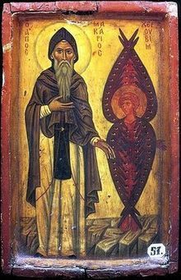
Leader: Our Holy Hermit Highlights for today
Macarius of Egypt (c. 295–392 A.D.), known as Macarius the Great, was a pioneering Desert Father whose teachings shaped early Christian asceticism and monasticism. After the death of his wife, he withdrew around age thirty to the desert of Scete, where he lived as a hermit for the next fifty years and was ordained a priest about a decade into his solitude. His profound spiritual insight, homilies, and guidance attracted many disciples among the growing monastic communities. Macarius was also revered for his healing and prophetic gifts. A noted story recounts his compassionate response to a pagan priest, whose respect for Macarius’s kindness led him to embrace Christianity and become an exemplary monk.
Read more about
Macarius of Egypt
please click the link on the send out

Slide 4
Invitation
Leader: As we settle into worship let your breath be soft, your mind be still, and your heart be open to the presence of God.
Opening Organ Music:
https://www.youtube.com/watch?v=U6k3Z0CBKAc

Slide 5
Leader and Cantor unmute
The Greeting
Leader:
The Grace of the lord Jesus Christ,
and the love of God,
and the fellowship of the Holy Spirit,
be with you all.
All: And also with you.

Slide 6
Gathering Prayer
Leader: Let us worship the God who gives,
who fills our lives with the beauty of creation,
who offers comfort and counsel to humanity,
while demanding nothing
but that we share in filling the world with kindness and justice.
All: God, you call us to walk with you in justice, in kindness, in humility.
Help us to see this is what you require,
to leave behind all other expectations
and be free to walk into the future you want for us as the people of God.
Amen.

Slide 7
Sentence
Leader: I invite our Cantor to proclaim the sentence for today.
Cantor:
What does the Lord require of you but to do justice, and to love kindness, and to walk humbly with your God?
Micah 6.8

Slide 8
Prayer of Approach
Leader: We pray the prayer of approach together
All: Righteous God,
as your light shines upon us,
we pledge to be a light to one another and to others.
We pledge to pray for one another and for others.
We pledge to listen to one another and to others.
We pledge to draw closer to one another and to others.
In your name, in your strength and to your glory.
Amen.

Slide 9
Our First Hymn is
Blessed Assurance
https://www.youtube.com/watch?v=1WQdwkCdXpU
We stay on mute
Leader and Cantor mute

Slide 10
The Deacon or LA Introduces Confession​
Christ the Son of God has been revealed as a light to the nations.​​
Silence may be kept.​..
​
Let us bring our darkness to his light, confessing our sins in penitence and faith.

Slide 11
All: ​Merciful God, our maker and our judge, ​
we have sinned against you ​in thought, word, and deed, ​
and in what we have failed to do: ​
we have not loved you with our whole heart; ​
we have not loved our neighbours as ourselves; ​
we repent, and are sorry for all our sins.​
Father, forgive us. Strengthen us to love and obey you
in newness of life; ​through Jesus Christ our Lord. ​
Amen.​

Slide 12
Words of Assurance offered by the Deacon or LA
These words of assurance from the First Letter of John declare that:
If anyone sins, we have an advocate with the Father, Jesus Christ the righteous. He is the perfect offering for our sin, and not for ours only, but for the sins of the whole world.
(1 John 2: 1-2)
In this is love, not that we loved God, but that he loved us and sent his Son to be the perfect offering for our sins.
(1 John 4:10)

Slide 13
Collect
Leader: Righteous God,
you confound the world’s wisdom
by giving your blessing to the lowly and pure in heart:
give us such a hunger and thirst for justice
and perseverance in striving for peace,
that in our words and deeds
the world may see the promise of your kingdom,
which has been revealed in Jesus Christ our Lord,
who lives and reigns with you in the unity of the Holy Spirit,
one God, for ever and ever.
Amen

Slide 14
The 1st reader unmutes
Leader: I invite the 1st reader to unmute and offer the 1st lesson when ready.
Reader 1: The 1st Reading is from Micah 6.1-8
¹ Hear what the Lord says: Rise, plead your case before the mountains, and let the hills hear your voice. ² Hear, you mountains, the controversy of the Lord , and you enduring foundations of the earth; for the Lord has a controversy with his people, and he will contend with Israel. ³ ‘O my people, what have I done to you? In what have I wearied you? Answer me!
Continues…

Slide 15
⁴ For I brought you up from the land of Egypt, and redeemed you from the house of slavery; and I sent before you Moses, Aaron, and Miriam. ⁵ O my people, remember now what King Balak of Moab devised, what Balaam son of Beor answered him, and what happened from Shittim to Gilgal, that you may know the saving acts of the Lord .’ ⁶ ‘With what shall I come before the Lord , and bow myself before God on high? Shall I come before him with burnt-offerings, with calves a year old?
Continues…

Slide 16
⁷ Will the Lord be pleased with thousands of rams, with tens of thousands of rivers of oil? Shall I give my firstborn for my transgression, the fruit of my body for the sin of my soul?’ ⁸ He has told you, O mortal, what is good; and what does the Lord require of you but to do justice, and to love kindness, and to walk humbly with your God?
For the word of the Lord. Thanks be to God.​

Slide 17
Leader: We now say the psalm antiphonally, I invite the first reader to lead, and we will all respond with our cantor as our voice.
Psalm 15
¹ Lord, who may abide in your tabernacle:
or who may dwell upon your holy hill?
² Whoever leads an uncorrupt life
and does the thing which is right:
who speaks the truth from the heart,
and has not slandered with the tongue;
³ Who has done no evil to a friend:
nor vented abuse against a neighbour;
Continues…

Slide 18
⁴ In whose eyes the worthless have no honour:
but who makes much of those that fear the Lord;
⁵ Whoever has sworn to a neighbour:
and will not go back on that oath;
⁶ Who has not put money to usury:
nor taken a bribe against the innocent.
⁷ Whoever does these things:
shall never be overthrown.

Slide 19
The 2nd reader unmutes
Leader: Thank you, I invite the 2nd reader to unmute and offer the 2nd lesson when ready.
Reader 2: The 2nd Reading is from 1 Corinthians 1.18-31
¹⁸ For the message about the cross is foolishness to those who are perishing, but to us who are being saved it is the power of God. ¹⁹ For it is written, ‘I will destroy the wisdom of the wise, and the discernment of the discerning I will thwart.’ ²⁰ Where is the one who is wise? Where is the scribe? Where is the debater of this age? Has not God made foolish the wisdom of the world? ²¹ For since, in the wisdom of God, the world did not know God through wisdom, God decided, through the foolishness of our proclamation, to save those who believe.
Continues…

Slide 20
²² For Jews demand signs and Greeks desire wisdom, ²³ but we proclaim Christ crucified, a stumbling-block to Jews and foolishness to Gentiles, ²⁴ but to those who are the called, both Jews and Greeks, Christ the power of God and the wisdom of God. ²⁵ For God’s foolishness is wiser than human wisdom, and God’s weakness is stronger than human strength. ²⁶ Consider your own call, brothers and sisters: not many of you were wise by human standards, not many were powerful, not many were of noble birth.
Continues…

Slide 21
²⁷ But God chose what is foolish in the world to shame the wise; God chose what is weak in the world to shame the strong; ²⁸ God chose what is low and despised in the world, things that are not, to reduce to nothing things that are, ²⁹ so that no one might boast in the presence of God. ³⁰ He is the source of your life in Christ Jesus, who became for us wisdom from God, and righteousness and sanctification and redemption, ³¹ in order that, as it is written, ‘Let the one who boasts, boast in the Lord.’
For the word of the Lord. Thanks be to God.

Slide 22

We pause before
​the Gospel ​​

Slide 23
The Gospel of our Lord Jesus Christ according to St Matthew Chapter 5 beginning at the 1st verse. All: Glory to you Lord Jesus Christ
¹ When Jesus saw the crowds, he went up the mountain; and after he sat down, his disciples came to him. ² Then he began to speak, and taught them, saying: ³ ‘Blessed are the poor in spirit, for theirs is the kingdom of heaven. ⁴ ‘Blessed are those who mourn, for they will be comforted. ⁵ ‘Blessed are the meek, for they will inherit the earth. ⁶ ‘Blessed are those who hunger and thirst for righteousness, for they will be filled. ⁷ ‘Blessed are the merciful, for they will receive mercy. ⁸ ‘Blessed are the pure in heart, for they will see God. ⁹ ‘Blessed are the peacemakers, for they will be called children of God. ¹⁰ ‘Blessed are those who are persecuted for righteousness’ sake, for theirs is the kingdom of heaven. ¹¹ ‘Blessed are you when people revile you and persecute you and utter all kinds of evil against you falsely on my account. ¹² Rejoice and be glad, for your reward is great in heaven, for in the same way they persecuted the prophets who were before you.
This is the gospel of the Lord. All: Praise to you Lord Jesus Christ.

Slide 24
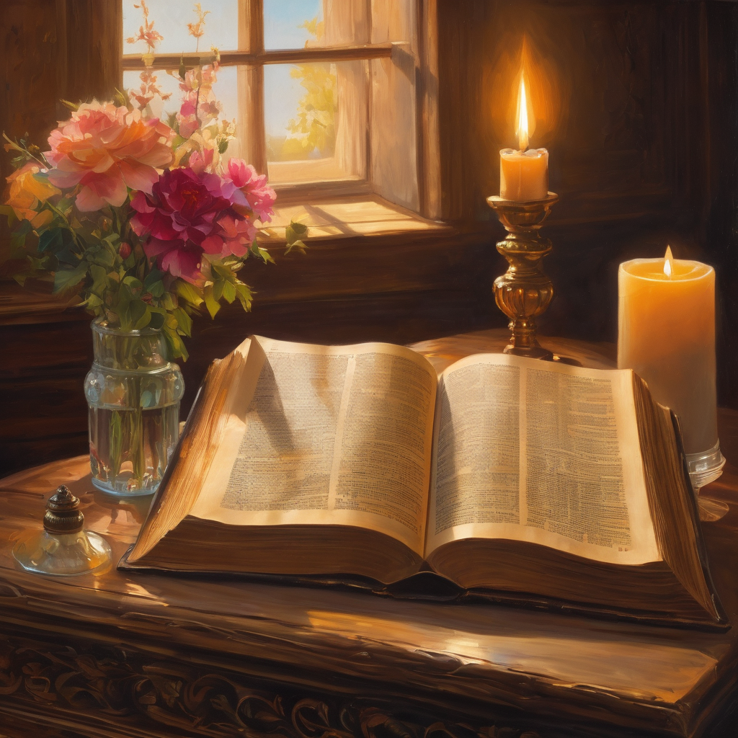
We pause
after ​the Gospel ​​

Slide 25
Leader: The Sermon is recorded to YouTube for sharing later.
Only the preacher's video and audio will be recorded.
The chat and other participants' feeds remain out of sight of the recording.
Leader and Cantor mute
Broadcaster exits screenshare
Preacher unmutes
Zoom buttons ”pins” preacher’s screen + selects “record to the cloud”
Sermon

Slide 26
Leader unmutes
Our next Hymn is
Blessed Are You
https://www.youtube.com/watch?v=K0pQpkCjv4o
We stay on mute
Leader mutes

Slide 27
The Leader and Cantor unmute
The Greeting of Peace
Leader: We are the body of Christ
All: God’s Spirit is with us
Leader: The peace of the Lord be always with you.
All: And also with you.
Leader: A sign of peace may be exchanged
You may like to type 'Peace' into the chat, use the 'raise hand’ or other reaction buttons, or just simply wave via the screen with your video turned on
(Broadcaster exits shared screen for a few moments for the exchange of peace)

Slide 28
Leader: As we enter prayer, I invite the second reader to unmute to lead our intercessions which follow the prayer of thanksgiving. Please feel free to change your body position as you need.

Slide 29
Prayer of Thanksgiving before Intercessions
Leader:
Eternal God, with love in our hearts, we adore you. With the whole of the Church, we worship you. With all we are and all we have we will nurture your gifts of kindness, justice and humility, and follow, serve and live for you today and every day. Amen.

Slide 30
Intercessions
Reader 2: We pray for creation and communities we share our lives with. We pause for a few moments to name either in our hearts, or out loud, or in the chat, those environments and communities we bring to the Lord in prayer.
PAUSE…
We entrust to you the community of Holy Hermits Online and our ministry partners:
Prosper the work of our hands and show us the way to your new creation.
Creator God, Hear our prayer.
St John's Cathedral Brisbane The Anglican Diocese of Southern Queensland St Gabriel’s, Carindale Benedictus Contemplative Church, Canberra Anglican Focus and Tithe.ly

Slide 31
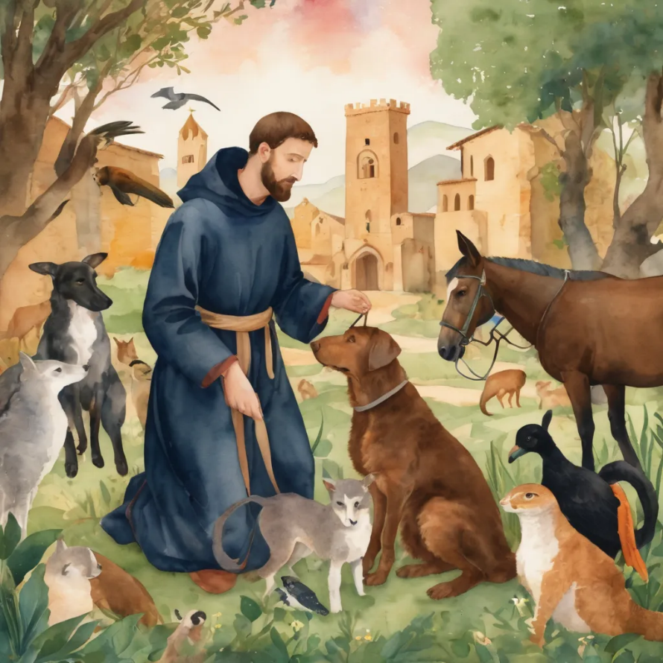
Reader 2: Loving Creator, we entrust to you all animals, especially those who are sick, anxious, ageing, lost, at risk, lonely, sad, hungry, in pain, homeless, abused, living in fear, encountering violence of any kind, in need of comfort, rehabilitation or transformation.
We invite your loving compassion for:
We name in our hearts, out loud or in the chat,
the animals we bring to the Lord in prayer. PAUSE…
Jasmine, ​
Leese(y), ​
Sid, Toots & Lulu​
Polly and Suki​
Fred, George & Percy​
Koshka ​
Jax
Lambert ​​
Kala, Nigel & Little One ​​
Toby​​
Taco​​
Paddy ​​
Rosie​

Slide 32
Reader 2: Eternal Trinity of Love, we uphold to you the people we love and carry cares for:
We name in our hearts, out loud or in the chat, those we bring to the Lord in prayer. PAUSE… We entrust to you those who have died, those who have died peacefully and those who have died tragically, The old and the young. Receive them into your Kingdom. Lord in your mercy, Hear our prayers. Amen.
Kerry, Les & Jake Julie, Ray, Tracey & Shane Mark, Desley & Bob ​​ Rachel, Mervyn & Gillian ​​Rev'd Shane & Janette​​ Alecia, Martin & Aidan​​ Steven & Vanessa | Barry​​ Dr Julie ​​ Ruth​​ Phil​ May Susan Tanya​ Craig Neva​ | Bill & Marjorie​​ Aaron & Andrea Dilys & Tony, Paul & Darhon Judy & Mary​​ Bob & Di​ Pat & Julie Miriam Gayanne | Kirsten, Greg, Daphne & Beau Alan & Gaylene​ Jess & Leah ​​ Bonnie & girls Liz’s Godchildren Barry & Gwen Matthew & Nicholas​

Slide 33
Pray Daily Cycle of Prayer
Leader: Loving God, joining with the Church in our cycle of prayer, we ask your blessings on:
The Church of England
The ongoing work of peace-making in Sudan & South Sudan •
The Anglican Church of Australia: The Primate - †Mark; The General Secretary - Anne; The General Synod and the Standing Committee
The Parish of Maleny: Ingrid, Kaye
Director of Clergy Development and Training: Michael
Anglican Schools Office, Church House: A/g Executive Director – Geoff, Executive Director & staff

Slide 34
Commitment prayer for the week: Companion Animals
God, we give thanks for your call to develop a Companion Animal Ministry at Holy Hermits Online. ​
​
We ask for your grace to guide us, as we build this ministry together. ​
​
Holy Spirit we ask your presence to be with us as we continue to develop resources together in this new season. ​
​
Provide us with wisdom and with compassion and with a sense of fun as we celebrate our companion animals and live this mission to outreach. ​
​
Alongside Holy Hermit St. Francis, we ask you Lord Jesus Christ, to enliven us in this ministry space. ​
​
Amen .
Continues…

Slide 35
Leader: Let us pray together the prayer which Jesus gave us saying:
All: Our Father in heaven,
hallowed be your name,
your kingdom come, your will be done,
on earth as in heaven.
Give us today our daily bread.
Forgive us our sins
as we forgive those who sin against us.
Save us from the time of trial
and deliver us from evil.
For the kingdom, the power,
and the glory are yours
now and for ever.
Amen.

Slide 36
Devotions

Slide 37
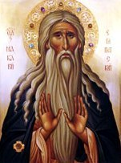
Hermit Wisdom

Slide 38
Leader: Macarius of Egypt
‘If you rebuke someone and do it with anger, you have allowed a passion to control you. You have not saved anyone and have destroyed yourself’.
‘How easy it is to say with every breath, “My Lord Jesus, have mercy upon me. I bless you, my Lord Jesus Christ. Help me”’.

Slide 39
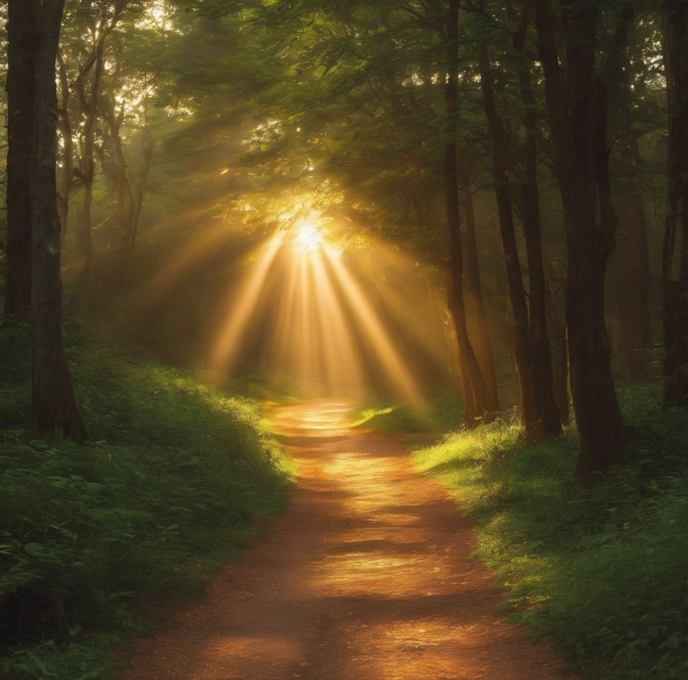
Leader: ​As we enter a few minutes of silence together, you are invited to pray this prayer of adoration and/or spend this time in contemplation. ​
The Spiritual Communion prayer follows on the next slide. Let us be still.
Leader and Cantor Mute.
​
Inspirational God, you show us the true meaning of fellowship and faithfulness. We rejoice at your presence with us and reassurance. As Father, you require us to bring justice to your world: no more, no less. As Son, you require us to learn from Jesus to love kindness: no more, no less. As Holy Spirit, you require us to walk humbly with you: no more, no less.
Amen.

Slide 40
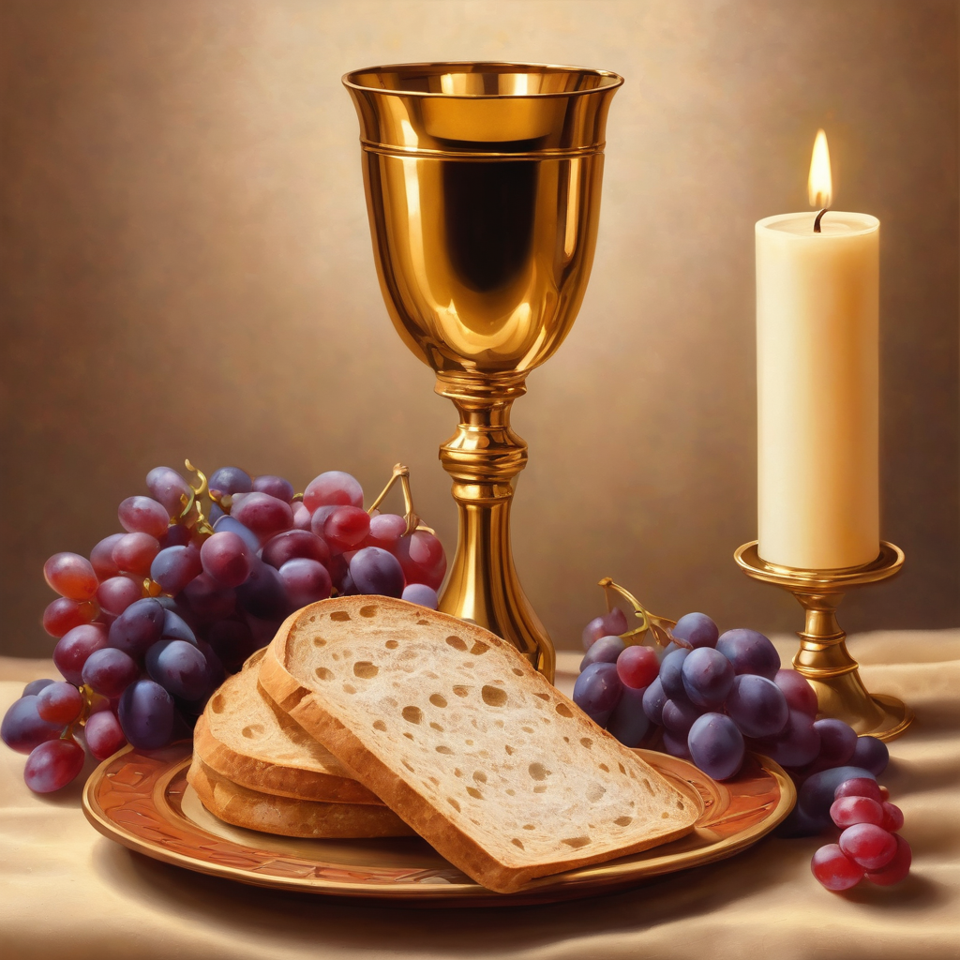
Oh, my Lord Jesus I turn to you
present at the Altar and in the Tabernacle. I believe that you are present in the Holy Sacrament of your most Sacred Body and Blood. I love you above all things and I desire to receive you into my Soul. I cannot at this moment receive you Sacramentally in Holy Communion. Come spiritually into my heart. Purify it, Sanctify it. Render my heart like your own heart. I embrace you as if you were already there and unite myself wholly with you. Never permit me to be separated from you. Lord, I am not worthy to receive you, but only say the word and I shall be healed. Amen
Making a
Spiritual Communion
(Prayed in silence)

Slide 41
Leader unmutes
Our final song is
Rejoice
https://www.youtube.com/watch?v=dCBGxDyYkpM
​We stay on mute
Leader and Cantor mute

Slide 42
Leader and cantor unmute
Sending Prayer
Leader: We pray our sending prayer together.
All:O God, what do you require of us?
Do you require us to be the best and do the most?
No.
Do you require us to turn our hearts to you and
live with justice, kindness and humility?
Yes.
Give us what we need to adopt the beautiful attitudes
you want for your people.
Amen.

Slide 43
The Benediction
Leader: Let us all invite God’s blessings together,
All: May the Lord bless us and keep us.
May the Lord’s face shine upon us and be gracious to us.
May the Lord’s countenance be lifted upon us,
and bring us peace. Amen

Slide 44
Notices
At 11.30am today we have our first workshop of the year, our Companion Animal Workshop, all are welcome
Rev’d Canon Jess will be leading a Lenten study for 6 weeks, more information to come
See HHO Events page for further upcoming events HHO Events especially at the Cathedral online

Slide 45
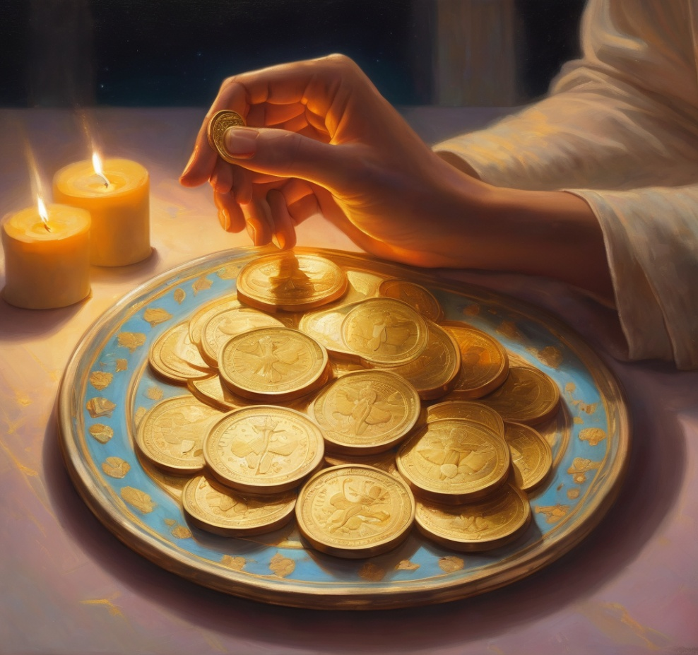
Leader: Thank you for your regular gifts to this ministry. Offerings are most welcome via:
The HHO App
Direct Debit
International Direct Debit
Please consider a one-off donation
or leaving a legacy in your Will
For further information go to HHO give page
https://holyhermits.com.au/give

Slide 46
Serving next week
Sunday 8th February
9:00 am AEST
Service Prep: Kristine | Chat Host: Rachel | First Reader: Liz
Music: Wiggles | Welcomer: Julie | Second Reader: Margo
Proof-reader: Chris | Priest: N/A | Preacher: Lauren
Broadcaster: Kieron | Deacon: Lauren | Fellowship: Leonie
Backup Broadcaster: Lauren | Leader: Lauren | Safety Officer: Leonie
Zoom Buttons: Viki | Cantor: Jeremy | Attendance: Rachel
Thank you for your ministry gifts
New Servers always welcome!
Please email Rev’d Lauren to get involved
holyhermits@anglicanchurchsq.org.au

Slide 47
Leader: I invite everyone to unmute for the Dismissal
Leader: Go in peace to love and serve the Lord.
All: In the name of Christ, Amen.

Slide 48

Fellowship time
Thank you, Julie for leading Fellowship
Please feel welcome to linger or pop a message in the chat and head off when you are ready.​
Artwork by Padlet: Blessed are the meek…
Extra resources developed
by Roots on the Web

