Slide 1
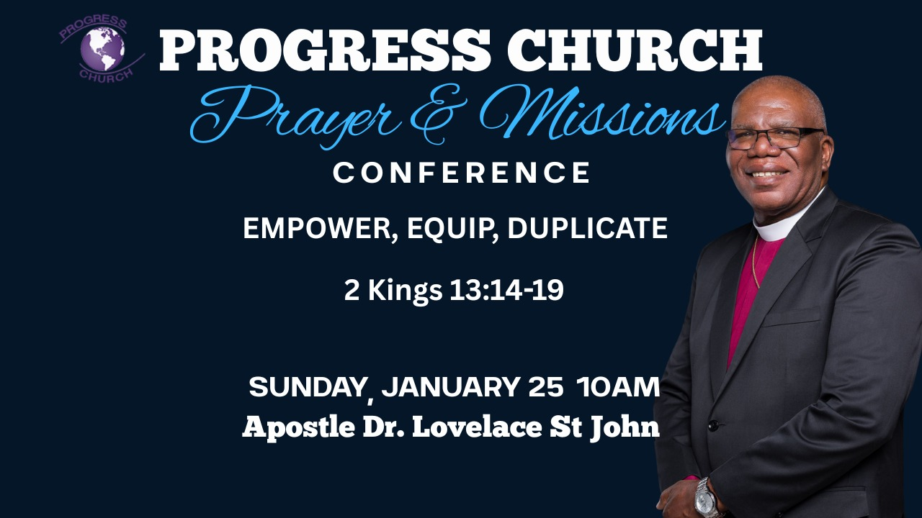

Slide 2



Scripture:
2 Kings 13: 14 – 19

Slide 3
INTRODUCTION
To shape the church for the future, we must duplicate not just our methods, but our passion. A lukewarm duplication leads to an incomplete victory.
In every generation, God raises men and women who carry His burden, His vision, and His fire. But the work of God cannot end with one generation. It must be passed on. That transfer, of calling, of assignment, of anointing, is what we can call duplication.
Duplication is not just about copying what someone does; it is about carrying how and why they do it. We are not only called to duplicate methods, but also to duplicate passion.

Slide 4
A DYING PROPHET AND A LIVING OPPORTUNITY
Elisha is on his deathbed. His ministry is almost over, but God’s purpose is not.
Joash the king comes weeping, calling Elisha “My father, my father…” (2 Kings 13:14). That shows he recognized Elisha’s importance, but recognition is not the same as imitation.

Slide 5
A DYING PROPHET AND A LIVING OPPORTUNITY con’t
Elisha does three important things before he dies
(vv. 15–19):
He puts a bow and arrows in the king’s hands, a method, a visible action.
B. He places his own hands upon the king’s hands, a picture of impartation, anointing, spiritual transfer.
C. He then commands the king to smite the ground with the arrows, a test of hunger and passion.

Slide 6
METHODS: WHAT WE DO CAN BE TAUGHT
Elisha gave Joash a clear instruction, a method:
“Take the arrows.” (v. 18) – That’s obedience to a prophetic act.
“Smite upon the ground.” – That’s a simple, repeatable action.
Methods in the church can be taught and duplicated:
How to pray.
How to fast.
How to evangelize.

Slide 7
METHODS: WHAT WE DO CAN BE TAUGHT
Methods in the church can be taught and duplicated:
How to follow up with new converts.
How to lead worship, preach, teach, organize and structure ministry.
These are like the arrows in our hands.
We can put arrows in the hands of the next generation, systems, strategies, doctrines, habits.

Slide 8
ELISHA DID HIS PART
He provided the tools.
He showed the pattern.
He spoke prophetically: “The arrow of the LORD’s deliverance” (v. 17).

Slide 9
ELISHA DID HIS PART
That is what spiritual fathers and leaders do:
They breakdown the work into teachable methods.
They model these methods in front of their sons and daughters in the faith.
They “put their hands” on the hands of the next generation, walking with them, correcting them, instructing them.
But methods alone are not enough.

Slide 10
PASSION: HOW WE DO IT DETERMINES THE SIZE OF OUR VICTORY
“He smote thrice and stayed.”(v. 18)
He stopped too soon.
He did too little.
Heaven had more planned than the king’s hunger could receive.

Slide 11
PASSION: HOW WE DO IT DETERMINES THE SIZE OF OUR VICTORY
Elisha said:
And the man of God was angry with him, and said,
“You should have struck five or six times; then you would have struck Syria till you had destroyed it! But now you will strike Syria only three times.”
Same arrows.
Same opportunity.
Same prophetic word.
Different level of passion, different level of victory.

Slide 12
METHODS WITHOUT PASSION
Joash had:
The right prophet.
The right tools (arrows).
The right instruction (smite the ground).
But he lacked:
Spiritual urgency.
Holy aggression.
Burning desire for total victory.
He copied the act but missed the spirit of the act.

Slide 13
PASSION WITHOUT METHODS
Some are passionate, but:
They refuse discipline.
They reject wisdom and structure.
They don’t honor the fathers’ methods of consistency, accountability, and doctrine.
Elisha did not only shout, “Be zealous!” He gave arrows and gave clear instructions.
Passion with no method is like fire with no fireplace, it burns wildly, then dies quickly.
The healthy pattern is:
Fathers and leaders must give methods, doctrine, systems, order, patterns of life.
Sons must add hunger, zeal, consistency, extra miles, sacrifice.

Slide 14
PASSION WITHOUT METHODS
Some are passionate, but:
They refuse discipline.
They reject wisdom and structure.
They don’t honor the fathers’ methods of consistency, accountability, and doctrine.
Elisha did not only shout, “Be zealous!” He gave arrows and gave clear instructions.
Passion with no method is like fire with no fireplace, it burns wildly, then dies quickly.
The healthy pattern is:
Fathers and leaders must give methods, doctrine, systems, order, patterns of life.
Sons must add hunger, zeal, consistency, extra miles, sacrifice.

Slide 15
SHAPING THE CHURCH FOR THE FUTURE
To shape the church for the future, we must duplicate not just our methods, but our passion.
LEADERS MUST MODEL BOTH ARROWS AND FIRE
Elisha didn’t only talk; he demonstrated:
He laid his hands on the king’s hands – mentoring by contact and closeness.
He spoke the meaning of the action – mentoring by explanation.
He tested the king’s response – mentoring by provocation.

Slide 16
TO OUR LEADERS
Don’t die with your arrows.
Elisha made sure the arrows were in the king’s hands before he died.
Pour out your methods, your wisdom, your experiences. Don’t protect your “secrets” of ministry, impart them.
Put your hands on their hands.

Slide 17
TO OUR LEADERS
Walk closely with your emerging leaders.
Pray with them, not only for them.
Let them see your struggles and sacrifices, not just your success.
Test and stretch their hunger.
Who shows up early without being asked twice?

Slide 18
TO OUR SONS, AND DAUGHTERS
Honor the arrows you are given.
Don’t despise structure. Don’t say, “I will do it my own way,” when there is a proven pattern that carries grace.
Multiply intensity, not laziness.
If your leaders prayed one hour, aim for two.
If they fasted one day, stretch for more.
Not in legalism, but in hunger.

Slide 19
TO OUR SONS, AND DAUGHTERS
Refuse to stop at “good enough.”
When God gives you a chance, an open door, an altar, a season of grace, keep striking:
Keep praying until there is a shift.
Keep evangelizing until there is a harvest.
Keep sowing until there is a breakthrough.
Elijah wore a mantle; Elisha got the spirit that was upon Elijah (2 Kings 2:15).

Slide 20
CONCLUSION
In 2 Kings 13:18–19, God was not just teaching Israel about arrows and battles; He was teaching every generation about duplication:
Arrows without hunger bring small victories.
Methods without passion build weak churches.
Partial obedience produces partial deliverance.

Slide 21
CONCLUSION con’t
God is looking for a generation that will say:
“We will not only take the arrows, we will strike the ground again and again and again, until every enemy is consumed, until every promise is fulfilled, until the church walks in the full measure of what Christ has provided.”
To shape the church for the future, we must duplicate not just our methods, but our passion.

