Slide 1


EMPOWER, EQUIP, DUPLICATE
PRAYER & MISSIONS CONFERENCE
PROGRESS CHURCH JAN 2026

Slide 2


2 Timothy 2:2 - And the things that you have heard from me among many witnesses, commit these to faithful men who will be able to teach others also.
TODAY'S SCRIPTURE
Matthew 9:37-38 - 37 Then He said to His disciples, “The harvest truly is plentiful, but the
laborers are few. 38 Therefore pray the Lord of
the harvest to send out laborers into His
harvest.”

Slide 3
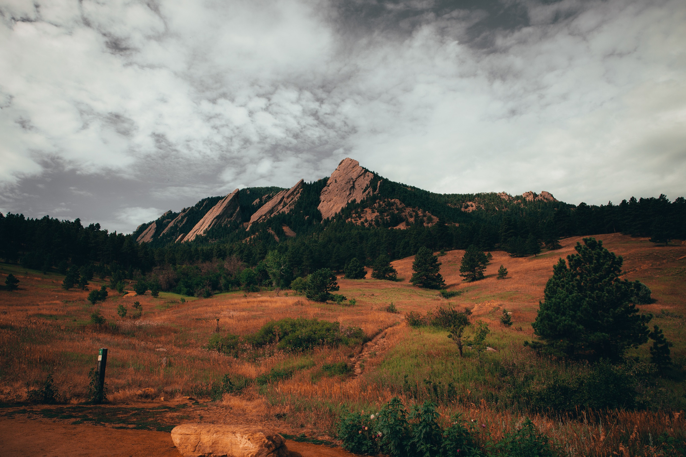
2 TIM 2 :1-7 YOU THEREFORE, MY SON, BE STRONG IN THE GRACE THAT IS IN CHRIST JESUS. 2 AND THE THINGS THAT YOU HAVE
HEARD FROM ME AMONG MANY WITNESSES, COMMIT THESE TO
FAITHFUL MEN WHO WILL BE ABLE TO TEACH OTHERS ALSO. 3
YOU THEREFORE MUST ENDURE[A] HARDSHIP AS A GOOD SOLDIER
OF JESUS CHRIST. 4 NO ONE ENGAGED IN WARFARE ENTANGLES
HIMSELF WITH THE AFFAIRS OF THIS LIFE, THAT HE MAY PLEASE
HIM WHO ENLISTED HIM AS A SOLDIER. 5 AND ALSO IF ANYONE
COMPETES IN ATHLETICS, HE IS NOT CROWNED UNLESS HE
COMPETES ACCORDING TO THE RULES. 6 THE HARDWORKING
FARMER MUST BE FIRST TO PARTAKE OF THE CROPS. 7 CONSIDER
WHAT I SAY, AND [B]MAY THE LORD GIVE YOU UNDERSTANDING IN
ALL THINGS.

Slide 4

MATTHEW 9:37-38 - 37 THEN HE SAID TO HIS DISCIPLES, “THE
HARVEST TRULY IS PLENTIFUL,
BUT THE LABORERS ARE FEW. 38 THEREFORE PRAY THE LORD OF
THE HARVEST TO SEND OUT
LABORERS INTO HIS HARVEST.”

Slide 5

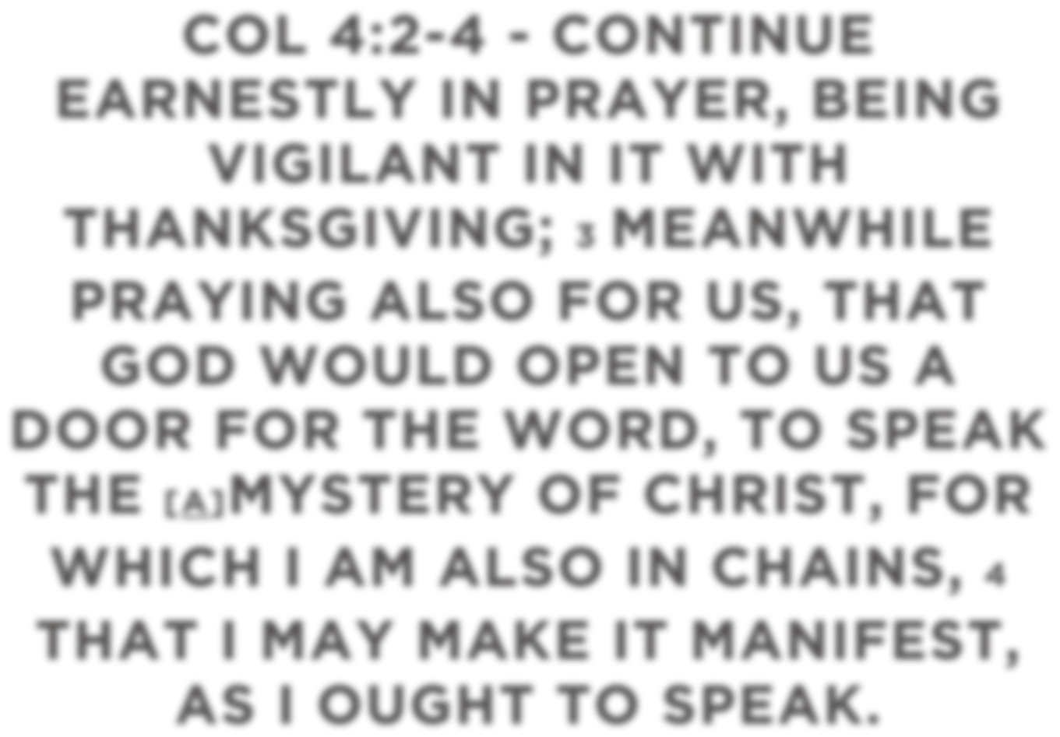

COL 4:2-4 - CONTINUE EARNESTLY IN PRAYER, BEING VIGILANT IN IT WITH THANKSGIVING; 3 MEANWHILE
PRAYING ALSO FOR US, THAT
GOD WOULD OPEN TO US A
DOOR FOR THE WORD, TO SPEAK
THE [A]MYSTERY OF CHRIST, FOR
WHICH I AM ALSO IN CHAINS, 4
THAT I MAY MAKE IT MANIFEST,
AS I OUGHT TO SPEAK.

Slide 6

MISSIONS BEGINS ON OUR KNEES THERE IS POWER IN PETITION LUKE 18 – THE STORY OF THE PERSISTENT WIDOW; AS IF JESUS IS GIVING US DIVINE PERMISSION AND PREROGATIVE TO WEAR HIM OUT. MATT 7 – ASK, SEEK, AND KNOCK – (PRESENT TENSE). THERE ARE CERTAIN THINGS THAT CAN ONLY BE EXPERIENCED THROUGH THE PORTAL OF CONSISTENCE IN PRAYER PRAYER IS AN ENCOUNTER WITH GOD. MORE THAN CHANGING THINGS, PRAYER CHANGES ME! IF YOU WANT A HEART FOR MISSIONS THEN PRAY! EVERY DAY WE DON’T PRAY IT’S LIKE WE’RE TELLING GOD ‘I GOT THIS’ PRAYER HAS NO SHELF LIFE. NO CHAIN OR LIMITATION CAN OR SHOULD STOP YOU AND ME FROM PRAYING.

Slide 7

THANK YOU! GOD BLESS YOU!

