Slide 1


Slide 2
The Covenant Ratified
Genesis 15:8-18

Slide 3
8 But Abram said,
“Sovereign Lord,
how can I know
that I will gain possession of it?”
Genesis 15: 8-18 NIV

Slide 4
9 So the Lord said to him,
“Bring me a heifer, a goat and a ram,
each three years old,
along with a dove and a young pigeon.”
Genesis 15: 8-18 NIV

Slide 5
10 Abram brought all these to him,
cut them in two and arranged the halves opposite each other;
the birds, however, he did not cut in half.
11 Then birds of prey came down on the carcasses, but Abram drove them away.
Genesis 15: 8-18 NIV

Slide 6
12 As the sun was setting,
Abram fell into a deep sleep,
and a thick and dreadful darkness
came over him.
Genesis 15: 8-18 NIV

Slide 7
13 Then the Lord said to him,
“Know for certain that for four hundred years your descendants will be strangers in a country not their own and that they
will be enslaved and mistreated there.
Genesis 15: 8-18 NIV

Slide 8
14 But I will punish the nation they serve as slaves, and afterward
they will come out with great possessions.
Genesis 15: 8-18 NIV

Slide 9
15 You, however,
will go to your ancestors in peace
and be buried at a good old age.
Genesis 15: 8-18 NIV

Slide 10
16 In the fourth generation your descendants will come back here, for the sin of the Amorites has not yet reached its full measure.”
Genesis 15: 8-18 NIV

Slide 11
17 When the sun had set and darkness had fallen, a smoking firepot with a blazing torch appeared and passed between the pieces.
Genesis 15: 8-18 NIV

Slide 12
18 On that day the Lord made a covenant with Abram and said, “To your descendants I give this land, from the Wadi of Egypt to the
great river, the Euphrates-
Genesis 15: 8-18 NIV

Slide 13
Abram Desired
a Sign

Slide 14
8 But Abram said,
“Sovereign Lord,
how can I know
that I will gain possession of it?”
Genesis 15: 8 NIV

Slide 15
9 So the Lord said to him,
“Bring me a heifer, a goat and a ram,
each three years old,
along with a dove and a young pigeon.”
Genesis 15: 9 NIV

Slide 16
God Alone
Ratified the Covenant

Slide 17
17 When the sun had set and darkness had fallen, a smoking firepot with a blazing torch appeared
and passed between the pieces.
Genesis 15: 17 NIV

Slide 18
12 As the sun was setting,
Abram fell into a deep sleep,
and a thick and dreadful darkness
came over him.
Genesis 15: 12 NIV

Slide 19
13 Christ redeemed us from the curse of the Law, having become a curse for us—
for it is written:
“Cursed is everyone who hangs on a tree”—
Galatians 3:13 NASB

Slide 20
Certainty =
Who God is

Slide 21
18 On that day the Lord made a covenant with Abram and said,
“To your descendants I give this land, from the Wadi of Egypt to the
great river, the Euphrates-
Genesis 15: 18 NIV

Slide 22
13 For example, there was God’s promise to Abraham.
Since there was no one greater to swear by, God took an oath in his own name, saying:
14 “I will certainly bless you,
and I will multiply your descendants beyond number.”
Hebrews 6:13-14 NLT

Slide 23
23 Let’s hold firmly to the confession of our hope without wavering,
for He who promised is faithful;
Hebrews 10:23 NASB

Slide 24
Conclusion:
God guaranteed the covenant’s success, requiring only our faith, trust and obedience. His desire is for us to live confident
in this truth:
His promises cannot fail.

Slide 25
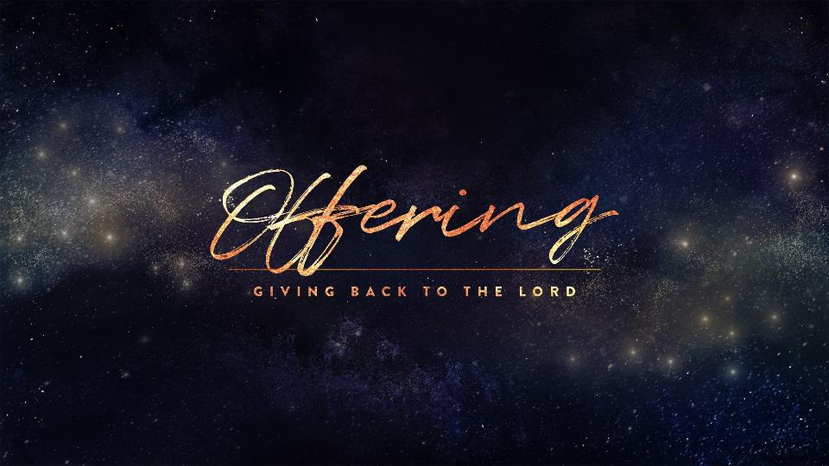

Slide 26


