Slide 1
Leader: Welcome to Holy Hermits Online Worship
3rd Sunday after Epiphany
Today, we remember Holy Hermit
St Anthony the Great
Service Prep: Lauren | Chat Host: Rachel | First Reader: Helen
Music: Lauren | Welcomer: Julie | Second Reader: Vanessa
Proof-reader: Chris | Priest: N/A | Preacher: Flashback
Broadcaster: Barry | Deacon: Lauren | Fellowship: Julie
Backup Broadcaster: Lauren | Leader: Jeremy | Safety Officer: Chris/Julie
Zoom Buttons: Viki | Cantor: Margo | Attendance: Rachel
Prep: 22/01/2026 Proofed:22/01/2026🌸

Slide 2






Hospitality
Leader:
Please mute for the service unless invited to offer your voice as part of the service ministry
Have the video camera on or off and turn the volume and brightness up or down on your device if things are too loud 🔉🔊or too bright🔅🔆
Our Cantor acts as our voice, offering the responses, in Bold Text, which we say together
Feel welcome to use the chat and reaction emojis 👍
🙏 Please take care of yourself in this space. 🙏 Come and go as you need
😴 It is great to take rest in this space, so falling asleep is also OK 😴
👂️ Remember, pastoral care is available to all in the community, if you'd like to speak to someone about anything spiritual. ❤️ Visit the help page at the website to reach out 🌐
Our Being Together ethos and safeguarding practices can also be accessed on the website 🫶​
🙌 Come as you are – we are all here together! 🙌
Notes:
Used Lent 2022

Slide 3
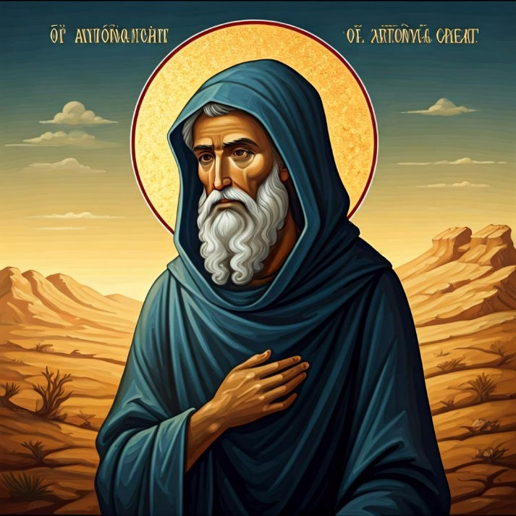
Leader: Our Holy Hermit Highlights for today
St Anthony the Great, born in 251 to a wealthy Egyptian family, gave up his fortune to live in the desert, seeking spiritual purity and battling temptation. His extreme devotion inspired many, leading to the formation of a monastic community and earning him the title "father of monasticism". His life story, chronicled by St Athanasius, became highly influential, while his teachings contributed to the sayings of the Desert Fathers and Mothers, shaping Christian monastic tradition.
Read more about St Anthony the Great please click the link on the send out

Slide 4
Invitation
Leader: As we settle into worship let your breath be soft, your mind be still, and your heart be open to the presence of God.
Ringing Church Bells: https://www.youtube.com/watch?v=to35u8KbWis

Slide 5
Leader and Cantor unmute
The Greeting
Leader:
The Grace of the lord Jesus Christ,
and the love of God,
and the fellowship of the Holy Spirit,
be with you all.
All: And also with you.

Slide 6
Gathering Prayer
Leader: Move outwards: towards the light that is coming.
Move outwards: as God gathers all the nations.
Move outwards: beyond your comfort zone and respond to God’s call.
All: God of light,
bringing joy and freedom to all nations.
Gather us to yourself,
call us to the light of your presence
and help us to shine outwards so that others can see your light. Amen.

Slide 7
Sentence
Leader: I invite our Cantor to proclaim the sentence for today.
Cantor:
Jesus went throughout Galilee, teaching in their synagogues and proclaiming the good news of the kingdom and curing every disease and every sickness among the people.
Matthew 4.23

Slide 8
Prayer of Approach
Leader: We pray the prayer of approach together
All: God of all that is good,
we have all taken different routes to get here,
we all have different stories to tell.
We all carry different burdens, different people in our hearts.
We all have different needs and face different challenges,
but together we come to you to be inspired by your word,
to sing our songs of praise, to move beyond our limitations,
to grow in the likeness of your Son, Jesus Christ,
in whose name we pray.
Amen.

Slide 9
Our First Hymn is
When I Needed a Neighbour
https://www.youtube.com/watch?v=B7a7LdgRh-k
We stay on mute
Leader and Cantor mute

Slide 10
The Deacon or LA Introduces Confession​
Christ the Son of God has been revealed as a light to the nations.​​
Silence may be kept.​..
​
Let us bring our darkness to his light, confessing our sins in penitence and faith.

Slide 11
All: ​Merciful God, our maker and our judge, ​
we have sinned against you ​in thought, word, and deed, ​
and in what we have failed to do: ​
we have not loved you with our whole heart; ​
we have not loved our neighbours as ourselves; ​
we repent, and are sorry for all our sins.​
Father, forgive us. Strengthen us to love and obey you
in newness of life; ​through Jesus Christ our Lord. ​
Amen.​

Slide 12
Words of Assurance offered by the Deacon or LA
These words of assurance from the First Letter of John declare that:
If anyone sins, we have an advocate with the Father, Jesus Christ the righteous. He is the perfect offering for our sin, and not for ours only, but for the sins of the whole world.
(1 John 2: 1-2)
In this is love, not that we loved God, but that he loved us and sent his Son to be the perfect offering for our sins.
(1 John 4:10)

Slide 13
Collect
Leader: O God,
the strength of all those who put their trust in you:
mercifully accept our prayers,
and because through the weakness of our mortal nature
we can do nothing good without you,
grant us the help of your grace,
that in keeping your commandments
we may please you both in will and deed;
through Jesus Christ our Lord. Amen.

Slide 14
The 1st reader unmutes
Leader: I invite the 1st reader to unmute and offer the 1st lesson when ready.
Reader 1: The 1st Reading is from Isaiah 9.1-4
¹ But there will be no gloom for those who were in anguish. In the former time he brought into contempt the land of Zebulun and the land of Naphtali, but in the latter time he will make glorious the way of the sea, the land beyond the Jordan, Galilee of the nations.
² The people who walked in darkness
have seen a great light;
those who lived in a land of deep darkness—
on them light has shined.
Continues…

Slide 15
³ You have multiplied the nation,
you have increased its joy;
they rejoice before you
as with joy at the harvest,
as people exult when dividing plunder.
⁴ For the yoke of their burden,
and the bar across their shoulders,
the rod of their oppressor,
you have broken as on the day of Midian.
For the word of the Lord. Thanks be to God.​

Slide 16
Leader: We now say the psalm antiphonally, I invite the first reader to lead, and we will all respond with our cantor as our voice.
Psalm 27. 1-10
¹ The Lord is my light and my salvation;
whom then shall I fear?:
the Lord is the stronghold of my life;
of whom shall I be afraid?
² When the wicked, even my enemies and my foes,
come upon me to devour me:
they shall stumble and fall.
³ If an army encamp against me,
my heart shall not be afraid:
Continues…

Slide 17
and if war should rise against me, yet will I trust.
⁴ One thing I have asked from the Lord,
which I will require:
that I may dwell in the house of the Lord
all the days of my life,
⁵ To see the fair beauty of the Lord:
and to seek his will in his temple.
⁶ For he will hide me under his shelter
in the day of trouble:
and conceal me in the shadow of his tent,
and set me high upon a rock.
Continues…

Slide 18
⁷ And now he will lift up my head:
above my enemies round about me.
⁸ And I will offer sacrifices in his sanctuary
with exultation:
I will sing, I will sing praises to the Lord.
⁹ O Lord, hear my voice when I cry:
have mercy upon me and answer me.
¹⁰ My heart has said of you, ‘Seek his face’:
your face, Lord, I will seek.

Slide 19
The 2nd reader unmutes
Leader: Thank you, I invite the 2nd reader to unmute and offer the 2nd lesson when ready.
Reader 2: The 2nd Reading is from 1 Corinthians 1.10-18
¹⁰ Now I appeal to you, brothers and sisters, by the name of our Lord Jesus Christ, that all of you should be in agreement and that there should be no divisions among you, but that you should be united in the same mind and the same purpose. ¹¹ For it has been reported to me by Chloe’s people that there are quarrels among you, my brothers and sisters. ¹² What I mean is that each of you says, ‘I belong to Paul’, or ‘I belong to Apollos’, or ‘I belong to Cephas’, or ‘I belong to Christ.’ ¹³ Has Christ been divided?
Continues…

Slide 20
Was Paul crucified for you? Or were you baptized in the name of Paul? ¹⁴ I thank God that I baptized none of you except Crispus and Gaius, ¹⁵ so that no one can say that you were baptized in my name. ¹⁶ (I did baptize also the household of Stephanas; beyond that, I do not know whether I baptized anyone else.) ¹⁷ For Christ did not send me to baptize but to proclaim the gospel, and not with eloquent wisdom, so that the cross of Christ might not be emptied of its power. ¹⁸ For the message about the cross is foolishness to those who are perishing, but to us who are being saved it is the power of God.
For the word of the Lord. Thanks be to God.

Slide 21

We pause before
​the Gospel ​​

Slide 22
The Gospel of our Lord Jesus Christ according to St Matthew Chapter 4 beginning at the 12th verse. All: Glory to you Lord Jesus Christ
¹² Now when Jesus heard that John had been arrested, he withdrew to Galilee.
¹³ He left Nazareth and made his home in Capernaum by the lake, in the territory of Zebulun and Naphtali,
¹⁴ so that what had been spoken through the prophet Isaiah might be fulfilled:
¹⁵ ‘Land of Zebulun, land of Naphtali,
on the road by the sea, across the Jordan, Galilee of the Gentiles—
¹⁶ the people who sat in darkness
have seen a great light,
and for those who sat in the region and shadow of death
light has dawned.’
Continue…

Slide 23
¹⁷ From that time Jesus began to proclaim, ‘Repent, for the kingdom of heaven has come near.’
¹⁸ As he walked by the Sea of Galilee, he saw two brothers, Simon, who is called Peter, and Andrew his brother, casting a net into the lake—for they were fishermen.
¹⁹ And he said to them, ‘Follow me, and I will make you fish for people.’
²⁰ Immediately they left their nets and followed him.
²¹ As he went from there, he saw two other brothers, James son of Zebedee and his brother John, in the boat with their father Zebedee, mending their nets, and he called them.
Continues…

Slide 24
²² Immediately they left the boat and their father, and followed him.
²³ Jesus went throughout Galilee, teaching in their synagogues and proclaiming the good news of the kingdom and curing every disease and every sickness among the people.
²⁴ So his fame spread throughout all Syria, and they brought to him all the sick, those who were afflicted with various diseases and pains, demoniacs, epileptics, and paralytics, and he cured them.
²⁵ And great crowds followed him from Galilee, the Decapolis, Jerusalem, Judea, and from beyond the Jordan.
This is the gospel of the Lord. All: Praise to you Lord Jesus Christ.

Slide 25
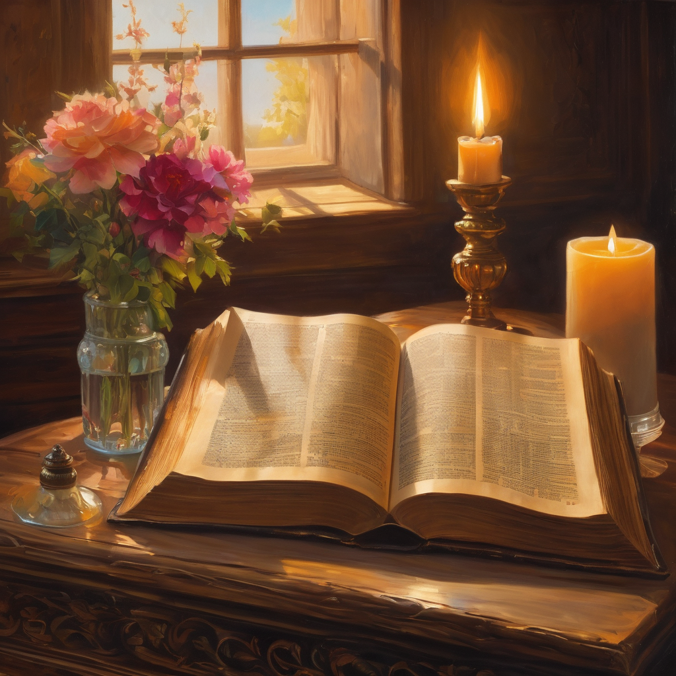
We pause
after ​the Gospel ​​

Slide 26
Leader: The Sermon is a Flashback sermon.
Leader and Cantor mute
Broadcaster exits screenshare
Flashback Sermon
Repent! About Turn
https://www.youtube.com/watch?v=t-R5kbbecdk

Slide 27
Leader unmutes
Our next Hymn is
I Will Make You Fishers Of Men
https://www.youtube.com/watch?v=HT-fry-aRos
We stay on mute
Leader mutes

Slide 28
The Leader and Cantor unmute
The Greeting of Peace
Leader: We are the body of Christ
All: God’s Spirit is with us
Leader: The peace of the Lord be always with you.
All: And also with you.
Leader: A sign of peace may be exchanged
You may like to type 'Peace' into the chat, use the 'raise hand’ or other reaction buttons, or just simply wave via the screen with your video turned on
(Broadcaster exits shared screen for a few moments for the exchange of peace)

Slide 29
Prayer of Thanksgiving before Intercessions
Leader: As we enter prayer, I invite the second reader to unmute to lead our intercessions which follow the prayer of thanksgiving. Please feel free to change your body position as you need.
Continue…

Slide 30
Prayer of Thanksgiving before Intercessions
Leader: Fearless God, how wonderful is your presence with us,
as you move us outwards –
from sorrow to joy: day by day;
from challenge to opportunity: day by day;
from darkness to light: day by day;
from oppression to freedom: day by day;
from gloom to glory: day by day;
from fear to fulfilment: day by day.
Through the power of your Holy Spirit.
Amen.

Slide 31
Intercessions
Reader 2: We pray for creation and communities we share our lives with. We pause for a few moments to name either in our hearts, or out loud, or in the chat, those environments and communities we bring to the Lord in prayer.
PAUSE…
We entrust to you the community of Holy Hermits Online and our ministry partners:
Prosper the work of our hands and show us the way to your new creation.
Creator God, Hear our prayer.
St John's Cathedral Brisbane The Anglican Diocese of Southern Queensland St Gabriel’s, Carindale Benedictus Contemplative Church, Canberra Anglican Focus and Tithe.ly

Slide 32
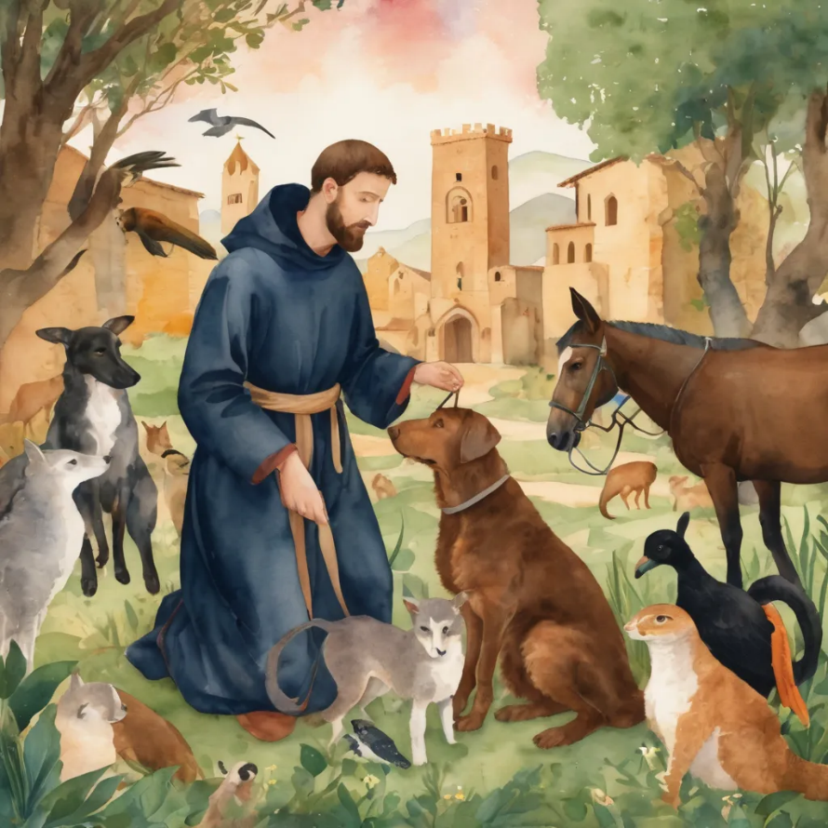
Reader 2: Loving Creator, we entrust to you all animals, especially those who are sick, anxious, ageing, lost, at risk, lonely, sad, hungry, in pain, homeless, abused, living in fear, encountering violence of any kind, in need of comfort, rehabilitation or transformation.
We invite your loving compassion for:
We name in our hearts, out loud or in the chat,
the animals we bring to the Lord in prayer. PAUSE…
Jasmine, ​
Leese(y), ​
Sid, Toots & Lulu​
Polly and Suki​
Fred, George & Percy​
Koshka ​
Jax
Lambert ​​
Kala, Nigel & Little One ​​
Toby​​
Taco​​
Paddy ​​
Rosie​

Slide 33
Reader 2: Eternal Trinity of Love, we uphold to you the people we love and carry cares for:
We name in our hearts, out loud or in the chat, those we bring to the Lord in prayer. PAUSE… We entrust to you those who have died, those who have died peacefully and those who have died tragically, The old and the young. Receive them into your Kingdom. Lord in your mercy, Hear our prayers. Amen.
Kerry, Les & Jake Julie, Ray, Tracey & Shane Mark, Desley & Bob ​​ Rachel, Mervyn & Gillian ​​Rev'd Shane & Janette​​ Alecia, Martin & Aidan​​ Steven & Vanessa | Barry​​ Dr Julie ​​ Ruth​​ Phil​ May Susan Tanya​ Craig Neva​ | Bill & Marjorie​​ Aaron & Andrea Dilys & Tony, Paul & Darhon Judy & Mary​​ Bob & Di​ Pat & Julie Miriam Gayanne | Kirsten, Greg, Daphne & Beau Alan & Gaylene​ Jess & Leah ​​ Bonnie & girls Liz’s Godchildren Barry & Gwen Matthew & Nicholas​

Slide 34
Pray Daily Cycle of Prayer
Leader: Loving God, joining with the Church in our cycle of prayer, we ask your blessings on:
The Diocese of Sydney – The Anglican Church of Australia
The Parish of Logan: Geoff, Robyn, Ian, Peter, Carol, Dianne, Mary, Peter
Anglicare SQ Symes Thorpe Residential Aged Care – Toowoomba

Slide 35
Commitment prayer for the week: People in need
God who gives shelter, we give thanks for opportunities to offer support and prayers for those that are struggling at this time to put a permanent roof over their heads and to shelter those they love.​​​​
Please shine a light on homelessness for the people and animals experiencing this and provide a way for homes to be found and others to help, especially governments and churches.​​​​
Please protect all living rough and give safety and security to families and young people, and those who are supporting them.​​​​
Continue…

Slide 36
The Commitment prayer (cont.):
Please help us channel and inspire the hospitality that Jesus and his followers sought and encouraged in their day, and especially strengthen those already offering this ministry.​​​​
Awaken compassion in the hearts of all people to reach out with a loving hand. When we feel disheartened by this unfolding situation, please refocus our energies to keep praying and finding small ways to help so we don't feel so overwhelmed.​​​​
Usher in a wave of change for systems to be transformed and ways made for large scale transformation. Amen.​​

Slide 37
Leader: Let us pray together the prayer which Jesus gave us saying:
All: Our Father in heaven,
hallowed be your name,
your kingdom come, your will be done,
on earth as in heaven.
Give us today our daily bread.
Forgive us our sins
as we forgive those who sin against us.
Save us from the time of trial
and deliver us from evil.
For the kingdom, the power,
and the glory are yours
now and for ever.
Amen.

Slide 38
Devotions

Slide 39

Hermit Wisdom

Slide 40
Leader: St Anthony the Great
“Do not be afraid to hear about virtue and do not be a stranger to the term. For it is not distant from us nor is it external to us; its realization lies within us and the work is easy if only we want it. The Greeks leave home and cross the seas in order to gain an education, but there is no need for us to go away on account of the Kingdom of God nor need we cross the sea in search of virtue. For the Lord has told us, 'The Kingdom of God is within you.' All that is needed for goodness is that which is within, the human heart."

Slide 41

Leader: ​As we enter a few minutes of silence together, you are invited to pray this prayer of adoration and/or spend this time in contemplation. ​
The Spiritual Communion prayer follows
on the next slide. Let us be still.
Leader and Cantor Mute.
​
God’s light brings freedom.
God’s light brings joy.
God’s light brings us together.
God’s light moves us outwards to others.
God’s light is for everyone.
Amen.

Slide 42
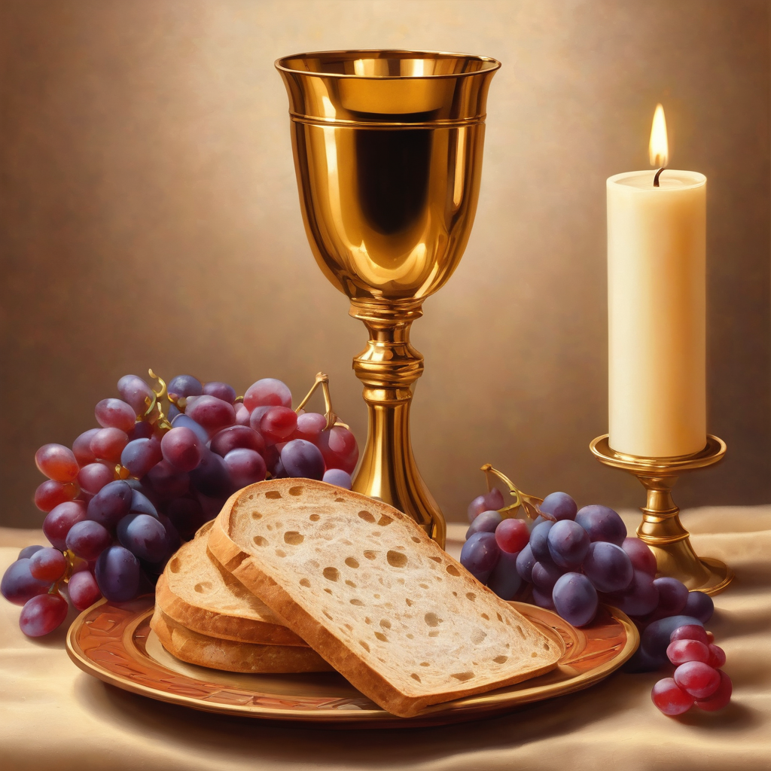
Oh, my Lord Jesus I turn to you
present at the Altar and in the
Tabernacle. I believe that you are
present in the Holy Sacrament of your
most Sacred Body and Blood. I love you
above all things and I desire to receive
you into my Soul. I cannot at this
moment receive you Sacramentally in
Holy Communion. Come spiritually into
my heart. Purify it, Sanctify it. Render
my heart like your own heart.
I embrace you as if you were already
there and unite myself wholly with
you. Never permit me to be separated
from you. Lord, I am not worthy to
receive you, but only say the word and I
shall be healed. Amen
Making a
Spiritual Communion
(Prayed in silence)

Slide 43
Leader unmutes
Our final song is
Go Forth And Tell!
https://www.youtube.com/watch?v=XNyDd9qtuk0
​We stay on mute
Leader and Cantor mute

Slide 44
Leader and cantor unmute
Sending Prayer
Leader: We pray our sending prayer together.
All: God of light,
keep us faithful as light-bearers.
Help us to keep our focus on you and then outwards to others.
Be with us as we move outwards beyond our comfort zone.
Help us, like the fishermen, to leave behind the familiar and safe
and move into your light with freedom and joy.
Amen.

Slide 45
The Benediction
Leader: Let us all invite God’s blessings together,
All: May the Lord bless us and keep us.
May the Lord’s face shine upon us and be gracious to us.
May the Lord’s countenance be lifted upon us,
and bring us peace. Amen

Slide 46
Notices
Sabbath January continues this week, a time of slowing down and refreshing.
Next Sunday: Companion Animal Ministry Workshop @ 11:30am
Rev’d Canon Jess will be leading a Lenten study for 6 weeks, more information to come
See HHO Events page for further upcoming events HHO Events especially at the Cathedral online

Slide 47
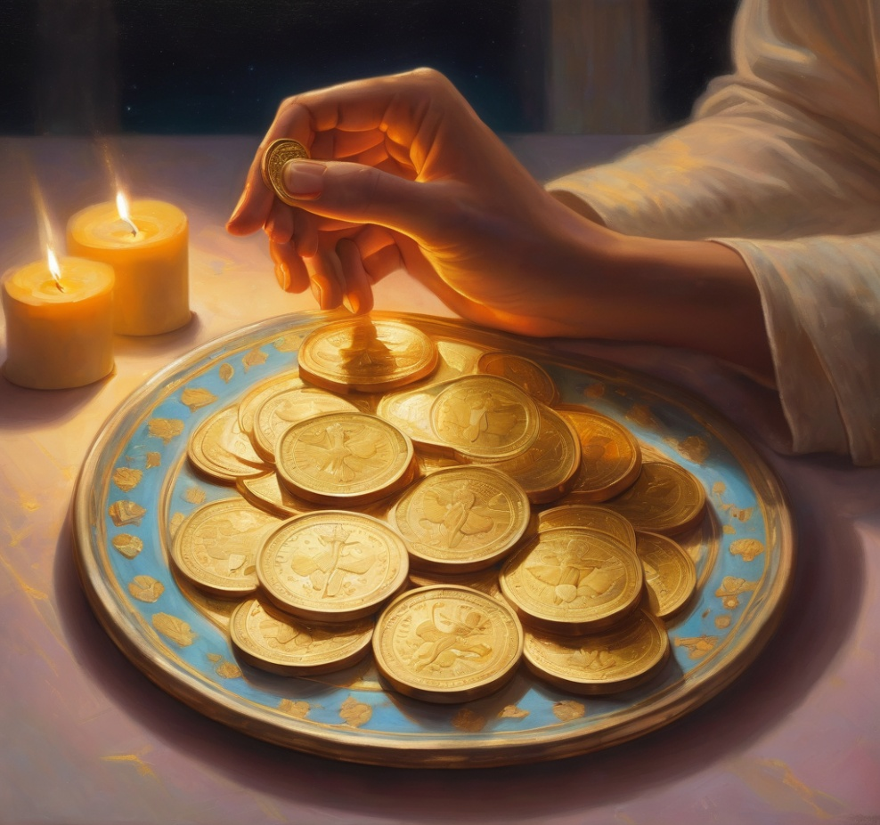
Leader: Thank you for your regular gifts to this ministry. Offerings are most welcome via:
The HHO App
Direct Debit
International Direct Debit
Please consider a one-off donation
or leaving a legacy in your Will
For further information go to HHO give page
https://holyhermits.com.au/give

Slide 48
Serving next week
Sunday 1st February
9:00 am AEST
Service Prep: Paul | Chat Host: Viki | First Reader: Phil
Music: Paul | Welcomer: Chris | Second Reader: Bob
Proof-reader: Viki | Priest: N/A | Preacher: Lauren
Broadcaster: Lauren | Deacon: Lauren | Fellowship: Julie
Backup Broadcaster: Barry | Leader: Jeremy | Safety Officer: Chris
Zoom Buttons: Paul | Cantor: Roselyn | Attendance: Viki
Thank you for your ministry gifts
New Servers always welcome!
Please email Rev’d Lauren to get involved
holyhermits@anglicanchurchsq.org.au

Slide 49
Leader: I invite everyone to unmute for the Dismissal
Leader: Go in peace to love and serve the Lord.
All: In the name of Christ, Amen.

Slide 50
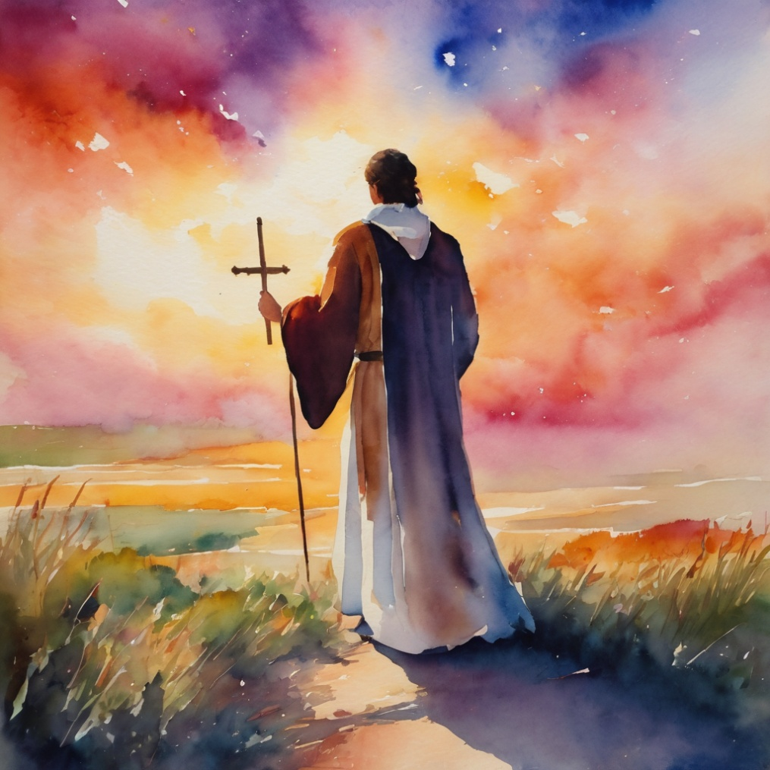
Fellowship time
Thank you, Julie for leading Fellowship
Please feel welcome to linger or pop a message in the chat and head off when you are ready.​
Extra resources developed
by Roots on the Web
Artwork by Padlet

