Slide 1


Slide 2
Covenant:
Portion Promised

Slide 3
Genesis 17:1-9 NIV
When Abram was ninety-nine years old, the Lord appeared to him and said,
“I am God Almighty; walk before me faithfully and be blameless.
2 Then I will make my covenant between me and you and will greatly increase your numbers.”

Slide 4
Genesis 17:1-9 NIV
3 Abram fell facedown, and God said to him,
4 “As for me, this is my covenant with you:
You will be the father of many nations.

Slide 5
Genesis 17:1-9 NIV
5 No longer will you be called Abram;
your name will be Abraham, for I have made you a father of many nations.
6 I will make you very fruitful;
I will make nations of you,
and kings will come from you.

Slide 6
Genesis 17:1-9 NIV
7 I will establish my covenant as an everlasting covenant between
me and you
and your descendants after you
for the generations to come,
to be your God and the God of your descendants after you.

Slide 7
Genesis 17:1-9 NIV
8 The whole land of Canaan, where you now reside as a foreigner, I will give
as an everlasting possession
to you and your descendants after you;
and I will be their God.”

Slide 8
Genesis 17:1-9 NIV
9 Then God said to Abraham,
“As for you, you must keep my covenant, you and your descendants after you
for the generations to come.

Slide 9
Portion Promised
Land

Slide 10
Genesis 15:7 NIV
7 He also said to him,
“I am the Lord, who brought you out of
Ur of the Chaldeans
to give you this land
to take possession of it.

Slide 11
Genesis 17:8 NIV
8 The whole land of Canaan,
where you now reside as a foreigner,
I will give
as an everlasting possession
to you and your descendants after you;
and I will be their God.

Slide 12
Portion Promised
Seed

Slide 13
Genesis 17:3-4 NIV
3 Abram fell facedown, and God said to him,
4 “As for me, this is my covenant with you:
You will be the father of many nations.

Slide 14
Genesis 17:8 KJV
8 And I will give unto thee,
and to thy seed after thee,
the land wherein thou art a stranger,
all the land of Canaan,
for an everlasting possession;
and I will be their God.

Slide 15
Galatians 3:16 NIV
16 Now to Abraham and his Seed
were the promises made.
He does not say, “And to seeds,” as of many, but as of one, “And to your Seed,”
who is Christ.

Slide 16
Galatians 3:29 NIV
29 If you belong to Christ,
then you are Abraham’s seed,
and heirs according to the promise.

Slide 17
Portion Promised
Blessing

Slide 18
Genesis 12:2-3 NIV
“I will make you into a great nation,
and I will bless you;
I will make your name great,
and you will be a blessing.
3 I will bless those who bless you,
and whoever curses you I will curse;
and all peoples on earth
will be blessed through you.

Slide 19
Genesis 15:1 NIV
the word of the Lord came to Abram in a vision:
“Do not be afraid, Abram.
I am your shield,
your very great reward.

Slide 20
Genesis 17:5-6 NIV
5 No longer will you be called Abram;
your name will be Abraham, for I have made you a father of many nations.
6 I will make you very fruitful;
I will make nations of you,
and kings will come from you.

Slide 21
Galatians 3:8 NIV
Scripture foresaw that
God would justify the Gentiles by faith, and announced the gospel in advance
to Abraham:
“All nations will be blessed through you.”

Slide 22
Conclusion:
God Himself has always been our portion. His covenant with Abraham was the beginning of restoring the lost portion due to sin. This covenant was established through a promise ultimately fulfilled through Christ,
the seed of Abraham and our Savior.

Slide 23
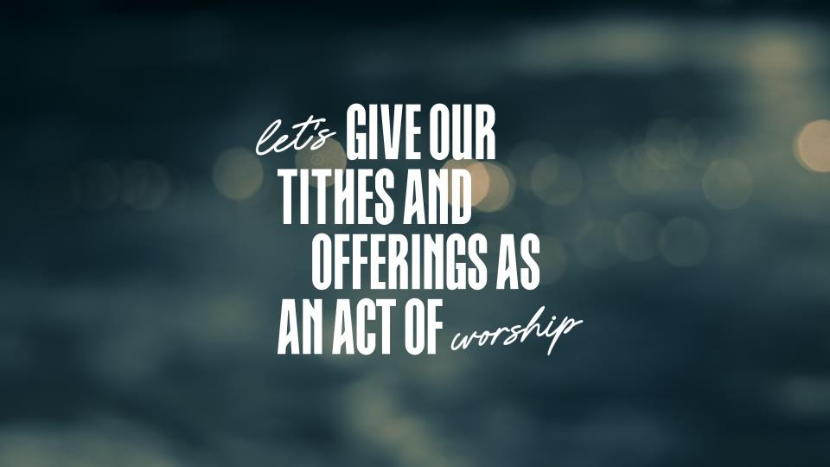

Slide 24


