Slide 1
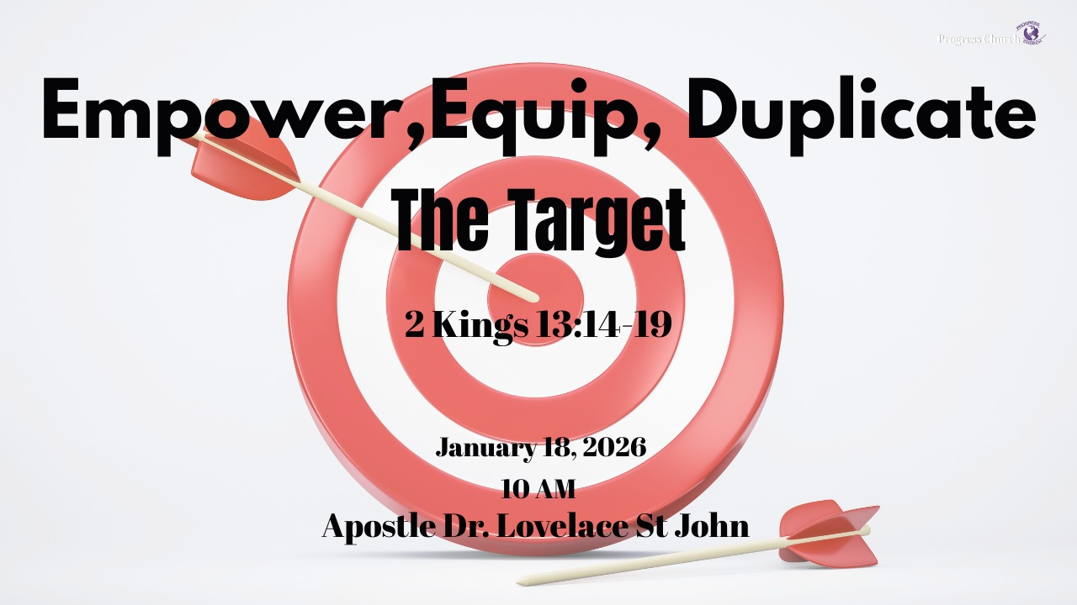

Slide 2



Scripture:
2 Kings 13: 14 – 19

Slide 3
INTRODUCTION
Elisha commands the King to open the window toward the enemy.
Equipping requires vision and a target. You cannot hit what you haven’t identified.
A church that refuses to empower and equip the next generation risks dying with the previous one.

Slide 4
INTRODUCTION con’t
In life and in the kingdom of God, many are sincere, many are busy, many are emotional, but not all are effective.
Why? Because effectiveness demands clarity. You cannot win a battle you have not defined. You cannot hit a target you have not identified.

Slide 5
2 KINGS 13:14–19 (SUMMARY)
King Joash comes to the prophet Elisha as Elisha is dying.
v. 14 – Joash weeps over Elisha, recognizing his value: “O my father, my father, the chariot of Israel, and the horsemen thereof.”
v. 15–16 – Elisha tells him: “Take bow and arrows.” Joash takes them. Elisha puts his hands on the king’s hands.

Slide 6
2 KINGS 13:14–19 (SUMMARY con’t)
v. 17 – Elisha says, “Open the window eastward” (toward the territory of Syria), and tells him to shoot. He shoots. Elisha calls it: “The arrow of the LORD’s deliverance, and the arrow of deliverance from Syria.”
v. 18–19 – Elisha then says, “Take the arrows… smite upon the ground.” Joash strikes three times and stops. Elisha is angry: “You should have smitten five or six times; then had you smitten Syria till you had consumed it. Now you shall smite Syria but three times.”

Slide 7
THERE WAS A CLEAR ENEMY & CLEAR BATTLEGROUND
The direction of the window was eastward, toward the front lines.
This was not general warfare; it was a specific conflict.
God did not tell Joash, “Just shoot anywhere.” The arrow was to be directed toward the real battle.
Equipping is always tied to a defined enemy, a defined need, a defined assignment.

Slide 8
THERE WAS A CLEAR ENEMY & CLEAR BATTLEGROUND
You must know:
What battles you are called to fight.
What territories you are called to influence.
What problems you are anointed to solve.
You cannot hit what you haven’t identified.

Slide 9
THE PROPHETIC ACT REVEALED THE TARGET
“And he said, Open the window eastward. And he opened it. And he said, The arrow of the LORD’s deliverance, and the arrow of deliverance from Syria” (vv. 17)
Elisha was helping Joash see what God was about to do.
The arrow was not just an arrow; it was a picture of God’s intention, a prophetic mapping of the target

Slide 10
THE PROPHETIC ACT REVEALED THE TARGET
Vision is spiritual sight.
God gives prophetic direction so we stop living generally and start living specifically.
INSIGHT:
Before God equips you, He often shows you:
A burden, A vision, A specific group of people, A particular need, A clear direction

Slide 11
EQUIPPING FOR YOUR "EAST WINDOW"
Elisha then commands the King to open the window toward the East and shoot.
Equipping is the process of providing the right tools (the bow and arrows) and the right direction (the East window).
Shaping the church for the future requires us to point the arrows toward the specific challenges of the next generation.

Slide 12
EQUIPPING FOR YOUR "EAST WINDOW"
Equipping others goes beyond giving permission; it involves preparation: Teaching Scripture. Training in spiritual disciplines.
Equipping is not just having tools; it is having God’s hand on your tools. It is not just skill; it is anointing. Not just information; it is impartation.

Slide 13
EQUIPPING REQUIRES VISION AND A TARGET.
A. God does not equip you in a vacuum, He equips you for a target.
Elisha did not just give Joash random arrows. He connected them to a specific battle
Your spiritual gifts are not for decoration; they are for a target.
Your experiences, good or painful, are not random; they are training for your assignment.
Your resources, relationships, and opportunities are equipment for a particular purpose.

Slide 14
EQUIPPING REQUIRES VISION AND A TARGET.
B. Vision is the window that directs your arrows
The arrows only matter in the direction of the open window.
Vision is that open window, the revealed direction of God for your life.
Without that:
You may be anointed, but scattered. Gifted, but unfocused. Busy, but not effective.

Slide 15
EQUIPPING REQUIRES VISION AND A TARGET.
A life without vision:
Shoots arrows in every direction. Tries everything, commits to nothing. Lives by reactions, not by revelation.
Equipping without vision leads to:
Frustration (“I know I have gifts, but I don’t know what they’re for”)
Comparison (“I’m trying to do what others are doing, not what I’m called to do”)
Waste (resources used where God never asked you to fight).

Slide 16
EQUIPPING REQUIRES VISION AND A TARGET.
C. Respond fully to God’s equipping or live with partial victory
Joash’s tragedy was not that God didn’t speak; it was that he didn’t fully respond.
God had given him the target.
God had given him the sign: the arrow of the Lord’s deliverance.
God had given him the instruction: strike the ground.
But Joash stopped at three.

Slide 17
EQUIPPING REQUIRES VISION AND A TARGET.
Equipping demands:
Consistency: Strike again.
Intensity: Strike like the outcome matters.
Perseverance: Keep pressing until the enemy is truly subdued.
You cannot fulfill a great vision with a casual response.

Slide 18
WARNINGS FROM THE TEXT
Emotions are not enough.
Joash wept over Elisha, but tears does not equal obedience or vision.
Proximity to anointing is not enough.
He was with Elisha, hearing clear instruction, but his own response limited him.
One act of obedience is not enough.
Shooting the first arrow was good; stopping at three strikes was disastrous.

Slide 19
WARNINGS FROM THE TEXT con’t
We must move:
From emotional attachment to spiritual fathers
To personal clarity, responsibility, diligence, and follow‑through.

Slide 20
APPLICATION – TODAY AND GOING FORWARD
A. Identify Your Target
Ask God and be honest with yourself:
What battle am I called to fight?
Not everything, this season.
B. Clarify Your Vision (Open the Window)
Write it down. Pray it through.
Vision should answer:
What has God put in my heart to do?
For whom?
Where?
With what?
Vision is not a vague desire; it is a clear direction.
1. Surrender Your Hands to God
2. Offer Him your abilities, your schedules, your skills, your influence.
3. Pick Up the Bow in Obedience
4. Identify a specific area where you have delayed doing what you know God has asked.
5. Aim at Your Real Battle. Name the “Aram” in your life.

Slide 21
CONCLUSION
The same God who opened the window for Joash can open your window.
The same God who put His hand on Joash’s hands wants to empower your hands today.
Your life, when aligned with God’s vision, will hit targets you never imagined.
Your arrows, your prayers, your service, your sacrifices, your obedience, can become “arrows of the Lord’s deliverance” to your generation.

Slide 22
CONCLUSION con’t
God reveals a target (Syria).
God opens a window (eastward).
God gives equipment (bow and arrows).
God lays His hand on our hands.
“Equipping requires vision and a target. You cannot hit what you haven’t identified.”

