Slide 1
Leader: Welcome to Holy Hermits Online Worship
2nd Sunday after Epiphany
Today, we remember Holy Hermit
St Syncletical of Alexandria
Service Prep: Kristine | Chat Host: Viki | First Reader: Paul
Music: Wiggles 🐶 | Welcomer: Chris | Second Reader: Liz
Proof-reader: Viki | Priest: N/A | Preacher: Lauren
Broadcaster: Kieron | Deacon: Lauren | Fellowship: Lauren
Backup Broadcaster: Barry | Leader: Julie | Safety Officer: Chris
Zoom Buttons: Paul | Cantor: Barry | Attendance: Viki
Prep: 10/01/2026 Proofed:11 /01/2026🌸

Slide 2


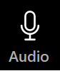



Hospitality
Leader:
Please mute for the service unless invited to offer your voice as part of the service ministry
Have the video camera on or off and turn the volume and brightness up or down on your device if things are too loud 🔉🔊or too bright🔅🔆
Our Cantor acts as our voice, offering the responses, in Bold Text, which we say together
Feel welcome to use the chat and reaction emojis 👍
🙏 Please take care of yourself in this space. 🙏 Come and go as you need
😴 It is great to take rest in this space, so falling asleep is also OK 😴
👂️ Remember, pastoral care is available to all in the community, if you'd like to speak to someone about anything spiritual. ❤️ Visit the help page at the website to reach out 🌐
Our Being Together ethos and safeguarding practices can also be accessed on the website 🫶​
🙌 Come as you are – we are all here together! 🙌
Notes:
Used Lent 2022

Slide 3
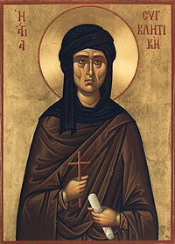
Leader: Our Holy Hermit Highlights for today
Syncletica of Alexandria is known as one of the holy Desert mothers from the 4th century. Born into a wealthy family, she was well known for her beauty but felt called to live in solitude and gave up all her wealth and position to retreat. She lived in a crypt in Alexandria, with her younger blind sister for years, devoting herself to spiritual practice and prayer. She was eventually sought out by people who had learnt of her holiness and wanted to get closer to God and ended up teaching other women in particular how to live in communion with God.
To read more about our hermits please click the link​​ in the send out

Slide 4
Invitation
Leader: As we settle into worship let your breath be soft, your mind be still, and your heart be open to the presence of God.
Opening Bells: https://www.youtube.com/watch?v=5Vty53kgTeU

Slide 5
Leader and Cantor unmute
The Greeting
Leader: The Grace of the lord Jesus Christ, and the
love of God, and the fellowship of the Holy
Spirit, be with you all.
All: And also with you.

Slide 6
Gathering Prayer
Leader:
God, reveal to us today more of who you are.
Help us to see with fresh eyes
your plan for our lives,
and for all of creation.
Amen.

Slide 7
Prayer of Adoration
All: Ever present God, you invite us to come and see
your creativity in our world,
revealing the hidden and shining your light;
Lord Jesus, you invite us to listen to your words
and to learn from your teaching,
revealing the hidden and shining your light;
Holy Spirit, you invite us to come and see
where you are at work in our world today,
revealing the hidden and shining your light.
Amen.

Slide 8
Sentence
Leader: I invite our Cantor to proclaim the sentence for today.
Cantor:
God is faithful; by him you were called into the fellowship of his Son, Jesus Christ our Lord.
1 Corinthians 1.9

Slide 9
Leader: We pray the prayer of approach together
All: God of daring and diversity,
we add our voices to the song of praise of all Christians.
We open our hearts
to receive the treasures hidden in your living Word.
We pledge to share those treasures with others
and reflect your love.
Amen.

Slide 10
Our First Hymn is
Christ Be Our Light
https://www.youtube.com/watch?v=kqOvksAAK88
We stay on mute
Leader and Cantor mute

Slide 11
The LA or Deacon Introduces Confession​
The Lord comes, bringing to light things now hidden in darkness, and disclosing the purposes of the heart.
​​
Silence may be kept.​..
​
Let us open our hearts and prepare for his coming, confessing our sins in penitence and faith.

Slide 12
All: ​Merciful God, our maker and our judge, ​
we have sinned against you ​in thought, word, and deed, ​
and in what we have failed to do: ​
we have not loved you with our whole heart; ​
we have not loved our neighbours as ourselves; ​
we repent, and are sorry for all our sins.​
Father, forgive us. Strengthen us to love and obey you
in newness of life; ​through Jesus Christ our Lord. ​
Amen.​

Slide 13
Words of Assurance offered by the Deacon or LA
These words of assurance from the First Letter of John declare that:
If anyone sins, we have an advocate with the Father, Jesus Christ the righteous. He is the perfect offering for our sin, and not for ours only, but for the sins of the whole world.
(1 John 2: 1-2)
In this is love, not that we loved God, but that he loved us and sent his Son to be the perfect offering for our sins.
(1 John 4:10)

Slide 14
Collect
Leader: Almighty God,
whose Son, our Saviour Jesus Christ,
is the light of the world: may your people,
illumined by your word and sacraments,
shine with the radiance of his glory,
that he may be known, worshipped,
and obeyed to the ends of the earth;
who lives and reigns with you and the Holy Spirit,
one God, now and for ever.
Amen.

Slide 15
The 1st reader unmutes
Leader: I invite the 1st reader to unmute and offer the 1st lesson when ready.
Reader 1: The 1st Reading is from Isaiah 49.1-7
¹ Listen to me, O coastlands, pay attention, you peoples from far away! The Lord called me before I was born, while I was in my mother’s womb he named me. ² He made my mouth like a sharp sword, in the shadow of his hand he hid me; he made me a polished arrow, in his quiver he hid me away.
Continues…

Slide 16
³ And he said to me, ‘You are my servant, Israel, in whom I will be glorified.’ ⁴ But I said, ‘I have laboured in vain, I have spent my strength for nothing and vanity; yet surely my cause is with the Lord , and my reward with my God.’ ⁵ And now the Lord says, who formed me in the womb to be his servant, to bring Jacob back to him, and that Israel might be gathered to him, for I am honoured in the sight of the Lord , and my God has become my strength—
Continues…

Slide 17
⁶ he says, ‘It is too light a thing that you should be my servant to raise up the tribes of Jacob and to restore the survivors of Israel; I will give you as a light to the nations, that my salvation may reach to the end of the earth.’ ⁷ Thus says the Lord , the Redeemer of Israel and his Holy One, to one deeply despised, abhorred by the nations, the slave of rulers, ‘Kings shall see and stand up, princes, and they shall prostrate themselves, because of the Lord , who is faithful, the Holy One of Israel, who has chosen you.’
For the word of the Lord. Thanks be to God.​

Slide 18
Leader: We now say the psalm antiphonally, I invite the first reader to lead, and we will all respond with our cantor as our voice.
Psalm 40
1-14
¹ I waited patiently for the Lord:
and he inclined to me and heard my cry.
² He brought me up from the pit of roaring waters,
out of the mire and clay:
and set my feet upon a rock, and made firm my foothold.
³ And he has put a new song in my mouth:
even a song of thanksgiving to our God.
⁴ Many shall see it and fear:
and shall put their trust in the Lord.
Continues…

Slide 19
⁵ Blessed are those who have made the Lord their hope:
who have not turned to the proud,
or to those who wander in deceit.
⁶ O Lord my God, great are the wonderful things
which you have done,
and your thoughts which are towards us:
there is none to be compared with you;
⁷ Were I to declare them and speak of them:
they are more than I am able to express.
⁸ Sacrifice and offering you do not desire:
but my ears you have marked for obedience;
Continues…

Slide 20
⁹ Burnt-offering and sin-offering you have not required:
then said I, Lo, I come.
¹⁰ In the scroll of the book it is written of me,
that I should do your will:
O my God, I long to do it, your law delights my heart.
¹¹ I have declared your righteousness
in the great congregation:
I have not restrained my lips, O Lord,
and that you know.
Continues…

Slide 21
¹² I have not hidden your righteousness in my heart:
I have spoken of your faithfulness and of your salvation.
¹³ I have not kept back your loving-kindness and your truth:
from the great congregation.
¹⁴ O Lord, do not withhold your mercy from me:
let your loving-kindness and your truth
ever preserve me.

Slide 22
The 2nd reader unmutes
Leader: Thank you, I invite the 2nd reader to unmute and offer the 2nd lesson when ready.
Reader 2: The 2nd Reading is from 1 Corinthians 1.1-9
¹ Paul, called to be an apostle of Christ Jesus by the will of God, and our brother Sosthenes, ² To the church of God that is in Corinth, to those who are sanctified in Christ Jesus, called to be saints, together with all those who in every place call on the name of our Lord Jesus Christ, both their Lord and ours: ³ Grace to you and peace from God our Father and the Lord Jesus Christ. ⁴ I give thanks to my God always for you because of the grace of God that has been given you in Christ Jesus,
Continues…

Slide 23
⁵ for in every way you have been enriched in him, in speech and knowledge of every kind— ⁶ just as the testimony of Christ has been strengthened among you— ⁷ so that you are not lacking in any spiritual gift as you wait for the revealing of our Lord Jesus Christ. ⁸ He will also strengthen you to the end, so that you may be blameless on the day of our Lord Jesus Christ. ⁹ God is faithful; by him you were called into the fellowship of his Son, Jesus Christ our Lord.
For the word of the Lord. Thanks be to God.

Slide 24

We pause before
​the Gospel ​​

Slide 25
Leader: The Gospel of our Lord Jesus Christ according to
St John 1.29-42
²⁹ The next day he saw Jesus coming towards him and declared, ‘Here is the Lamb of God who takes away the sin of the world! ³⁰ This is he of whom I said, “After me comes a man who ranks ahead of me because he was before me.” ³¹ I myself did not know him; but I came baptizing with water for this reason, that he might be revealed to Israel.’ ³² And John testified, ‘I saw the Spirit descending from heaven like a dove, and it remained on him.
Continues…

Slide 26
³⁴ And I myself have seen and have testified that this is the Son of God.’ ³⁵ The next day John again was standing with two of his disciples, ³⁶ and as he watched Jesus walk by, he exclaimed, ‘Look, here is the Lamb of God!’ ³⁷ The two disciples heard him say this, and they followed Jesus. ³⁸ When Jesus turned and saw them following, he said to them, ‘What are you looking for?’ They said to him, ‘Rabbi’ (which translated means Teacher), ‘where are you staying?’
Continues…

Slide 27
³⁹ He said to them, ‘Come and see.’ They came and saw where he was staying, and they remained with him that day. It was about four o’clock in the afternoon. ⁴⁰ One of the two who heard John speak and followed him was Andrew, Simon Peter’s brother. ⁴¹ He first found his brother Simon and said to him, ‘We have found the Messiah’ (which is translated Anointed). ⁴² He brought Simon to Jesus, who looked at him and said, ‘You are Simon, son of John. You are to be called Cephas’ (which is translated Peter).
For the word of the Lord. Thanks be to God.

Slide 28
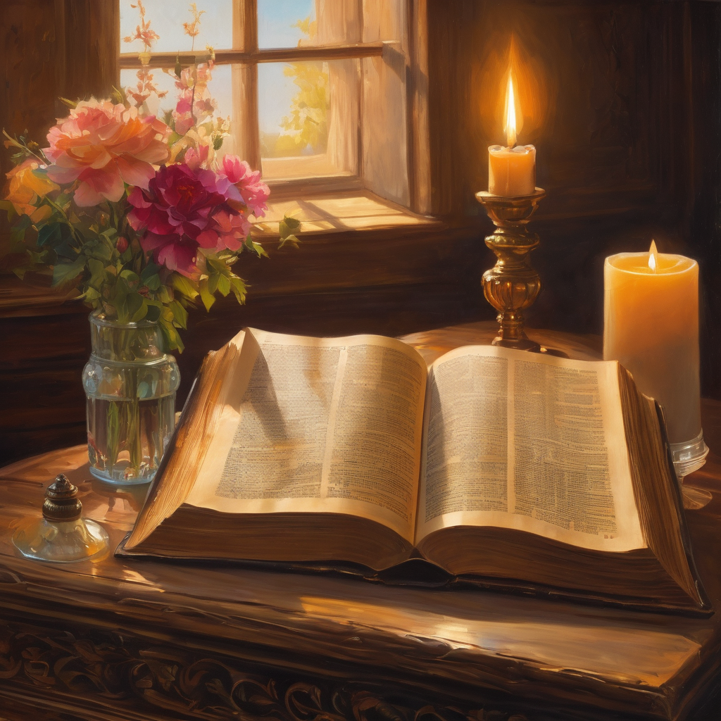
We pause
after ​the Gospel ​​

Slide 29
Leader: The Sermon is recorded to YouTube for sharing later.
Only the preacher's video and audio will be recorded.
The chat and other participants' feeds remain out of sight of the recording.
Leader and Cantor mute
Broadcaster exits screenshare
Preacher unmutes
Zoom buttons ”pins” preacher’s screen + selects “record to the cloud”
Sermon

Slide 30
Leader unmutes
Our next Hymn is
In Christ Alone
https://www.youtube.com/watch?v=TIuwNSi-vfE
We stay on mute
Leader mutes

Slide 31
The Leader and Cantor unmute
The Greeting of Peace
Leader: We are the body of Christ
All: God’s Spirit is with us
Leader: The peace of the Lord be always with you.
All: And also with you.
Leader: A sign of peace may be exchanged
You may like to type 'Peace' into the chat, use the 'raise hand’ or other reaction buttons, or just simply wave via the screen with your video turned on
(Broadcaster exits shared screen for a few moments for the exchange of peace)

Slide 32
Prayer of Thanksgiving before Intercessions
Leader: As we enter prayer, I invite the second reader to unmute to lead our intercessions which follow the prayer of thanksgiving. Please feel free to change your body position as you need.
Leader: God of revelation and risk,
with Christians of all ages in all places
we celebrate that you are our strength and joy.
In searching, we find and are found;
from exile, we are guided to a place we can truly call home;
from darkness, you can shine light and unveil a new dawn;
and, in following you, our faith flourishes
and our lives reflect your love.
Amen.

Slide 33
Intercessions
Reader 2: We pray for creation and communities we share our lives with. We pause for a few moments to name either in our hearts, or out loud, or in the chat, those environments and communities we bring to the Lord in prayer.
PAUSE…
We entrust to you the community of Holy Hermits Online and our ministry partners:
Prosper the work of our hands and show us the way to your new creation.
Creator God, Hear our prayer.
St John's Cathedral Brisbane The Anglican Diocese of Southern Queensland St Gabriel’s, Carindale Benedictus Contemplative Church, Canberra Anglican Focus and Tithe.ly

Slide 34
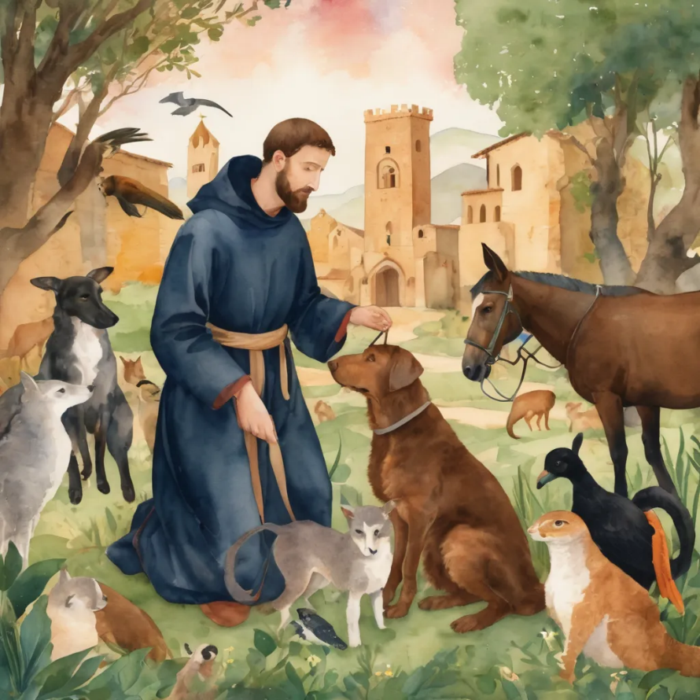
Reader 2: Loving Creator, we entrust to you all animals, especially those who are sick, anxious, ageing, lost, at risk, lonely, sad, hungry, in pain, homeless, abused, living in fear, encountering violence of any kind, in need of comfort, rehabilitation or transformation.
We invite your loving compassion for:
We name in our hearts, out loud or in the chat,
the animals we bring to the Lord in prayer. PAUSE…
Jasmine, ​
Leese(y), ​
Sid, Toots & Lulu​
Polly and Suki​
Fred, George & Percy​
Koshka ​
Jax
Lambert ​​
Kala, Nigel & Little One ​​
Toby​​
Taco​​
Paddy ​​
Rosie​

Slide 35
Reader 2: Eternal Trinity of Love, we uphold to you the people we love and carry cares for:
We name in our hearts, out loud or in the chat, those we bring to the Lord in prayer. PAUSE… We entrust to you those who have died, those who have died peacefully and those who have died tragically, The old and the young. Receive them into your Kingdom. Lord in your mercy, Hear our prayers. Amen.
Kerry, Les & Jake Julie, Ray, Tracey & Shane Mark, Desley & Bob ​​ Rachel, Mervyn & Gillian ​​Rev'd Shane & Janette​​ Alecia, Martin & Aidan​​ Steven & Vanessa | Barry​​ Dr Julie ​​ Ruth​​ Phil​ May Susan Tanya​ Craig Neva​ | Bill & Marjorie​​ Aaron & Andrea Dilys & Tony, Paul & Darhon Judy & Mary​​ Bob & Di​ Pat & Julie Miriam Gayanne | Kirsten, Greg, Daphne & Beau Alan & Gaylene​ Jess & Leah ​​ Bonnie & girls Liz’s Godchildren Barry & Gwen Matthew & Nicholas​

Slide 36
Pray Daily Cycle of Prayer
Leader: Loving God, joining with the Church in our cycle of prayer, we ask your blessings on:
Province de L’Eglise Anglicane Du Congo
The Diocese of North West Australia: †Darrell; Clergy and People
The Parish of Ithaca-Ashgrove: Margaret, Pam, Jack, Kathy
Ministry with Young Adults
The Springfield Anglican College, Springfield: Principal - Steven; Chaplain - Jonathan; Chair of College Council - Michael; members of College Council; staff & students

Slide 37
Prayer for those in time of flood and bushfire
Gracious God, In times of disaster when floods and bushfires threaten your creation, we turn to you for comfort and strength. We lift-up to you all those affected by these disasters, the displace, injured grieving, those who have lost homes and livelihoods. Grant them comfort, strength, and hope.
We pray for all who offer aid and assistance – the firefighter, rescue workers, volunteers and all who work to bring relief and support. Grant them wisdom, resilience, and protection as they serve others in need.
May you presence guide us and bring healing to the land and its people. Help us to stand together in compassion and support, as we seek to rebuild and renew the communities affected by these disasters. Amen.

Slide 38
Commitment prayer for the week:
Sustainability
Generous God, We hold before you the financial stability and future sustainability of Holy Hermits Online. Guide us as we seek to grow our community’s giving, so we may continue the work you have called us to—being together in this digital space. Show us where to place our energy as we explore new funding sources and fresh opportunities. Be present with us and those we meet as we reach out to charitable trusts and foundations, inviting their support for our outreach—especially to those unable to get to Church in person. ​

Slide 39
Stir the hearts of all who believe in this mission to greater generosity, creativity, and commitment. We thank you for the partnerships you have already blessed us with, especially our home base at St John’s Cathedral.​ We pray in the name of Jesus, who lived on mission and said, ​
If in my name you ask me for anything, I will do it.​
Amen.
Continues…

Slide 40
Leader: Let us pray together the prayer which Jesus gave us saying:
All: Our Father in heaven,
hallowed be your name,
your kingdom come, your will be done,
on earth as in heaven.
Give us today our daily bread.
Forgive us our sins
as we forgive those who sin against us.
Save us from the time of trial
and deliver us from evil.
For the kingdom, the power,
and the glory are yours
now and for ever.
Amen.

Slide 41
Devotions

Slide 42
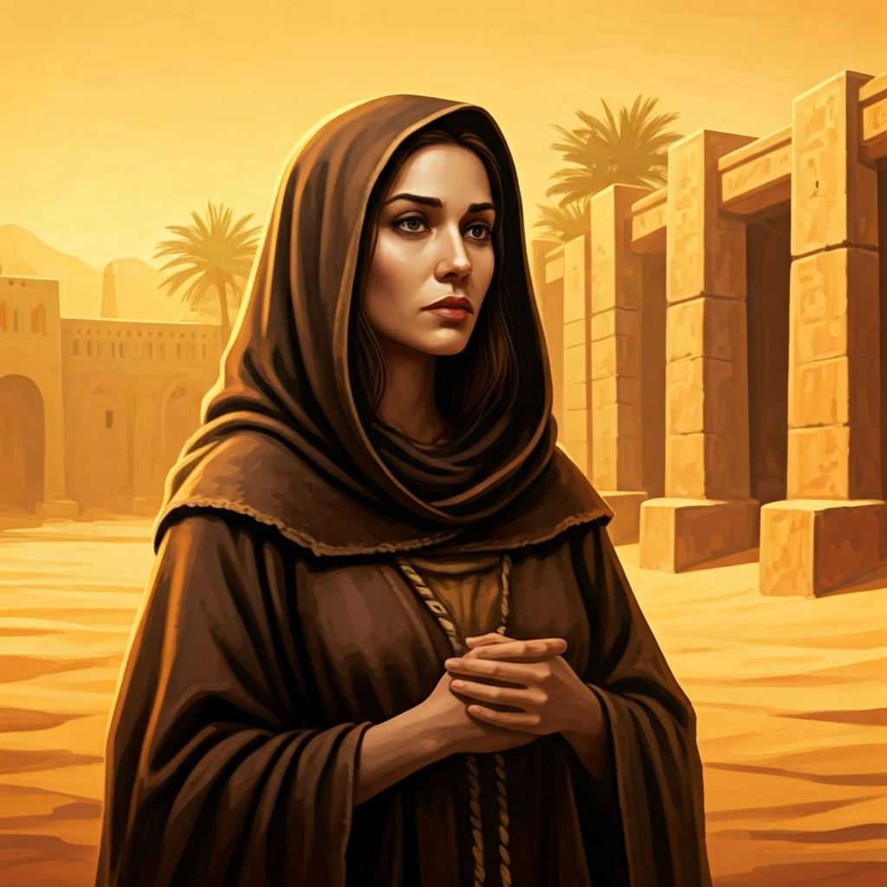
Hermit Wisdom

Slide 43
Leader: Syncletica of Alexandria
"There are many who live in the mountains and behave as if they were in the town, and they are wasting their time. It is possible to be a solitary in one's mind while living in a crowd, and it is possible for one who is a solitary to live in the crowd of his own thoughts."
“In the beginning there are a great many battles and a good deal of suffering for those who are advancing towards God and afterwards, ineffable joy. It is like those who wish to light a fire; at first they are choked by the smoke and cry, and by this means obtain what they seek (as it is said: ‘Our God is a consuming fire’ [Heb. 12.24]): so we also must kindle the divine fire in ourselves through tears and hard work.”​

Slide 44
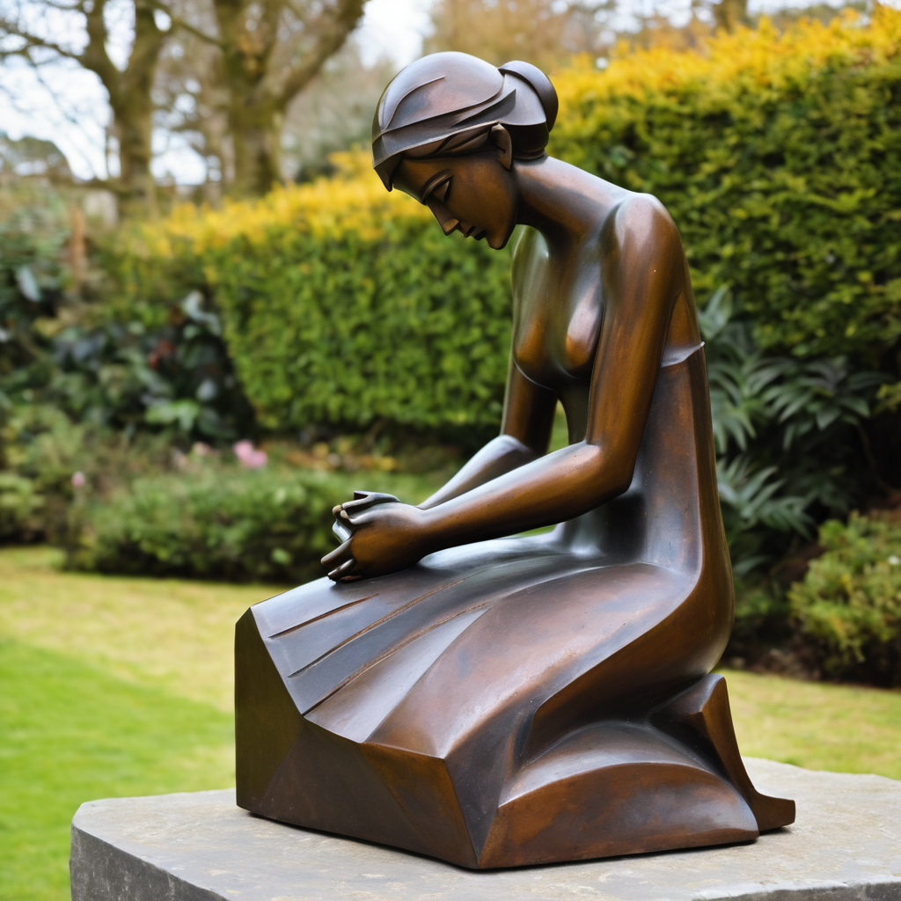
Leader: ​As we enter a few minutes of silence together, you are invited to pray this prayer of adoration and/or spend this time in contemplation. ​
The Spiritual Communion prayer follows
on the next slide. Let us be still.
Leader and Cantor Mute.
​
Almighty God,
by whose grace alone we are accepted
and called to your service:
strengthen us by your Holy Spirit
and make us worthy of our calling;
through Jesus Christ our Lord.

Slide 45
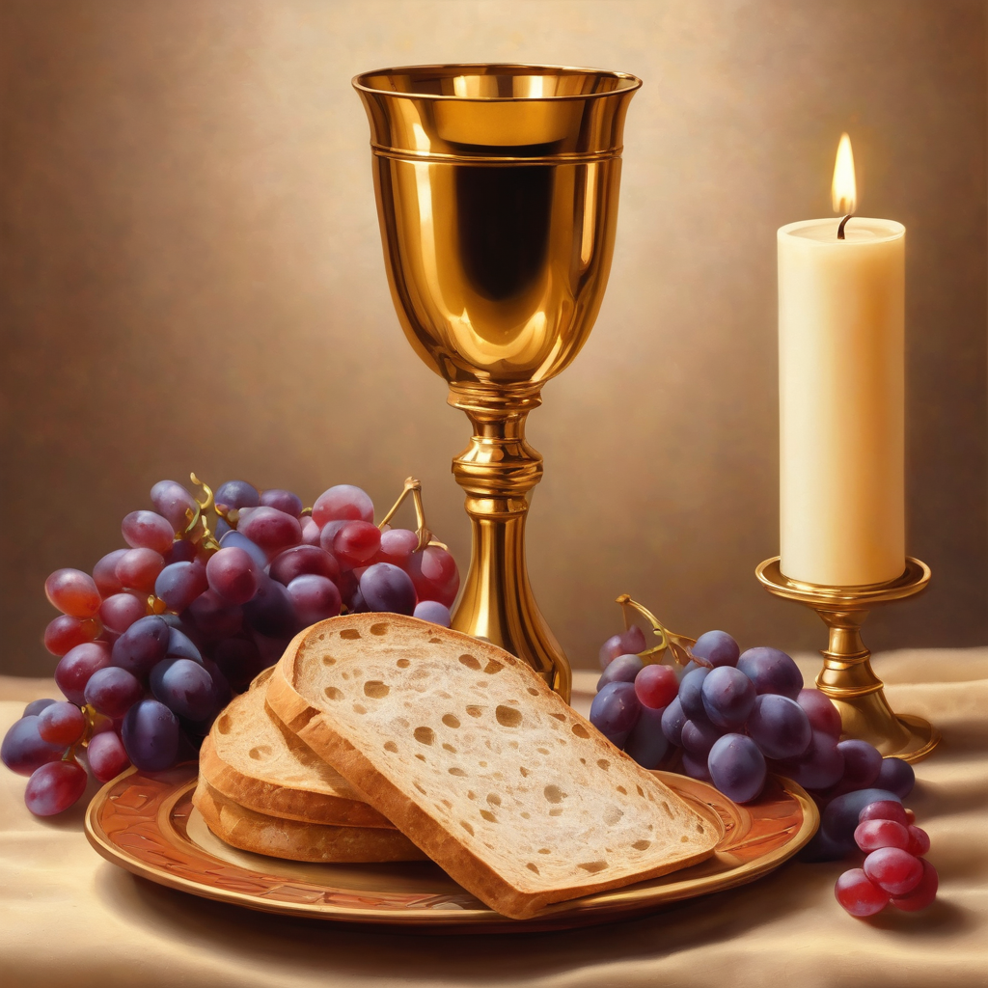
Oh, my Lord Jesus I turn to you
present at the Altar and in the
Tabernacle. I believe that you are
present in the Holy Sacrament of your
most Sacred Body and Blood. I love you
above all things and I desire to receive
you into my Soul. I cannot at this
moment receive you Sacramentally in
Holy Communion. Come spiritually into
my heart. Purify it, Sanctify it. Render
my heart like your own heart.
I embrace you as if you were already
there and unite myself wholly with
you. Never permit me to be separated
from you. Lord, I am not worthy to
receive you, but only say the word and I
shall be healed. Amen
Making a
Spiritual Communion
(Prayed in silence)

Slide 46
Leader unmutes
Our final song is
Here I Am To Worship
https://www.youtube.com/watch?v=03G52K9X2hQ
​We stay on mute
Leader and Cantor mute

Slide 47
Leader and cantor unmute
Sending Prayer
Leader: We pray our sending prayer together.
All:
As we go out into the world, may we see more of who God is. May we be ready to listen to the words of Jesus. May we have the courage to say to others, ‘Come and see’. Amen.

Slide 48
The Benediction
Leader: Let us all invite God’s blessings together,
All: May the Lord bless us and keep us.
May the Lord’s face shine upon us and be gracious to us.
May the Lord’s countenance be lifted upon us,
and bring us peace. Amen

Slide 49
Notices
Welcome back Rev'd Lauren, we hope you had a nice relaxing break
Sabbath January continues, a time of slowing down and refreshing
See HHO Events page for further upcoming events HHO Events especially at the Cathedral online

Slide 50
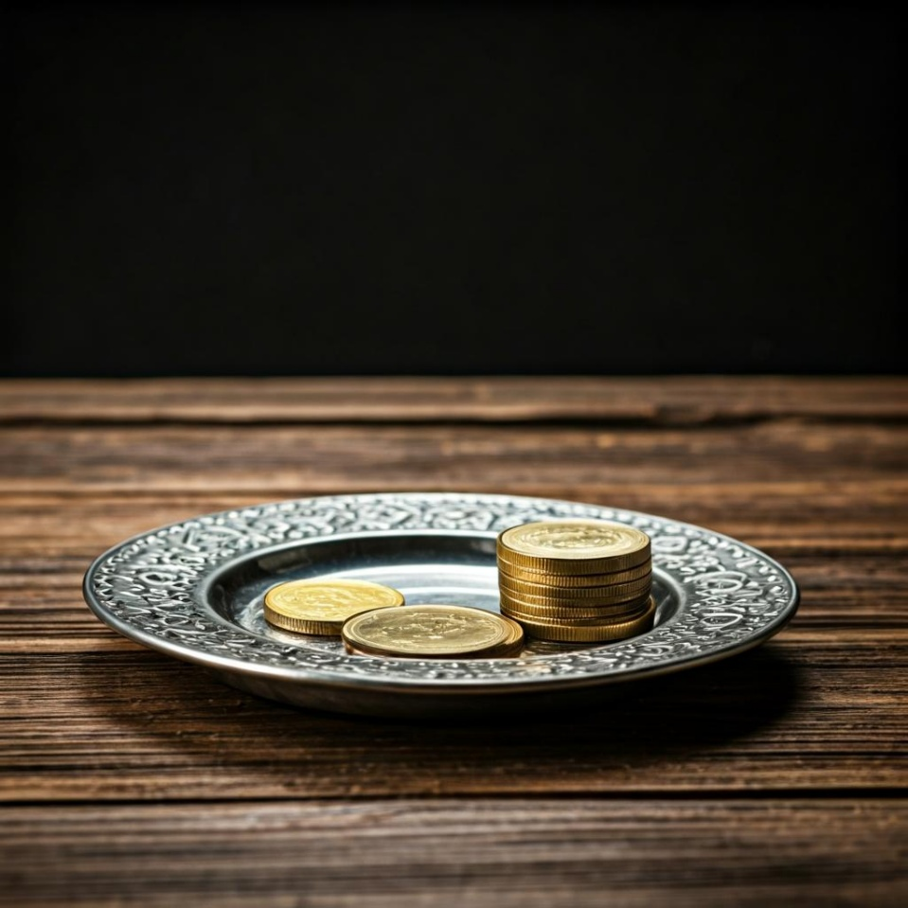
Leader: Thank you for your regular gifts to this ministry. Offerings are most welcome via:
The HHO App
Direct Debit
International Direct Debit
Please consider a one-off donation
or leaving a legacy in your Will
For further information go to HHO give page
https://holyhermits.com.au/give

Slide 51
Serving next week
Sunday 25th February
9:00 am AEST
Service Prep: Lauren | Chat Host: Rachel | First Reader: Helen
Music: Lauren | Welcomer: Julie | Second Reader: Vanessa
Proof-reader: Chris | Priest: St. John’s priest | Preacher: St. John’s priest
Broadcaster: Barry | Deacon: N/A | Fellowship: Julie
Backup Broadcaster: Paul | Leader: Jeremy | Safety Officer: Chris
Zoom Buttons: Viki | Cantor: Margo | Attendance: Rachel
Thank you for your ministry gifts
New Servers always welcome!
Please email Rev’d Lauren to get involved
holyhermits@anglicanchurchsq.org.au

Slide 52
Leader: I invite everyone to unmute for the Dismissal
Leader: Go in peace to love and serve the Lord.
All: In the name of Christ, Amen.

Slide 53
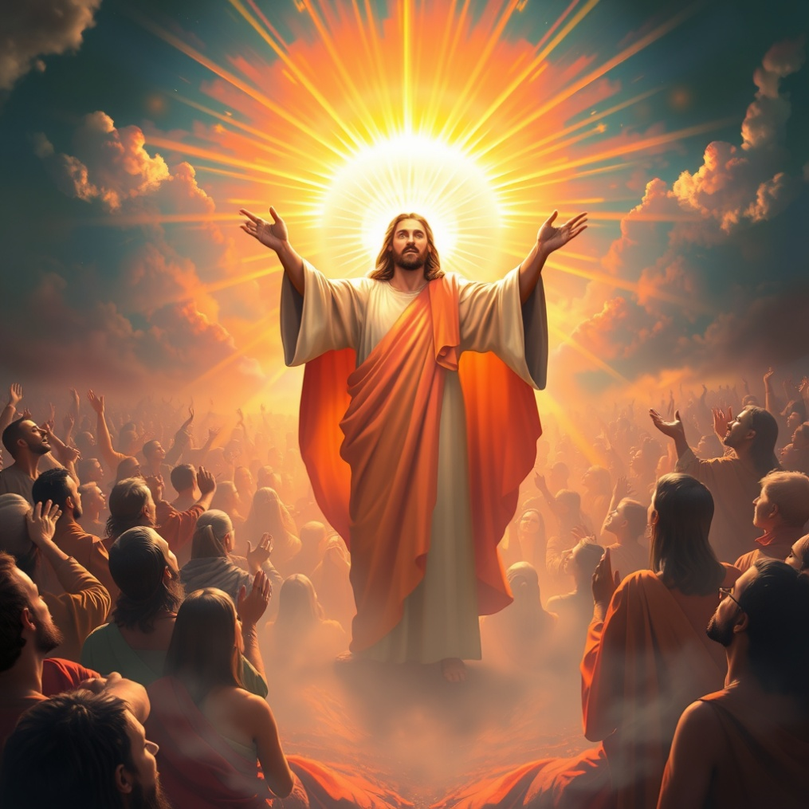
Fellowship time
Thank you, Lauren for leading Fellowship
Please feel welcome to linger or pop a message in the chat and head off when you are ready.​
Extra resources developed
by Roots on the Web
Artwork by Padlet

