Slide 1
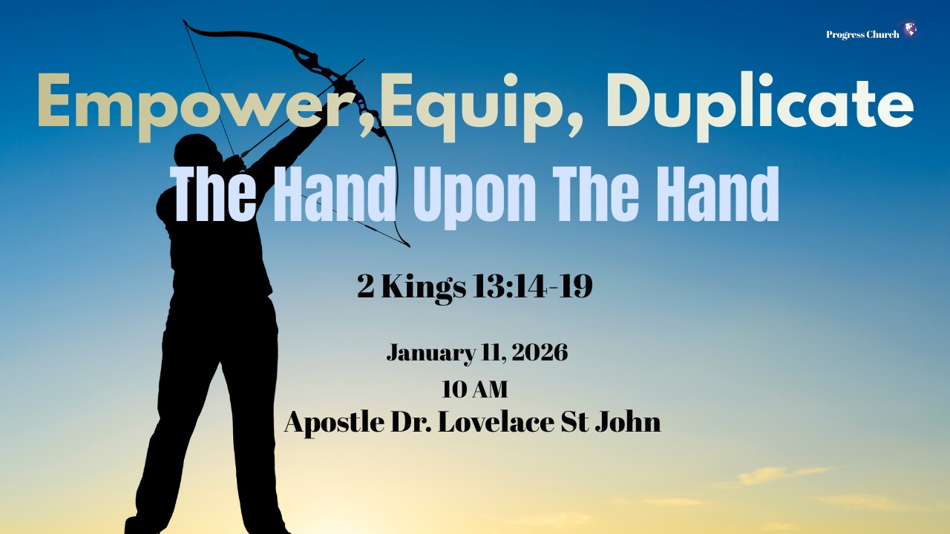

Slide 2



SCRIPTURE
Scripture:
2 Kings 13: 14 – 19

Slide 3
INTRODUCTION
Our level of passion and obedience today determines the strength of the victory for the generation of tomorrow.
Into this moment, God arranges a prophetic drama:
A bow, Arrows.
A window opened eastward toward the enemy,
A frail prophet, A fearful king,
And one critical gesture: the hand upon the hand.
A dying prophet and a desperate king.
Elisha, the man who carried a double portion of Elijah’s spirit, is on his deathbed.
A king is afraid of the future.

Slide 4
THE CONDITION
King Joash comes to him weeping, crying, “My father, my father, the chariot of Israel and its horsemen!” (v. 14),
God of that man, recognizing that the true power and protection of Israel has not been in chariots or armies, but in the man of God and the
Israel is under constant threat from Aram (Syria). Joash is king, but he is fearful, inconsistent, and spiritually compromised.
He has position, but little spiritual power. He has a throne, but no clear direction.
“O my father, my father, the chariots of Israel and their horsemen!”

Slide 5
THE MEANING OF THE HAND UPON THE HAND
Human Responsibility
Elisha tells Joash, “Take a bow and arrows. Draw the bow” (vv. 15–16).
God does not pick up the bow for him.
God does not draw the string for him.
The king must hold, aim, and draw.
This is the call of God to each of us:
Take what God has given you.
Divine Empowerment
It is a picture of cooperation with God.
You move, and God empowers.
You obey, and God strengthens.
You aim, and God gives the impact.

Slide 6
THE OPEN WINDOW: AIMED - VICTORY
“Elisha said, ‘Open the window eastward.’ And he opened it. Then Elisha said, ‘Shoot,’ and he shot.” (v. 17)
The window opens toward the enemy’s territory, toward Aram.
This shot is not target practice. It is prophetic declaration.
It is God saying: Aim your faith at the area of your greatest warfare. At your greatest struggle. At that one thing that is holding you back.
“Elisha said, ‘The Lord’s arrow of victory, the arrow of victory over Syria!’” (v. 17)

Slide 7
THE HAND UPON YOUR HAND TODAY
What does this mean for us now?
God Still Places His Hand on Weak Hands.
Your weakness does not disqualify you from God’s empowerment.
“‘Not by might, nor by power, but by my Spirit,’ says the Lord of hosts.” (Zechariah 4:6)

Slide 8
YOU MUST TAKE THE BOW
God will not shoot the arrows you refuse to pick up.
Use the gift He has given you.
Step into the assignment He has placed before you.
Pray the prayers, preach the word, serve the people, start the work.
Waiting for a feeling is often a way of postponing obedience.
When you pick up the bow, you will feel the weight of His hand.

Slide 9
AIM WHERE THE BATTLE IS:
Some only aim at safe targets.
The areas where they feel strong,
The places where there is little resistance.
God says, “Open the window toward your Aram.”
Aim your faith:
At the addiction that has defined your family line.
At the bitterness that has ruled your heart.
At the fear that has shut your mouth.
At the unbelief that has paralyzed your steps.
Let the arrow of the Lord’s victory be aimed at your real war.

Slide 10
APPLICATION – TODAY AND GOING FORWARD
1. Surrender Your Hands to God
2. Offer Him your abilities, your schedules, your skills, your influence.
3. Pick Up the Bow in Obedience
4. Identify a specific area where you have delayed doing what you know God has asked.
5. Aim at Your Real Battle. Name the “Aram” in your life.

Slide 11
CONCLUSION
The question is not whether God is able, but whether we are willing:
To take the bow
To open the window
To shoot the arrow,
To strike the ground.
Let this be your heart’s cry:
“Lord, put Your hand upon my hand.
Take my weakness into Your strength.
I will not stand idle while You offer victory”.

