Slide 1
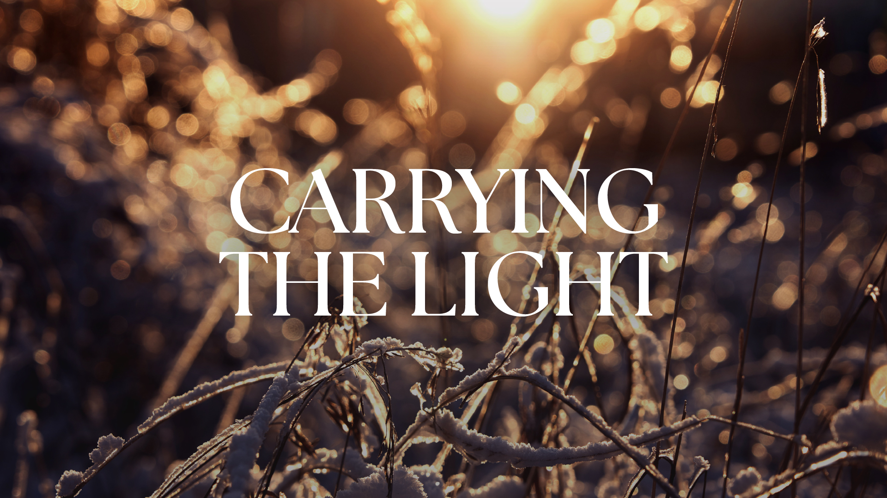
Gathering Music

Slide 2
https://www.farwellumc.com/
Welcome and Announcements

Slide 3
Prelude

Slide 4
Opening Prayer

Slide 5

1 Corinthians 1:18-31
Pg. Scripture

Slide 6

For the message of the cross is foolishness to those who are perishing, but to us who are being saved it is the power of God. ¹⁹ For it is written:
“I will destroy the wisdom of the wise;
the intelligence of the intelligent I will frustrate.”^{[c]}

Slide 7
²⁰ Where is the wise person? Where is the teacher of the law? Where is the philosopher of this age? Has not God made foolish the wisdom of the world? ²¹ For since in the wisdom of God the world through its wisdom did not know him,

Slide 8
God was pleased through the foolishness of what was preached to save those who believe. ²² Jews demand signs and Greeks look for wisdom, ²³ but we preach Christ crucified: a stumbling block to Jews and foolishness to Gentiles, ²⁴ but to those whom God has called, both Jews and Greeks,

Slide 9
Christ the power of God and the wisdom of God. ²⁵ For the foolishness of God is wiser than human wisdom, and the weakness of God is stronger than human strength.
²⁶ Brothers and sisters, think of what you were when you were called.

Slide 10
Not many of you were wise by human standards; not many were influential; not many were of noble birth. ²⁷ But God chose the foolish things of the world to shame the wise; God chose the weak things of the world to shame the strong. ²⁸ God chose the lowly things of this world and

Slide 11
the despised things—and the things that are not—to nullify the things that are, ²⁹ so that no one may boast before him. ³⁰ It is because of him that you are in Christ Jesus, who has become for us wisdom from God—that is, our righteousness, holiness and redemption.

Slide 12
³¹ Therefore, as it is written: “Let the one who boasts boast in the Lord.”^{[d]}

Slide 13

Be Thou My Vision
UMH #451
Notes:
Praise Song

Slide 14

Be thou my vision,
O Lord of my heart;
naught be all else to me,
save that thou art.
Be Thou My Vision
#451
Notes:
Praise Song

Slide 15
Thou my best thought,
by day or by night,
waking or sleeping,
thy presence my light.
Be Thou My Vision
#451
Notes:
Praise Song

Slide 16
Be thou my wisdom,
and thou my true word;
I ever with thee
and thou with me, Lord;
Be Thou My Vision
#451
Notes:
Praise Song

Slide 17
thou and thou only,
first in my heart,
great God of heaven,
my treasure thou art.
Be Thou My Vision
#451
Notes:
Praise Song

Slide 18
Great God of heaven,
my victory won, may
I reach heaven’s joys,
O bright heaven’s Sun!
Be Thou My Vision
#451
Notes:
Praise Song

Slide 19
Heart of my own heart,
whatever befall,
still be my vision,
O Ruler of all.
Be Thou My Vision
#451
Notes:
Praise Song

Slide 20
Matthew 5:13-20
Pg. Scripture

Slide 21
“You are the salt of the earth. But if the salt loses its saltiness, how can it be made salty again? It is no longer good for anything, except to be thrown out and trampled underfoot.
¹⁴ “You are the light of the world. A town built on a hill cannot be hidden.

Slide 22
¹⁵ Neither do people light a lamp and put it under a bowl. Instead they put it on its stand, and it gives light to everyone in the house. ¹⁶ In the same way, let your light shine before others, that they may see your good deeds and glorify your Father in heaven.

Slide 23
¹⁷ “Do not think that I have come to abolish the Law or the Prophets; I have not come to abolish them but to fulfill them. ¹⁸ For truly I tell you, until heaven and earth disappear, not the smallest letter, not the least stroke of a pen, will by any means disappear from the Law until everything is accomplished.

Slide 24
¹⁹ Therefore anyone who sets aside one of the least of these commands and teaches others accordingly will be called least in the kingdom of heaven, but whoever practices and teaches these commands will be called great in the kingdom of heaven.

Slide 25
²⁰ For I tell you that unless your righteousness surpasses that of the Pharisees and the teachers of the law, you will certainly not enter the kingdom of heaven.

Slide 26
This is the word of God for the people of God.
All: Thanks be to God.

Slide 27
Call To Worship

Slide 28
Children of God, when fears press in on every side, we can proclaim with confidence:
God is our light and salvation! Whom shall we fear?

Slide 29
When our problems overwhelm us and we feel pressed in on every side, we can declare with confidence:
God is the stronghold of our lives! Of whom shall we be afraid?

Slide 30
No matter the troubles we face, we seek after God and to live in the house of God forever.
God shelters and protects us in the day of trouble.

Slide 31
Come, let us worship God with joy, for God is our light and salvation!
We come to worship as bearers of the Light. Thanks be to God! Amen.

Slide 32
Oh How He Loves You And Me
TFWS #2108
Notes:
Praise Song

Slide 33
Oh how he loves you and me!
Oh how he loves you and me!
He gave his life,
What more could he give?
Oh how he loves you;
O how he loves me;
Oh how he loves you and me!

Slide 34
Jesus to Calv’ry did go;
His love for sinners to show.
What he did there
Brought hope from despair.
Oh how he loves you;
O how he loves me;
Oh how he loves you and me!

Slide 35

Joys and Prayer Requests

Slide 36

The Lord’s Prayer
Our father,
Who art in heaven
Hallowed be thy name.
Thy kingdom come,
Thy will be done
Notes:
Lord’s Prayer

Slide 37
The Lord’s Prayer
On earth
As it is in heaven.
Give us this day
Our daily bread
And forgive us
Our trespasses
Notes:
Lord’s Prayer

Slide 38
The Lord’s Prayer
As we forgive those
Who trespass against us.
And lead us not into
Temptation
But deliver us from evil
Notes:
Lord’s Prayer

Slide 39
The Lord’s Prayer
For thine is the kingdom
And the power,
And the glory forever.
Amen
Notes:
Lord’s Prayer

Slide 40
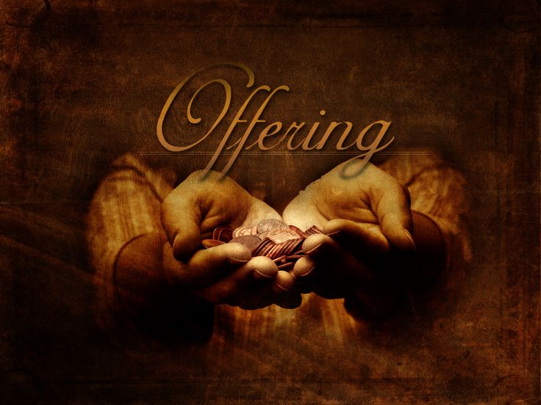
Notes:
Offering

Slide 41


Praise the Lord who reigns above and
Keeps his court below;
Praise the holy God of love and
All his greatness show;
Doxology
Notes:
Doxology lyrics

Slide 42
praise him for his noble deeds,
Praise him for his matchless power;
Him from whom all good proceeds let
Earth and heaven adore.
Doxology
Notes:
Doxology lyrics

Slide 43
Steadfast Light of our salvation, in a world that trembles with uncertainty and teaches us to fear, you shine with unwavering hope. You call us to seek your face and trust in your presence more than in our own strength

Slide 44
Receive these gifts, given in joyful confidence. Use our offerings to build a world where your light leads, your justice reigns, and your people—unafraid—become living testimonies of your goodness. In the name of Christ, our rock and redeemer, we pray. Amen.

Slide 45
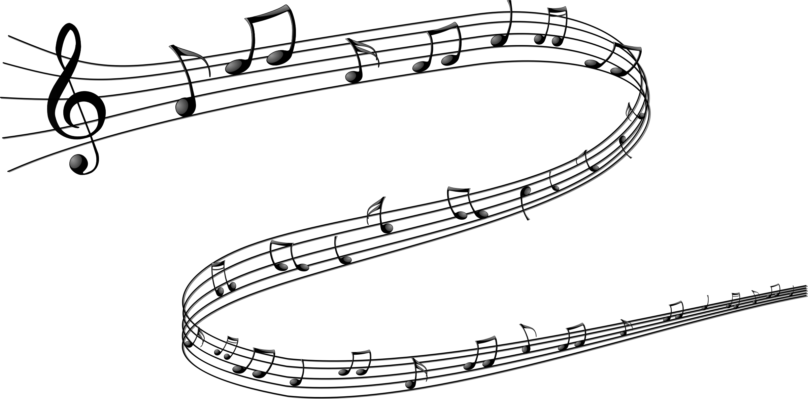

Choir
Anthem

Slide 46
Dr Ray Francis

Slide 47
The Old Rugged Cross
UMH #504
Notes:
Praise Song

Slide 48
On a hill far away
Stood an old rugged cross,
The emblem of suffering and shame.
The Old Rugged Cross
UMH #504
Notes:
Praise song

Slide 49
And I love that old cross
Where the dearest and best
For a world of lost sinners was slain.
The Old Rugged Cross
UMH #504
Notes:
Praise song

Slide 50
So I’ll cherish the old rugged cross,
Till my trophies at last I lay down;
I will cling to the old rugged cross,
And exchange it one day for a crown.
The Old Rugged Cross
UMH #504
Notes:
Praise song

Slide 51
O that old rugged cross,
So despised by the world,
Has a wondrous attraction for me;
For the dear Lamb of God left his glory above
To bear it to dark Calvary.
The Old Rugged Cross
UMH #504
Notes:
Praise song

Slide 52
So I’ll cherish the old rugged cross,
Till my trophies at last I lay down;
I will cling to the old rugged cross,
And exchange it one day for a crown.
The Old Rugged Cross
UMH #504
Notes:
Praise song

Slide 53
In that old rugged cross,
Stained with blood so divine,
A wondrous beauty I see,
For twas on that old cross Jesus suffered and died,
To pardon and sanctify me!
The Old Rugged Cross
UMH #504
Notes:
Praise song

Slide 54
So I’ll cherish the old rugged cross,
Till my trophies at last I lay down;
I will cling to the old rugged cross,
And exchange it one day for a crown.
The Old Rugged Cross
UMH #504
Notes:
Praise song

Slide 55
To the old rugged cross
I will ever be true,
Its shame and reproach gladly bear;
The Old Rugged Cross
UMH #504
Notes:
Praise song

Slide 56
Then he’ll call me some day
To my home far away,
Where his glory forever I’ll share.
The Old Rugged Cross
UMH #504
Notes:
Praise song

Slide 57
So I’ll cherish the old rugged cross,
Till my trophies at last I lay down;
I will cling to the old rugged cross,
And exchange it one day for a crown.
The Old Rugged Cross
UMH #504
Notes:
Praise song

Slide 58
God is our light, our hope, our all in all:
Blessed be God, now and forever!
Christ is our home, our life, our joy:
Blessed be God, now and forever!
Our worship concludes; our service continues.
Blessed be God, now and forever! Amen

Slide 59


