Slide 1


Slide 2


Slide 3

Worshipper
Geff Gomez

Slide 4
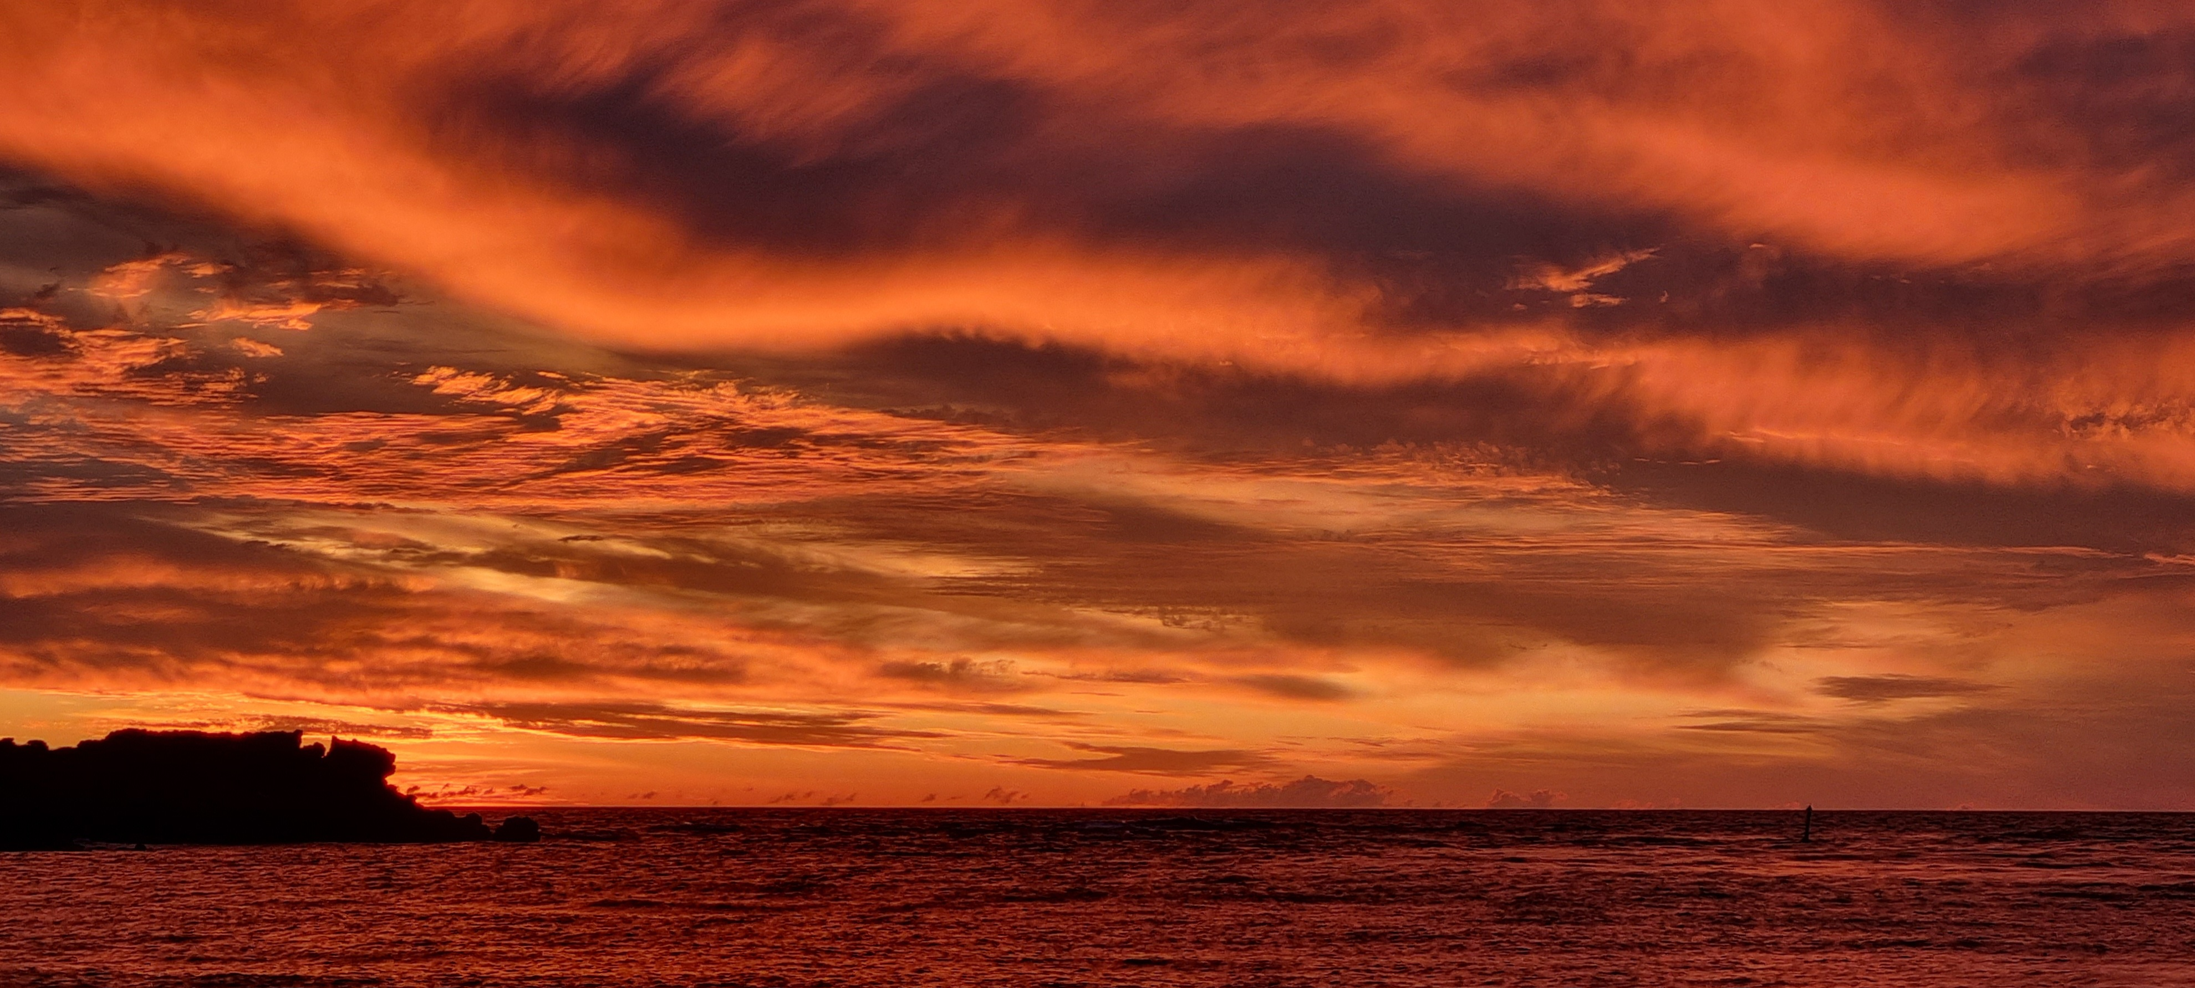

Slide 5

Psalm 95
Come, let us sing for joy to the Lord;
let us shout aloud to the Rock of our salvation.
Let us come before him with thanksgiving
and extol him with music and song.

Slide 6
For the Lord is the great God,
the great King above all gods.
In his hand are the depths of the earth,
and the mountain peaks belong to him.
The sea is his, for he made it,
and his hands formed the dry land.

Slide 7
Come, let us bow down in worship,
let us kneel before the Lord our Maker;
for he is our God
and we are the people of his pasture,
the flock under his care.

Slide 8
Today, if only you would hear his voice,
“Do not harden your hearts as you did at Meribah,
as you did that day at Massah in the wilderness,
⁹ where your ancestors tested me;

Slide 9
they tried me, though they had seen what I did.
For forty years I was angry with that generation;
I said, ‘They are a people whose hearts go astray,
and they have not known my ways.’
So I declared on oath in my anger,
‘They shall never enter my rest.’”

Slide 10
What is Worship?
Worth-ship
Dedicated

Slide 11
What made David “a man after God’s own heart?”
Worshipper
Humble
Honest

Slide 12
Jesus – our Perfect model
John 5:19
“the Son can do nothing by himself; he can do only what he sees his Father doing, because whatever the Father does the Son also does.”

Slide 13
John 14:31
“the world may learn that I love the Father and do exactly what my Father has commanded me”.
Matt 4:10
“For it is written: ‘Worship the Lord your God, and serve him only.’ ” Jesus quoting Deuteronomy 6:13

Slide 14
What or Whom do we Worship?
We all worship

Slide 15
What or Whom do we Worship?
We all worship
Worshiping God. How much?

Slide 16
How do we Worship?
In Community

Slide 17
How do we Worship?
In Community
In Truth

Slide 18
How do we Worship?
In Community
In Truth
In Spirit

Slide 19
How do we Worship?
In Community
In Truth
In Spirit
With Sabbath rest

Slide 20


Slide 21


Slide 22


Slide 23

During School Term
During School Term

Slide 24


