Slide 1
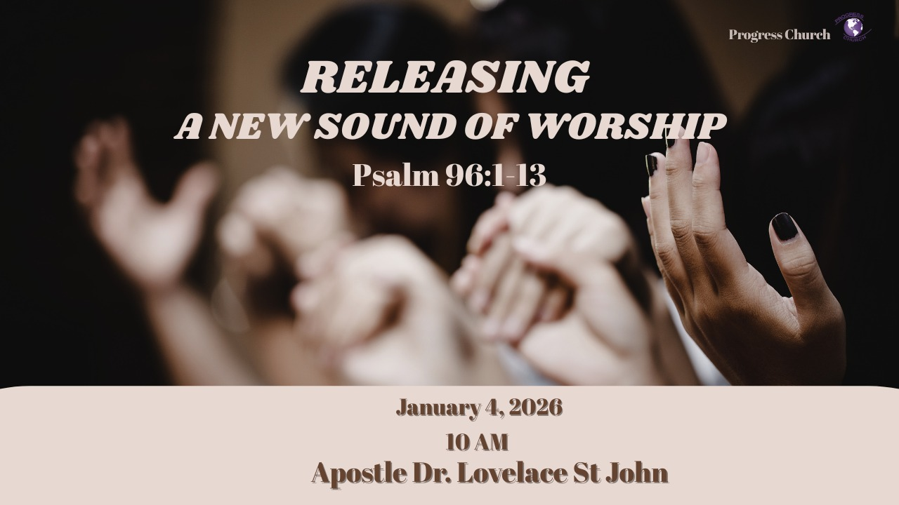

Slide 2



Scripture:
Psalm 96: 1 -13

Slide 3
INTRODUCTION
A new year represents a new beginning, new mercies, new opportunities, and a fresh move of God.
Psalm 96 opens with an invitation: “Sing to the Lord a new song.”
A new sound of worship is not just new lyrics or new music, it is the overflow of a renewed heart, a revived spirit, and a refreshed walk with God.
God is calling us to release a new sound that reflects new faith.

Slide 4
A NEW SOUND
Psalm 96:1–2 — “Sing to the Lord a new song; sing to the Lord, all the earth. Sing to the Lord, bless His name; proclaim the good news of His salvation from day to day.”
1. A new song requires a new work of God in us.
You cannot sing a new song with an old, weary, or hardened heart.
Why "new"? Not necessarily a new melody, but a renewed heart, a fresh perspective, a deeper revelation of God. It's worship that isn't stale, or habitual

Slide 5
A NEW SOUND
Psalm 96:1–2 — “Sing to the Lord a new song; sing to the Lord, all the earth. Sing to the Lord, bless His name; proclaim the good news of His salvation from day to day.”
2. Worship is refreshed when salvation becomes real again.
3. A new year calls for renewed spiritual disciplines.
Prayer, word, consecration, thanksgiving, these reset the heart to worship.

Slide 6
GOD’S INCOMPARABLE GREATNESS
(Psalm 96:4-6)
His Supreme Worth (v. 4): "For great is the LORD and most worthy of praise; he is to be feared above all gods."
1. Beyond Comparison: He is not like other gods, but THE God. His greatness demands our highest praise.
2. Feared Above All: A reverence and awe that recognizes His sovereignty and power.

Slide 7
GOD’S INCOMPARABLE GREATNESS
(Psalm 96:4-6)
His Supreme Worth (v. 4): "For great is the LORD and most worthy of praise; he is to be feared above all gods."
3. Worship lifts God higher than every competing voice.
Verse 5: “All the gods of the nations are idols.”
A new sound of worship combats the idols of fear, culture, and self.

Slide 8
A NEW SOUND CALLS US INTO DEEPER SURRENDER- (Psalm 96:7–9)
1. Worship demands giving, not only singing.
Give Him glory, honor, gratitude, obedience, and your whole life.
Bring Offerings and Worship
2. The “beauty of holiness”.
You cannot release a new sound with an old lifestyle.
3. Worship as surrender positions us to hear God clearly in the new year.

