Slide 1
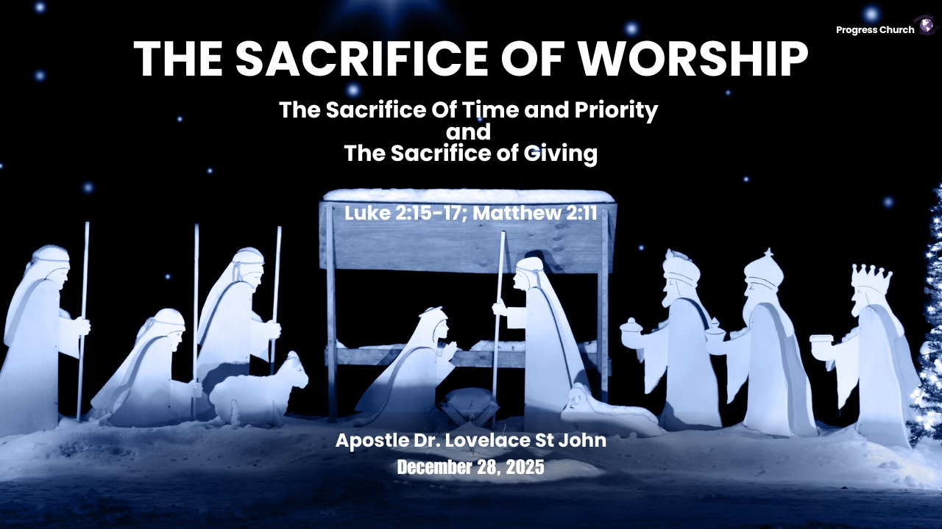

Slide 2



SCRIPTURE
LUKE 2: 15 – 17 & MATTHEW 2: 11

Slide 3
INTRODUCTION
Shepherds — The Sacrifice of Time & Priority
They Responded Immediately to God’s Revelation (Luke 2:15)
They Chose God’s Word Above Their Routine
After hearing the angelic message, the shepherds said, “Let us now go”

Slide 4
INTRODUCTION
Shepherds — The Sacrifice of Time & Priority
They did not delay, debate, or overthink—they moved at God’s word.
Their response showed that revelation requires a response.
Worship begins when we prioritize God’s voice over daily routine.

Slide 5
They Sacrificed Their Time and Responsibilities (Luke 2:15)
They Left Their Flocks Behind
Leaving their flocks was risky, inconvenient, and costly.
They understood, seeking the Savior matters more than protecting comfort.
Worship is giving God time and attention, even when life is busy or demanding.

Slide 6
They Made Seeking Jesus Their First Priority (Luke 2:16)
They Went “With Haste”
“With haste” shows urgency, eagerness, and hunger.
They rearranged their schedule, their work, and their commitments to meet Jesus.

Slide 7
They Made Seeking Jesus Their First Priority (Luke 2:16)
They did not wait for a convenient moment; they made Him the priority.
Worship is choosing the greater thing over the lesser things that compete for our hearts.

Slide 8
Their Encounter Marked Them as Witnesses
(Luke 2:17)
What We Prioritize, We Proclaim
After seeing the Child, they made known what was told to them.
Their worship turned into witness.
Their time with Jesus produced a message they couldn’t keep quiet.
Giving Jesus our time fuels our testimony

Slide 9
Wise Men — The Sacrifice of Giving
Matthew 2:11
Their Worship Began With a Long and Costly Journey (Matthew 2:1–2)
They Sacrificed Distance, Time, and Comfort
The Wise Men traveled hundreds of miles, possibly months across deserts and dangers.
Their journey shows that worship costs something: effort, pursuit, and persistence.
Worship is not passive; it requires seeking Christ even when it stretches us.

Slide 10
They Entered His Presence With Great Reverence (Matthew 2:11)
They Bowed Before a Child-King
Before giving anything, they fell down and worshiped Him.
Their posture revealed their understanding, Jesus deserves honor before He receives gifts.
True giving flows from a heart surrendered in worship.

Slide 11
They Gave Their Best, Not Their Leftovers
(Matthew 2:11)
Their Gifts Were Sacrificial and Symbolic
Gold — a gift for a King: costly, precious, honorable.
Frankincense — a gift for deity: used in temple worship.
Myrrh — a gift symbolizing sacrifice and suffering.
They opened their treasures, not their scraps.
Worship means giving God our best time, talent, treasure, and ourselves.

Slide 12
Their Giving Was an Expression of Joy
(Matthew 2:10–11)
They Rejoiced Before They Gave
They experienced “exceeding great joy” when the star led them to Jesus.
Joy prepared their hearts for generous worship.
True giving is not forced, it flows from joyful gratitude for who Jesus is.

