Slide 1
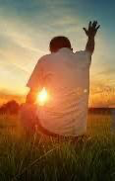

CLIC CHURCH
Thanksgiving: The Key to Hear and Encounter God
PRESENTED BY
Pastor Daniel Lee

Slide 2
YOU ARE NOT ALONE
Do not fear, for I am with you; do not be dismayed, for I am your God. I will strengthen you and help you; I will uphold you with my righteous right hand.” Isaiah 41:10 NIV

Slide 3
The deeper question is:
Where was God in it all?
How do we hear Him as we move forward?

Slide 4
1) Thanksgiving is the key to hearing God

Slide 5
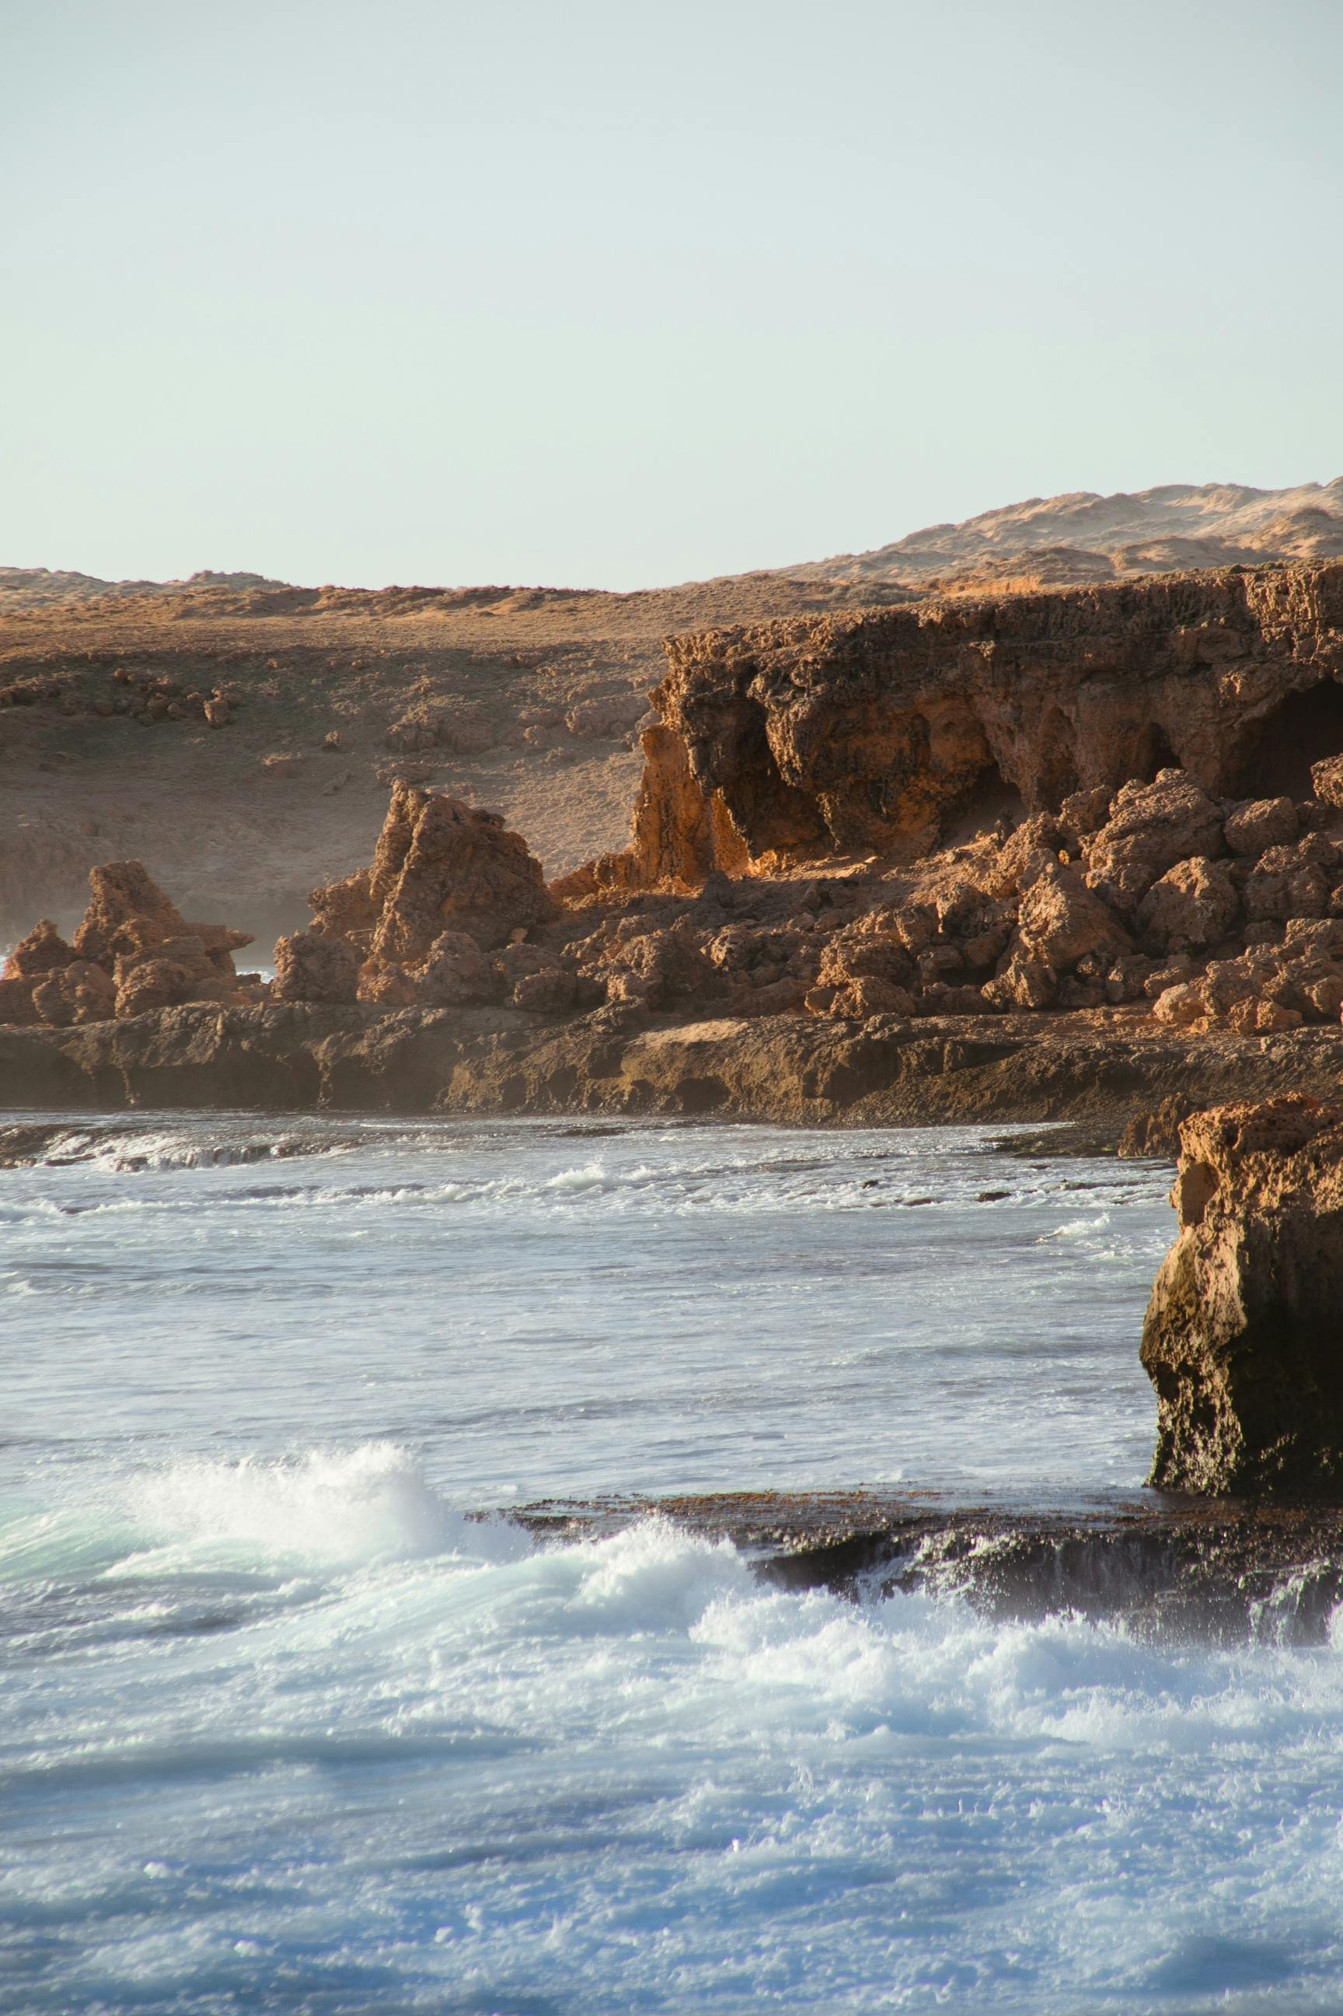
PSALM 100:4 (NIV)
Enter his gates with thanksgiving and his courts with praise; give thanks to him and praise his name.

Slide 6
Thanksgiving brings us into a place where we can hear God more clearly.

Slide 7
Thanksgiving is the antidote for worry

Slide 8
When do I need to be thankful the most?
It’s when I feel the least.

Slide 9
PHILIPPIANS 4:6–7
Do not be anxious about anything, but in every situation, by prayer and petition, with thanksgiving, present your requests to God. 7 And the peace of God, which transcends all understanding, will guard your hearts and your minds in Christ Jesus.

Slide 10
A spirit of thankfulness is one of the most distinctive marks of a Christian whose heart is attuned to the Lord.
BILLY GRAHAM

Slide 11
THANKSGIVING OPENS OUR EARS TO THE VOICE OF GOD.

Slide 12
2) Thanksgiving Opens Our Hearts to Encounter Jesus

Slide 13
LUKE 17:11-19 (NIV)
Jesus Heals Ten Men With Leprosy
11 Now on his way to Jerusalem, Jesus travelled along the border between Samaria and Galilee. 12 As he was going into a village, ten men who had leprosy[a] met him. They stood at a distance 13 and called out in a loud voice, “Jesus, Master, have pity on us!”

Slide 14
14 When he saw them, he said, “Go, show yourselves to the priests.” And as they went, they were cleansed.
15 One of them, when he saw he was healed, came back, praising God in a loud voice. 16 He threw himself at Jesus’ feet and thanked him—and he was a Samaritan.

Slide 15
17 Jesus asked, “Were not all ten cleansed? Where are the other nine? 18 Has no one returned to give praise to God except this foreigner?” 19 Then he said to him, “Rise and go; your faith has made you well.”

Slide 16
“YOUR FAITH HAS MADE YOU WELL”
Greek:
ἡ πίστις σου σέσωκέν σε
(hē pistis sou sesōken se)
·σέσωκέν (sesōken) comes from sōzō
It means:
o to save
o to rescue
o to restore
o to make whole

Slide 17
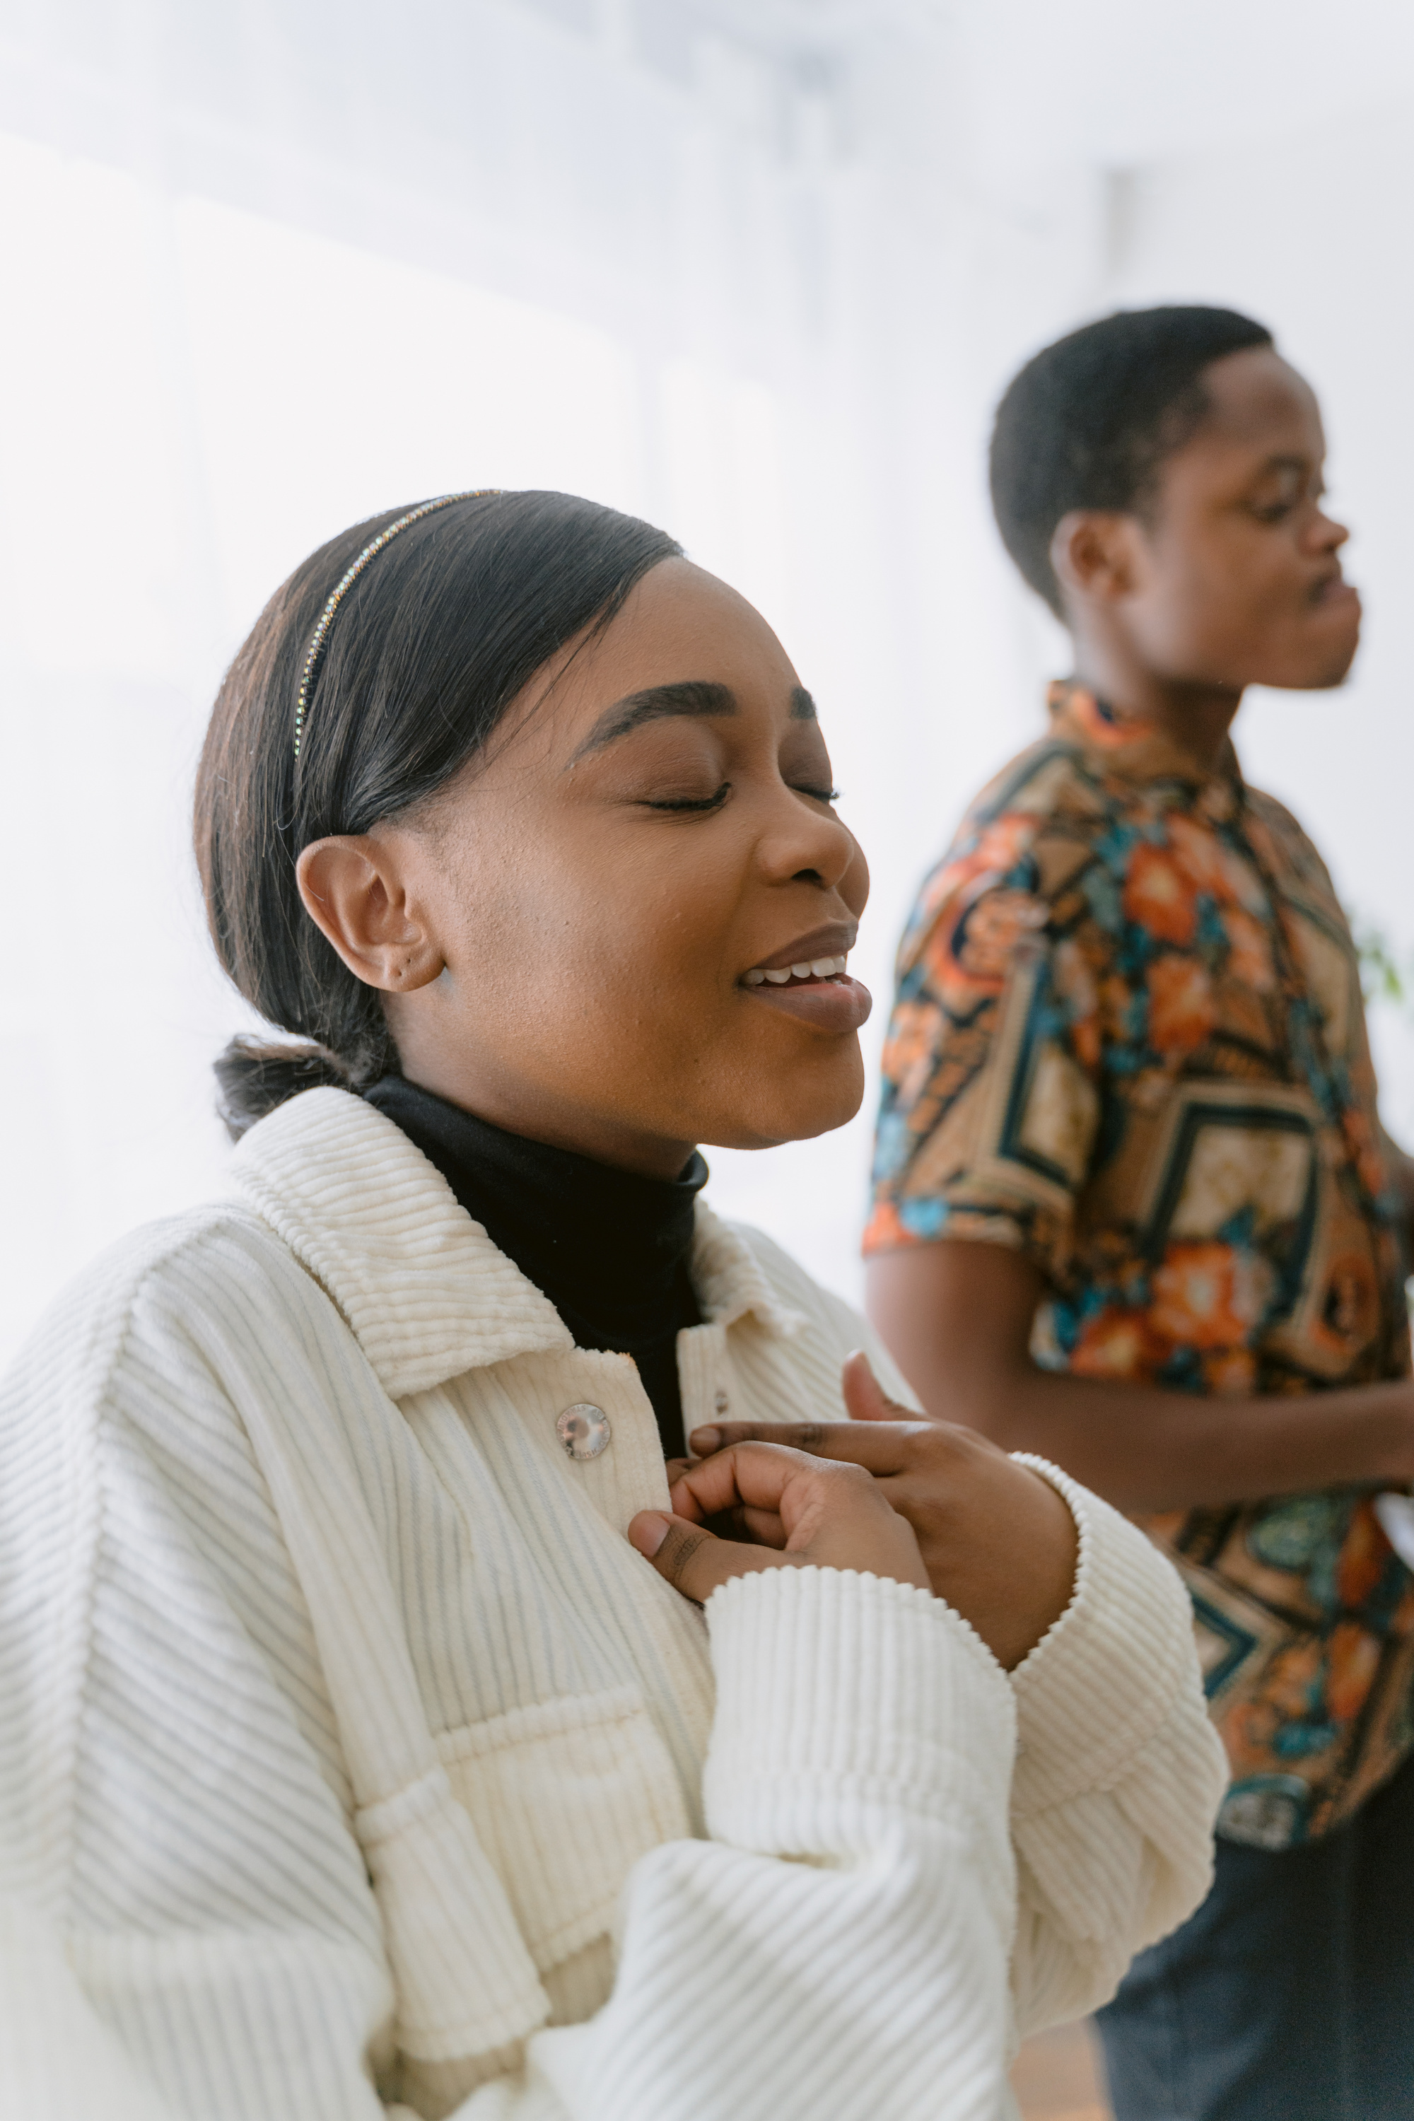
Psalm 136:1 Give thanks to the Lord, for he is good.
His love endures forever.

Slide 18
3) Thanksgiving Releases the Power of Multiplication

Slide 19
Matthew 14:19–21 (NIV):
“And he directed the people to sit down on the grass. Taking the five loaves and the two fish and looking up to heaven, he gave thanks and broke the loaves. Then he gave them to the disciples, and the disciples gave them to the people. They all ate and were satisfied, and the disciples picked up twelve basketfuls of broken pieces that were left over. The number of those who ate was about five thousand men, besides women and children.”

Slide 20
THANKSGIVING
When we give thanks for what we have,
God multiplies it beyond what we imagine.

Slide 21
TESTIMONY
Samuel Fang

Slide 22
TESTIMONY
Carys Lee

Slide 23
TESTIMONY
Bruce Ouyang

Slide 24
TESTIMONY
Anthony Zhang

Slide 25
JAMES 4:8 (NIV)
Come near to God and He will come near to you

