Slide 1


Slide 2
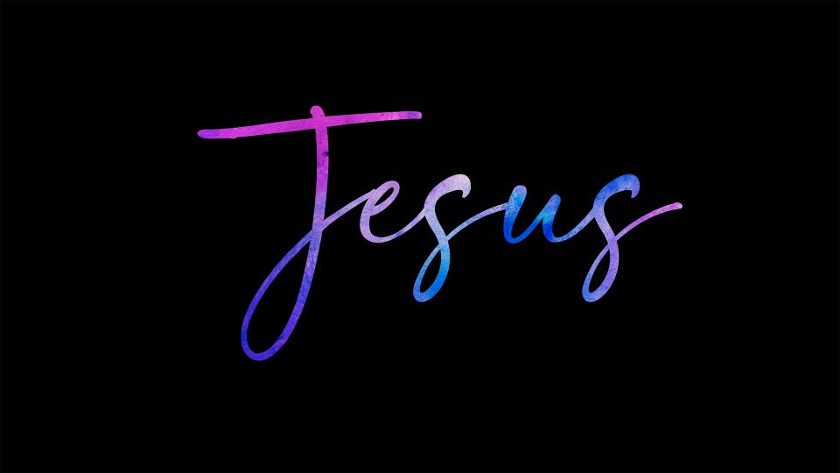
Simply
2025 Focus

Slide 3
God, after He spoke long ago to the fathers in the prophets in many portions and in many ways, 2 in these last days has spoken to us in His Son, whom He appointed heir of all things, through whom He also made the world.
Hebrews 1: 1-12 NASB

Slide 4
3 And He is the radiance of His glory and the exact representation of His nature, and upholds all things by the word of His power.
Hebrews 1: 1-12 NASB

Slide 5
When He had made purification of sins, He sat down at the right hand of the Majesty on high, 4 having become so much better than the angels, to the extent that He has inherited a more excellent name than they.
Hebrews 1: 1-12 NASB

Slide 6
5 For to which of the angels did He ever say,
“You are My Son,
Today I have fathered You”?
Hebrews 1: 1-12 NASB

Slide 7
And again,
“I will be a Father to Him
And He will be a Son to Me”?
Hebrews 1: 1-12 NASB

Slide 8
6 And when He again brings the firstborn into the world, He says,
“And let all the angels of God worship Him.”
7 And regarding the angels He says,
“He makes His angels winds,
And His ministers a flame of fire.”
Hebrews 1: 1-12 NASB

Slide 9
8 But regarding the Son He says,
“Your throne, God, is forever and ever,
And the scepter of righteousness is the scepter of His kingdom.
Hebrews 1: 1-12 NASB

Slide 10
9 You have loved righteousness and
hated lawlessness;
Therefore God, Your God, has anointed You
With the oil of joy above Your companions.”
Hebrews 1: 1-12 NASB

Slide 11
10 And,
“You, Lord, in the beginning laid the foundation of the earth,
And the heavens are the works of Your hands;
11 They will perish, but You remain;
Hebrews 1: 1-12 NASB

Slide 12
And they all will wear out like a garment,
12 And like a robe You will roll them up;
Like a garment they will also be changed.
But You are the same,
And Your years will not come to an end.”
Hebrews 1: 1-12 NASB

Slide 13
Simply Jesus
All Sufficient

Slide 14
8 But regarding the Son He says,
“Your throne, God, is forever and ever,
And the scepter of righteousness is the scepter
of His kingdom.
Hebrews 1: 8 NASB

Slide 15
9 For in Christ all the fullness of the Deity lives in bodily form,
10 and in Christ you have been brought to fullness.
He is the head over every power and authority.
Colossians 2: 9-10 NIV

Slide 16
8 And God is able to make all grace overflow to you, so that,
always having all sufficiency
in everything,
you may have an abundance for every good deed;
2 Corinthians 9:8 NASB

Slide 17
Simply Jesus
All Supreme

Slide 18
18 And he is the head of the body,
the church; he is the beginning and
the firstborn from among the dead,
so that in everything he might have
the supremacy.
Colossians 1: 18 NIV

Slide 19
18 Then Jesus came to them and said,
“All authority in heaven and on earth
has been given to me.”
Matthew 28:18 NIV

Slide 20
And they all will wear out like a garment,
12 And like a robe You will roll them up;
Like a garment they will also be changed.
But You are the same,
And Your years will not come to an end.
Hebrews 1: 11-12 NASB

Slide 21
Simply Jesus
No Add On’s
Needed

Slide 22
6 And when He again brings the firstborn into the world, He says,
“And let all the angels of God worship Him.”
7 And regarding the angels He says,
“He makes His angels winds,
And His ministers a flame of fire.”
Hebrews 1: 6-7 NASB

Slide 23
Simply Jesus
Conclusion:
Jesus is the radiance of God’s glory, upholding all things by the power of His Word. There is no name higher for us to call on. He is all sufficient and all supreme. He is our Lord and Messiah. Let our faith reflect His Truth.

Slide 24


Slide 25


