Slide 1
Leader: Welcome to Holy Hermits Online Worship
The 1st Sunday after Christmas
Today, we remember Holy Hermit
Sr Wendy Beckett
Service Prep: Leonie | Chat Host: Rachel | First Reader: Roselyn
Music: Viki & Wiggles 🐶 | Welcomer: Julie | Second Reader: Paul
Proof-reader: Kristine | Priest: N/A | Preacher: Lauren
Broadcaster: Lauren | Deacon: Lauren | Fellowship: Leonie
Backup Broadcaster: Paul | Leader: Lauren | Safety Officer: Leonie
Zoom Buttons: Paul | Cantor: Barry | Attendance: Rachel
Prep: 20/12/2025 Proofed: 22/12/2025

Slide 2


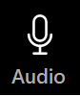



Hospitality
Leader:
Please mute for the service unless invited to offer your voice as part of the service ministry
Have the video camera on or off and turn the volume and brightness up or down on your device if things are too loud 🔉🔊or too bright🔅🔆
Our Cantor acts as our voice, offering the responses, in Bold Text, which we say together
Feel welcome to use the chat and reaction emojis 👍
🙏 Please take care of yourself in this space. 🙏 Come and go as you need
😴 It is great to take rest in this space, so falling asleep is also OK 😴
👂️ Remember, pastoral care is available to all in the community, if you'd like to speak to someone about anything spiritual. ❤️ Visit the help page at the website to reach out 🌐
Our Being Together ethos and safeguarding practices can also be accessed on the website 🫶​
🙌 Come as you are – we are all here together! 🙌
Notes:
Used Lent 2022

Slide 3
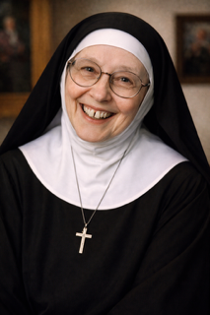
Leader: Our Holy Hermit Highlights for today
Sr Wendy Beckett was a South African born British nun, who died on Boxing Day 2018. She taught in South Africa for 15 years before returning to England. Nicknamed the ‘Art Nun’ she made art accessible through her numerous TV appearances and writings. Seeking a life of solitude, Sr Wendy lived in a basic house trailer in the grounds of the Carmelite Monastery in Norfolk.
To read more about our hermits please click the link​​ in the send out

Slide 4
Invitation
Leader: As we settle into worship let your breath be soft, your mind be still, and your heart be open to the presence of God.
Opening Epic Music:
https://www.youtube.com/watch?v=SXQvG1nrxtY

Slide 5
Leader and Cantor unmute
The Greeting
Leader:
The Grace of the lord Jesus Christ,
and the love of God,
and the fellowship of the Holy Spirit,
be with you all.
All: And also with you.

Slide 6
.
Gathering Prayer
Leader:
Lord, we praise and thank you for the joy and wonder of Christmas, and for all the blessings we enjoy at this time. As we continue to celebrate the good news of your birth, help us to be mindful of those who are in pain, difficulty or danger at this time. Please be with them as we thank you for being with us Amen.

Slide 7
Prayer of Adoration
All: Lord God, you are the giver of all that is good and just and right, you give beyond measure. You are the giver of a gift beyond the value of gold, beyond the potency of any frankincense, beyond the cleansing of any myrrh, beyond life and death. In your sight, we are far more precious than anything else. Thanks and praise be to you.
Amen.

Slide 8
Sentence
Leader: I invite our Cantor to proclaim the sentence for today.
Cantor:
Because Jesus himself was tested by what he suffered, he is able to help those who are being tested.
Hebrews 2.18

Slide 9
Prayer of Approach
All: We may not have seen a star in the east, but we have come to worship you, our God. We may not have travelled far and wide,
but we have found you and bring the gifts of
our presence and praise.
Amen.

Slide 10
Our First Hymn is
O Come, All Ye Faithful
https://www.youtube.com/watch?v=F9KBLAPMl2Q
We stay on mute
Leader and Cantor mute

Slide 11
The Deacon Introduces Confession​
The Lord comes, bringing to light things now hidden in darkness, and disclosing the purposes of the heart.
​​
Silence may be kept.​..
​
Let us open our hearts and prepare for his coming, confessing our sins in penitence and faith.

Slide 12
All: ​Merciful God, our maker and our judge, ​
we have sinned against you ​in thought, word, and deed, ​
and in what we have failed to do: ​
we have not loved you with our whole heart; ​
we have not loved our neighbours as ourselves; ​
we repent, and are sorry for all our sins.​
Father, forgive us. Strengthen us to love and obey you
in newness of life; ​through Jesus Christ our Lord. ​
Amen.​

Slide 13
Words of Assurance offered by the Deacon
These words of assurance from the First Letter of John declare that:
If anyone sins, we have an advocate with the Father, Jesus Christ the righteous. He is the perfect offering for our sin, and not for ours only, but for the sins of the whole world.
(1 John 2: 1-2)
In this is love, not that we loved God, but that he loved us and sent his Son to be the perfect offering for our sins.
(1 John 4:10)

Slide 14
Collect
Leader:
Almighty God, who wonderfully created, and yet more wonderfully restored, the dignity of human nature:
in your mercy, bring us to share the divine life of Jesus Christ,
who came to share our human life, and who now lives and reigns with you and the Holy Spirit, one God, now and for ever.
Amen.

Slide 15
The 1st reader unmutes
Leader: I invite the 1st reader to unmute and offer the 1st lesson when ready.
Reader 1: The 1st Reading is from Jeremiah 31.15-20
¹⁵ Thus says the Lord : A voice is heard in Ramah, lamentation and bitter weeping. Rachel is weeping for her children; she refuses to be comforted for her children, because they are no more.
Continues…

Slide 16
¹⁶ Thus says the Lord : Keep your voice from weeping, and your eyes from tears; for there is a reward for your work, says the Lord : they shall come back from the land of the enemy; ¹⁷ there is hope for your future, says the Lord : your children shall come back to their own country. .
Continues…

Slide 17
¹⁸ Indeed I heard Ephraim pleading: ‘You disciplined me, and I took the discipline; I was like a calf untrained. Bring me back, let me come back, for you are the Lord my God. ¹⁹ For after I had turned away I repented; and after I was discovered, I struck my thigh; I was ashamed, and I was dismayed because I bore the disgrace of my youth.’
Continues…

Slide 18
²⁰ Is Ephraim my dear son? Is he the child I delight in? As often as I speak against him, I still remember him. Therefore I am deeply moved for him; I will surely have mercy on him, says the Lord .
For the word of the Lord. Thanks be to God.​

Slide 19
Leader: We now say the psalm antiphonally, I invite the first reader to lead and we will all respond with the Response in Bold along with our cantor as our voice.
Psalm 124
¹ If the Lord had not been on our side,
now may Israel say:
if the Lord had not been on our side,
when our enemies rose against us,
² Then they would have swallowed us alive:
when their anger was kindled against us.
³ Then the waters would have overwhelmed us,
and the torrent gone over us:
the raging waters would have gone clean over us.
Continues…

Slide 20
⁴ But praised be the Lord:
who has not given us as a prey to their teeth.
⁵ We have escaped like a bird from the snare of the fowler: the snare is broken, and we have gone free.
⁶ Our help is in the name of the Lord:
who has made heaven and earth.

Slide 21
The 2nd reader unmutes
Leader: Thank you. I invite the 2nd reader to unmute and offer the 2nd lesson when ready.
Reader 2: The 2nd Reading is from 1 John 1.5-2.2
1 ⁵ This is the message we have heard from him and proclaim to you, that God is light and in him there is no darkness at all. ⁶ If we say that we have fellowship with him while we are walking in darkness, we lie and do not do what is true; ⁷ but if we walk in the light as he himself is in the light, we have fellowship with one another, and the blood of Jesus his Son cleanses us from all sin. ⁸ If we say that we have no sin, we deceive ourselves, and the truth is not in us.
Continues…

Slide 22
⁹ If we confess our sins, he who is faithful and just will forgive us our sins and cleanse us from all unrighteousness. ¹⁰ If we say that we have not sinned, we make him a liar, and his word is not in us. 2 ¹ My little children, I am writing these things to you so that you may not sin. But if anyone does sin, we have an advocate with the Father, Jesus Christ the righteous; ² and he is the atoning sacrifice for our sins, and not for ours only but also for the sins of the whole world.
For the word of the Lord. Thanks be to God.

Slide 23

We pause before
​the Gospel ​​

Slide 24
The Gospel of our Lord Jesus Christ according to St Matthew Chapter 2 beginning at the 13th verse
All: Glory to you Lord Jesus Christ.
¹³ Now after they had left, an angel of the Lord appeared to Joseph in a dream and said, ‘Get up, take the child and his mother, and flee to Egypt, and remain there until I tell you; for Herod is about to search for the child, to destroy him.’ ¹⁴ Then Joseph got up, took the child and his mother by night, and went to Egypt, ¹⁵ and remained there until the death of Herod. This was to fulfil what had been spoken by the Lord through the prophet, ‘Out of Egypt I have called my son.’
Continues…

Slide 25
¹⁶ When Herod saw that he had been tricked by the wise men, he was infuriated, and he sent and killed all the children in and around Bethlehem who were two years old or under, according to the time that he had learned from the wise men. ¹⁷ Then was fulfilled what had been spoken through the prophet Jeremiah:
¹⁸ ‘A voice was heard in Ramah, wailing and loud lamentation, Rachel weeping for her children; she refused to be consoled, because they are no more.’
This is the Gospel of the Lord. All: Praise to you Lord Jesus Christ.

Slide 26
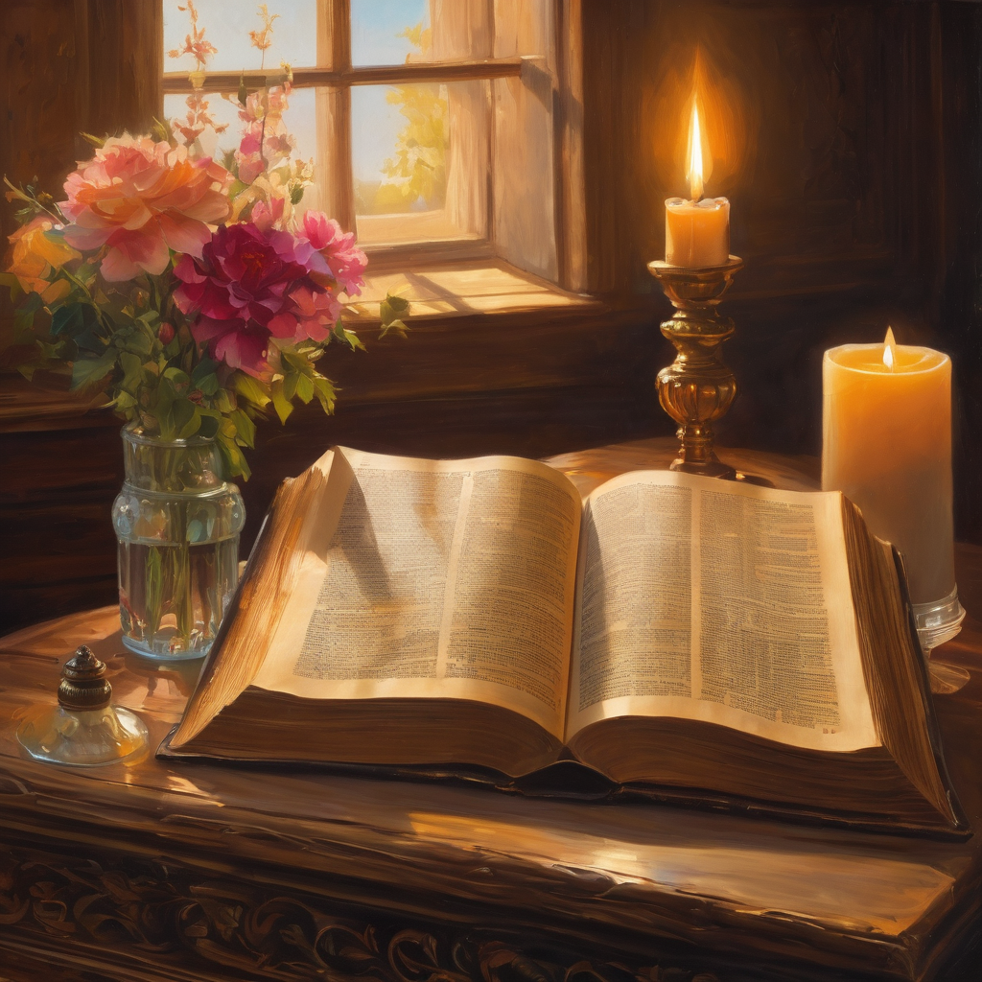
We pause
after ​the Gospel ​​

Slide 27
Leader: The Sermon is recorded to YouTube for sharing later.
Only the preacher's video and audio will be recorded.
The chat and other participants' feeds remain out of sight of the recording.
Leader and Cantor mute
Broadcaster exits screenshare
Preacher unmutes
Zoom buttons ”pins” preacher’s screen + selects “record to the cloud”
Sermon

Slide 28
Leader unmutes
Our next Hymn is
Star of Mercy
https://www.youtube.com/watch?v=2OnLc5323ew
We stay on mute
Leader mutes

Slide 29
The Leader and Cantor unmute
The Greeting of Peace
Leader: We are the body of Christ
All: God’s Spirit is with us
Leader: The peace of the Lord be always with you.
All: And also with you.
Leader: A sign of peace may be exchanged
You may like to type 'Peace' into the chat, use the 'raise hand’ or other reaction buttons, or just simply wave via the screen with your video turned on
(Broadcaster exits shared screen for a few moments for the exchange of peace)

Slide 30
Prayer of Thanksgiving before Intercessions
Leader: As we enter prayer, I invite the second reader to unmute to lead our intercessions which follow the prayer of thanksgiving. Please feel free to change your body position as you need.
Leader: We bring our praises to our Almighty God. We give you thanks that each life is special and precious in your sight. We give you thanks for those who have offered us care in times of need, comfort in times of loss, attention when we felt neglected. Help us, as your treasured children, to pay that giving and care forwards. Open our eyes to those who are suffering and grieving at this time. We thank you for the solace of your presence and ask that we may share it with those who need it most. Amen.

Slide 31
Intercessions
Reader 2: We pray for creation and communities we share our lives with. We pause for a few moments to name either in our hearts, or out loud, or in the chat, those environments and communities we bring to the Lord in prayer.
PAUSE…
We entrust to you the community of Holy Hermits Online and our ministry partners:
Prosper the work of our hands and show us the way to your new creation.
Creator God, Hear our prayer.
St John's Cathedral, Brisbane The Anglican Diocese of Southern Queensland St Gabriel’s, Carindale Benedictus Contemplative Church, Canberra Anglican Focus and Tithe.ly

Slide 32
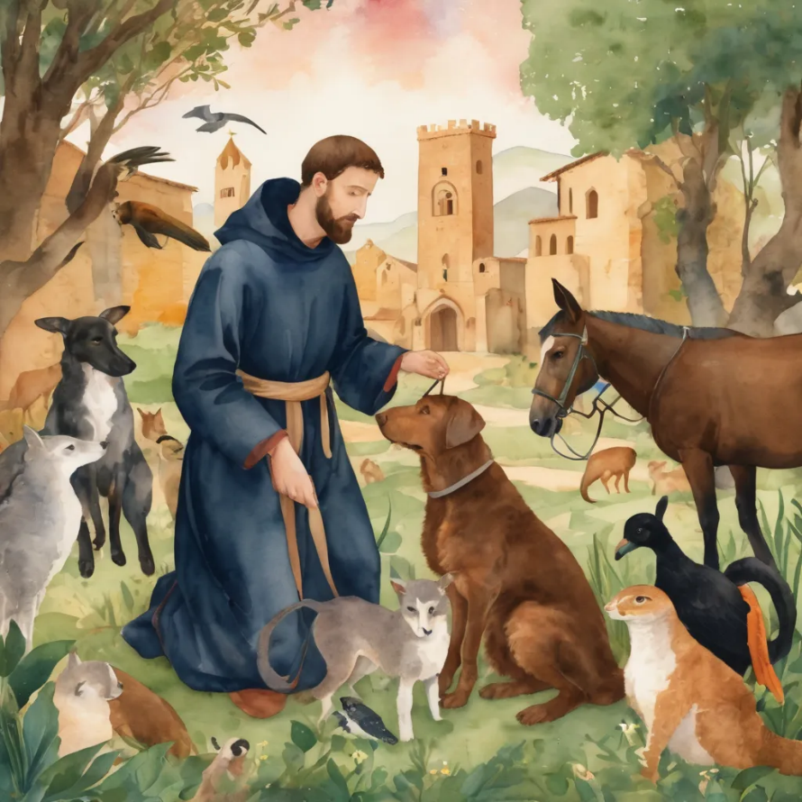
Reader 2: Loving Creator, we entrust to you all animals, especially those who are sick, anxious, ageing, lost, at risk, lonely, sad, hungry, in pain, homeless, abused, living in fear, encountering violence of any kind, in need of comfort, rehabilitation or transformation.
We invite your loving compassion for:
We name in our hearts, out loud or in the chat,
the animals we bring to the Lord in prayer. PAUSE…
Jasmine, ​
Leese(y), ​
Sid, Toots & Lulu​
Polly and Suki​
Fred, George & Percy​
Koshka ​
Jax
Lambert ​​
Kala, Nigel & Little One ​​
Toby​​
Taco​​
Paddy ​​
Rosie​

Slide 33
Reader 2: Eternal Trinity of Love, we uphold to you the people we love and carry cares for:
We name in our hearts, out loud or in the chat, those we bring to the Lord in prayer. PAUSE… We entrust to you those who have died, those who have died peacefully and those who have died tragically, The old and the young. Receive them into your Kingdom. Lord in your mercy, Hear our prayers. Amen.
Kerry, Les & Jake Julie, Ray, Tracey & Shane Mark, Desley & Bob ​​ Rachel, Mervyn & Gillian ​​Rev'd Shane & Janette​​ Alecia, Martin & Aidan​​ Steven & Vanessa | Barry​​ Dr Julie ​​ Ruth​​ Phil​ May Susan Tanya​ Craig Neva​ | Bill & Marjorie​​ Aaron & Andrea Dilys & Tony, Paul & Darhon Judy & Mary​​ Bob & Di​ Pat & Julie Miriam | Kirsten, Greg, Daphne & Beau Alan & Gaylene​ Jess & Leah ​​ Bonnie & girls Liz’s Godchildren Barry & Gwen Matthew & Nicholas​

Slide 34
Pray Daily Cycle of Prayer
Leader: Loving God, joining with the Church in our cycle of prayer, we ask your blessings on:
The Anglican Church of Canada
The Parish of East Redland: Cameron, Shan, Aubrey, Allan, Bill, George, Peter, Bruce, David, Clive, Neville, David, Susan, & Kate
Anglicare SQ Home and Community, North Region (Townsville)

Slide 35
Commitment prayer for the week:
Prayer during the emergence of AI
https://youtu.be/uhkBwPKHNXw?si=WwSOZUNb3P8SiEm7

Slide 36
Leader: Let us pray together the prayer which Jesus gave us saying:
All: Our Father in heaven,
hallowed be your name,
your kingdom come, your will be done,
on earth as in heaven.
Give us today our daily bread.
Forgive us our sins
as we forgive those who sin against us.
Save us from the time of trial
and deliver us from evil.
For the kingdom, the power,
and the glory are yours
now and for ever.
Amen.

Slide 37
Devotions

Slide 38
Hermit Wisdom

Slide 39
Leader: Teachings from Holy Hermit Sr Wendy Beckett
"God never sends suffering. Never. It is never "God's will" that we should suffer. God would like us not to suffer. But since the world brings suffering, and since God refuses to use His almighty power and treat us as foolish children, He aligns Himself with us, goes into Auschwitz with us, is devastated by 9/11 with us, and draws us with Him through it all into fulfillment. This is a high price to pay for our human freedom, but it is worth it. To be mere automatons for whom God arranges the world to cause us no suffering would mean we never have a self. We could not make choices."

Slide 40
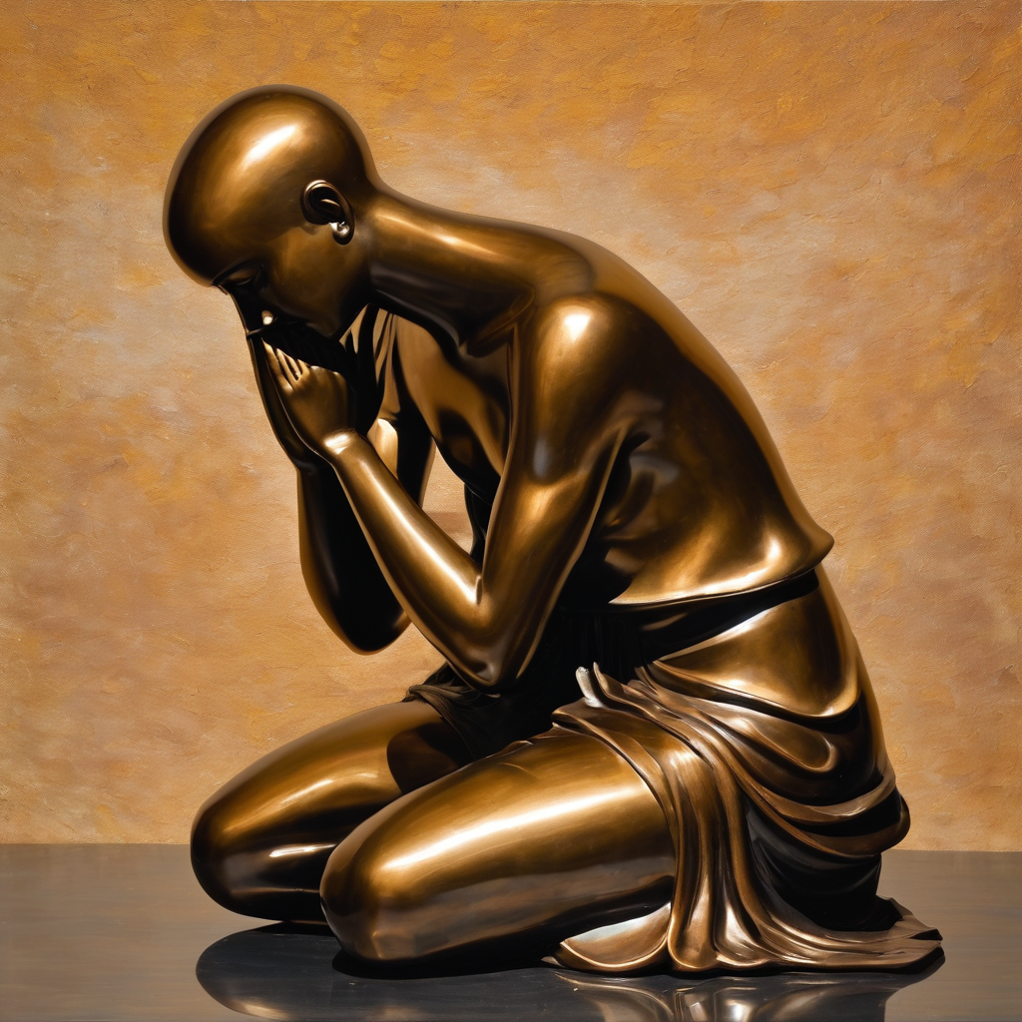
.
Leader: ​As we enter a few minutes of silence together, you are invited to pray this prayer of adoration and/or spend this time in contemplation. ​
The Spiritual Communion prayer follows
on the next slide. Let us be still.
Leader and Cantor Mute.
​
Caring God, we pray for all those who are hurting right now. We pray for all those who are crying right now. We ask that you would comfort them and surround them with your love. Amen

Slide 41
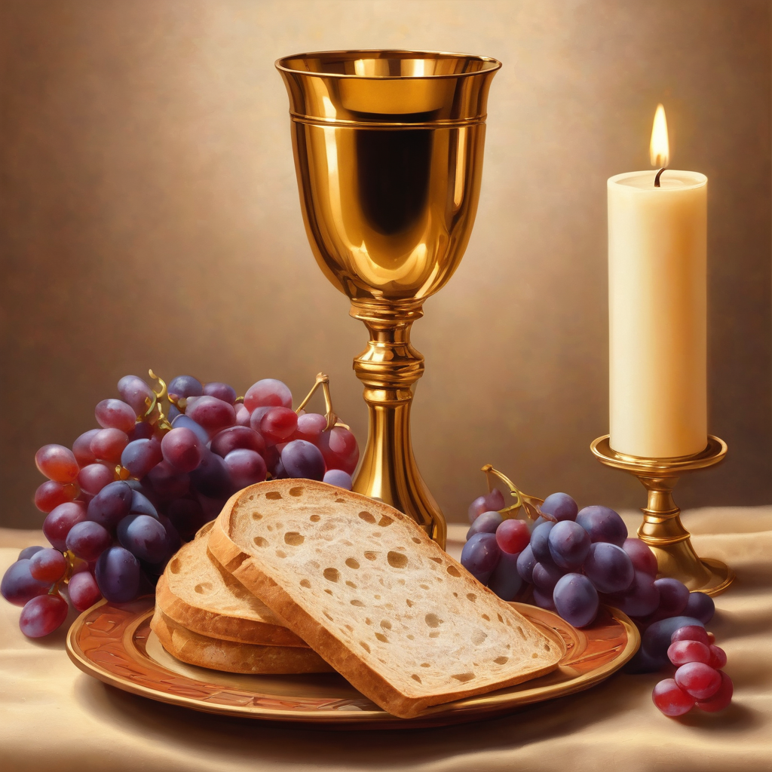

Oh, my Lord Jesus I turn to you present at the Altar and in the Tabernacle. I believe that you are present in the Holy Sacrament of your most Sacred Body and Blood.
I love you above all things and I desire to receive you into my Soul. I cannot at this moment receive you Sacramentally in Holy Communion.
Come spiritually into my heart.
Purify it, Sanctify it. Render my heart like your own heart.
I embrace you as if you were already there and unite myself wholly with you.
Never permit me to be separated from you.
Lord, I am not worthy to receive you, but only say the word and I shall be healed. Amen
Making a
Spiritual Communion
(Prayed in silence)

Slide 42
Leader unmutes
Our final song is
Heaven Touched the Earth
https://www.youtube.com/watch?v=VC9fz0gQhTA
​We stay on mute
Leader and Cantor mute

Slide 43
.
Leader and cantor unmute
Sending Prayer
Leader: We pray our sending prayer together.
All: Lord, at this time of bright lights and celebrations, thank you for the joy and blessings of the season. Please help us as we go to remain mindful of those who see more darkness than light and feel more sorrow than joy. Help us to do all we can to show them your love. Amen

Slide 44
The Benediction
Leader: Let us all invite God’s blessings together,
All: May the Lord bless us and keep us.
May the Lord’s face shine upon us and be gracious to us. May the Lord’s countenance be lifted upon us,
and bring us peace.
Amen

Slide 45
Notices
January is our Sabbath month, a time of slowing down
Rev’d Lauren is on leave from the 29th December to the 14th January, for all pastoral care needs please contact the Cathedral Pastoral Care Team through the HHO page Pastoral and Spiritual Care
Next Sunday we remember Holy Hermit St Seraphim of Serov
See HHO Events page for further upcoming events HHO Events

Slide 46

Offerings: Thank you for your regular gifts to this ministry
Offerings are most welcome via
The HHO App
Direct Debit
International Direct Debit
Please consider a one-off donation
or leaving a legacy in your Will
For further information go to HHO give page
https://holyhermits.com.au/give

Slide 47
Serving next week 4th January
The Epiphany of Our Lord
9:00 am AEST
Service Prep: Paul | Chat Host: Viki | First Reader: Jeremy
Music: Paul | Welcomer: Chris | Second Reader: Phil
Proof-reader: Rachel | Priest: N/A | Preacher: Flashback
Broadcaster: Kieron | Deacon: N/A | Fellowship: Leonie
Backup Broadcaster: Paul | Leader: Julie | Safety Officer: Chris
Zoom Buttons: Paul | Cantor: Roselyn | Attendance: Viki
Thank you for your ministry gifts
New Servers always welcome!
Please email Rev’d Lauren to get involved
holyhermits@anglicanchurchsq.org.au

Slide 48
Leader: I invite everyone to unmute for the Dismissal
Leader: Go in peace to love and serve the Lord.
All: In the name of Christ, Amen.

Slide 49
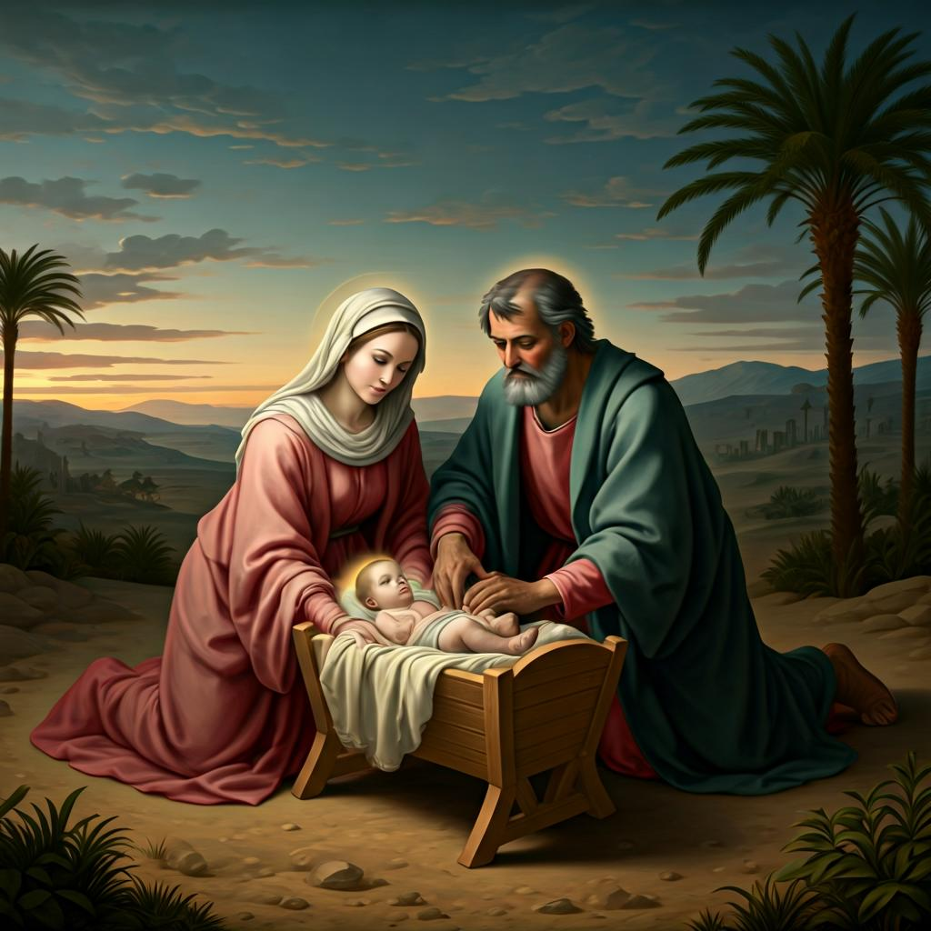
Fellowship time
Thank you, Leonie for leading Fellowship
Celebrate
Birthdays and Anniversaries
Please feel welcome to linger or pop a message in the chat and head off when you are ready.​
Extra resources developed
by Roots on the Web
Artwork by Padlet &
Images by ChatGPT

