Slide 1

The King of Joy
Robyn Christie

Slide 2
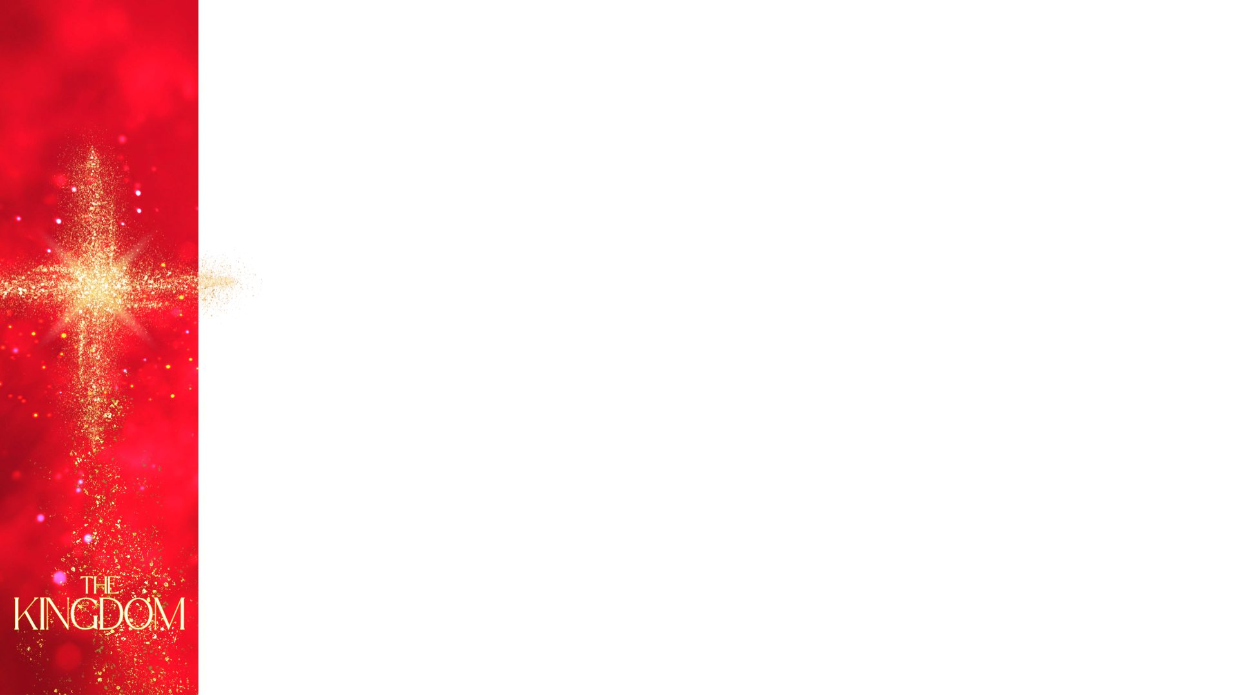
Romans 14:17
The Kingdom of heaven is not a matter of eating and drinking but of righteousness, peace and joy in the Holy Spirit”

Slide 3
Luke 2:10 -11
But the angel said to them,
“Do not be afraid. I bring you good news that will cause great joy for all the people.Today in the town of David a Savior has been born to you; he is the Messiah, the Lord.

Slide 4
Psalm 16:11
You make known to me the path of life; you will fill me with joy in your presence,
with eternal pleasures at your right hand.
Psalm 89:15
Blessed are the people who know the joyful sound! They walk, O LORD, in the light of Your countenance. NKJV

Slide 5
Zephaniah 3:17
The Lord your God is with you, the Mighty Warrior who saves.
He will take great delight in you; in his love he will no longer rebuke you,
but will rejoice over you with singing.”

Slide 6
Isaiah 35:1 – 10
The desert and the parched land will be glad: the wilderness will rejoice and blossom. Like the crocus, it will burst into bloom; it will rejoice greatly and shout for joy.
The glory of Lebanon will be given to it, the splendor of Carmel and Sharon; they will see the glory of the Lord, the splendor of our God.

Slide 7
Strengthen the feeble hands, steady the knees that give way;
say to those with fearful hearts, “Be strong, do not fear; your God will come, he will come with vengeance; with divine retribution
he will come to save you.”

Slide 8
Then will the eyes of the blind be opened and the ears of the deaf unstopped. Then will the lame leap like a deer, and the mute tongue shout for joy.
Water will gush forth in the wilderness and streams in the desert.
The burning sand will become a pool, the thirsty ground bubbling springs.
In the haunts where jackals once lay, grass and reeds and papyrus will grow.

Slide 9
And a highway will be there; it will be called the Way of Holiness; it will be for those who walk on that Way. The unclean will not journey on it;
wicked fools will not go about on it.
No lion will be there, nor any ravenous beast;
they will not be found there. But only the redeemed will walk there,

Slide 10
John 15:11
I have told you this so that my joy may be in you and that your joy may be complete.

Slide 11
John 16:22
So with you: Now is your time of grief, but I will see you again and you will rejoice, and no one will take away your joy.

Slide 12
JOY
Jesus centred
Oriented to Kingdom
Yielded to the King

Slide 13
Galations 5:22
22 But the fruit of the Spirit is love, joy, peace, forbearance, kindness, goodness, faithfulness,

Slide 14
Philippians 4:4-7
Rejoice in the Lord always. I will say it again: Rejoice! Let your gentleness be evident to all. The Lord is near. Do not be anxious about anything, but in every situation, by prayer and petition, with thanksgiving, present your requests to God. And the peace of God, which transcends all understanding, will guard your hearts and your minds in Christ Jesus.

Slide 15
Philippians 4:8-9
Finally, brothers and sisters, whatever is true, whatever is noble, whatever is right, whatever is pure, whatever is lovely, whatever is admirable—if anything is excellent or praiseworthy—think about such things. Whatever you have learned or received or heard from me,or seen in me—put it into practice. And the God of peace will be with you.

Slide 16
Hebrews 12:1 – 2
Therefore, since we are surrounded by such a great cloud of witnesses, let us throw off everything that hinders and the sin that so easily entangles. And let us run with perseverance the race marked out for us,

Slide 17
fixing our eyes on Jesus, the pioneer and perfecter of faith. For the joy set before him he endured the cross, scorning its shame, and sat down at the right hand of the throne of God.

Slide 18
"The joy of God has gone through the poverty of the manger and the agony of the cross; that is why it is invincible, irrefutable. It does not deny the anguish, when it is there, but finds God in the midst of it".
Dietrich Boenhoffer

Slide 19
The world has come under a different law. Christmas is not only a historic event that happened once, on which our salvation rests. Christmas is the promise of a new order of things, of life, of our existence.
Alfred Delp

