Slide 1


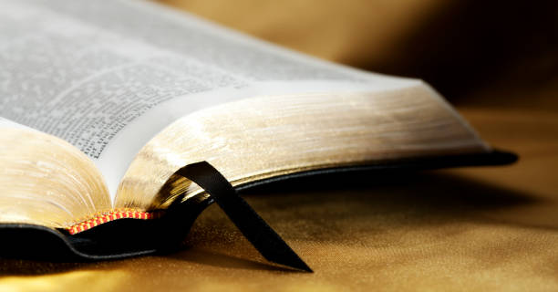

SCRIPTURE READING
ROMANS 1: 1b- 4
https://www.istockphoto.com/

Slide 2
The Gospel of God,
which He promised beforehand through His prophets in the Holy Scriptures,
concerning His Son,
who was born of a descendant of David
according to the flesh,
who was declared the Son of God with power by the resurrection from the dead,
according to the Spirit of holiness,
Jesus Christ our Lord.
Romans 1: 1b – 4 (NASB, 1999)

Slide 3


https://stock.adobe.com/

Slide 4

WHO IS COMING?
WHY CELEBRATE THE COMING OF JESUS INTO THE WORLD?

Slide 5
A SEEK – AND – SAVE MISSION
“For the Son of man has come to seek and to save that which was lost”
Luke 19: 10 (NASB, 1999)

Slide 6
IN THIS SEASON, LET US FOCUS ON THE REASON WHY HE CAME
INTO THE WORLD.
MAY THE SPIRIT OF OUR CELEBRATION BE THE SPIRIT IN WHICH HE CAME.
HE CAME TO SEARCH FOR THOSE WHO WERE LOST,
HE CAME TO SEEK FOR THOSE WHOSE HEARTS LONGED FOR SOMETHING MORE THAN THE WORLD COULD SATISFY
JESUS CHRIST CAME TO RESCUE LOST PEOPLE FROM THE WRATH TO COME
(1 Thessalonians 1: 10)

Slide 7
ADVENT IS A SEASON FOR THINKING ABOUT & CELEBRATING THE HEART & MISSION OF GOD.
THIS SEASON IS ABOUT
OUR ETERNAL, MAGNIFICENT, MIGHTY, AWESOME GOD CHOOSING TO IDENTIFY SO TOTALLY WITH US
THAT HE SENT HIS SON ON
A SEARCH AND RESCUE MISSION TO SAVE US
GOD IS A SENDING, PURSUING, SEARCHING, SAVING GOD

Slide 8

OUR ETERNAL GOD STEPPED INTO TIME.
THE CREATOR OF ALL THINGS BECAME PART OF HIS CREATION
HOW

Slide 9
THE ALMIGTHY GOD BECAME APPROACHABLE
THE INFINITE ONE BECAME AN INFANT.
THE WORD BECAME FLESH, AND DWELT AMONG US
John 1: 14

Slide 10
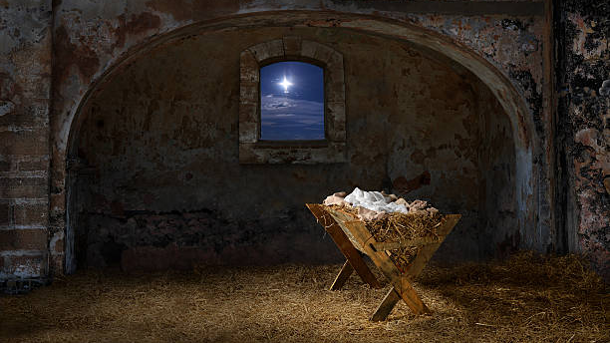
THE BIRTH OF A CHILD
CHANGES EVERYTHING
ROMANS 1: 1 -4;
LUKE 1:1 – 2: 40
CLIC
23-25 INTREPID STREET,
BERWICK
21st DECEMBER 2025

Slide 11
The birth of a child changes everything
You can prepare for the birth of a child,
but you will still be surprised.

Slide 12
There will be joy, pain, sacrifice,
unexpected developments, tears, laughter, inconvenient times, sleepless nights,
perhaps even frustration and anger…

Slide 13
In essence , the birth of a child brings change – a disruption to our normal well-ordered lives –
and
change is something that most struggle with, change causes us to react in unexpected ways

Slide 14
And change came..
..this child that was born some two thousand years ago changed everything.
This child’s birth provoked a response in so many people – from kings, governors, wise men, shepherds, a young mother and father..

Slide 15
This child provoked a response..
..an outburst of praise from an angelic choir,
..a call to some shepherds to come away from looking after their sheep to “go and see” Messiah

Slide 16

Who is He in yonder stall, At whose feet the shepherds fall? ‘Tis the Lord! O wondrous story! ‘Tis the Lord, the King of Glory! At His feet we humbly fall Crown Him! Crown Him, Lord of all!
Benjamin Russel Hanby (1833 – 1867)

Slide 17
A ray of hope flickers in the sky A tiny star lights up way up high All across the land, dawns a brand new morn this comes to pass when a child is born… …The winds of change whisper in the trees And the walls of doubt crumble, tossed and torn, this comes to pass when a child is born
THE SONG EXPRESSES THE YEARNING OF MANY HEARTS
BUT TRUE HOPE IS NOT JUST IN ANY CHILD
BUT THE CHILD BORN OF MARY, A SON THAT IS GIVEN TO US

Slide 18
THIS CHILD WAS
NO ORDINARY CHILD
THIS CHILD WAS MESSIAH,
CHRIST THE LORD

Slide 19
NO ORDINARY CHILD
JESUS IS THE VISIBLE IMAGE OF THE INVISIBLE GOD,
CLOTHED IN HUMILITY
YET
CARRYING THE FULL WEIGHT OF DIVINE AUTHORITY

Slide 20
The Son of God became a man to enable men to become sons of God.
C.S. LEWIS
GOD CAME DOWN.
THE INFINITE BECAME AN INFANT.
THE ETERNAL GOD STEPPED INTO TIME,
HE WHO WAS DIVINE BECAME HUMAN

Slide 21
WHY DID GOD DO IT?
BECAUSE OF THE PROMISE OF HIS GOOD NEWS
“THE GOSPEL OF GOD”
ROMANS 1: 1b (NASB, 1999

Slide 22
THE PROMISE
IS
THE CLIMAX OF THOUSANDS OF PROMISES & PROPHETIC WORDS SPOKEN OVER AT LEAST 4O CENTURIES

Slide 23
IT IS THE ANSWER TO ALL THOSE PUZZLING QUESTIONS OVER THE YEARS –
AN ANSWER & A SOLUTION –
THE GOSPEL,
THE GOOD NEWS OF GOD

Slide 24
BUT WHAT IS
THE GOOD NEWS OF GOD
ABOUT?

Slide 25
The Gospel of God,
which He promised beforehand through His prophets in the Holy Scriptures,
concerning His Son,
who was born of a descendant of David
according to the flesh,
who was declared the Son of God with power by the resurrection from the dead,
according to the Spirit of holiness,
Jesus Christ our Lord.
Romans 1: 1b – 4 (NASB, 1999)

Slide 26
..CONCERNING HIS SON..
ROMANS 1: 3 (NASB, 1999)
THE GOOD NEWS IS ABOUT THE CENTRALITY OF JESUS:
HIS IDENTITY, LIFE, DEATH, RESURRECTION, REIGN
THE GOSPEL IS JESUS

Slide 27


ASPECTS OF JESUS

Slide 28

JESUS WAS FULLY HUMAN
‘.. A descendant of David according to the flesh..”
Romans 1: 3b (NASB, 1999)

Slide 29
JESUS WAS A MAN, SOMEONE REAL, WITH PARENTS AND ANCESTORS
JESUS WAS JEWISH, CIRCUMCISED, WHO KEPT THE LAW AND WHO COULD FULFILL THE LORD’S PROMISES TO ISRAEL
JESUS WAS THE RIGHTFUL KING, HEIR TO DAVID’S THRONE, THE ONE WHO WOULD COME AND RULE OVER THE NATIONS ON BEHALF OF YHWH

Slide 30

JESUS WAS THE SON OF GOD
‘.. declared the Son of God with power..”
Romans 1: 4a (NASB, 1999)

Slide 31
THIS JEWISH MAN, THE SON OF A CARPENTER, WHO HAD BROTHERS AND SISTERS, SPOKE WITH A GALILEAN ACCENT, WHO GOT THIRSTY & HUNGRY, WHO ATE AND SLEPT, WHO LAUGHED AND CRIED AND WASHED FEET, WAS
THE SON OF GOD IN POWER
JESUS – THIS MAN FROM NAZARETH – WAS (AND IS) GOD’S MESSIAH.
HE WAS (AND IS)THE SON OF GOD IN POWER
AND “GOD OVER ALL”
(Romans 9:5 )

Slide 32

JESUS WAS RESURRECTED FROM THE DEAD ACCORDING TO THE SPIRIT OF HOLINESS
‘.. by the resurrection from the dead, according to the Spirit of Holiness..”
Romans 1: 4b (NASB, 1999)

Slide 33
THE AUTHORITY GIVEN TO JESUS IS ANNOUNCED TO THE WORLD BY THE HOLY SPIRIT
JESUS WAS RAISED FROM THE DEAD ACCORDING TO THE SPIRIT OF HOLINESS IN ALL PERFECTION & PURITY
THE RESURRECTION IS THE FATHER’S PROCLAIMATION OF THE SON’S LORDSHIP BY THE HOLY SPIRIT’S POWER

Slide 34

JESUS CHRIST OUR LORD
‘.. Jesus Christ our Lord.”
Romans 1: 4b (NASB, 1999)
KEY POINTS:
JESUS IS THE “CHRIST”, THE PROMISED KING OF ISRAEL
2) JESUS IS “LORD”, THE RULER OF THE WHOLE WORLD.
JESUS IS “OUR” LORD, HE IS THE PERSON WHO WE CAN
KNOW, PRAISE, LOVE & FOLLOW.

Slide 35


https://stock.adobe.com/

Slide 36
THE GOSPEL IS PRIMARILY A PERSON,
NOT AN EVENT.
IT IS
“OF GOD, CONCERNING HIS SON”

Slide 37
WHAT WILL BE YOUR
RESPONSE
TO JESUS CHRIST?

Slide 38
www.clichurch.com

