Slide 1
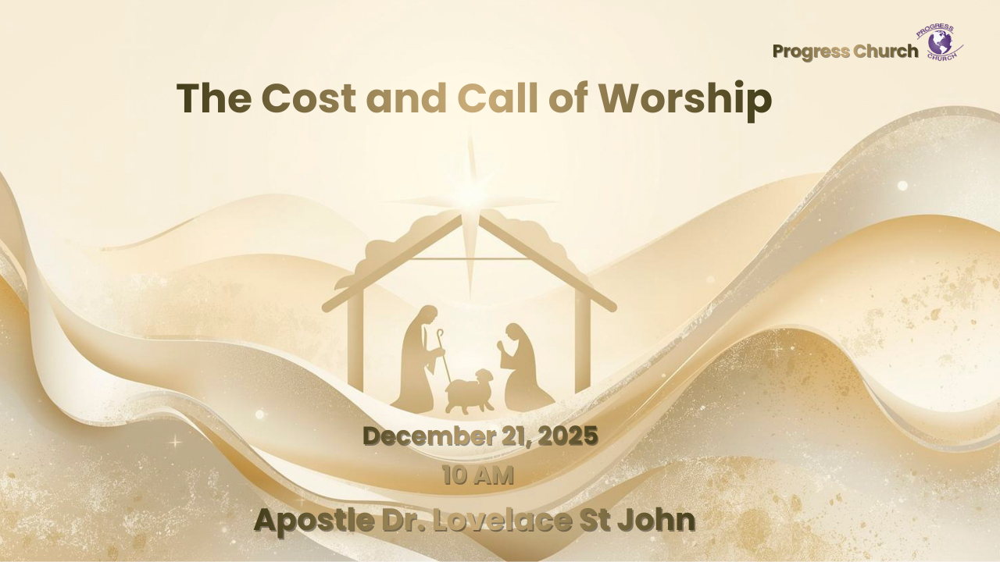

Slide 2



SCRIPTURE
Theme Scripture Passages
Mary’s Worship — Luke 1:38
Joseph’s Worship — Matthew 1:24
Shepherds’ Worship — Luke 2:15–20
Wise Men’s Worship — Matthew 2:10–11

Slide 3
INTRODUCTION
When we hear "worship," we often think of singing, prayer, or church attendance. These are indeed forms of worship.
But is worship always comfortable, convenient, or cost-free?
The Christmas narrative reveals a deeper, more challenging truth, true worship often involves significant personal cost and a response to God's specific call.
The Christmas story illustrate how authentic worship demands a cost and requires a specific call.

Slide 4
THE COST AND CALL OF WORSHIP
MARY’S WORSHIP — THE COST OF SURRENDER (Luke 1:38)
1. Worship Answers God’s Call
2. Worship Costs Our Comfort and Reputation
3. Worship Makes Room for God’s Purpose

Slide 5
THE COST AND CALL OF WORSHIP
JOSEPH’S WORSHIP — THE COST OF OBEDIENCE (Matthew 1:24)
1. Worship Requires Obedience to God’s Word
2. Worship Calls Us to Protect What God Is Doing
3. Worship Means Trusting God Beyond Logic

Slide 6
THE COST AND CALL OF WORSHIP
SHEPHERDS’ WORSHIP — THE COST OF PRIORITY & PRESENCE (Luke 2:15–20)
1. Worship Requires Leaving Lesser Things
2. Worship Requires Seeking Jesus with Urgency
3. Worship Results in Witness

Slide 7
THE COST AND CALL OF WORSHIP
WISE MEN’S WORSHIP — THE COST OF GIVING (Matthew 2:10–11)
1. Worship Requires Diligent Pursuit
2. Worship Requires Joyful Sacrifice
3. Worship Offers God Our Best

