Slide 1
Welcome to Holy Hermits Online Worship
The 4th Sunday of Advent A
“Love”
Service Prep: Kristine | Chat Host: Viki | First Reader: Bob
Music: Wiggles 🐶 | Priest: Dean Peter | Second Reader: Margo
Proof-reader: Viki | Deacon: | Preacher: Dean Peter
Broadcaster: Kieron | Welcomer: Chris | Fellowship: Julie
Backup Broadcaster: Barry | Leader: Jeremy | Safety Officer: Chris
Zoom Buttons: Viki | Cantor: Vanessa | Attendance: Viki

Slide 2






Hospitality
Leader: Please mute for the service unless invited to offer your voice as part of the service ministry
Have the video camera on or off and turn the volume and brightness up or down on your device if things are too loud 🔉🔊or too bright🔅🔆
Our Cantor acts as our voice, offering the responses, in Bold Text, which we say together
Feel welcome to use the chat and reaction emojis 👍
🙏 Please take care of yourself in this space. 🙏 Come and go as you need
😴 It is great to take rest in this space, so falling asleep is also OK 😴
👂️ Remember, pastoral care is available to all in the community, if you'd like to speak to someone about anything spiritual. ❤️ Visit the help page at the website to reach out 🌐
Our Being Together ethos and safeguarding practices can also be accessed on the website 🫶​
🙌 Come as you are – we are all here together! 🙌
Notes:
Used Lent 2022

Slide 3
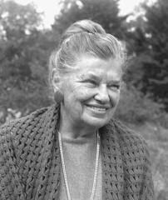
Leader: Our Holy Hermit Highlights for today
Catherine De Huek Doherty
Catherine Doherty (born Ekaterina Fyodorovna Kolyschkine on August 15, 1896, in Nizhny Novgorod, Russia) grew up in a noble family and was baptized into the Russian Orthodox Church. Educated in Egypt, she encountered Catholicism.
During World War I, she served as a decorated Red Cross nurse. After the Russian Revolution, she fled to Finland and England. Catherine converted to Catholicism in 1919 and emigrated to Canada.
Following a successful lecture tour, Catherine embraced poverty and began serving the poor in Toronto, founding Friendship House in 1932. This ministry expanded to Harlem and other U.S. cities, promoting Catholic social teaching and racial harmony. In 1947, she moved to Combermere, Ontario, where Catherine established Madonna House Apostolate. She dedicated her life to helping the poor until her death on December 14, 1985.
To read more about our Holy Hermits please click the link​​ in the send out or go to our web site

Slide 4
Invitation
Leader: As we settle into worship let your breath be soft, your mind be still, and your heart be open to the presence of God.
Music https://www.youtube.com/watch?v=VBMvnx1o0ug

Slide 5
Leader and Cantor unmute
The Greeting
Leader: The Lord is coming!
Prepare the way.
All: The Lord is coming!
We are making ready,

Slide 6
Gathering Prayer
Leader: Come, Lord Jesus. Come be with us.
Come be with us in our joys and celebrations.
Come be with us to bless us and inspire us.
Come be with us to correct and guide us.
Come be with us to heal and save us.
Come, Lord Jesus, come.
All: As Christmas draws near, we gather to worship
and to join with others throughout the centuries
and around the world in saying,
Come, Lord Jesus. Come be with us.
Amen.

Slide 7
The Trisagion
All: Holy God,
holy and mighty,
holy and immortal,
have mercy on us.

Slide 8
Sentence
Leader: I invite our Cantor to proclaim the sentence for today.
Cantor: A virgin shall conceive and bear a son, and his name shall be called Emmanuel: God with us.
Matthew 1.23

Slide 9
Prayer of Approach
All:
We gather, as Advent draws to a close: Come Jesus, be with us.
In the stillness of the night: Come Jesus, be with us.
In the movement of the day: Come Jesus, be with us.
In the rest and balm of sleep: Come Jesus, be with us.
In the activity of our waking: Come Jesus, be with us.
As Advent draws to a close and Christmas dawns:
Come Jesus, be with us.
Amen.

Slide 10
Leader unmutes
Our first hymn is
Awaken and Prepare Us
https://www.youtube.com/watch?v=2X5nzx3xfJg
​We stay on mute
Leader and Cantor mute

Slide 11
Preparing for confession
Leader: Compassionate God, sometimes we make our world too small
and look inwards, not outwards.
All: Forgive us when we lack confidence to care and courage to act.
Leader: Sometimes our hearts are too small
and we miss opportunities to make a difference.
All: Forgive us when we lack confidence to care and courage to act.
Continue…

Slide 12
Leader: Sometimes our lives are too full and we are oblivious
to those who feel empty.
All: Forgive us when we lack confidence to care and courage to act.
Leader: Sometimes we don’t look after ourselves enough
and cause others to fret and worry.
All: Forgive us when we lack confidence to care and courage to act.

Slide 13
The LA Introduces Confession​
The Lord comes, bringing to light things now hidden in darkness, and disclosing the purposes of the heart.
​​
Silence may be kept.​..
​
Let us open our hearts and prepare for his coming, confessing our sins in penitence and faith.

Slide 14
All: ​Merciful God, our maker and our judge, ​
we have sinned against you ​in thought, word, and deed, ​and in what we have failed to do: ​
we have not loved you with our whole heart; ​
we have not loved our neighbours as ourselves; ​
we repent, and are sorry for all our sins.​
Father, forgive us. Strengthen us to love and obey you in newness of life; ​through Jesus Christ our Lord. ​Amen.​

Slide 15
Words of Assurance offered by the LA
These words of assurance from the First Letter of John declare that:
If anyone sins, we have an advocate with the Father, Jesus Christ the righteous. He is the perfect offering for our sin, and not for ours only, but for the sins of the whole world.
(1 John 2: 1-2)
In this is love, not that we loved God, but that he loved us and sent his Son to be the perfect offering for our sins.
(1 John 4:10)

Slide 16
>If there is no priest present this slide is skipped<
The Priest offers the Absolution
Almighty God who has promised forgiveness to all who turn to God in faith; pardon you and set you free from all your sins, strengthen you in all goodness and keep you in eternal life, through Jesus Christ our Lord.
Amen.

Slide 17
Collect
Leader: Gracious God,
you chose the virgin Mary, by your grace,
to be the mother of our Lord and Saviour:
so fill us with your grace,
that with her we may rejoice in your salvation,
and in all things embrace your will;
through Jesus Christ our Lord,
who lives and reigns with you in the unity of the Holy Spirit,
one God, now and for ever. Amen.

Slide 18
Prayer for sustainability
Leader: Generous God, we hold before you the financial stability and future sustainability of Holy Hermits Online. Guide us as we seek to grow our community’s giving, so we may continue the work you have called us to – being together in this digital space. Show us where to place our energy as we explore new funding sources and fresh opportunities. Be present with us and those we meet as we reach out to charitable trusts and foundations, inviting their support for our outreach – especially to those unable to get to Church in person.
Continue…

Slide 19
Stir the hearts of all who believe in this mission to greater generosity, creativity, and commitment. We thank you for the partnerships you have already blessed us with, especially our home base at St John’s Cathedral. We pray in the name of Jesus, who lived on mission and said,
If in my name you ask me for anything, I will do it.
Amen.

Slide 20
The 1st Reader unmutes
Leader: I invite the 1st Reader to unmute and offer the 1st reading when ready.
Reader 1: The 1st Reading is from Isaiah 7:10-16
¹⁰ Again the Lord spoke to Ahaz, saying, ¹¹ Ask a sign of the Lord your God; let it be deep as Sheol or high as heaven. ¹² But Ahaz said, I will not ask, and I will not put the Lord to the test. ¹³ Then Isaiah said: ‘Hear then, O house of David! Is it too little for you to weary mortals, that you weary my God also? ¹⁴ Therefore the Lord himself will give you a sign. Look, the young woman is with child and shall bear a son, and shall name him Immanuel.
Continues…

Slide 21
.
¹⁵ He shall eat curds and honey by the time he knows how to refuse the evil and choose the good. ¹⁶ For before the child knows how to refuse the evil and choose the good, the land before whose two kings you are in dread will be deserted.
Hear the word of the Lord. Thanks be to God.​

Slide 22
Leader: We now say the psalm antiphonally, I invite the 1st Reader to lead, and we will all respond with the Response in Bold along with our cantor as our voice.
¹ Hear, O Shepherd of Israel,
you that led Joseph like a flock:
you that are enthroned upon the cherubim,
shine out in glory;
² Before Ephraim, Benjamin and Manasseh:
stir up your power, and come to save us.
³ Restore us again, O Lord of hosts:
show us the light of your countenance,
and we shall be saved.
Psalm
80.1-7
80.17-19
Continues…

Slide 23
⁴ O Lord God of hosts:
how long will you be angry at your people’s prayer?
⁵ You have fed them with the bread of tears:
and given them tears to drink in good measure.
⁶ You have made us the victim of our neighbours:
and our enemies laugh us to scorn.
⁷ Restore us again, O Lord of hosts:
show us the light of your countenance,
and we shall be saved.
Continues…

Slide 24
¹⁷ Let your power rest on the man at your right hand:
on that son of man
whom you made so strong for yourself.
¹⁸ And so we shall not turn back from you:
give us life, and we will call upon your name.
¹⁹ Restore us again, O Lord of hosts:
show us the light of your countenance,
and we shall be saved.

Slide 25
The 2nd Reader unmutes
Leader: Thank you, 1st reader. I invite the 2nd Reader to unmute and offer the 2nd reading when ready.
Reader 2: The 2nd Reading is from Romans 1.1-7
¹ Paul, a servant of Jesus Christ, called to be an apostle, set apart for the gospel of God, ² which he promised beforehand through his prophets in the holy scriptures, ³ the gospel concerning his Son, who was descended from David according to the flesh ⁴ and was declared to be Son of God with power according to the spirit of holiness by resurrection from the dead, Jesus Christ our Lord, ⁵ through whom we have received grace and apostleship to bring about the obedience of faith among all the Gentiles for the sake of his name,
Continues…

Slide 26
⁶ including yourselves who are called to belong to Jesus Christ, ⁷ To all God’s beloved in Rome, who are called to be saints: Grace to you and peace from God our Father and the Lord Jesus Christ.
Hear the word of the Lord. Thanks be to God.

Slide 27

We pause before
​the Gospel ​​

Slide 28
Deacon: The Gospel of our Lord Jesus Christ according to St Matthew Chapter 1 beginning at the 18th verse.
All: Glory to you Lord Jesus Christ.
¹⁸ Now the birth of Jesus the Messiah took place in this way. When his mother Mary had been engaged to Joseph, but before they lived together, she was found to be with child from the Holy Spirit.
¹⁹ Her husband Joseph, being a righteous man and unwilling to expose her to public disgrace, planned to dismiss her quietly.
²⁰ But just when he had resolved to do this, an angel of the Lord appeared to him in a dream and said, ‘Joseph, son of David, do not be afraid to take Mary as your wife, for the child conceived in her is from the Holy Spirit.
Continues…

Slide 29
²¹ She will bear a son, and you are to name him Jesus, for he will save his people from their sins.’
²² All this took place to fulfil what had been spoken by the Lord through the prophet:
²³ ‘Look, the virgin shall conceive and bear a son,
and they shall name him Emmanuel’,which means, ‘God is with us.’
²⁴ When Joseph awoke from sleep, he did as the angel of the Lord commanded him; he took her as his wife,
²⁵ but had no marital relations with her until she had borne a son; and he named him Jesus.
This is the Gospel of the Lord. All: Praise to you Lord Jesus Christ.

Slide 30
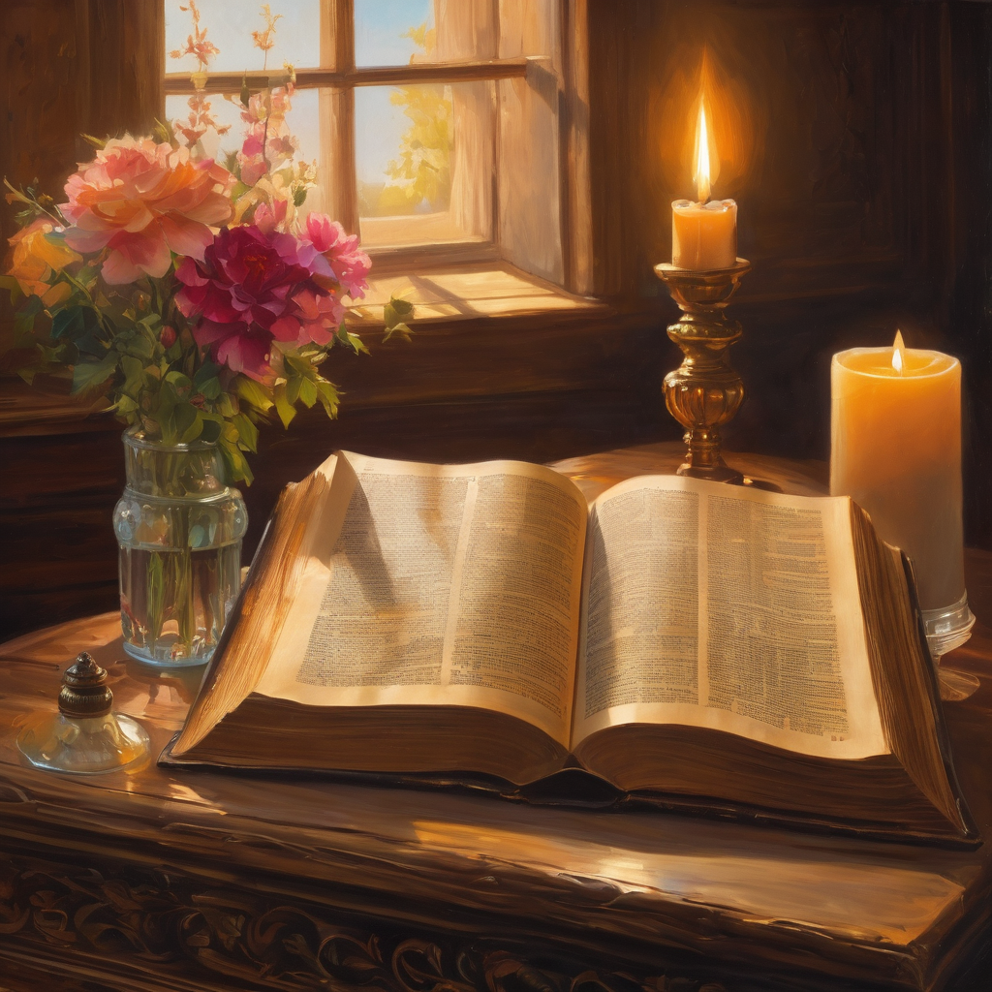
We pause
after ​the Gospel ​​

Slide 31
Leader: The Sermon is recorded to YouTube for sharing later.
Only the preacher's video and audio will be recorded.
The chat and other participants' feeds remain out of sight of the recording.
Leader and Cantor mute
Broadcaster exits screenshare
Preacher unmutes
Zoom buttons ”pins” preacher’s screen + selects “record to the cloud”
Sermon

Slide 32
Leader unmutes
Our next hymn is
Of the Father's Love Begotten
https://www.youtube.com/watch?v=NCzftU79qJg
​We stay on mute
Leader and Cantor mute

Slide 33
The Leader and Cantor unmute
The Greeting of Peace
Leader: We are the body of Christ
All: God’s Spirit is with us
Leader: The peace of the Lord be always with you.
All: And also with you.
Leader: A sign of peace may be exchanged
You may like to type 'Peace' into the chat, use the 'raise hand’ or other reaction buttons, or just simply wave via the screen with your video turned on
(Broadcaster exits shared screen for a few moments for the exchange of peace)

Slide 34
Reflection
Leader: We pause to reflect on Love
How do we experience God’s love?
Are there areas of our lives into which we could invite more love?
Pause…

Slide 35
Prayer of Thanksgiving before Intercessions
Leader:
We praise you, Almighty God, for walking with us through Advent.
We praise and thank you:
that you have guided us and shown us the way;
that you have revealed yourself in the expected and unexpected;
that you have been balm to our pain and companion in our joy;
that we have seen prophecies fulfilled, promises upheld;
that we have glimpsed hope in the desperate times;
Continues…

Slide 36
that in death there is life, where there is loss there is gain;
that tears of sadness can be transformed to tears of joy.
We praise you for the greatness of your transforming power.
And, as we wait for Christmas Day, we shout:
Come, Jesus, be with us.
Amen.

Slide 37
2nd Reader unmutes Intercessions
Reader 2: We pray for creation and communities we share our lives with. We pause for a few moments to name either in our hearts, or out loud, or in the chat, those environments and communities we bring to the Lord in prayer.
PAUSE…
We entrust to you the community of Holy Hermits Online and our ministry partners:
Prosper the work of our hands and show us the way to your new creation.
Creator God, Hear our prayer.
St John's Cathedral Brisbane The Anglican Diocese of Southern Queensland St Gabriel’s, Carindale Benedictus Contemplative Church, Canberra Anglican Focus and Tithe.ly

Slide 38
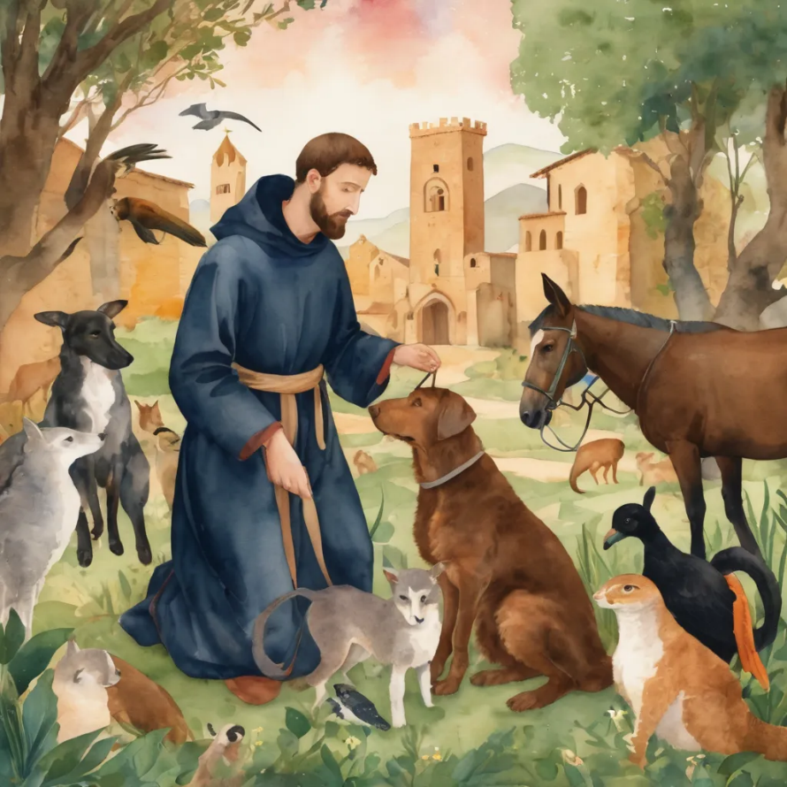
Reader 2: Loving Creator, we entrust to you all animals, especially those who are sick, anxious, ageing, lost, at risk, lonely, sad, hungry, in pain, homeless, abused, living in fear, encountering violence of any kind, in need of comfort, rehabilitation or transformation.
We invite your loving compassion for:
We name in our hearts, out loud or in the chat,
the animals we bring to the Lord in prayer. PAUSE…
Jasmine, ​
Leese(y), ​
Sid, Toots and Lulu​
Polly and Suki​
Fred, George and Percy​
Koshka ​
Lambert ​​
Kala, Nigel and Little One ​​
Toby​​
Taco​​
Paddy and Jax​​
Rosie​

Slide 39
Reader 2: Eternal Trinity of Love, we uphold to you the people we love and carry cares for:
We name in our hearts, out loud or in the chat, those we bring to the Lord in prayer. PAUSE… Lord in your mercy, Hear our prayers. Amen.
Kerry and Les, Jake,​​ Dr Julie, ​​ Julie and Ray, Tracey, Shane Jess and Leah ​​ May ​​ Kirsten, Greg, Daphne & Beau​​ Tanya​ Matthew & Nicholas​ Alan & Gaylene​ Susan | Barry​​ Dilys and Tony, Paul and Darhon Judy and Mary​​ Mark, Desley and Bob ​​ Ruth​​ Phil​ Rachel, Mervyn & Gillian Liz’s Godchildren Bonnie and girls | Bill and Marjorie​​ Rev'd Shane & Janette​​ Alecia, Martin and Aidan​​ Aaron and Andrea ​​ Neva​ Bob and Di​ Steven, Vanessa and Craig Miriam Barry and Gwen Pat and Julie

Slide 40
Pray Daily Cycle of Prayer
Leader: Loving God, joining with the Church in our cycle of prayer, we ask your blessings on:
The Anglican Church of Burundi
The Diocese of Rockhampton: †Peter; Clergy and People
The Parish of Coolum: Karen, Richard, Jocelyn, Jim, Richard
The Park – Centre for Mental Health, Wacol
All Saints Anglican School, Merrimac: Headmaster – Matthew; Chaplain - Ann; Chair of School Council - John; members of School Council; staff & students

Slide 41
Prayer for Deliverance Ministry
Leader: Come Holy Spirit and make the hearts of your servants,
Reverend Claye and the deliverance ministry team, your dwelling place and home. ​May darkness be dispelled by your light, and troubles calmed by your peace. ​​​
Lord Jesus, we ask that you protect, guide and strengthen them, and all whom they encounter. ​​Give them courage, ability, wisdom and discernment. ​​​
Continues…

Slide 42
​​​Surround them with sound advice and support, that they may have insight and discretion. ​​Drawing on the Holy Spirit may they be strong in vocation and trust in you. ​​​
We pray for those in need of healing and their ongoing relationship with
you, as they journey towards the fullness and freedom of eternal life. ​May all evil and pain be transformed through the suffering of Christ and all dying glorified by your risen life. ​
Amen.

Slide 43
Leader: Let us pray together the prayer which Jesus gave us saying:
All: Our Father in heaven,
hallowed be your name,
your kingdom come, your will be done,
on earth as in heaven.
Give us today our daily bread.
Forgive us our sins
as we forgive those who sin against us.
Save us from the time of trial
and deliver us from evil.
For the kingdom, the power,
and the glory are yours
now and for ever.
Amen.

Slide 44
Devotions

Slide 45
Hermit Wisdom

Slide 46
Leader: Teachings from Holy Hermits Catherine De Huek Doherty
One of Catherine’s themes was the duty of the moment.
"The duty of the moment is what you should be doing at any given time, in whatever place God has put you. You may not have Christ in a homeless person at your door, but you may have a little child. If you have a child, your duty of the moment may be to change a dirty diaper. So you do it. But you don't just change that diaper, you change it to the best of your ability, with great love for both God and that child.... There are all kinds of good Catholic things you can do, but whatever they are, you have to realize that there is always the duty of the moment to be done. And it must be done, because the duty of the moment is the duty of God."

Slide 47

Leader: ​As we enter a few minutes of silence together, you are invited to pray this prayer of adoration and/or spend this time in contemplation. ​
The Spiritual Communion prayer follows
on the next slide. Let us be still.
Leader and Cantor mute
​
As Christmas approaches, we prepare to
join in adoration of you with the humble shepherds,
the proclaiming angels and the gifting wise men.
We adore you with our all, with our everything.
Amen.

Slide 48
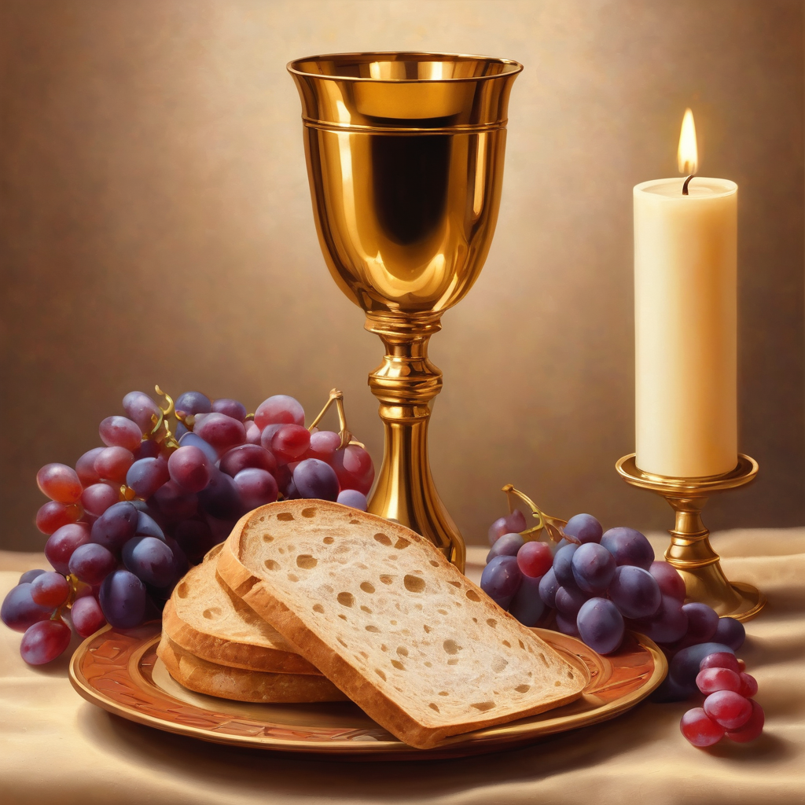
Oh, my Lord Jesus I turn to you present at the Altar and in the Tabernacle. I believe that you are present in the Holy Sacrament of your most Sacred Body and Blood.
I love you above all things and I desire to receive you into my Soul. I cannot at this moment receive you Sacramentally in Holy Communion. Come spiritually into my heart. Purify it, Sanctify it. Render my heart like your own heart. I embrace you as if you were already there and unite myself wholly with you. Never permit me to be separated from you. Lord, I am not worthy to receive you, but only say the word and I shall be healed. Amen
Making a
Spiritual Communion
(Prayed in silence)

Slide 49
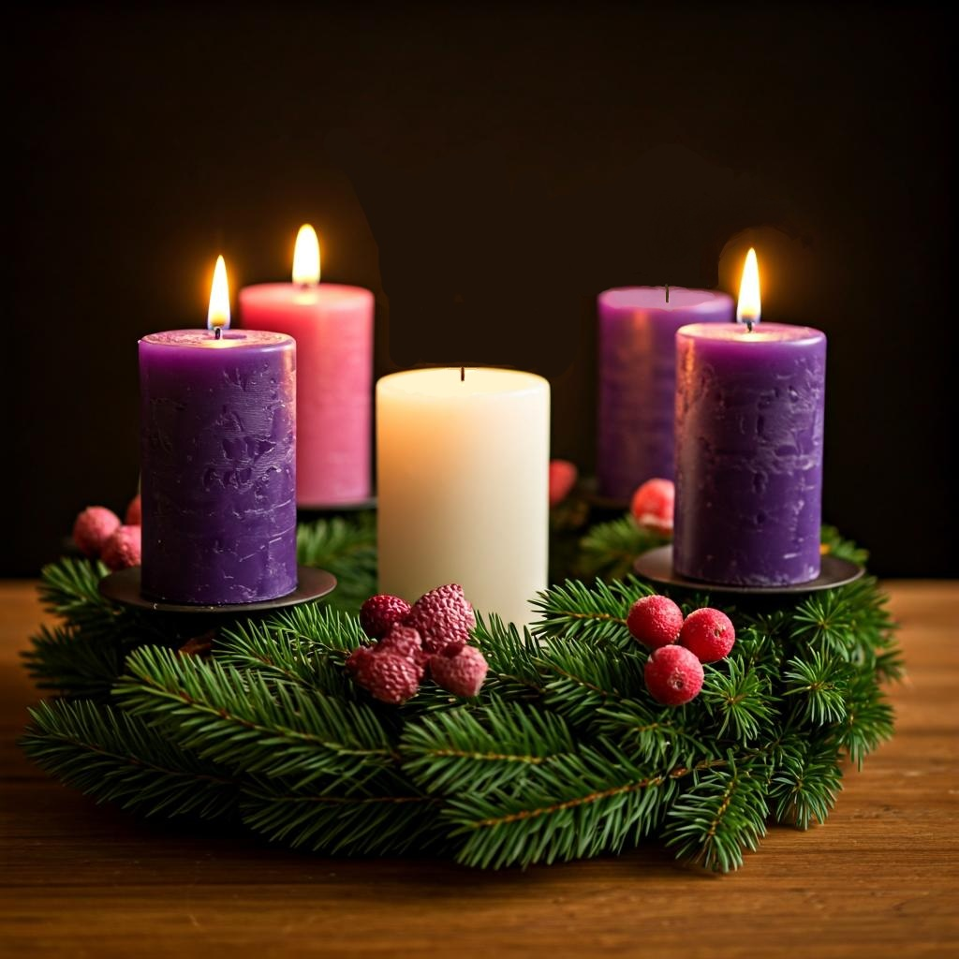

Lighting The Advent Wreath: LOVE
Leader: In a world of unrest, where war and oppression are rife, where destruction and hate are the norm and peace is far from us, Lord, we call upon you to come.
All: Come, Lord Jesus, Come.
Leader: We long for hope, and pray for peace, as we await the God of Love in the promised child, Lord we call upon you to come.
All: Come, Lord Jesus, Come.
Leader: We long for hope, and pray for peace, as we await the God of Love in the promised child, Lord we call upon you to come.
All: Come, Lord Jesus, Come, and bring us your hope.

Slide 50
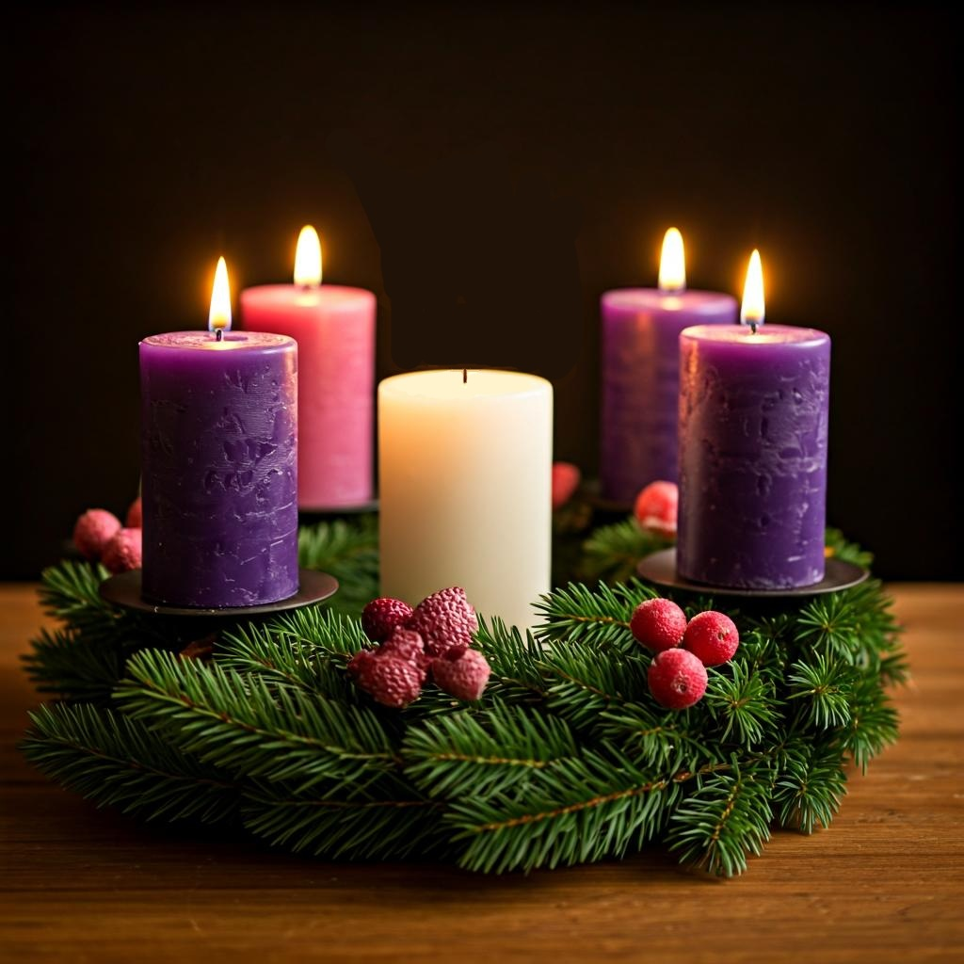

Light the third purple (love) candle.
Leader: Let us Pray,
All: God of hope, who brought love into this world,
be the love that dwells between us.
God of hope, who brought peace into this world,
be the peace that dwells between us.
God of hope, who brought joy into this world,
be the joy that dwells between us.
God of hope, the rock we stand upon,
be the light and focus of our lives.
Amen.

Slide 51
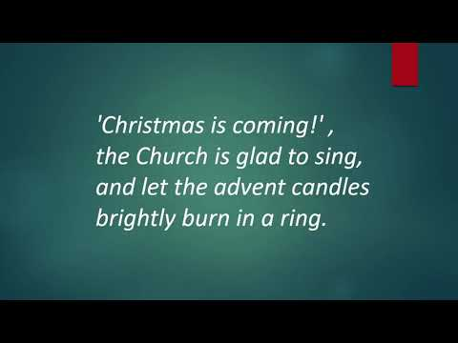
Notes:
Link for video: Christmas is coming! - Advent Ring 4 https://www.youtube.com/watch?v=cv_tt4d2mVo (just in case ☺)

Slide 52

A Personal Prayer for each of us in the silence
Lord, may the whole world come to know about your love.
May all the people of the whole world praise you.
And, just as the water covers the sea, may the whole world be covered with your glory.
Lord, may we care for the world and for each other, as people who know your love.
Amen.

Slide 53
Leader unmutes
Our final song is
No Room For The King
https://www.youtube.com/watch?v=HeIPA81IZNI
​We stay on mute
Leader and Cantor mute

Slide 54
Sending Prayer
All: Thank you, Lord, that you came at Christmas to be with us and that you come afresh to us each new day.
Send us out now to be signs of your loving presence
to others who need you too.
For your name’s sake, we pray.
Amen.

Slide 55
>If there is no priest present this slide is skipped<
The Priest offers the Blessing
The peace of God which passes all understanding keep your hearts and minds in the knowledge and love of God, and of his Son, Jesus Christ our Lord; and the blessing of God almighty, the Father, the Son, and the Holy Spirit, be among you and remain with you always. Amen.

Slide 56
The Benediction
Leader: Let us all invite God’s blessings together,
All: May the Lord bless us and keep us.
May the Lord’s face shine upon us and be gracious to us.
May the Lord’s countenance be lifted upon us and bring us peace.
Amen

Slide 57
Notices
A big 'Thank You' for being with us today, Dean Peter
Later today at 6pm will be our Blue Christmas service, please use the same link that brought you here this morning to attend
10am Wednesday 24th December we have our 9 Lessons & Carols Christmas Eve service
10am Thursday 25th December will be our contemplative Christmas Day service; all welcome to either or both lovely services
Next week we remember Holy Hermit Sister Wendy Beckett
See HHO Events page for further upcoming events HHO Events

Slide 58

Offerings: Thank you for your regular gifts to this ministry
Offerings are most welcome via
The HHO App
Direct Debit
International Direct Debit
Please consider a one-off donation
or leaving a legacy in your Will
For further information go to HHO give page
https://holyhermits.com.au/give

Slide 59
The Dismissal
Leader: I invite everyone to unmute for the Dismissal
Leader: Go in peace to love and serve the Lord.
All: In the name of Christ, Amen.

Slide 60
Serving next week 28th December
1st Sunday after Christmas
9:00 am AEST
Service Prep: Leonie | Chat Host: Rachel | First Reader: Roselyn
Music: Wiggles 🐶 | Priest: N/A | Second Reader: Paul
Proof-reader: Kristine | Deacon: Lauren | Preacher: Lauren
Broadcaster: Lauren | Welcomer: Julie | Fellowship: Leonie
Backup Broadcaster: Paul | Leader: Lauren | Safety Officer: Leonie
Zoom Buttons: Paul | Cantor: Barry | Attendance: Rachel
Thank you for your ministry gifts
New Servers always welcome!
Please email Rev’d Lauren to get involved
holyhermits@anglicanchurchsq.org.au

Slide 61

Fellowship time
Thank you, Julie
for leading Fellowship
Please feel welcome to linger or pop a message in the chat and head off when you are ready.​
Extra resources developed
by Roots on the Web
All artwork by Padlet

