Slide 1
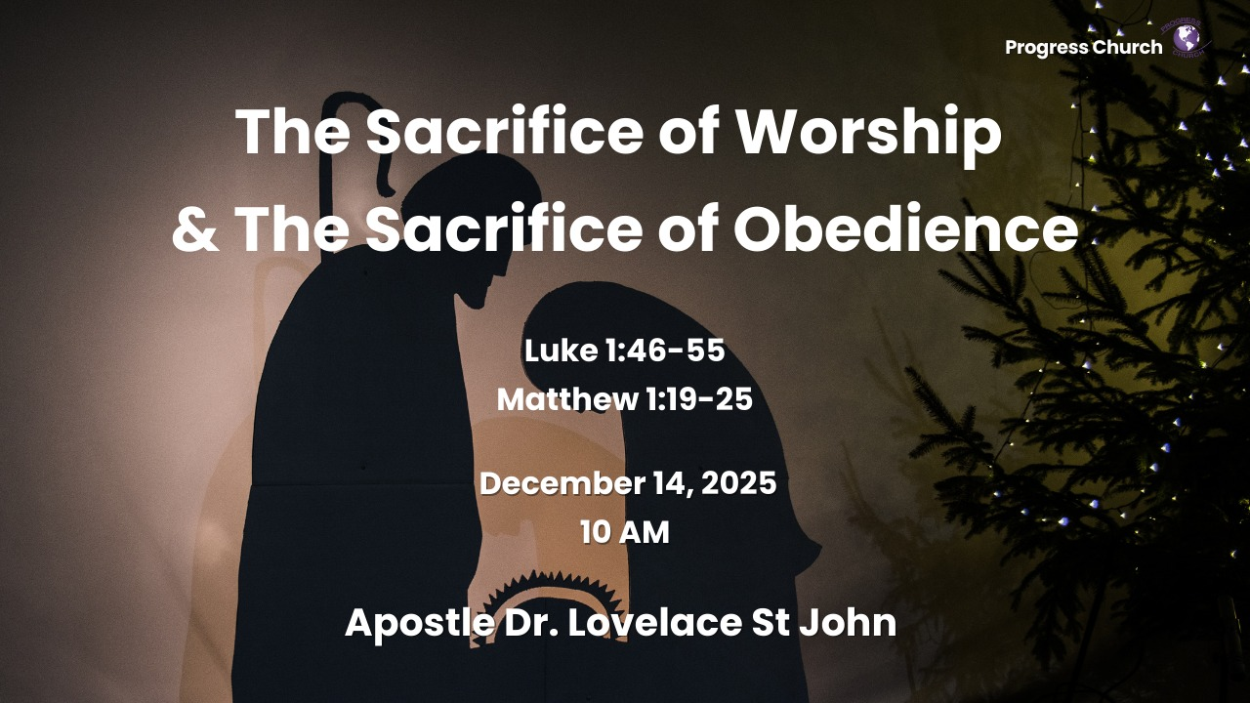

Slide 2



SCRIPTURE
LUKE 1: 46 – 55 & MATTHEW 1: 19 – 25

Slide 3
INTRODUCTION
When God Interrupts Our Plans
The Divine Interruption
The Challenge of Surrender

Slide 4
The Call to Surrender: (Luke 1:26-34)
An Unimaginable Message
Troubled and Pondering
God's Promise of Impossibility

Slide 5
The Nature of Surrender: Let It Be To Me According to Your Word (Luke 1:38)
Mary's Radical "Yes“
Acceptance of the Unknown
The Sacrifice in Surrender

Slide 6
The Cost and Reward of Surrendered Life: (Luke 1:39-55)
The Immediate and Future Costs of Mary's "Yes”
Participation in God's Redemptive Plan
Joy in the Magnificat

Slide 7
Joseph -The Sacrifice of Obedience
(Matthew 1:19 – 25)
His Obedience Required Courage (Matthew 1:20–21)
Obedience in the Face of Fear
Joseph was afraid—afraid of uncertainty, public perception, and stepping into a divine assignment he didn’t fully understand.
God’s first words to him were, “Do not be afraid.”
True worship often begins where fear ends.

Slide 8
His Obedience Required Courage
(Matthew 1:20–21)
Obedience in the Face of Fear
God’s first words to him were, “Do not be afraid.”
True worship often begins where fear ends.

Slide 9
His Obedience Required Laying Down His Own Plans (Matthew 1:24–25)
God’s call interrupted his plans and redirected his entire destiny.
He obeyed without arguing, without delay, and without conditions, he did as the angel commanded.

Slide 10
His Obedience Became an Act of Worship
(Romans 12:1)
Worship Is More Than a Song, It’s Sacrificial Obedience
Joseph never said a recorded word in Scripture, yet his obedience spoke louder than any sermon.
His obedience protected Mary, preserved the incarnation, and positioned Jesus for prophecy fulfillment.
True worship is not emotional expression, it is a yielded life.

