Slide 1
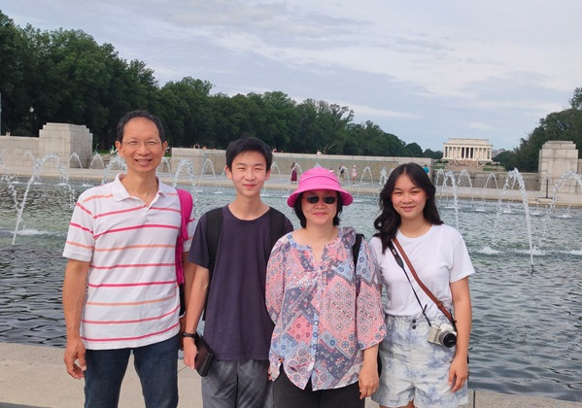
Educating, encouraging and empowering blue-collar families in Taiwan
Ming-Da,
Kitty
Grace
Jonah

Slide 2
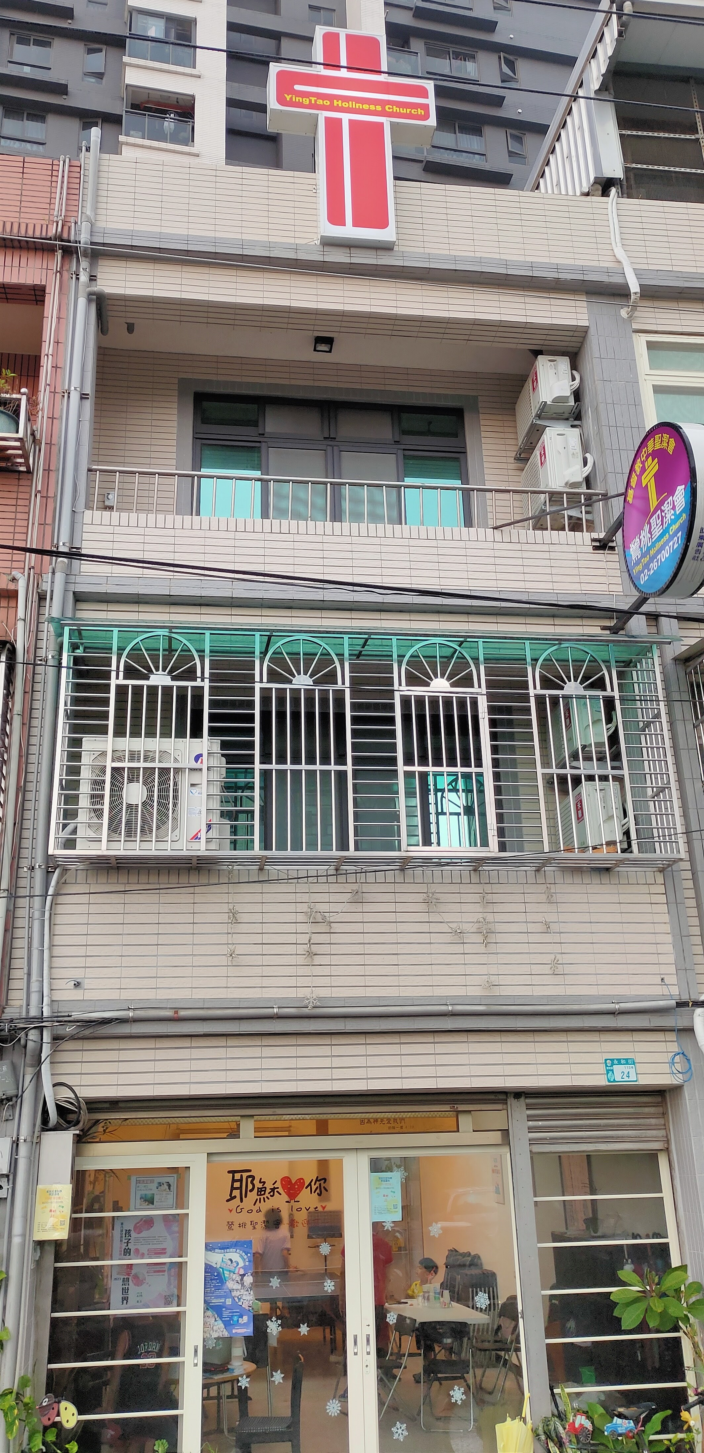
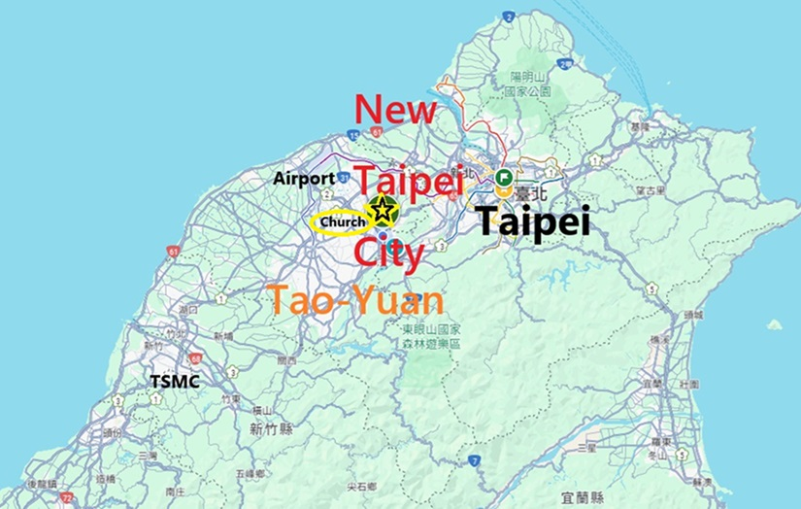
Ying-Tao Church
Yingge, New Taipei City
Established in 2016

Slide 3
Our church is located in a working-class neighborhood.
There are local Taiwanese workers here, as well as migrant workers from Southeast Asia.

Slide 4
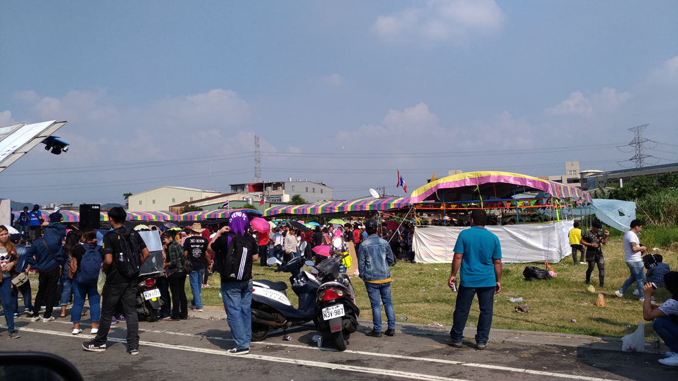
Thai migrant workers gather to celebrate their religious festival in the community.

Slide 5
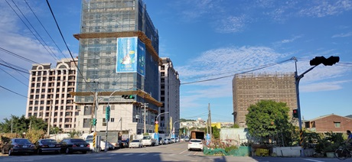
The new areas of the community are also developing, and more outsiders are moving in.

Slide 6
Our church is an evangelical church that emphasizes biblical teaching and evangelism.

Slide 7
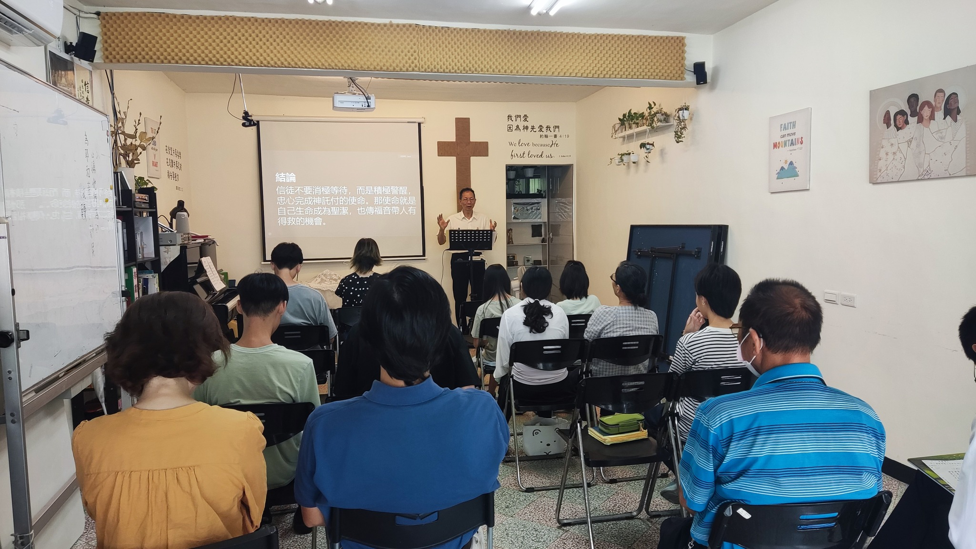
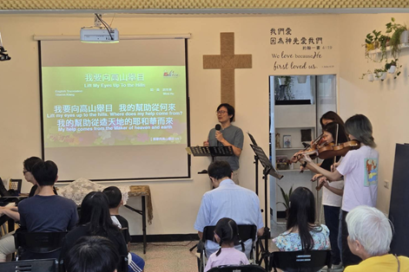
Sunday Service

Slide 8
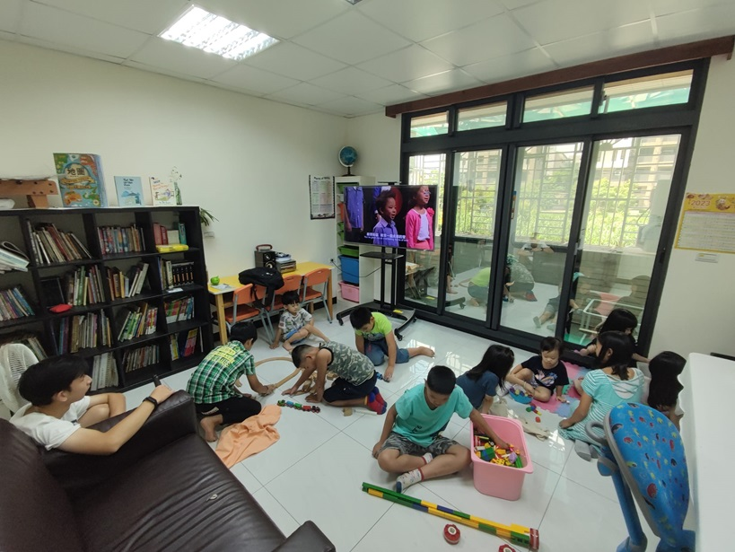
Kids Sunday School

Slide 9
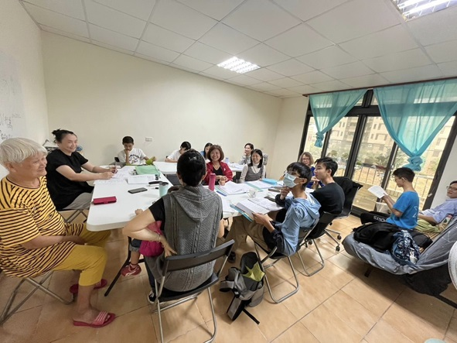
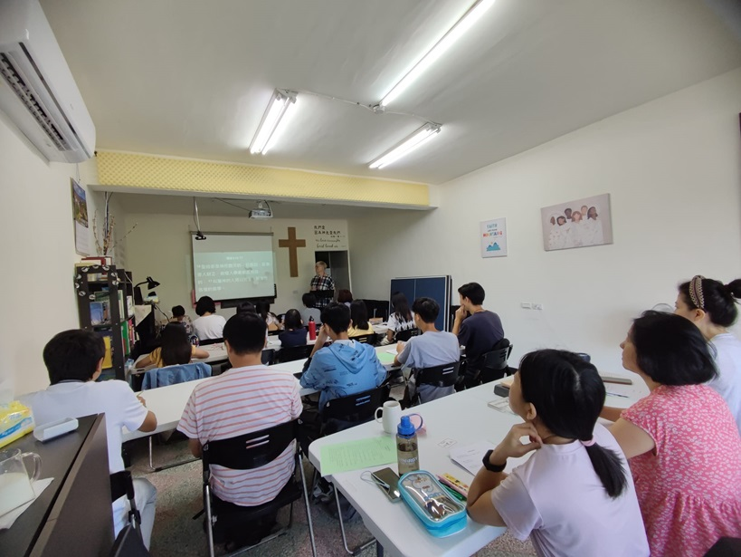
Precept Bible Study

Slide 10
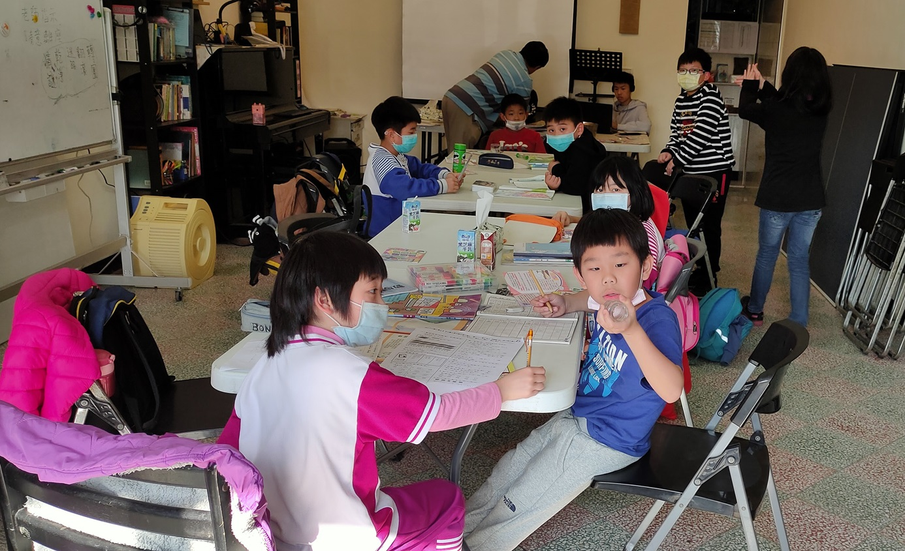
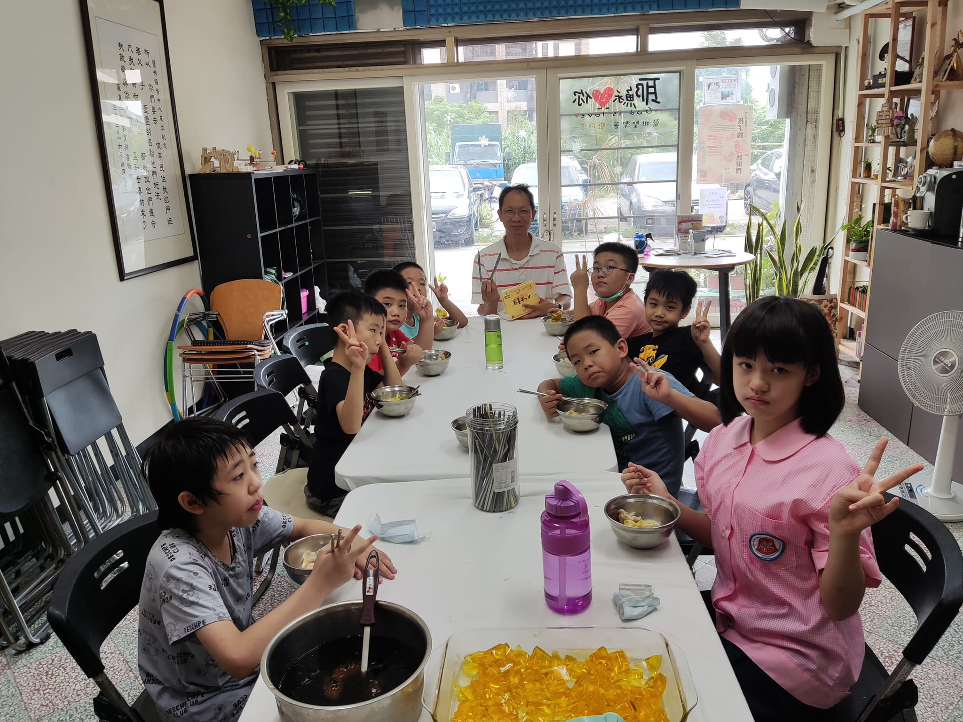
After school program

Slide 11
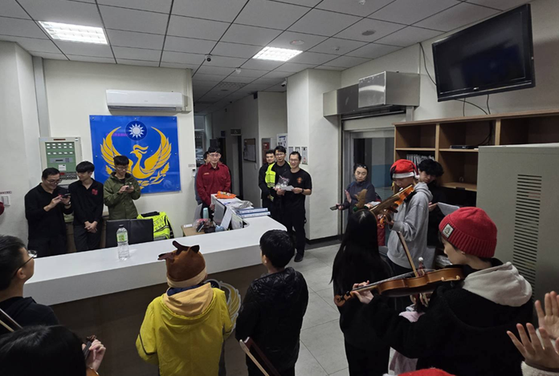
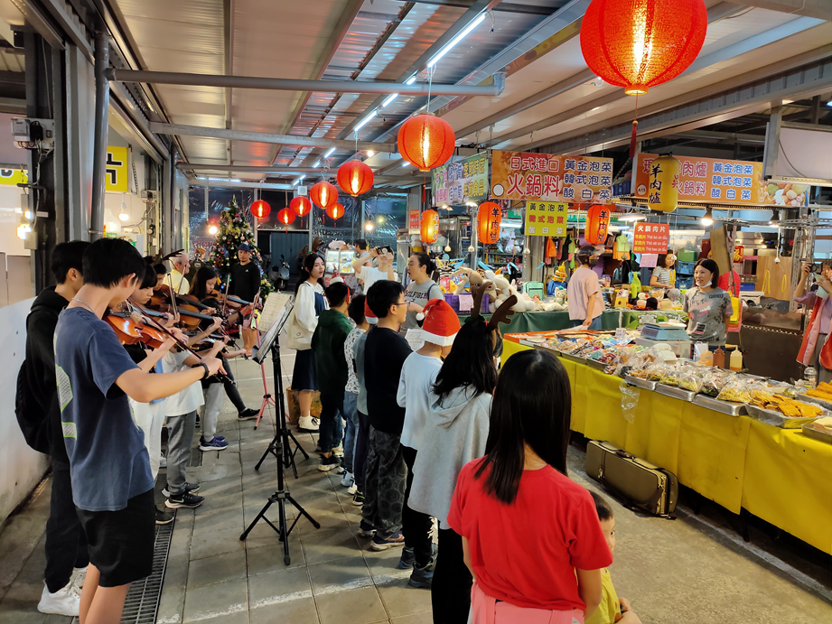
Caroling in market place and fire station

Slide 12
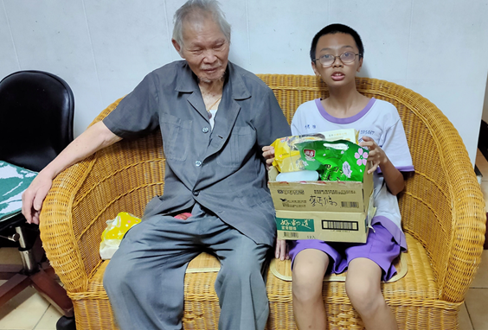
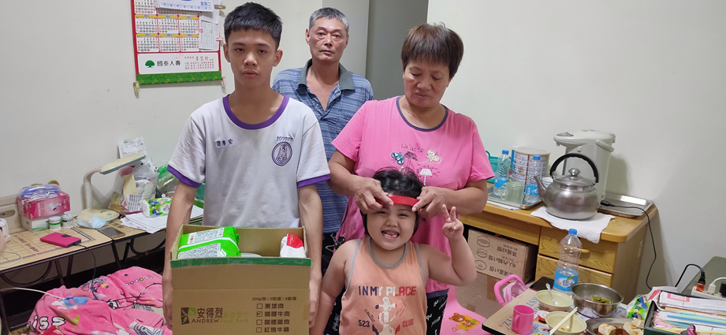
Help needy family

Slide 13
Connect to community
Building bridges
from school to families,
from families to Christ.

Slide 14
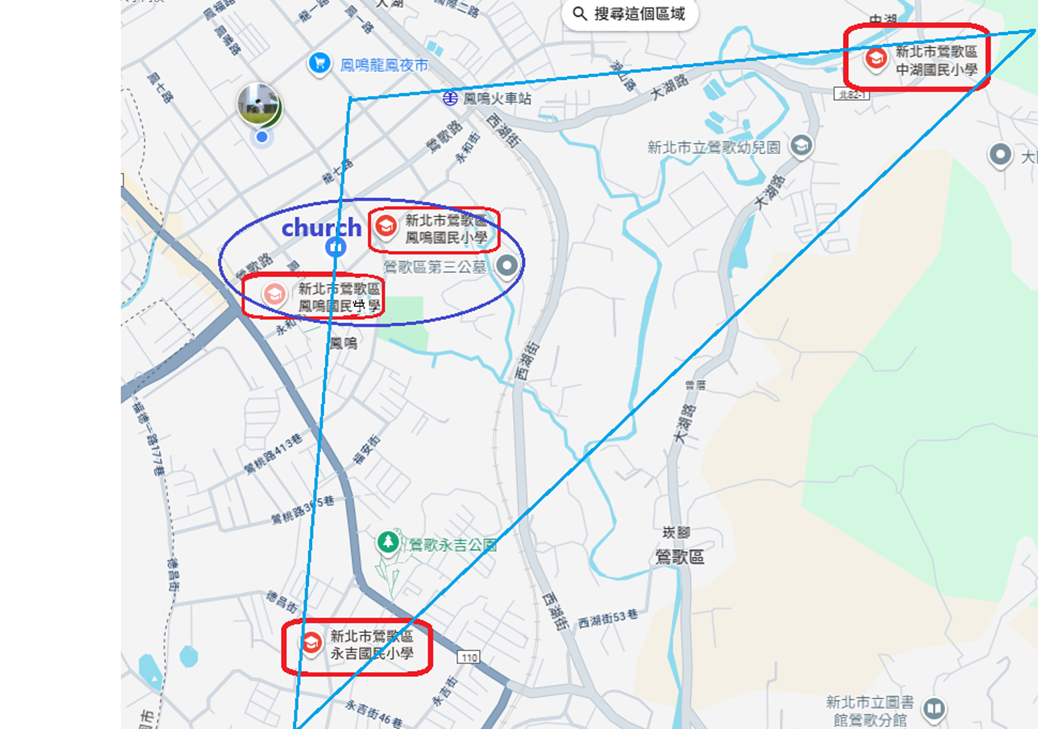
Connect to four schools near church.

Slide 15
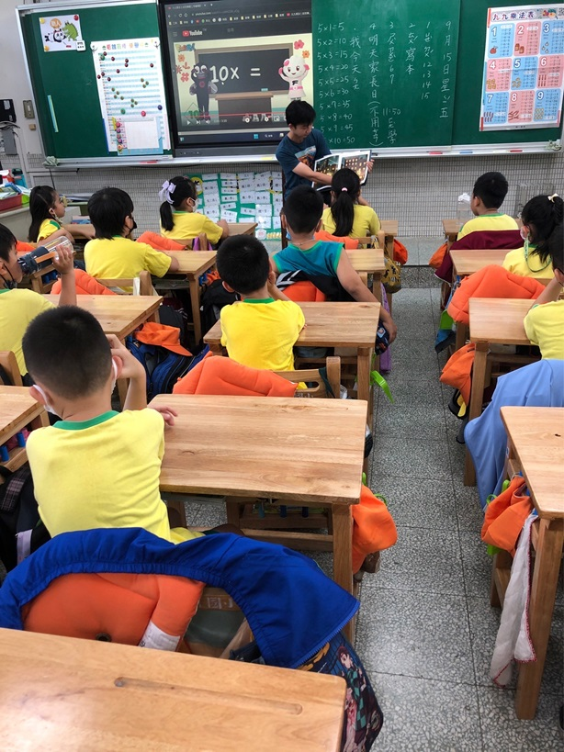
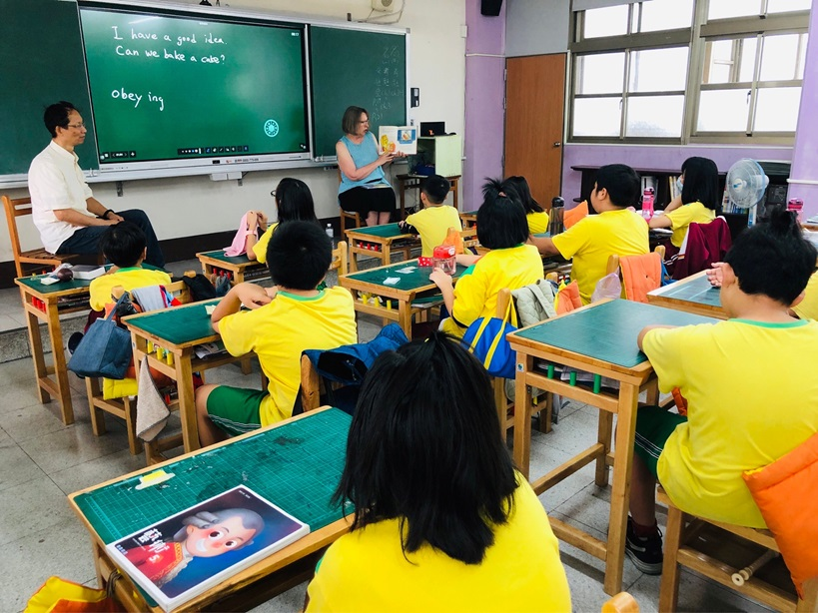
Morning reading program in
Chong-Hu Elementary

Slide 16
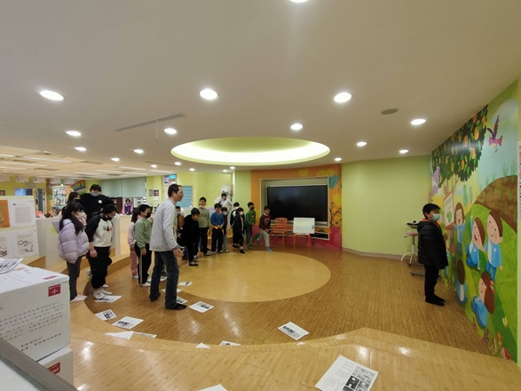
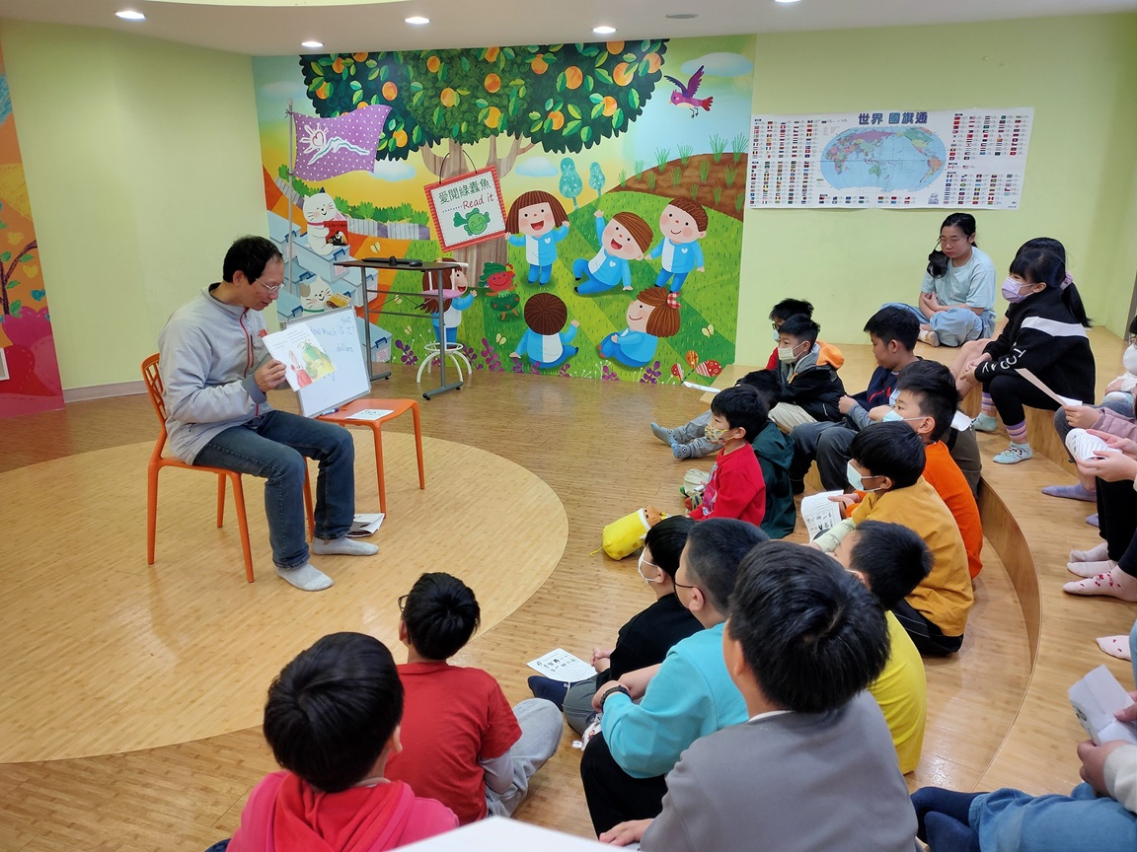
Morning reading program in
Yong-Ji Elementary

Slide 17
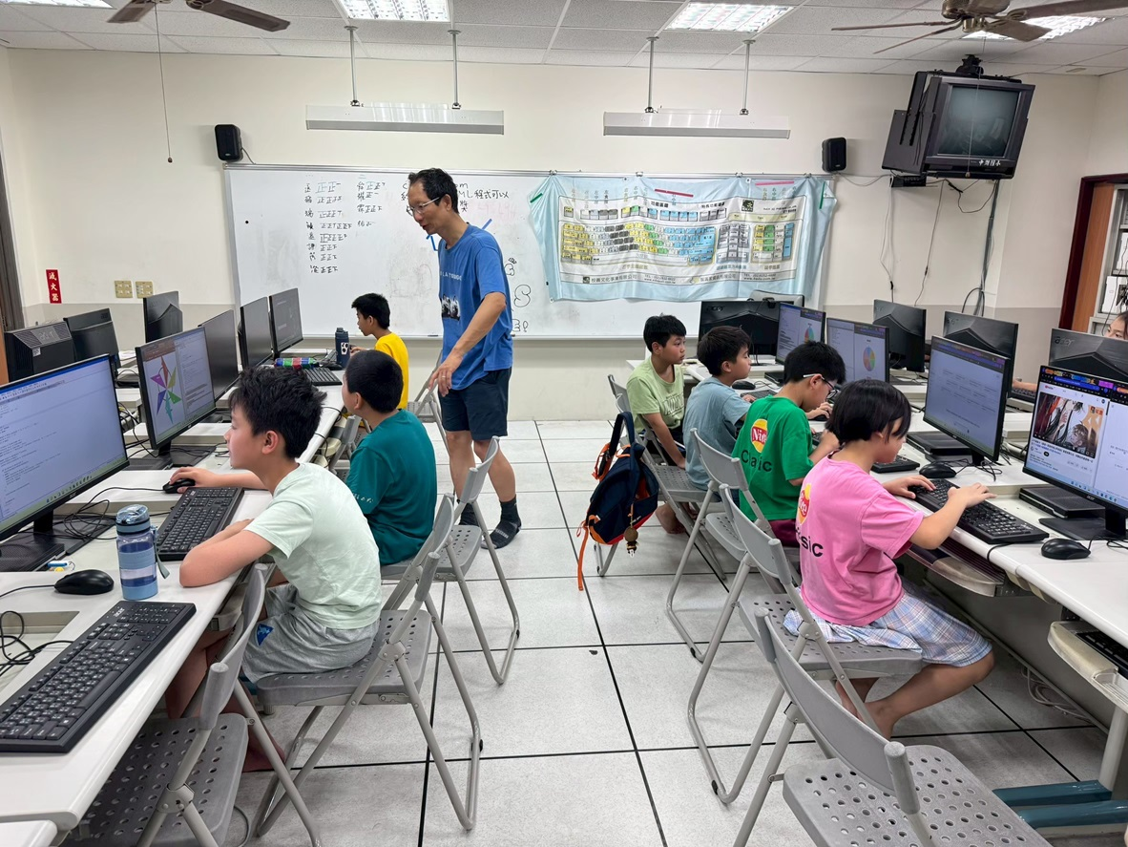
Saturday Computer class in Chong-Hu Elementary

Slide 18
Partner with churches

Slide 19
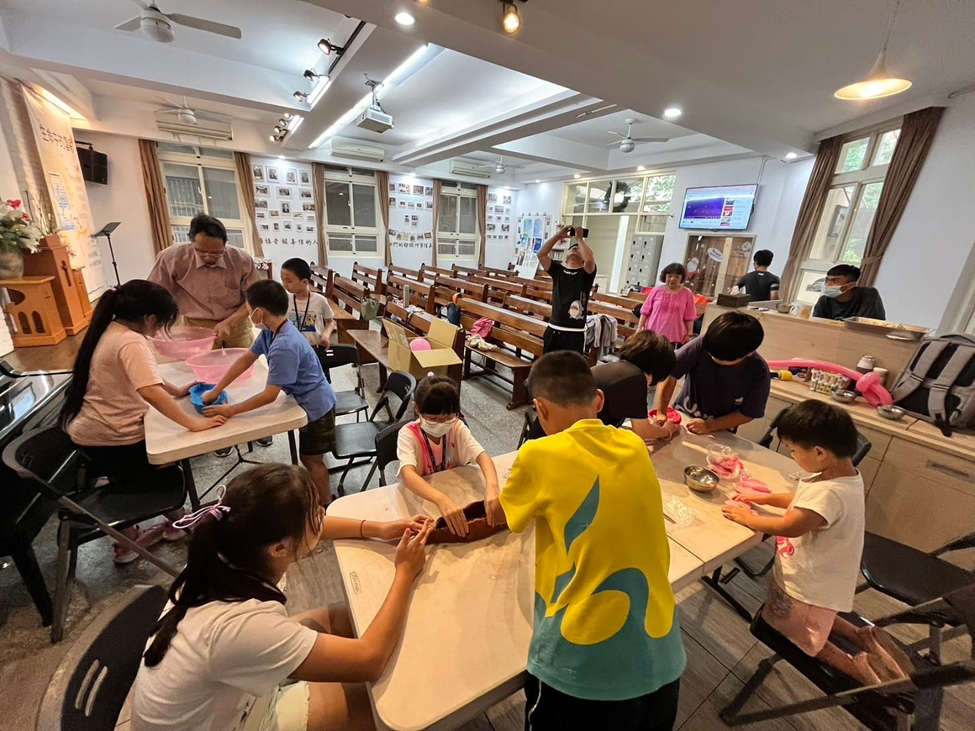
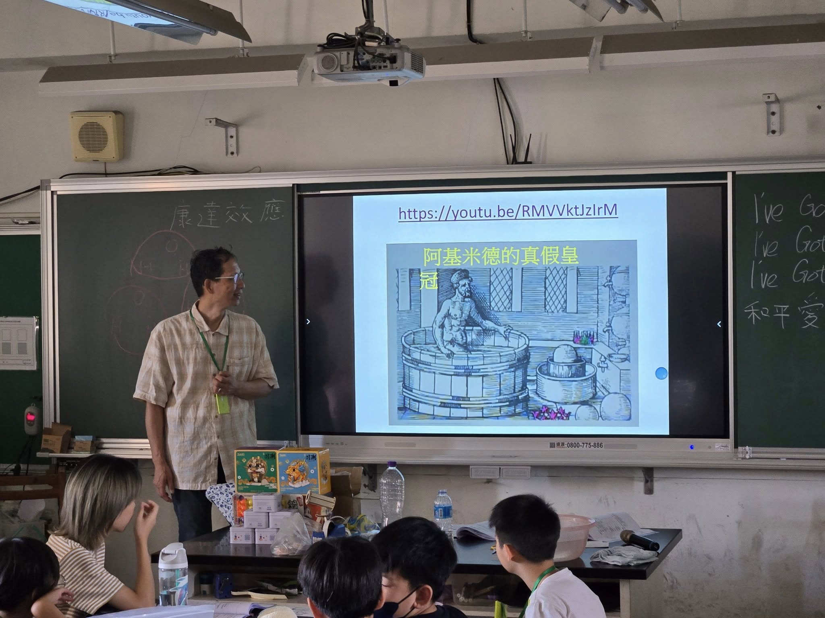
Collaborated with the Tsz Wan Shan Baptist Church H .K. to hold a summer science camp at Fengming Elementary

Slide 20
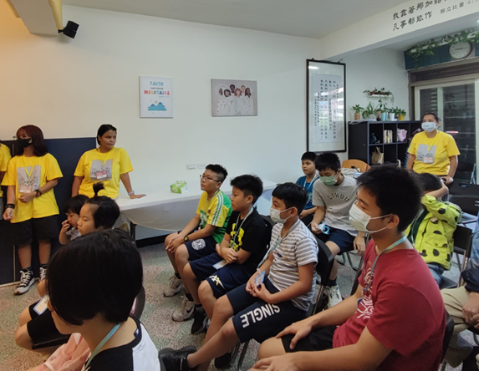
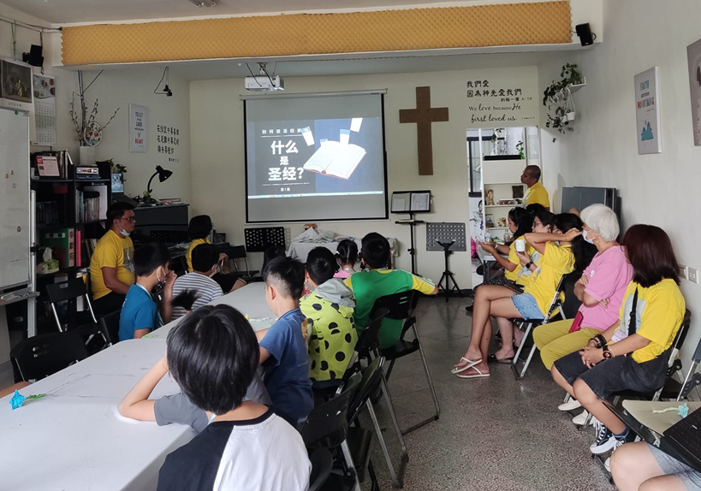
VBS run by a short-term mission team from Manila, Philippine.

Slide 21
Present Christmas story and Easter story in schools
With IMB missionaries.

Slide 22
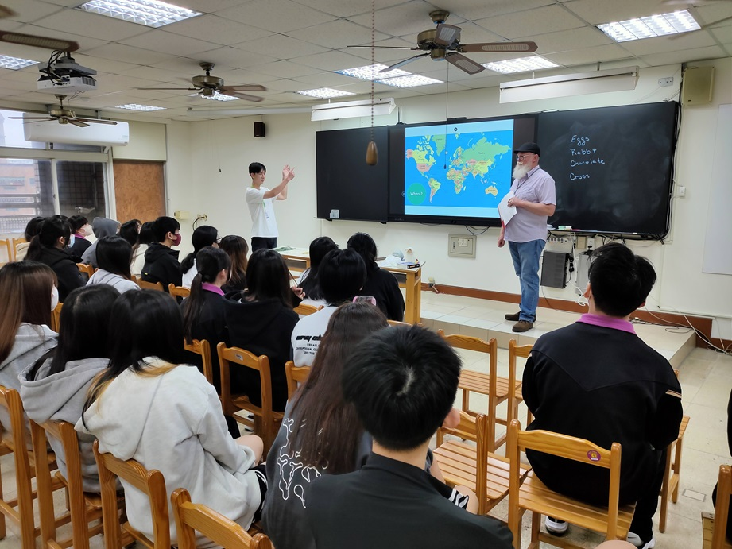
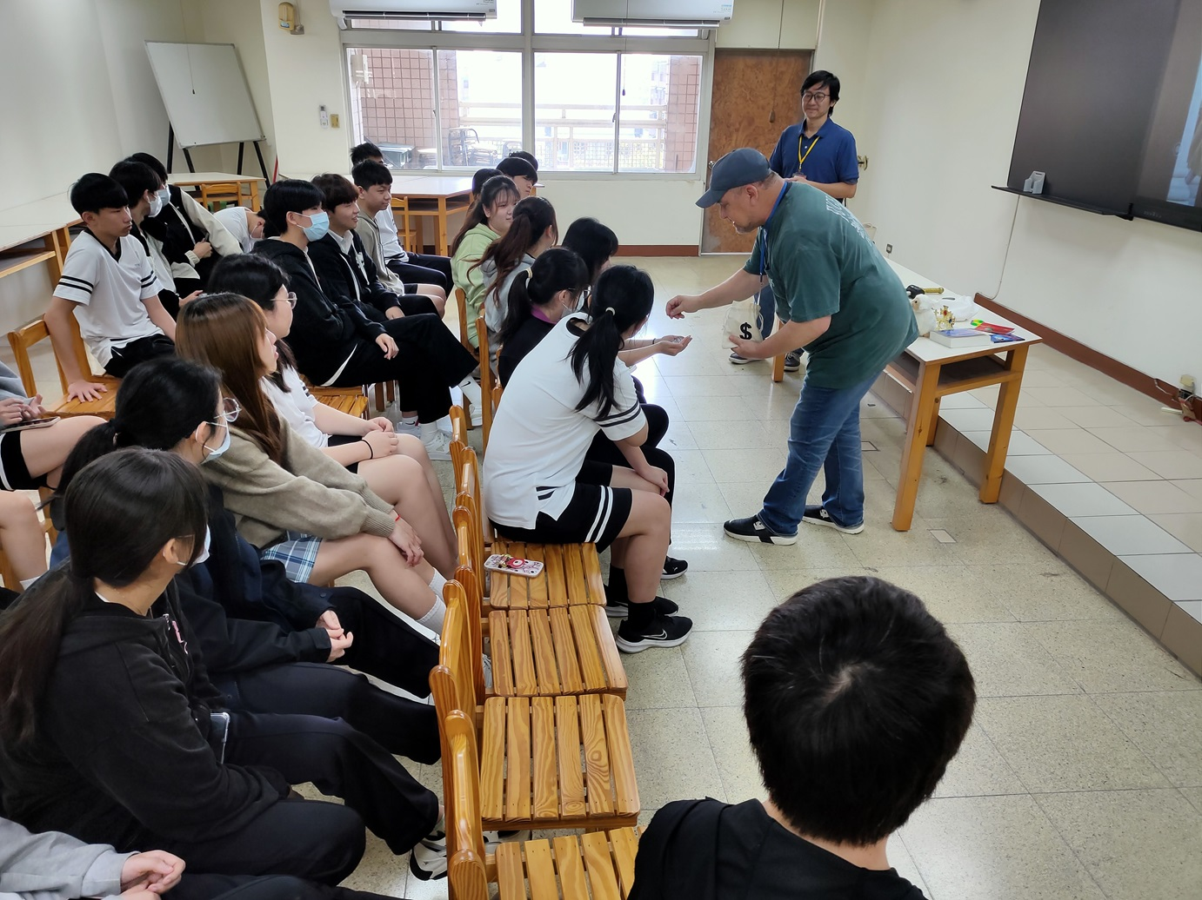

Slide 23
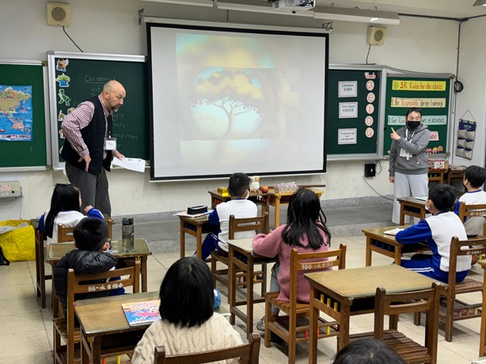
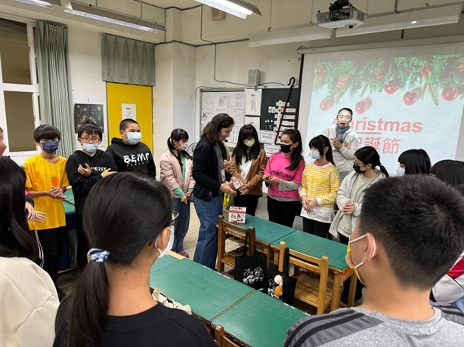

Slide 24
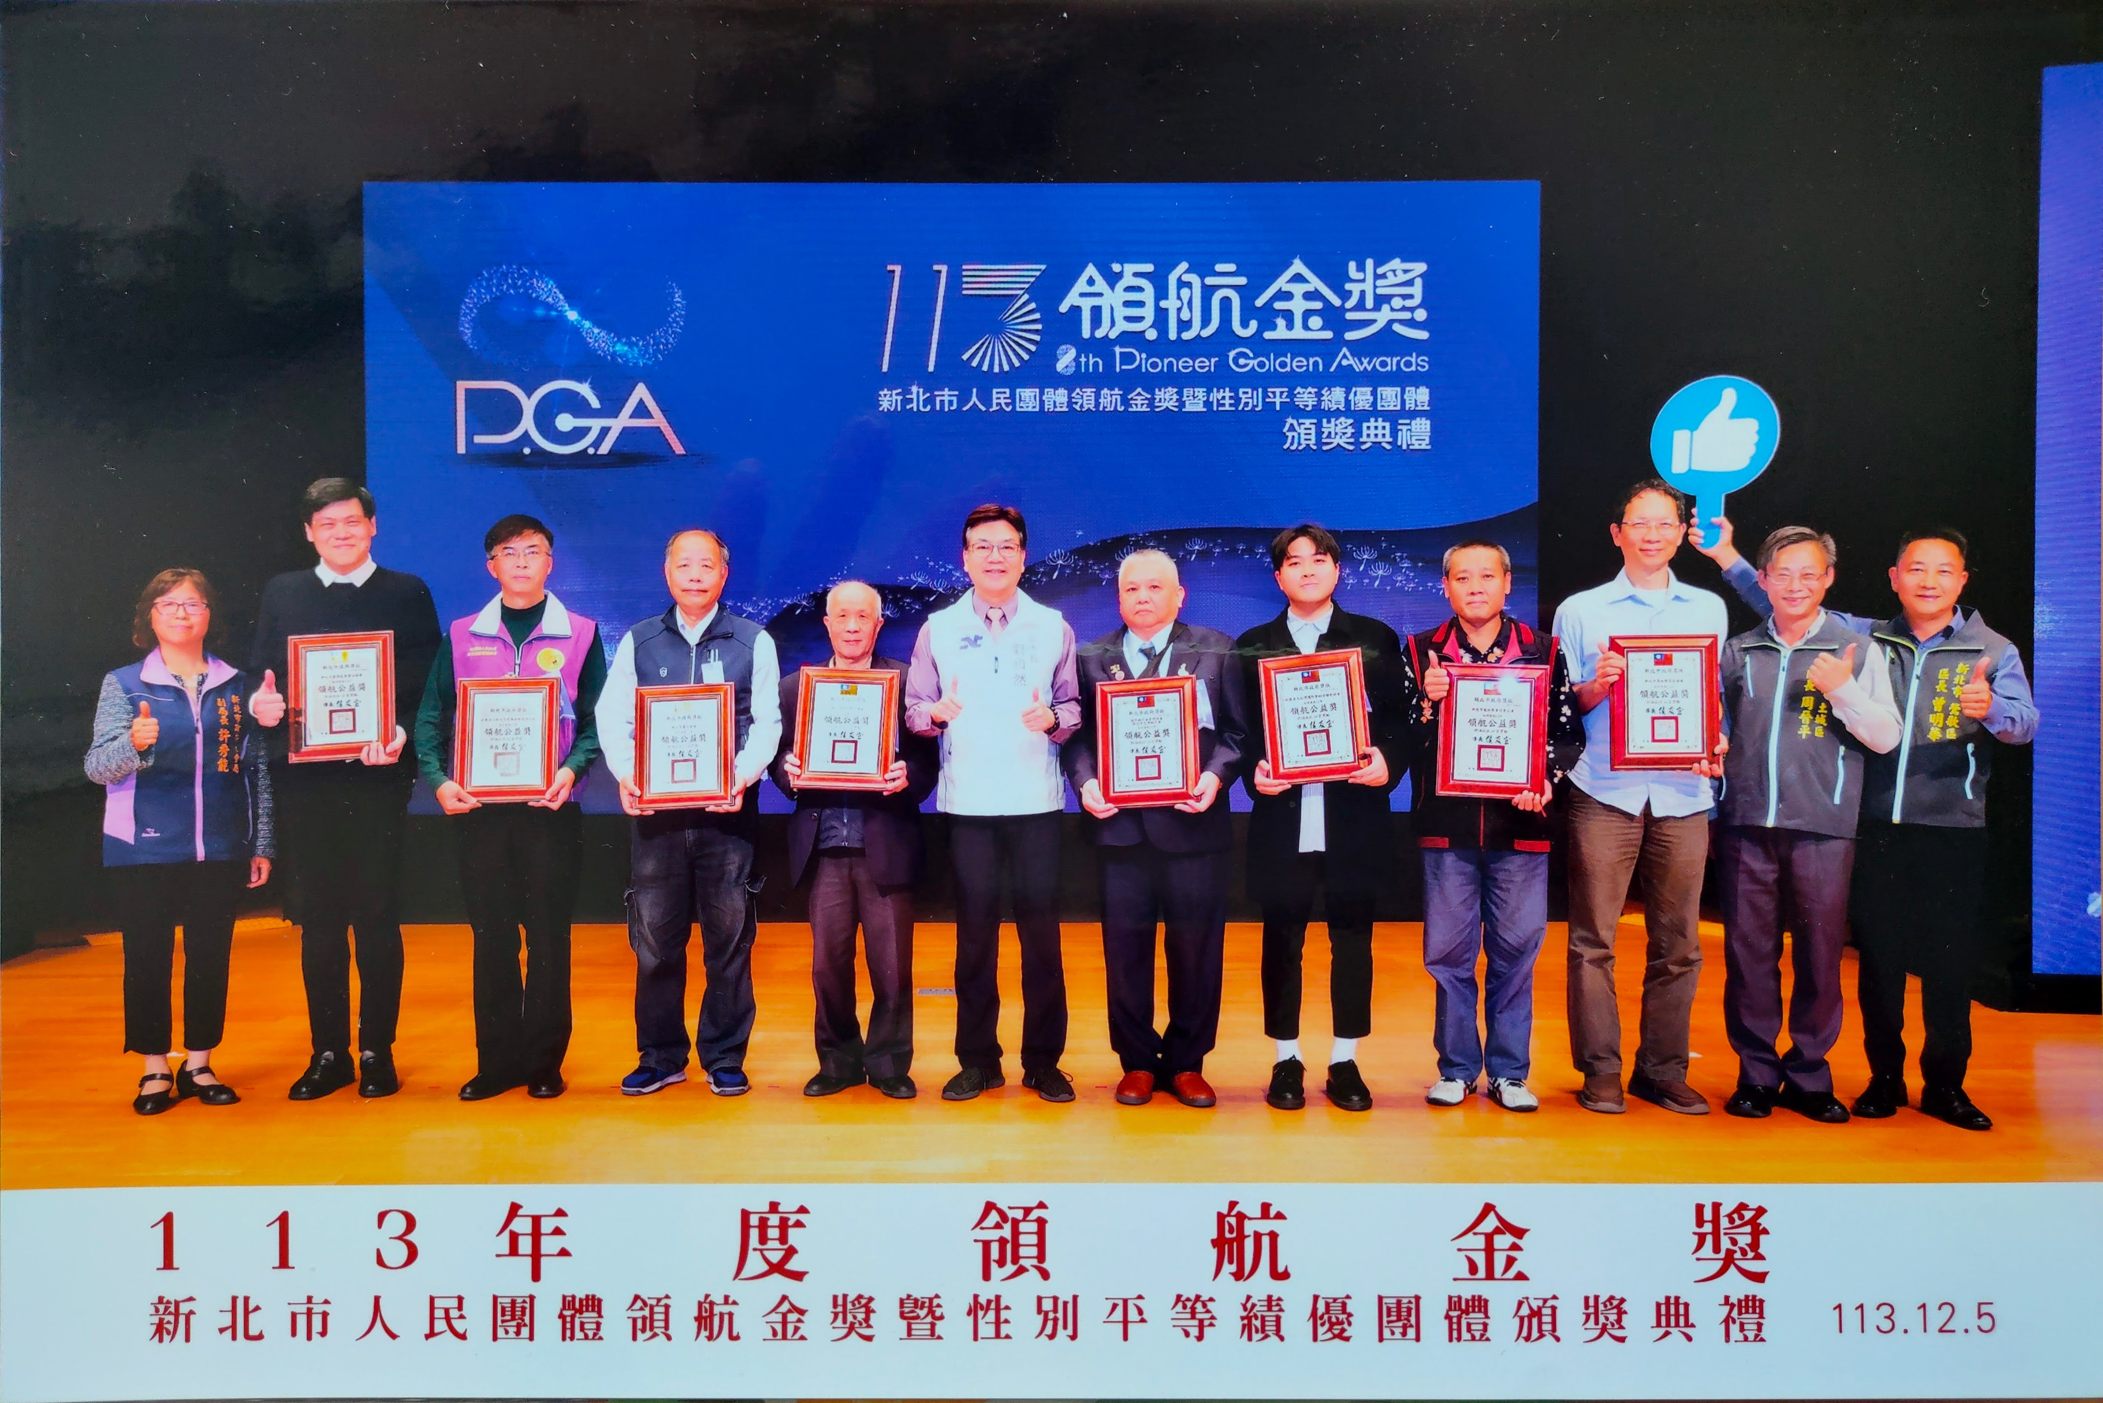
The church received a Community Service Award from the New Taipei City Government.

Slide 25
Because most Taiwanese traditional follows folk religion, they all think that all religions encourage people to do good. Therefore, through volunteer activities, the community can get to know God’s love, which gives us greater opportunities to share the Gospel in the community.

Slide 26
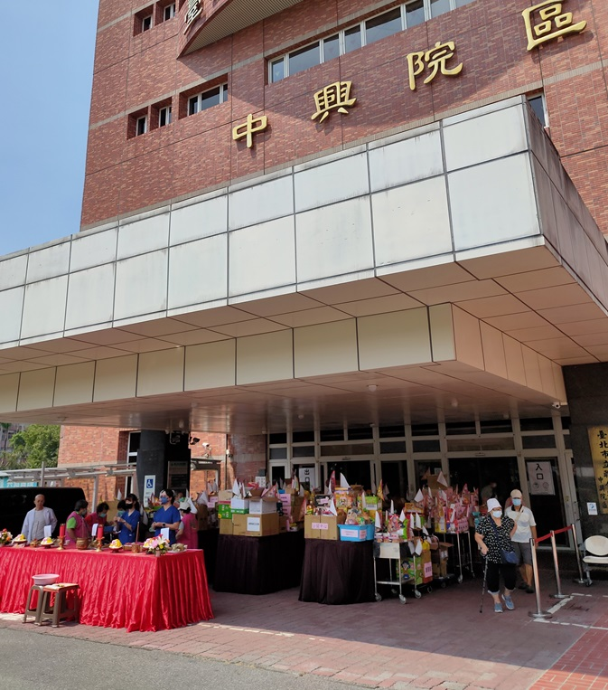
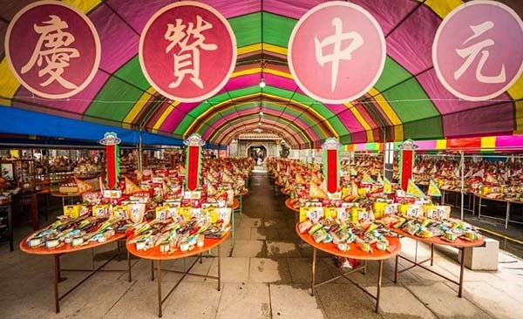
Ghost Festival
The lunar calendar July is called the "Ghost Month." In folk religion, it is believed that the gates of hell open during this month, so people offer food and worship ghosts to appease them.

Slide 27
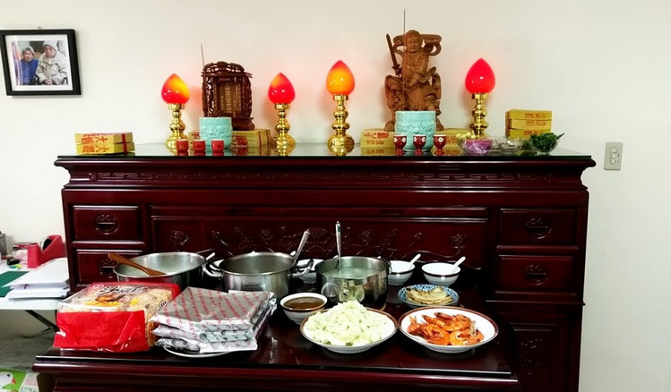
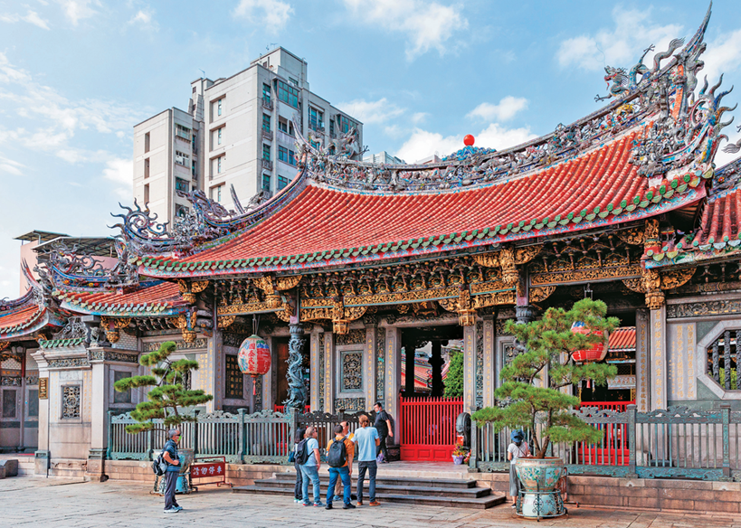
Taoists will worship their ancestors at home or go to temples to worship idols. (deities).

Slide 28
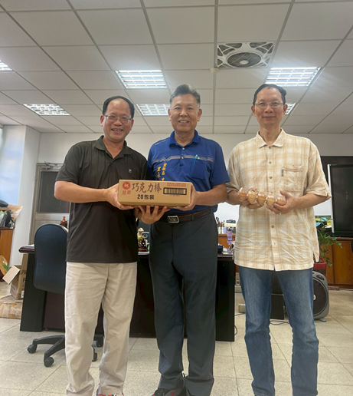
Prayer request:
The people on the far left in the photos is the principal of Yong-Ji t primary school. I have chances to chat with him in his office.
Please pray for me that I will have the opportunity to read the Bible together with him.

